Slide 1



Who Wants To Be A Millionaire

Slide 2

50 : 50
9 £1 MILLION
8 £500,000

7 £250,000
6 £125,000
First
question
Are you ready?
5 £100,000
4 £50,000
3 £32,000
2 £25,000
1 £1,000
Which of these is it easy to get addicted to?
A: Broccoli
B: Smoking and vaping
C: Playing with friends
D: Talking

Slide 3
50 : 50
9 £1 MILLION
8 £500,000

7 £250,000
6 £125,000
First
question
Are you ready?
5 £100,000
4 £50,000
3 £32,000
2 £25,000
1 £1,000
Which of these is it easy to get addicted to?
A: Eating broccoli
B: Smoking and vaping
C: Playing with friends
D: Talking

Slide 4

50 : 50
9 £1 MILLION
8 £500,000

7 £250,000
6 £125,000
5 £100,000
4 £50,000
3 £32,000
2 £25,000
1 £1,000
What is the addictive ingredient in cigarettes and vapes?
A: Nicotine
B: Soap
C: Methanol
D: Ammonia

Slide 5
50 : 50
9 £1 MILLION
8 £500,000

7 £250,000
6 £125,000
5 £100,000
4 £50,000
3 £32,000
2 £25,000
1 £1,000
What is the addictive ingredient in cigarettes and vapes?
A: Nicotine
B: Soap
C: Methanol
D: Ammonia

Slide 6




50 : 50
9 £1 MILLION
14
8 £500,000

7 £250,000
6 £125,000
5 £100,000
4 £50,000
3 £32,000
2 £25,000
1 £1,000
2 £200
How old do you have to be to buy cigarettes or vapes legally?
A: 18
B: 14
C: 16
D: 21

Slide 7
50 : 50
9 £1 MILLION
14
8 £500,000

7 £250,000
6 £125,000
5 £100,000
4 £50,000
3 £32,000
2 £25,000
1 £1,000
How old do you have to be to buy cigarettes or vapes legally?
A: 18
B: 14
C: 16
D: 21

Slide 8




50 : 50
9 £1 MILLION
8 £500,000

7 £250,000
6 £125,000
5 £100,000
4 £50,000
3 £32,000
2 £25,000
1 £1,000
What is the main ingredient in cigarettes?
A: Wood
B: Straw
C: Coconut
D: Tobacco

Slide 9
50 : 50
9 £1 MILLION
8 £500,000

7 £250,000
6 £125,000
5 £100,000
4 £50,000
3 £32,000
2 £25,000
1 £1,000
What is the main ingredient in cigarettes?
A: Wood
B: Straw
C: Coconut
D: Tobacco

Slide 10
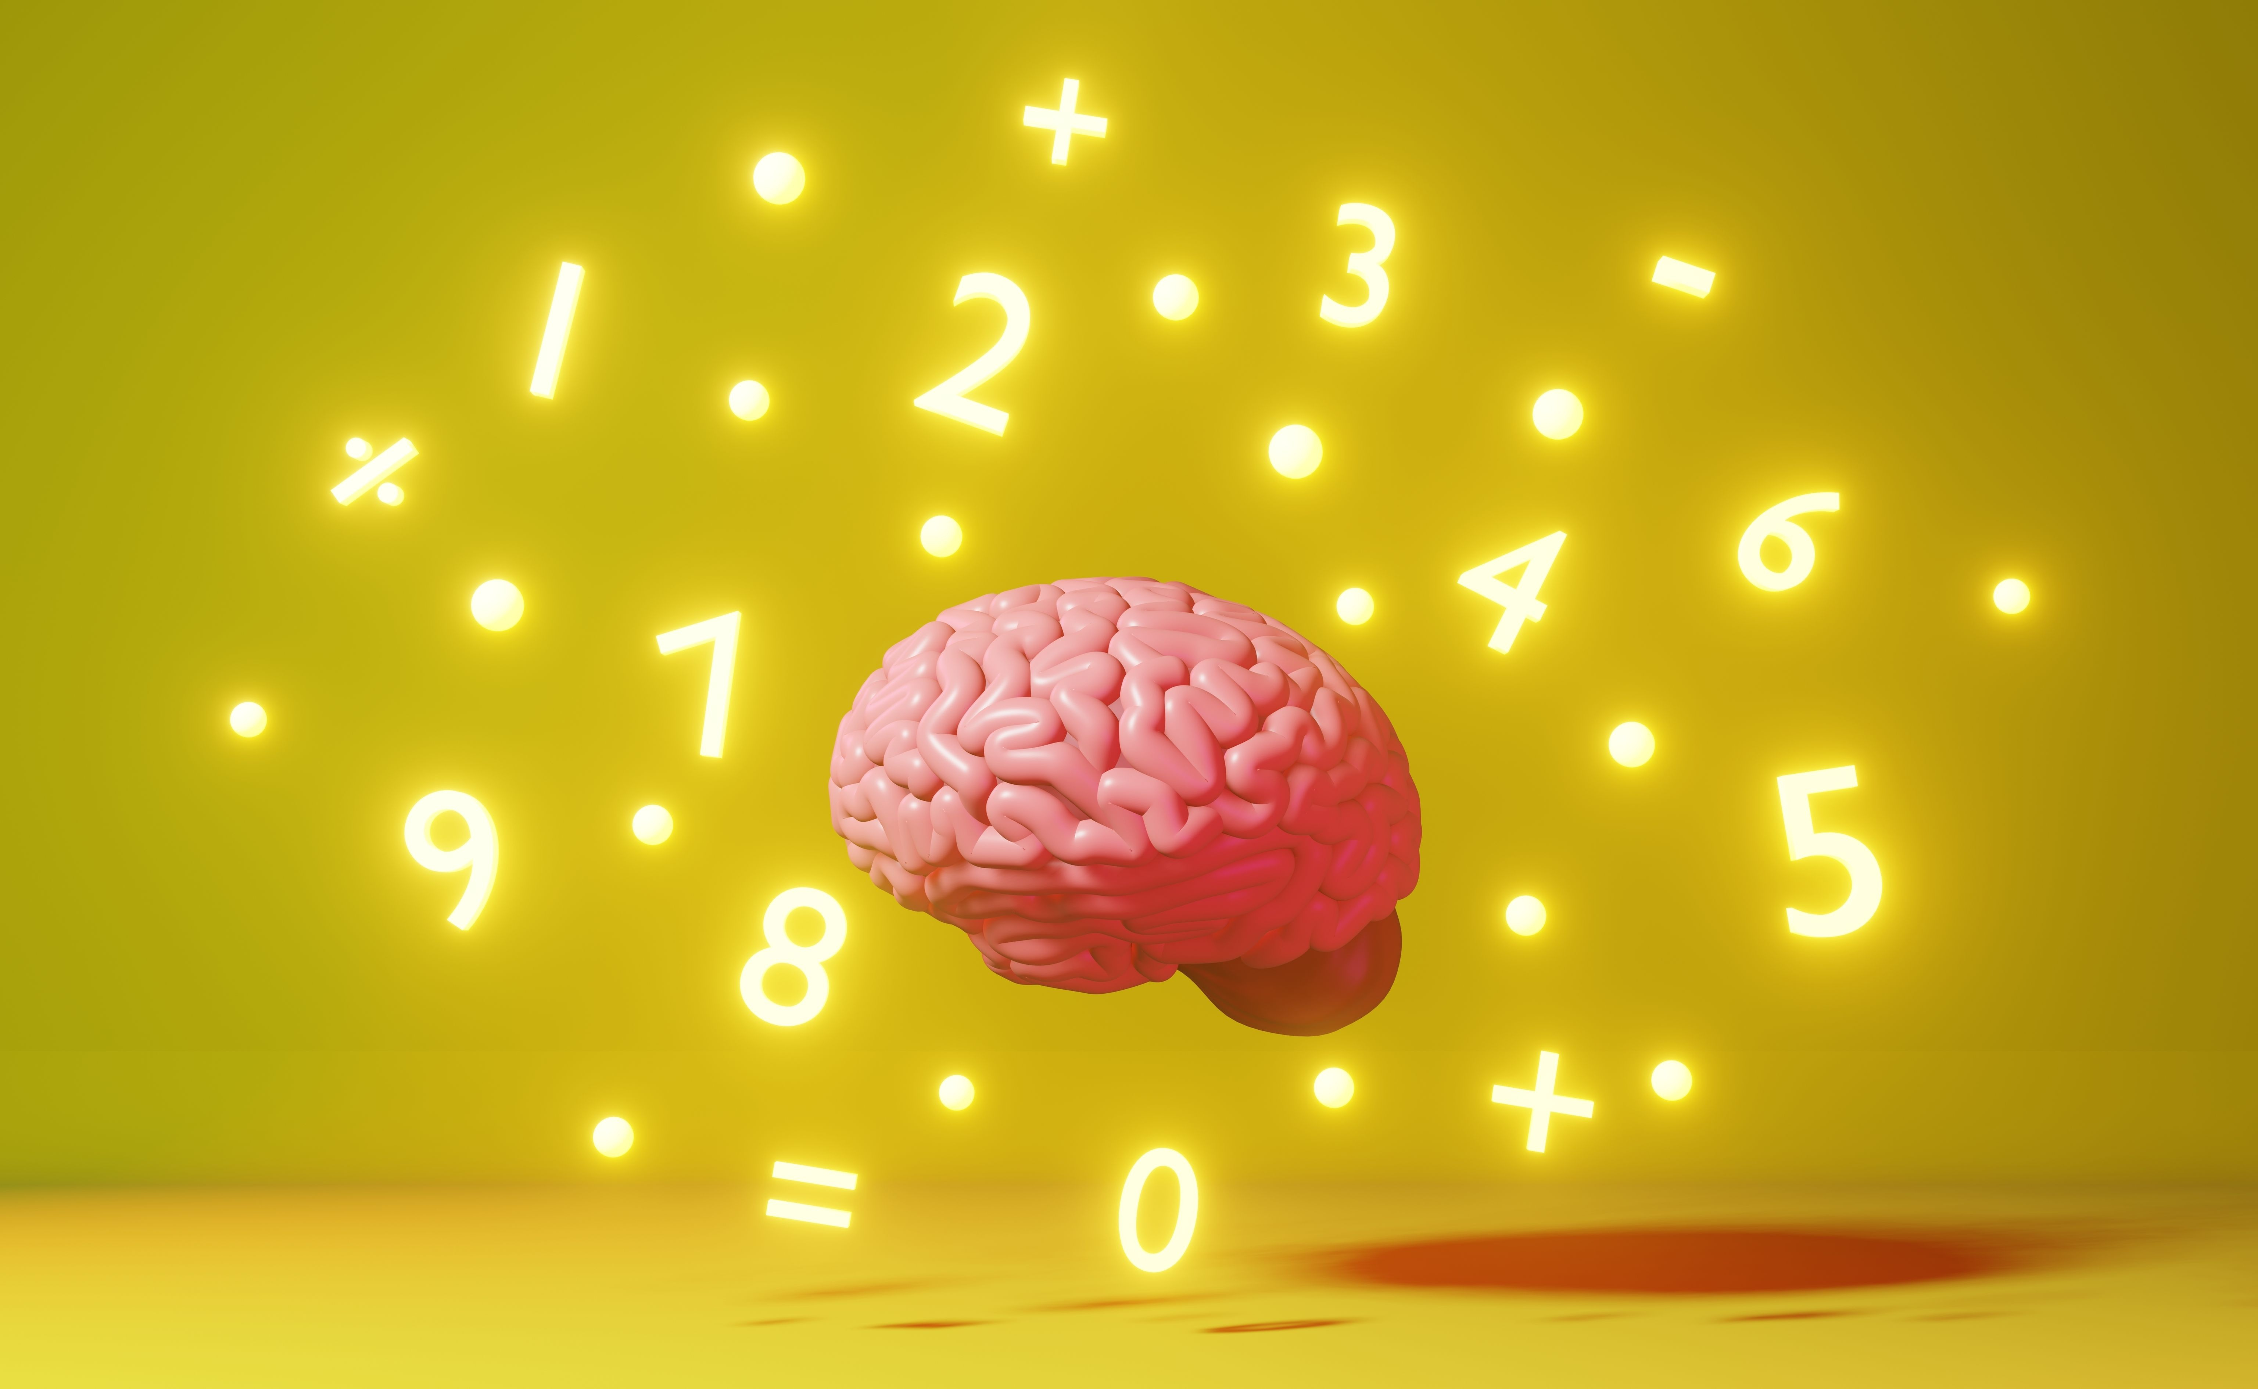
50 : 50
9 £1 MILLION
8 £500,000

7 £250,000
6 £125,000
5 £100,000
4 £50,000
3 £32,000
2 £25,000
1 £1,000
At what age will your brain stop developing?
A: 25
B: 16
C: 40
D: 12

Slide 11
50 : 50
9 £1 MILLION
8 £500,000

7 £250,000
6 £125,000
5 £100,000
4 £50,000
3 £32,000
2 £25,000
1 £1,000
At what age will your brain stop developing?
A: 25
B: 16
C: 40
D: 12

Slide 12





50 : 50
9 £1 MILLION
8 £500,000

7 £250,000
6 £125,000
5 £100,000
4 £50,000
3 £32,000
2 £25,000
1 £1,000
Which of these things is it easy to become addicted to?
A: Water
B: Apples
C: Smoking and vaping
D: Singing

Slide 13

50 : 50
9 £1 MILLION
8 £500,000

7 £250,000
6 £125,000
5 £100,000
4 £50,000
3 £32,000
2 £25,000
1 £1,000
Which of these things is it easy to become addicted to?
A: Water
B: Apples
C: Smoking and vaping
D: Singing

Slide 14




50 : 50
9 £1 MILLION
8 £500,000

7 £250,000
6 £125,000
5 £100,000
4 £50,000
3 £32,000
2 £25,000
1 £1,000
What is used to make the flavours in vapes?
A: Fruit
B: Vegetables
C: Spices
D: Chemicals

Slide 15
50 : 50
9 £1 MILLION
8 £500,000

7 £250,000
6 £125,000
5 £100,000
4 £50,000
3 £32,000
2 £25,000
1 £1,000
What is used to make the flavours in vapes?
A: Fruit
B:Vegetables
C: Spices
D: Chemicals

Slide 16
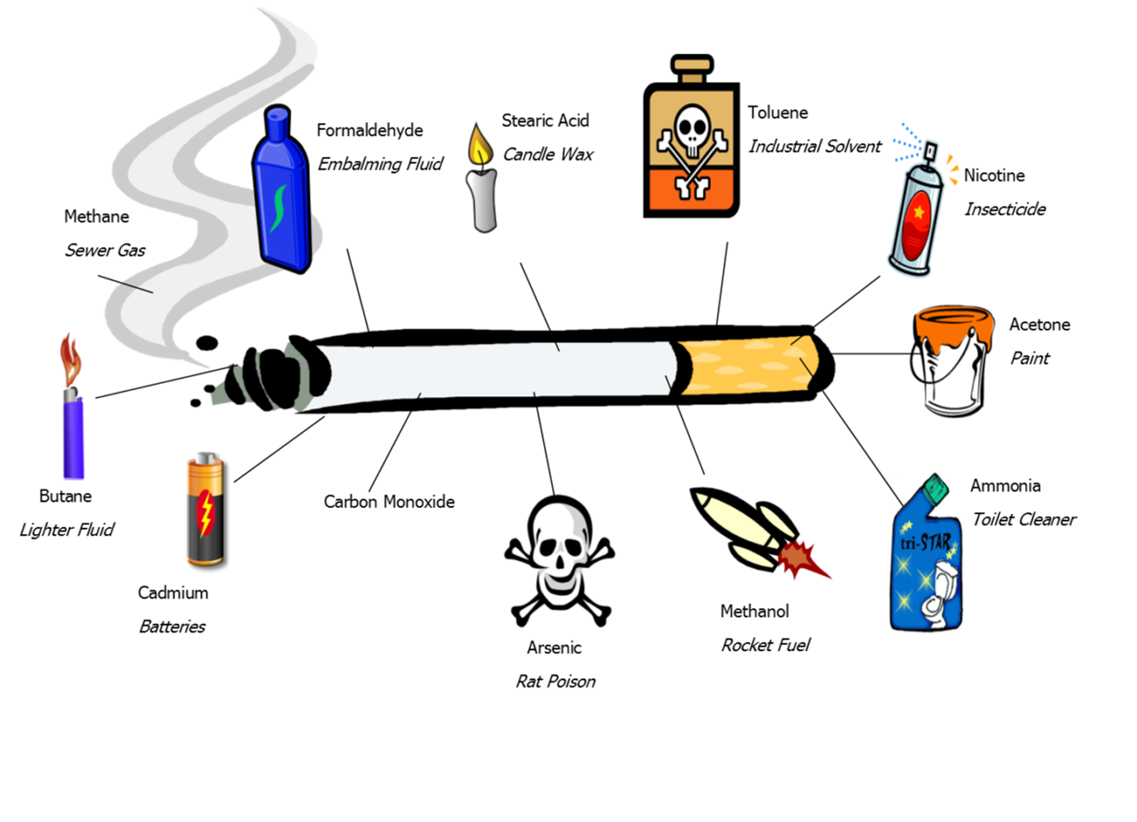
50 : 50
9 £1 MILLION
8 £500,000

7 £250,000
6 £125,000
5 £100,000
4 £50,000
3 £32,000
2 £25,000
1 £1,000
How many chemicals does a cigarette produce when it is burned?
A: 15
B: Over 4000
C: 500
D: 80

Slide 17
50 : 50
9 £1 MILLION
8 £500,000

7 £250,000
6 £125,000
5 £100,000
4 £50,000
3 £32,000
2 £25,000
1 £1,000
How many chemicals does a cigarette produce when it is burned?
A: 15
B: Over 4000
C: 500
D: 80

Slide 18

50 : 50
9 £1 MILLION
8 £500,000

7 £250,000
6 £125,000
The
last
question
5 £100,000
4 £50,000
3 £32,000
2 £25,000
1 £1,000
Which of these is not found in vapes?
A: Nicotine
B: Chemicals
C: Vitamins
D: Heavy metals

Slide 19
50 : 50
9 £1 MILLION
8 £500,000

7 £250,000
6 £125,000
The
last
question
5 £100,000
4 £50,000
3 £32,000
2 £25,000
1 £1,000
Which of these is not found in vapes?
A: Nicotine
B: Chemicals
C: Vitamins
D: Heavy metals

Slide 20
Any
Questions?

