Slide 1







Sharing the Learning Series
Whole Systems Physical Activity:
Locality approach and the role of greenspace

Slide 2

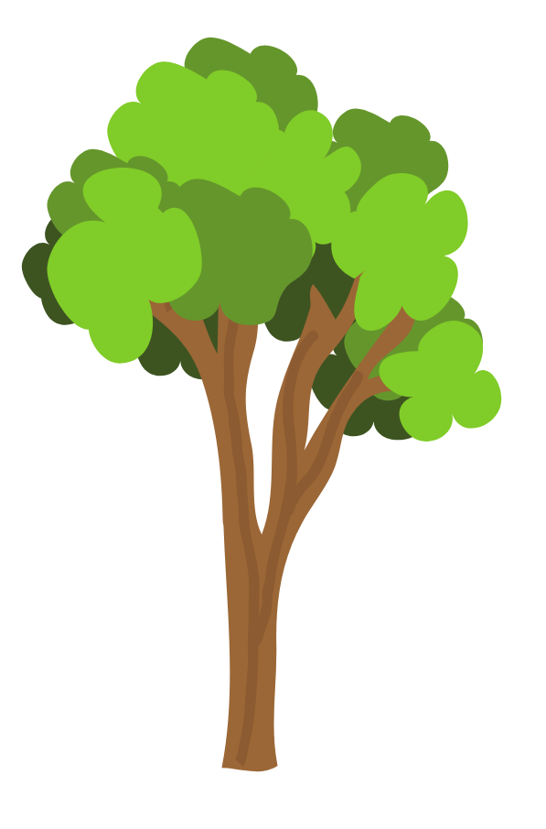


Doncaster Future Parks

Slide 3



Identification of 15 parks
Focused engagement:
  DMBC & partners
  Friends of groups
  Borough wide parks survey
Quality/Value assessments
21 Borough wide park survey
Stakeholder parks workshop
Officer parks workshop
2018
Overarching Framework
Bespoke Parks Plans
Social Capacity Proposals
Evaluation Framework
Delivery Plan
2017
2019
Government select committee:
The future of pubic parks
Doncaster Talks
Notes:
Land Use Consultants commissioned through GDM to develop plans, proposals & framework.
Quality – green flag criteria Value- what each park has to offer
Output of that work –
Framework
15 plans – they are not creating brand new parks – uplift and revisit the basics of a park, creating welcoming and accessable spaces.
Proposals to support and develop community's
Evaluation framework along with theory of change
Costed delivery plan -

Slide 4

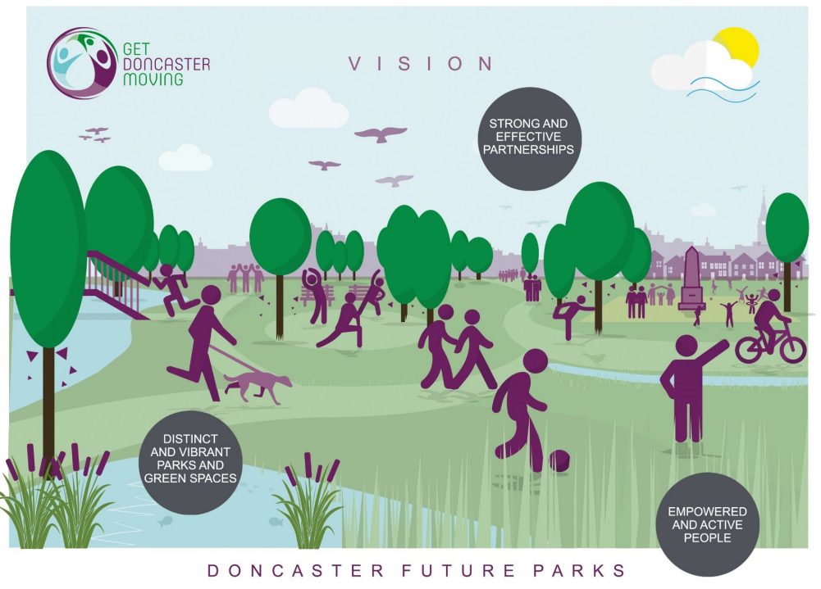

Notes:
Future Parks vision statement.

Slide 5
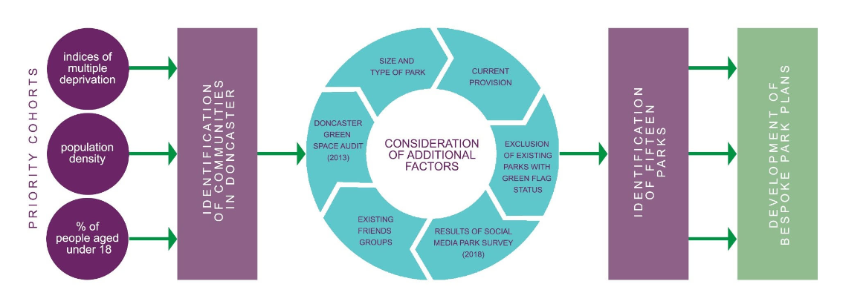
Notes:
Selection Process for 15 parks

Slide 6
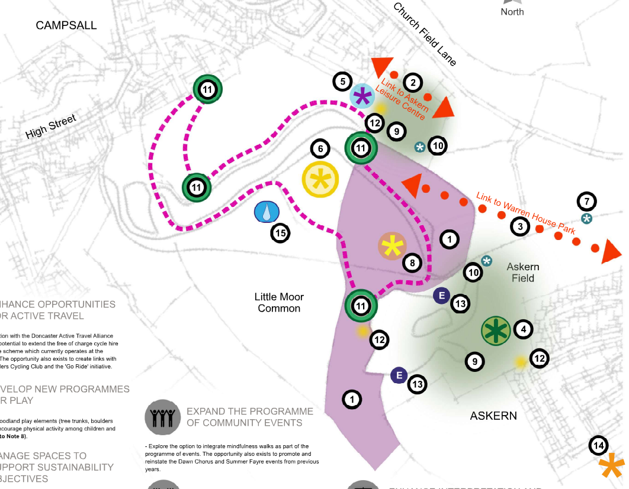
Notes:
Example of proposed interventions to take place on the site.

Slide 7






Further
engagement
Existing insight
Quality and Value assessment
Revised Parks
Plans
Bespoke Parks
Plans
Future Parks
Vision
Notes:
Rather than drag and drop project – engage with each community to bring them on-board with each project – aware that each site and community is unique.
Iterative approach – reflecting on our learning throughout each cycle.
Build on existing understanding and with a proposed bespoke park plan built around a vision
Support through partnerships –
TCV – DGSN & corporate volunteering
CFE – responsive partner surveys – guidance on engagement - develop case studies – build on theory of change build around the vision.
HUQ – footfall data
DMBC – landscape design

Slide 8
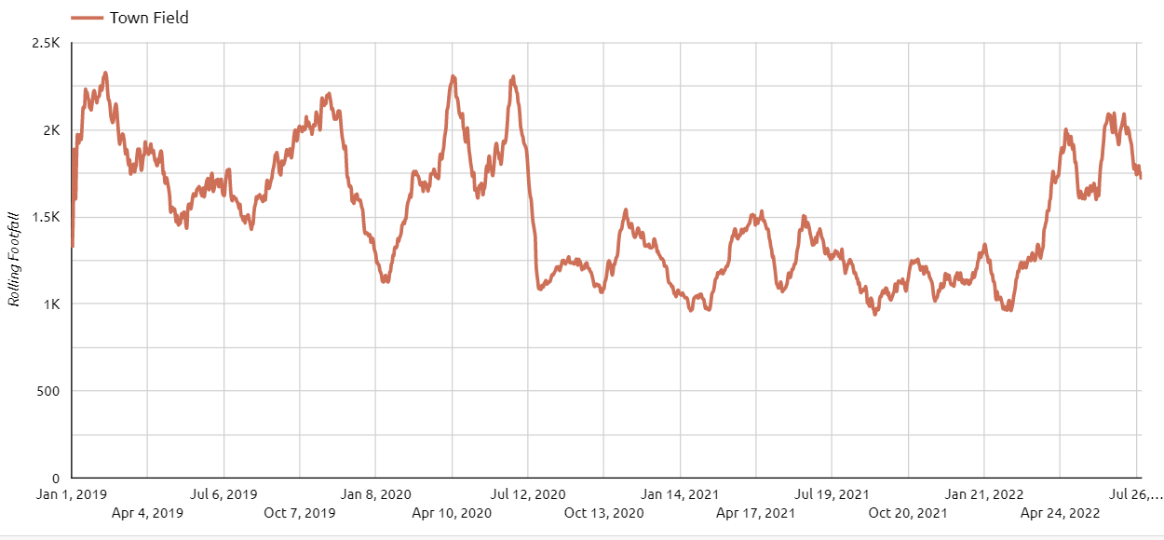
Understanding Parks usage.
Notes:
Using mobile phone GPS location to identify park users – Understand parks usage, increase and decrease in footfall.
Example given Town field – heavily used as a commuter route work and schools. Impact of working from home.

Slide 9
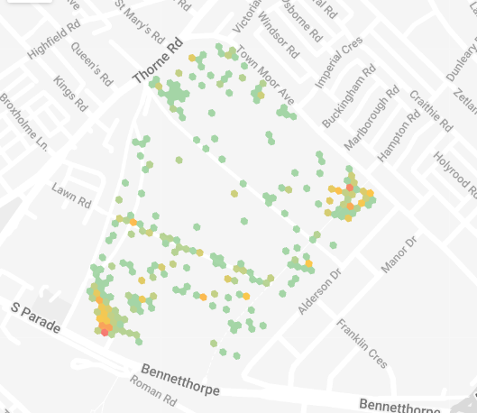
Notes:
Understand patterns of use. Identify most used routes/ areas of congregation. Identify if infrastructural changes make a difference.
Dwell time and hourly footfall.

Slide 10

The Crags | Hexthorpe Park | Campsall Country Park | Town Field
154 | 165 | 215 | 1181
Weeks Live - 4 | Weeks Live - 4 | Weeks Live – 4 | Weeks Live - 7
Online Advertising (Facebook) of roadshow event | Online Advertising (Facebook) of roadshow event | Online engagement / survey Live. Promotion through Facebook ads | Online engagement / survey Live. Promotion through Facebook ads/promotion of roadshow
Promote presence of survey via email to: Ward members, Well Doncaster, Communities teams, Friends of, Local Schools | Promote presence of survey via email to: Ward members, Well Doncaster, Communities teams, Friends of, Local Schools | Promote presence of survey via email to: Ward members, Well Doncaster, Communities teams, Friends of, Local Schools | Promote presence of survey via email to: Ward members, Well Doncaster, Communities teams, Friends of, Local Schools
Roadshow/ on site engagement. GDM (Inc. landscape & TCV), Friends Of, Well Doncaster, Street Scene. | Translation of survey into multiple languages: Polish, Romanian, Slovakian | * No face to face due to new lockdown restrictions coming into place. | Translation of survey into multiple languages: Mandarin, Urdu, Slovakian, Latvian, Romanian, Polish
Online adverts for roadshow switch to advert to fill in survey | Roadshow/ on site engagement/ free drink & cake from dell café GDM (Inc. landscape & TCV), Friends Of, Well Doncaster, Street Scene. |  | On site posters with QR code link to survey
 | Online adverts for roadshow switch to advert to fill in survey |  | Work with Young Advisors to engage with younger residents. Face to face
 |  |  | Assessment after 3 weeks to identify low demographics
 |  |  | Young Advisors target school groups due to low numbers
 |  |  | Roadshow/ on site engagement. GDM (Inc. landscape & TCV), Young Advisors, Well Doncaster, Street Scene.
Notes:
Diversified engagement processes throughout each iteration. –
Collaboration.
Re-occurring themes around safety
Heavy focus on the built and physical environment – how do we build sustainable community engagement?
Push on the pop up animation, flexible, cost effective, replicable.

Slide 11
Further
engagement
Existing insight
Quality and Value assessment
Revised Parks
Plans
Bespoke Parks
Plans
Future Parks
Vision
Notes:
Rather than drag and drop project – engage with each community to bring them on-board with each project – aware that each site and community is unique.
Iterative approach – reflecting on our learning throughout each cycle.
Build on existing understanding and with a proposed bespoke park plan built around a vision
Support through partnerships –
TCV – DGSN & corporate volunteering
CFE – responsive partner surveys – guidance on engagement - develop case studies – build on theory of change build around the vision.
HUQ – footfall data
DMBC – landscape design

Slide 12

DONCASTER GREEN SPACE NETWORK
South Line
Fo Askern Lake
East Line
Fo Campsall Country Park
Central Line
Fo Arksey Park
North Line
Fo Adwick Park
Thorne Community Woodland
Borough Wide Line
Fo Highfields Country Park
Fo Quarry Park
Bentley Park
Natural England
Green Flag Destination
Fo Edenthorpe Park
Fo Barnsley Road Playing Field
Glass Park Millennium Trust
Doncaster Naturalist Society
Fo Cusworth Hall
Fo Sandall Park
Fo Sandall Beat Wood
Fo Grove Gardens
Fo Cantley Park
Don Catchment Rivers Trust
Fo Elmfield Park
Fo Hyde Park Cemetery
Yorkshire Wildlife Trust
Fo Hexthorpe Park
The Conservation Volunteers
Distribution of Friends of Groups representing parks and public open spaces across Doncaster.
Borough wide line shows distribution of Non Government Organisations and Trust based within the City of Doncaster associated with Green and Blue infrastructure.
Fo Martin Wells Lake
Fo Edlington Pit Wood
Fo Hatchell Wood
The Mosaic Trust
Fo Jubilee Park
Fo The Crags
Notes:
Network diagram of existing Fo Groups by locality & borough wide organisations involved with the network.
Network was in existence prior to FP – Future parks workingto understand, support this network

Slide 13

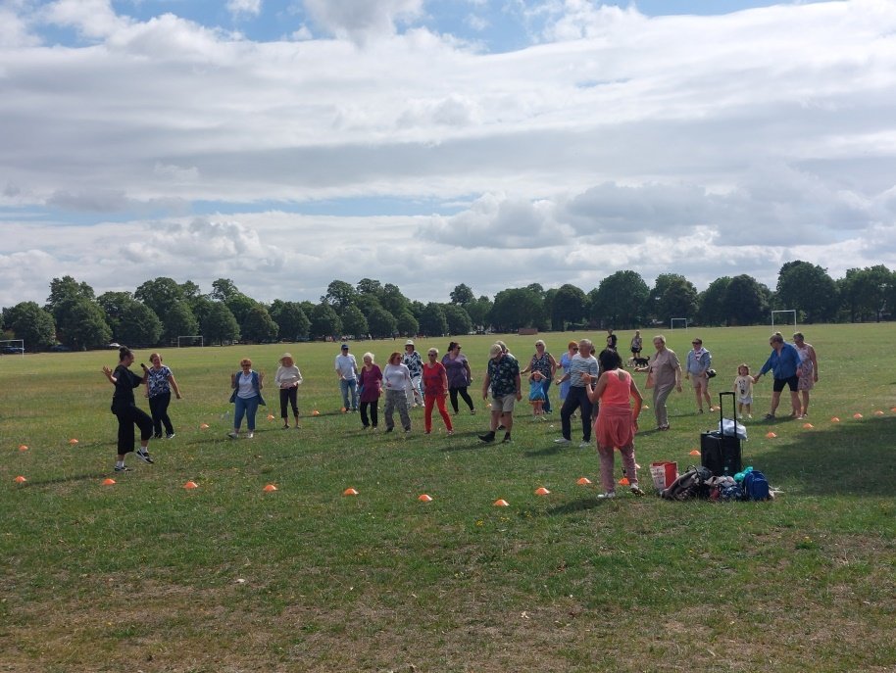
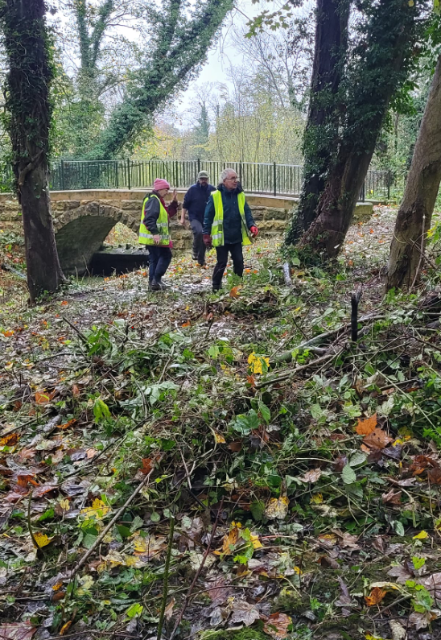
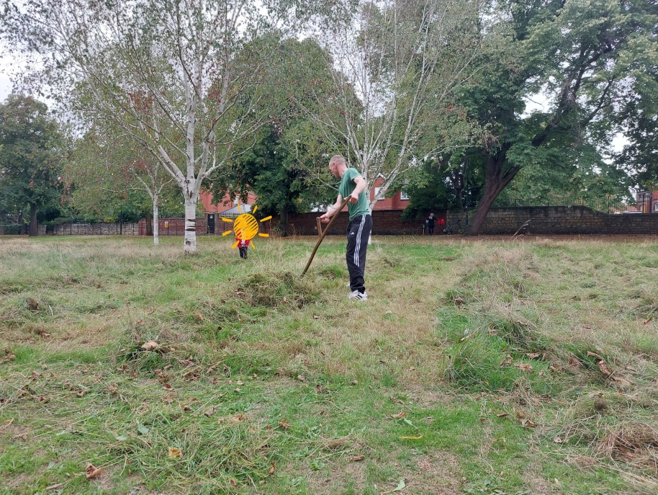
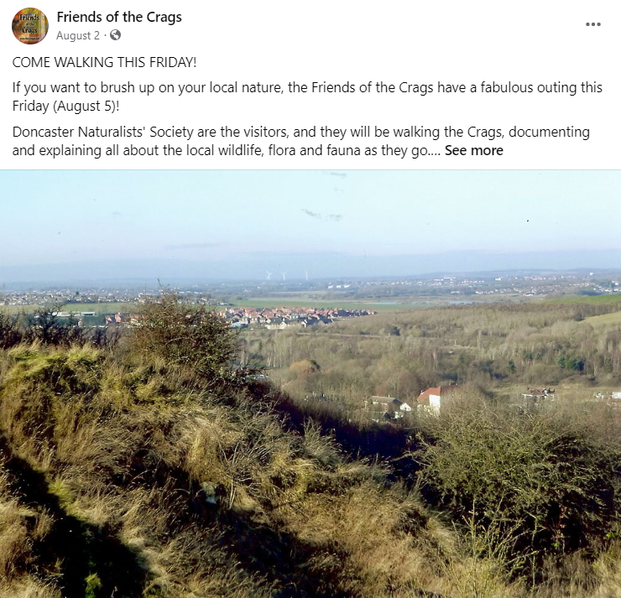
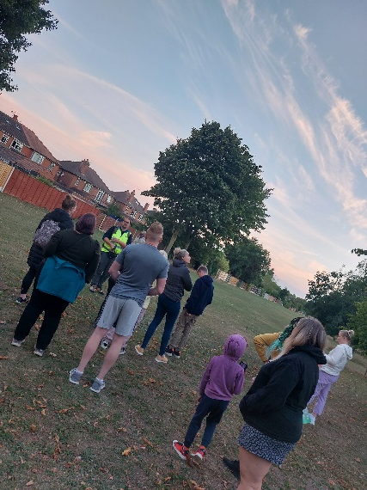

Slide 14
Supply and Demand
Do Nothing –or-
Buy in Bat Walk Leaders
DMBC Countryside Rangers arranged 3 fully booked bat walks in partnership with Friends of Sandall Park. Rangers at capacity to deliver any additional sessions
Green Space Network Bat Walk leader training / invest in bat detectors.
Volunteer led bat walks across multiple locations.
Option 1
15 volunteer bat walk leaders across network
Option 2
BATS

Slide 15
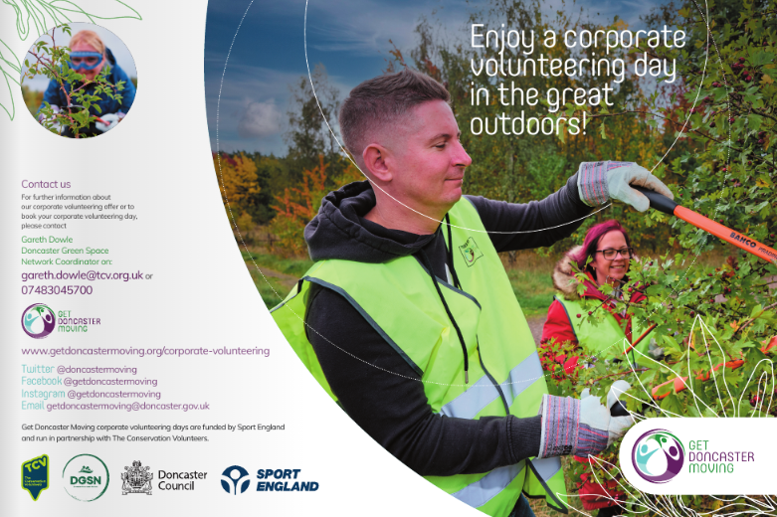
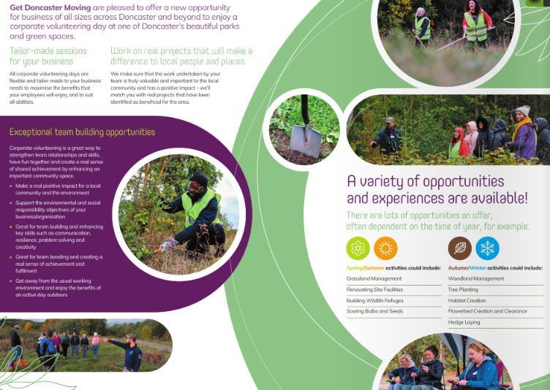
Notes:
Building up a Corporate volunteering offer for local businesses, green space can benefit as result of localised engagement/responsibility – about to test pilot event within Public Health (50-60 participants) before roll out.
Also mention design guide.

Slide 16
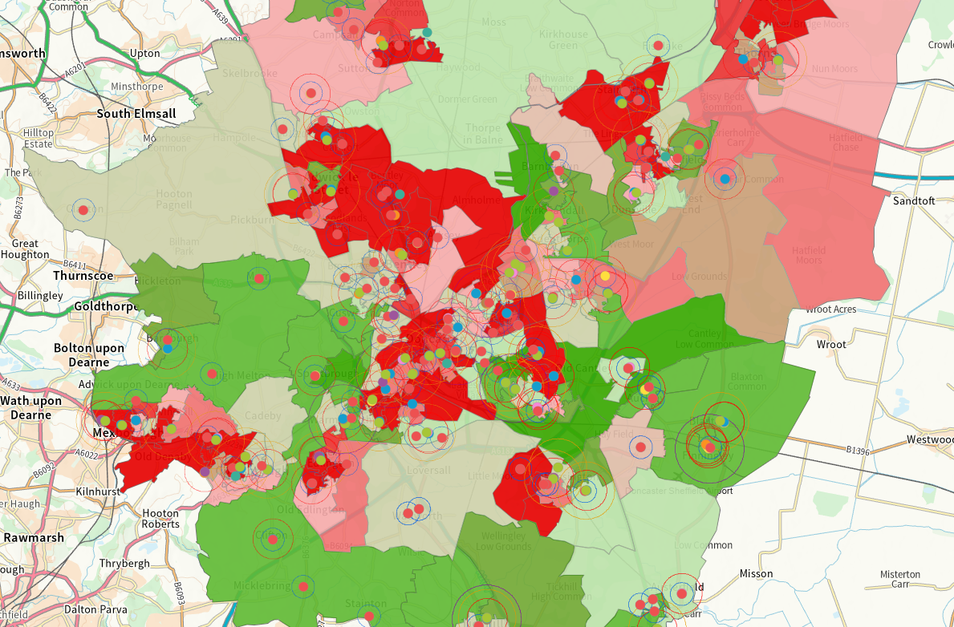
Notes:
Revise Approach to fixed play provision – move away from like for like
Analysis of existing play provision Understand
Consider play provided by others
Consultation: Ward members, portfolio holders & public
Understand the need
Take on board recent work by YSF on access by young girls.
Quality / Value score to play important role moving forward
Consider reduction in provision – destination play with local play
Develop play environments suitable for all ages/abilities
Demonstrate ‘art of the possible’ enable people to think in new ways about play

