Slide 1

Developing Our Place Based Approach In Calderdale
Sharing & Learning Series
Anthony Whittaker – Community Project Manager

Slide 2
What to Expect
Conditions We Aim to Create
Local People
Organisations
Physical Conditions
Whole of Systems Approach
Placed Based Work in Calderdale – Previous Approach
Inputs/Outputs
Outcomes
Learnings
Placed Based Work In Calderdale – Testing a New Community Led Approach
Community Led Approach
Journey & Learning So Far

Slide 3
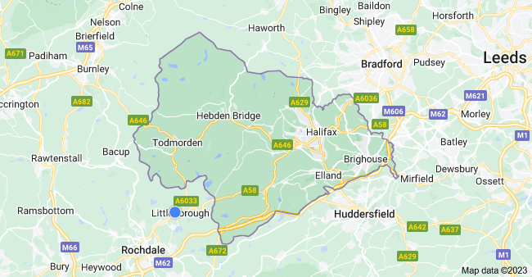
Active Calderdale
Place Partner
Funded by Sport England

Slide 4
Conditions We Aim to Create
1
2
3
LOCAL ORGANISATIONS
5. People see and have role models who are regularly active - ‘people like them’
6. People have support & encouragement to move more from individuals and organisations that they know, value and trust
LOCAL PEOPLE
1. People have reasons to move more, reasons that matter to them
2. People have opportunities to move more
4. People know the benefits of moving more and the opportunities and are reminded of them regularly
3. People know what’s expected of them to be physically active and are reminded regularly
LOCAL PHYSICAL CONDITIONS
7. People have access to safe, accessible and attractive places and spaces to move more – streets, public realm, parks, green spaces
8. People have access to attractive, inclusive, affordable and timely opportunities to move more – formal and informal
PEOPLE
PLACE
PERSONAL

Slide 5
1 = People
2 = Organisations
3 = Physical conditions
1
2
3

Slide 6
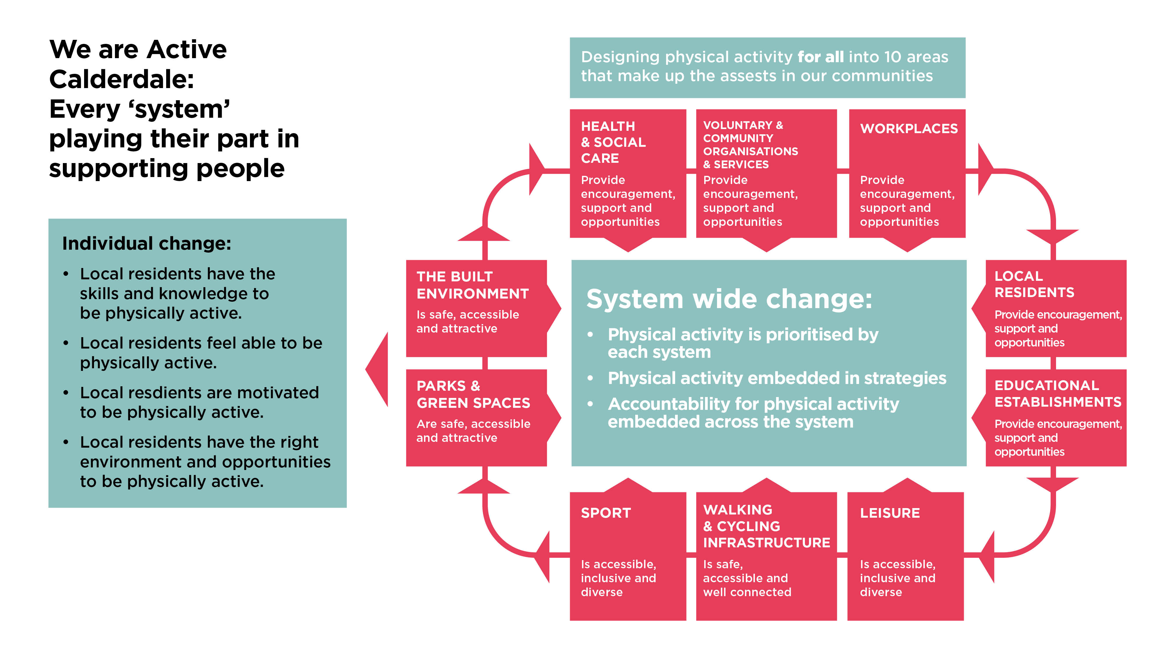
Lower socio-economic groups
Women and girls
People with a disability or long-term health condition
Black, Asian & Minority Ethnic communities
Older adults

Slide 7
Placed Based Approach in Calderdale – Evolution of Our Previous Approach
Preparation Stage
Asset mapping
Creating relationships
Activation Stage
Redesign Workshop
Core documents
Stimulating communities
Allocated investment
Community decisions
Maintenance Stage
Active Partnerships
Preparation Stage
Asset mapping
Creating relationships
Activation Stage
Redesign Workshop

Slide 8
Conditions We Aim to Create – Outcomes of Our Previous Approach
1
2
3
LOCAL ORGANISATIONS
5. People see and have role models who are regularly active - ‘people like them’
6. People have support & encouragement to move more from individuals and organisations that they know, value and trust
LOCAL PEOPLE
1. People have reasons to move more, reasons that matter to them
2. People have opportunities to move more
4. People know the benefits of moving more and the opportunities and are reminded of them regularly
3. People know what’s expected of them to be physically active and are reminded regularly
LOCAL PHYSICAL CONDITIONS
7. People have access to safe, accessible and attractive places and spaces to move more – streets, public realm, parks, green spaces
8. People have access to attractive, inclusive, affordable and timely opportunities to move more – formal and informal
PEOPLE
PLACE
PERSONAL

Slide 9
Outcomes of Our Previous Approach
1 = People
2 = Organisations
3 = Physical conditions
1
2
3

Slide 10
Headline Learnings From Previous Approach
Understand the level of value to be part of the active agenda before investing resources
Be clear on the ask and the offer, this builds trust quickly
Timings aren’t always timely
Go where the energy is
Social media can create new relationships quickly
Redesign workshop - Only use when the asset is ready, it can vary on how it's delivered (presentation or conversation)
Codesigning core documents and presenting them back to delivery teams is an important aspect in the successful activation and use of documents such as our Play Your Part booklet
Community challenges stimulate engagement however, they should always be codesigned and aim to give some responsibility to assets
Sustainability isn't always obvious in planning but can still lead to sustainable projects by showing the value of the project to assets
The Local residents' section of whole of systems approach is extremely important to gain views much wider than can be done through other system areas
Those who represent the community are better placed to make decisions that affect their community than we are
Under-represented areas benefit the most from investment/focus
Connecting the system has great benefits for a wide range of agendas

Slide 11
Placed Based Work in Calderdale
Testing a New Community Led Approach
10 Hyperlocal Areas
Community Workshops
Allocated Funds
Community Decisions

Slide 12
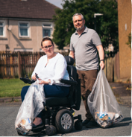
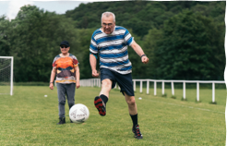
To Create:
3
Local Physical Conditions
Safer, more accessible and more attractive parks and greenspaces
Safer, more accessible and more attractive streets with things to do and see
More accessible, attractive and inclusive sport, physical activity and leisure opportunities
So That:
More local people are active in parks and green spaces and the local environment
More local people are walking, cycling and wheeling for travel and leisure
More local people are taking part in formal and informal sport, leisure and physical activity opportunities

Slide 13

2
Local organisations
Community Led Approach
Process
Workshop 1
Application Support
Workshop 2
Release Funds
Implement Ideas
Partnership Meetings
Subgroup
Community Panel

Slide 14
Rational for Evolving the Approach - Main Points
Focusing resources in hyperlocal areas can have more of an impact than a widespread approach
Local people and assets know their communities best and should decide what local conditions should look like
A Community Led Approach supports our principles of being codesigned, collaborative, targeted and sustainable
Assets become and stay well connected
Previous approach didn’t focus enough on physical assets such as parks and greenspaces

Slide 15
Conditions We Aim to Create – Anticipated Outcomes of Our New Approach
1
2
3
LOCAL ORGANISATIONS
5. People see and have role models who are regularly active - ‘people like them’
6. People have support & encouragement to move more from individuals and organisations that they know, value and trust
LOCAL PEOPLE
1. People have reasons to move more, reasons that matter to them
2. People have opportunities to move more
4. People know the benefits of moving more and the opportunities and are reminded of them regularly
3. People know what’s expected of them to be physically active and are reminded regularly
LOCAL PHYSICAL CONDITIONS
7. People have access to safe, accessible and attractive places and spaces to move more – streets, public realm, parks, green spaces
8. People have access to attractive, inclusive, affordable and timely opportunities to move more – formal and informal
PEOPLE
PLACE
PERSONAL

Slide 16
Anticipated Outcomes of Our New Community Led Approach
1 = Active People
2 = Organisations promoting physical activity as part of what they do
3 = Safe, accessible, attractive physical conditions
1
2
3

Slide 17
Community Led Approach – Updates
Four geographical areas
Community Panels
Funding proposals
Legal agreements

Slide 18
Community Led Approach – Learning So Far
Empowering the community has been well received
It's Important to align with other projects
Workshop attendees should represent the system
Responsibilities should be confirmed when designing improved conditions
When you lead with the money, more organisations can be influenced
Community Panel – conflicts of interests possible
Communities can be very different – easier to use funds in some areas than others

Slide 19
Our First Ever Community Led Workshop
Community Led Workshop in Rastrick

