Slide 1
JU:MP
Greenspace Developments
Notes:
A reminder on what is JU:MP

Slide 2
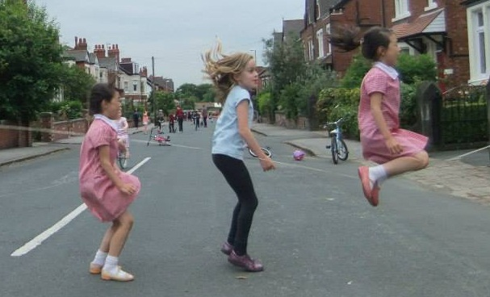
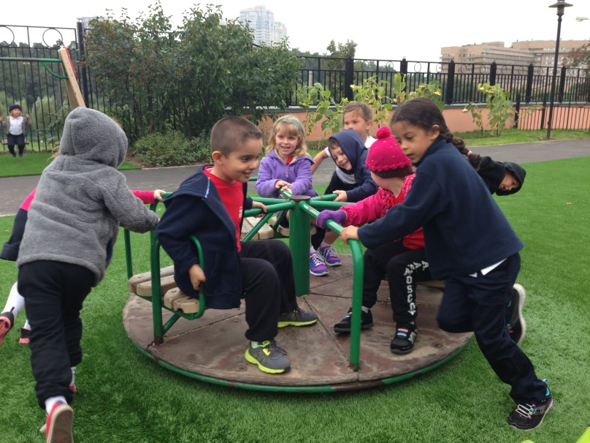
Why we need free play
Greater level of physical activity
Child-led free play
Higher levels of sociability and improved mental wellbeing
Increased community cohesion
Intrinsic value of children’s play and independence - United Nations Convention on the Rights of the Child (1989) Article 31
Notes:
Child led free play – ‘free’ in more than one sense – not directed
Higher levels of sociability and improved mental wellbeing - children having greater confidence and improved social skills from greater experience, and also links into:
wider community benefits such as closer neighbourhood relations, a stronger sense of community, and less fear of crime.
Intrinsic value of children’s play and independence - Article 31 (leisure, play and culture): Every child has the right to relax, play and
take part in a wide range of cultural and artistic activities – fundamental part of their development
This is my street. Children play out in my street because we organise a highly successful street play scheme using the model developed by Playing Out. But Playing Out, Dinah and I were all interested to know how we can move towards streets that don’t need the physical barriers to provide the safety and the incentive for play.

Slide 3
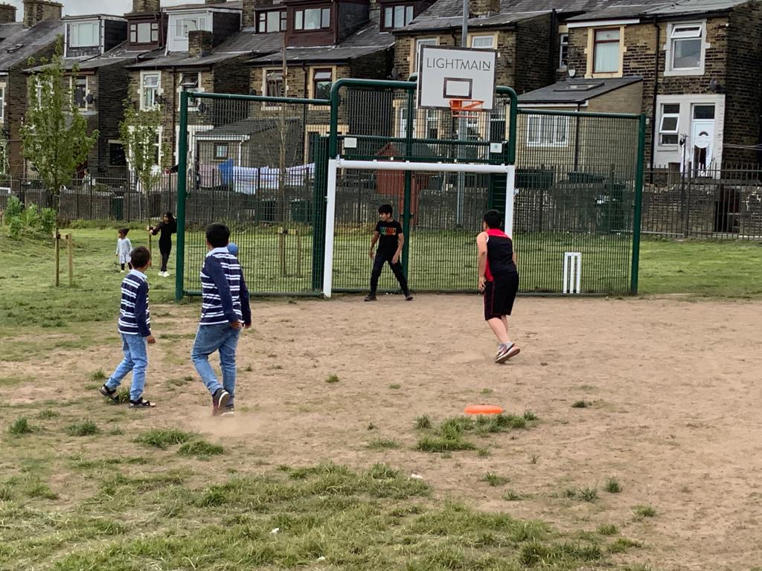
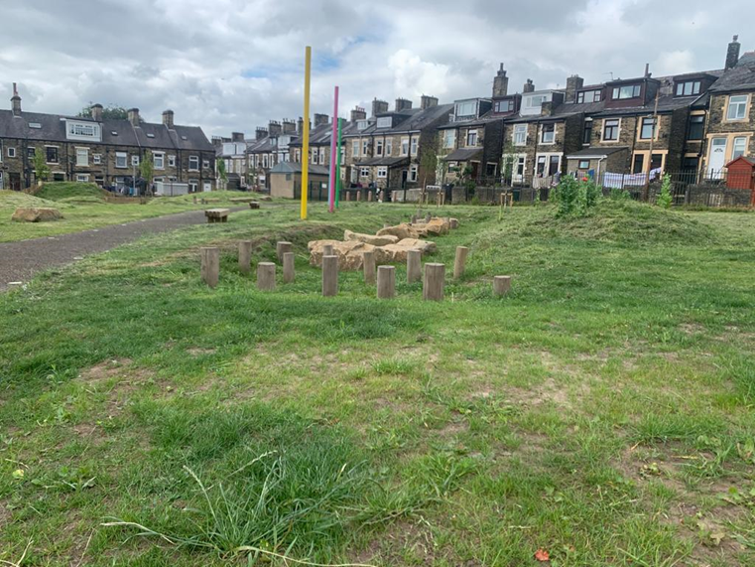
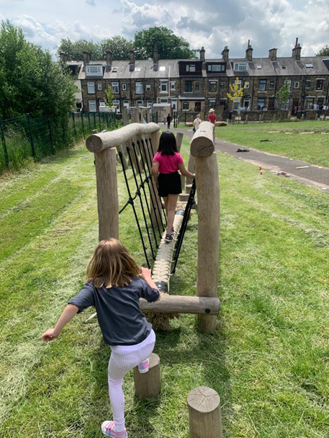
8 Greenspace Developments
3 complete and 5 in community engagement and design phase
JU:MP Greenspace Developments
Kashmir Park
Kashmir Park - Toller
Notes:
Here is just brief update on some of the workstreams underway:
8 greenspace developments are underway as access to local parks or greenspace is key in getting children outdoors and active.
progress - see slide
This is Kashmir Park – once a fenced off overgrown area - now a highly valued local park which is well used for children’s play and looked after by the local community who do regular litter picks

Slide 4
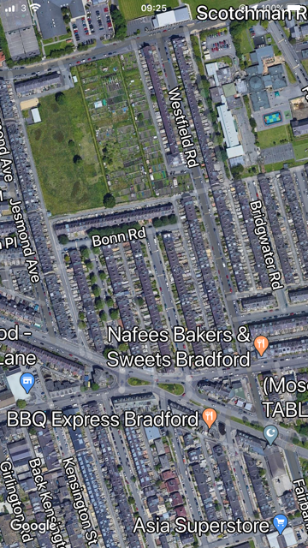
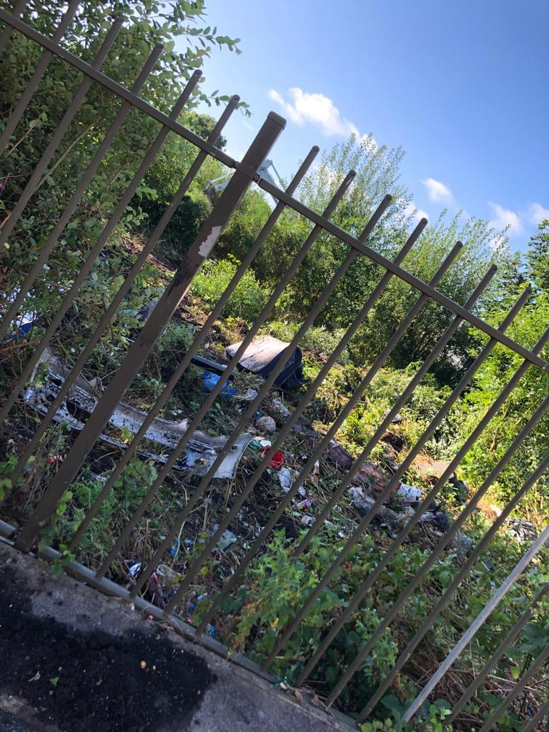
Kashmir Park Development
Notes:
Zuby – There are stark inequalities in access to greenspace for some multi-ethnic communities in inner city areas of Bradford and evidence shows this can lead to poorer mental and physical health.
As you can see from this photo, the Toller area is densely populated and many houses have no gardens.
This area of derelict, fenced off greenspace next to the allotments had been identified as a potential site for a new park by the council

Slide 5
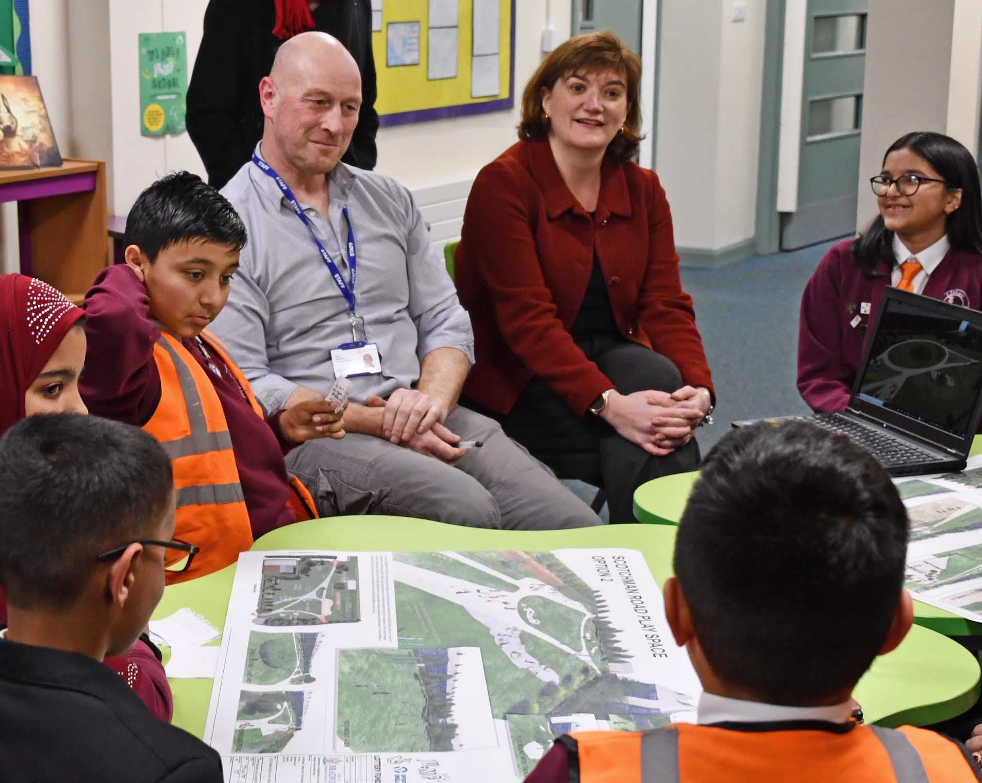
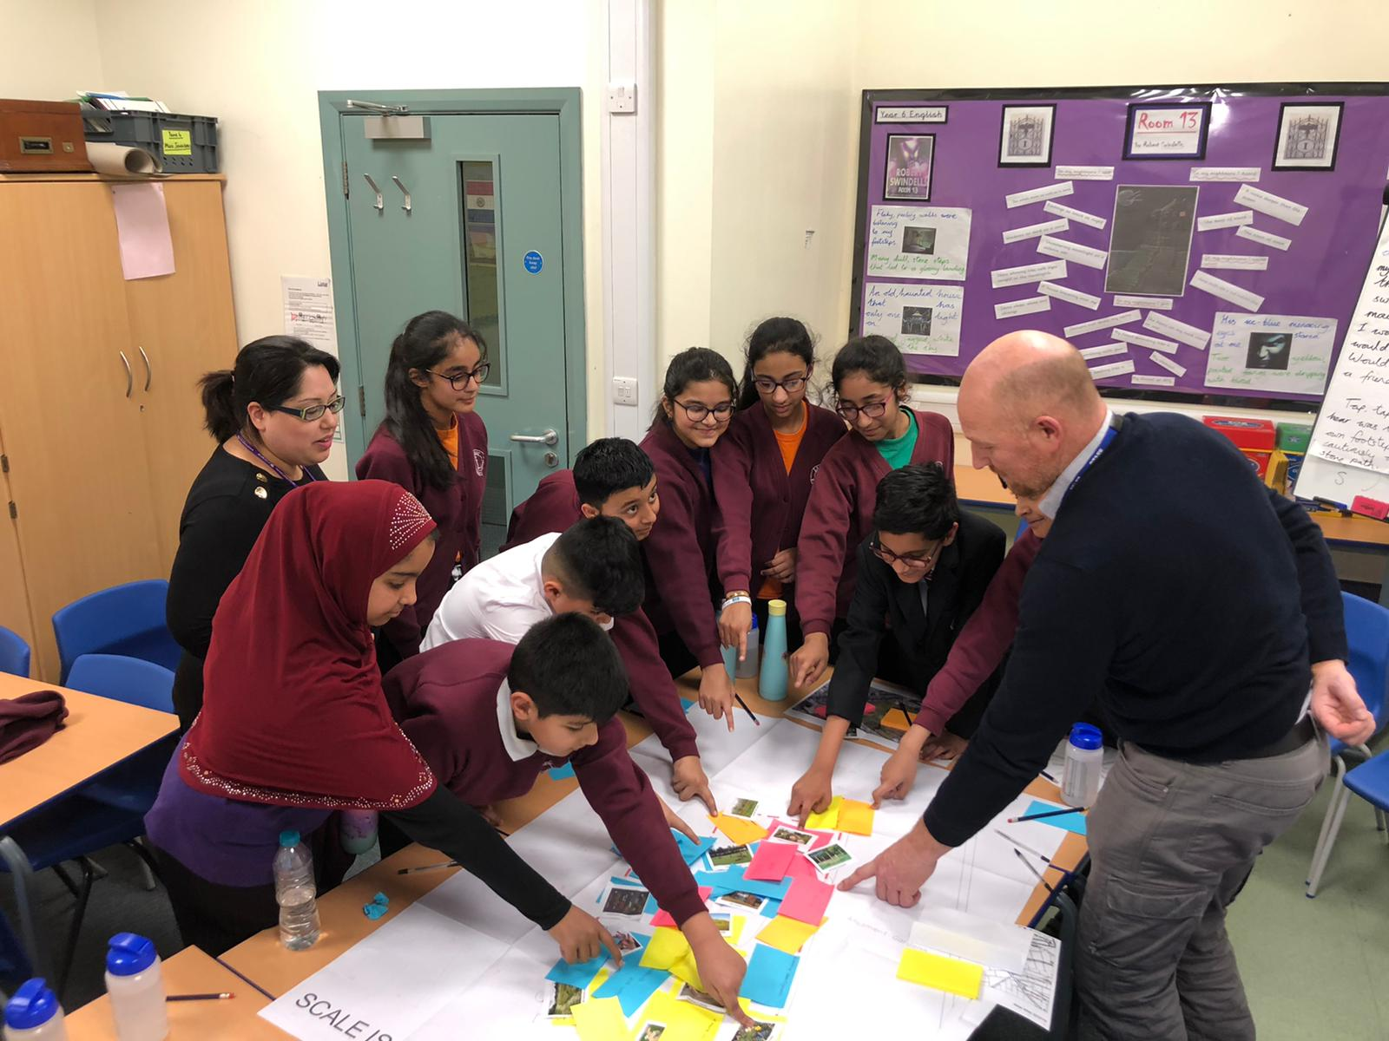
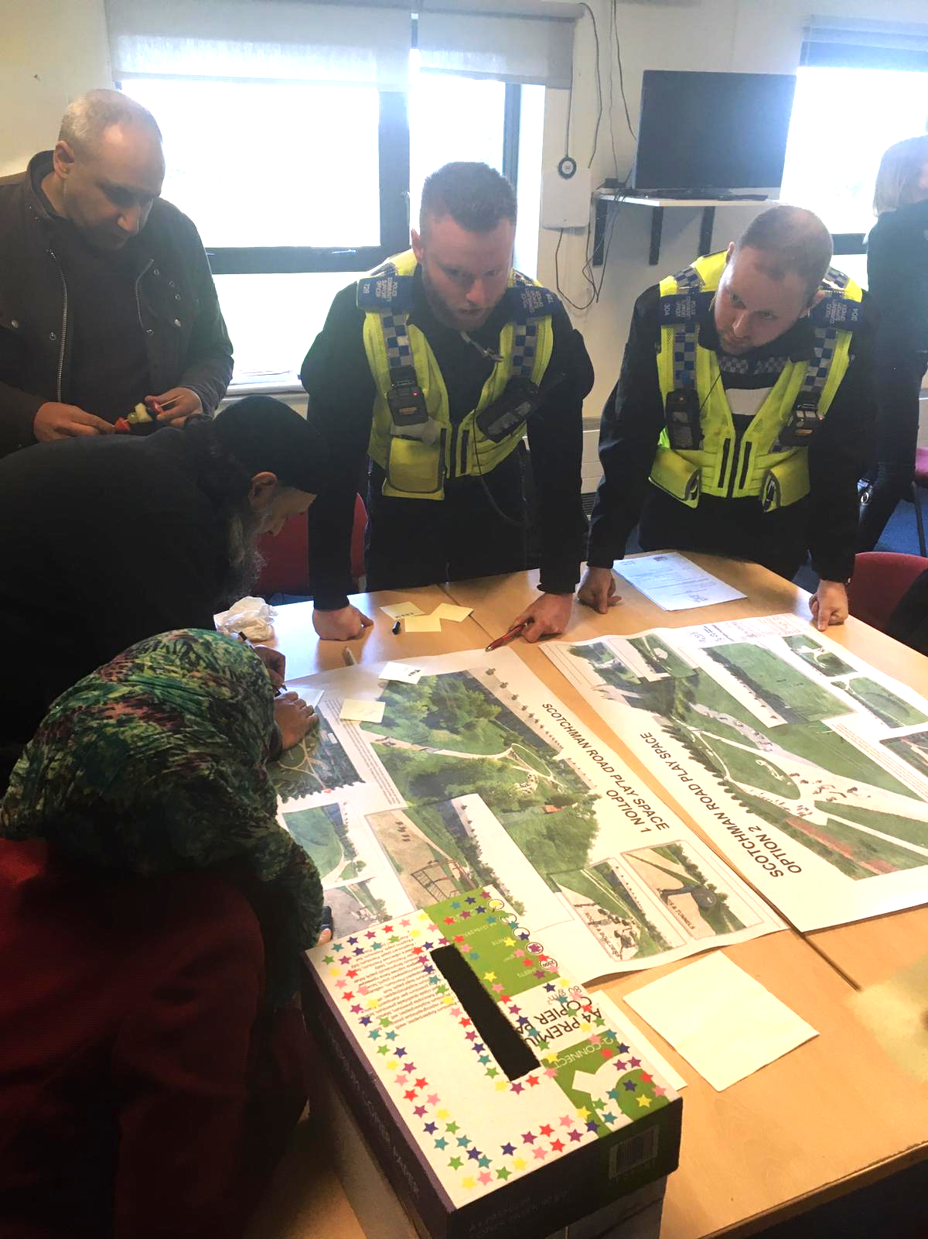
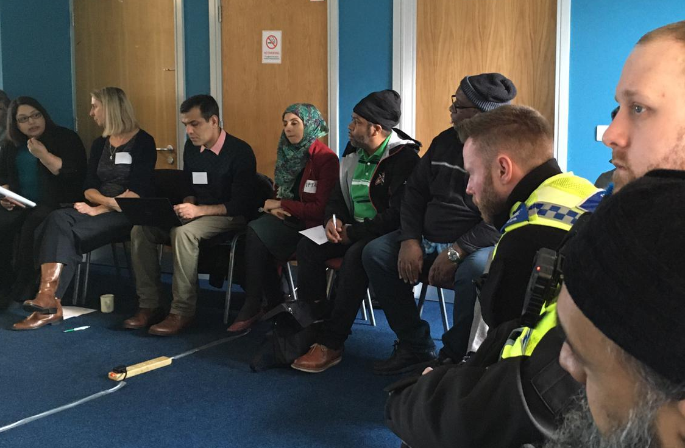
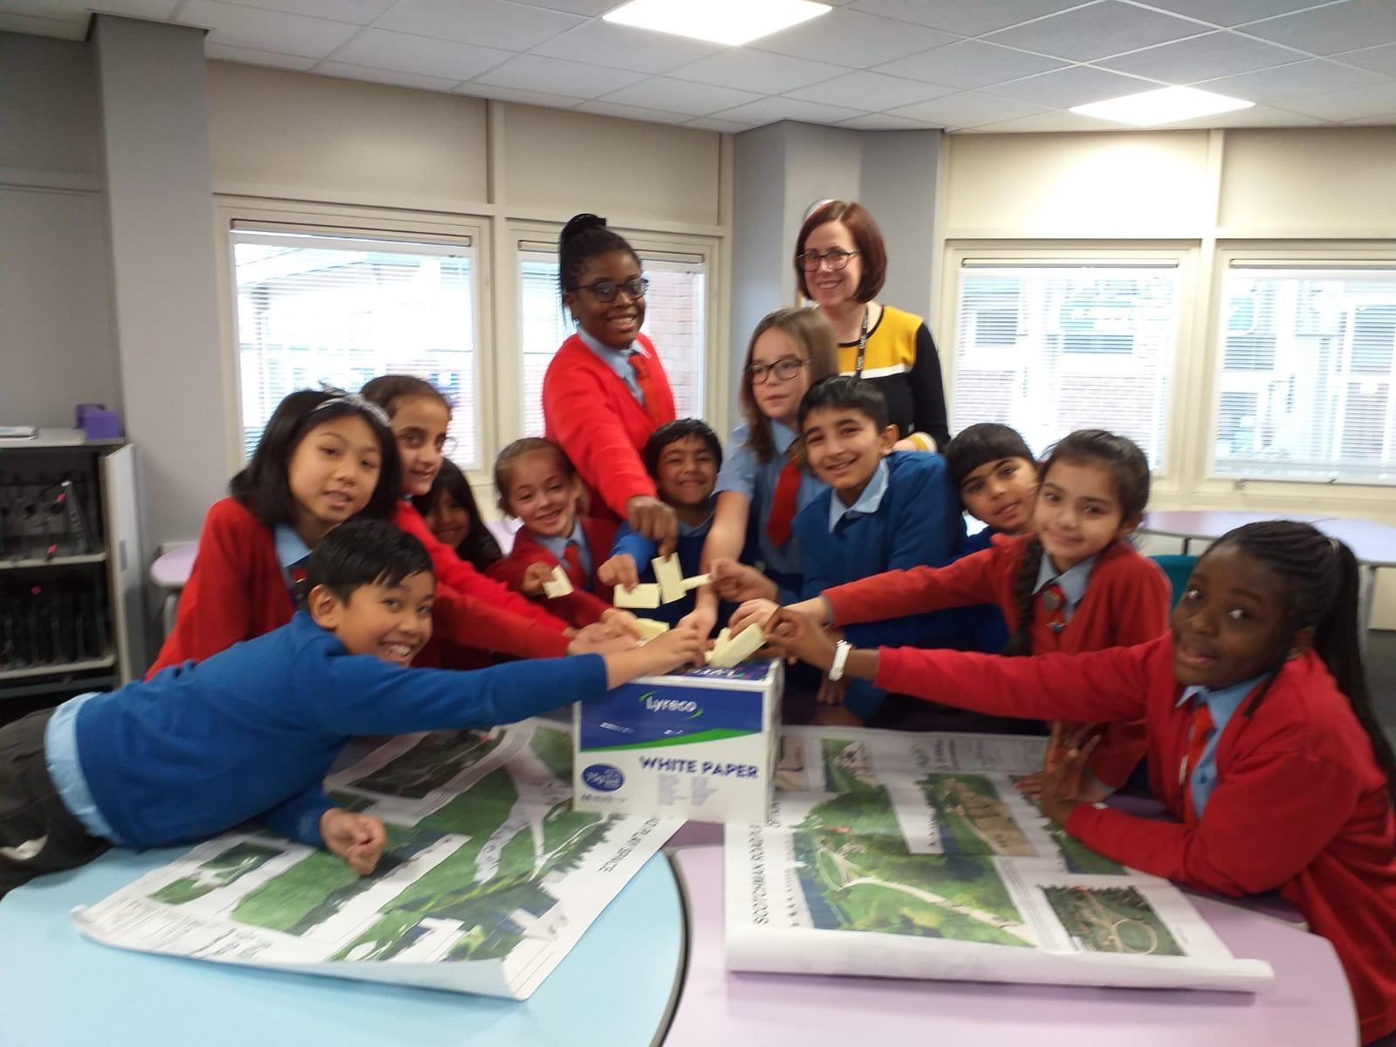


Kashmir Park - Designed by school children and community
Over 2000 people voted for the two design options
Ongoing activation

Slide 6
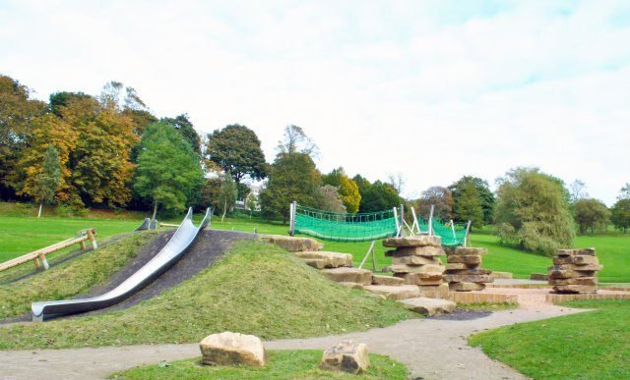
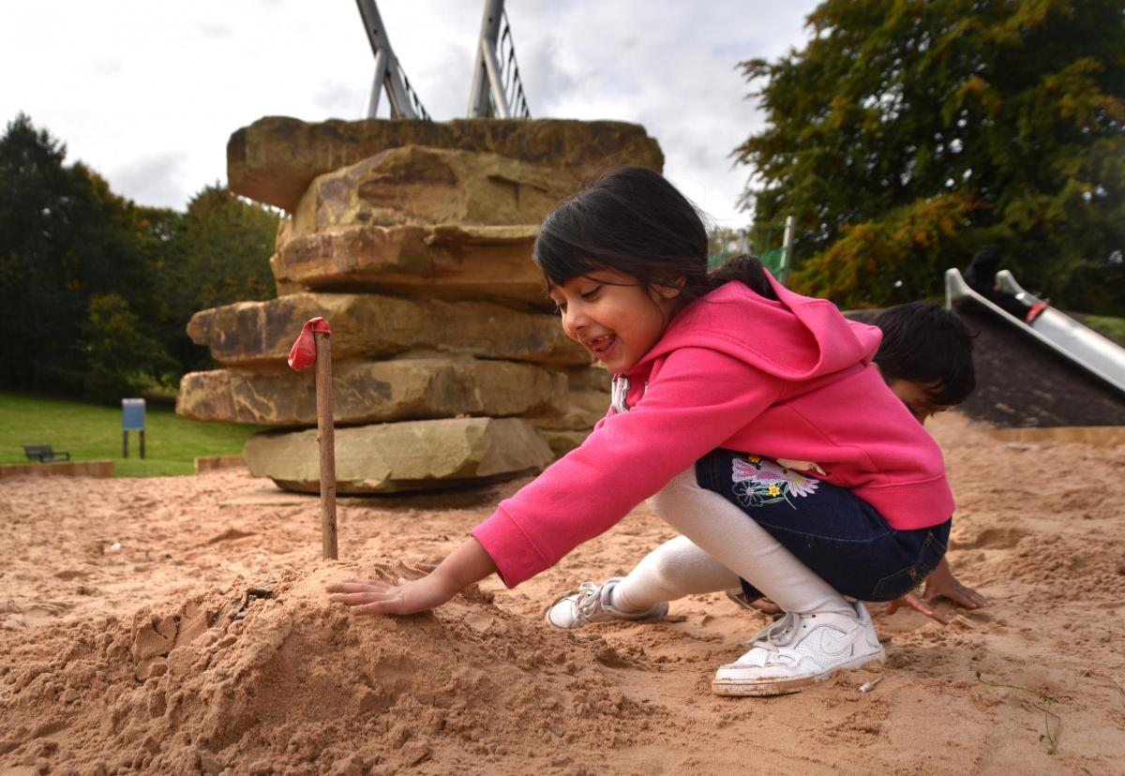
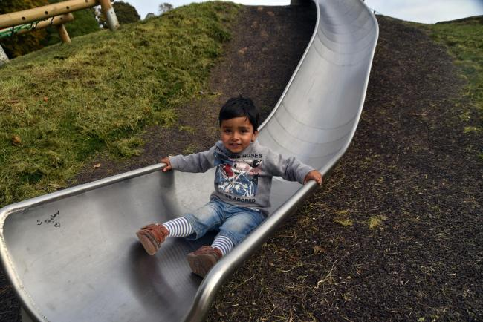
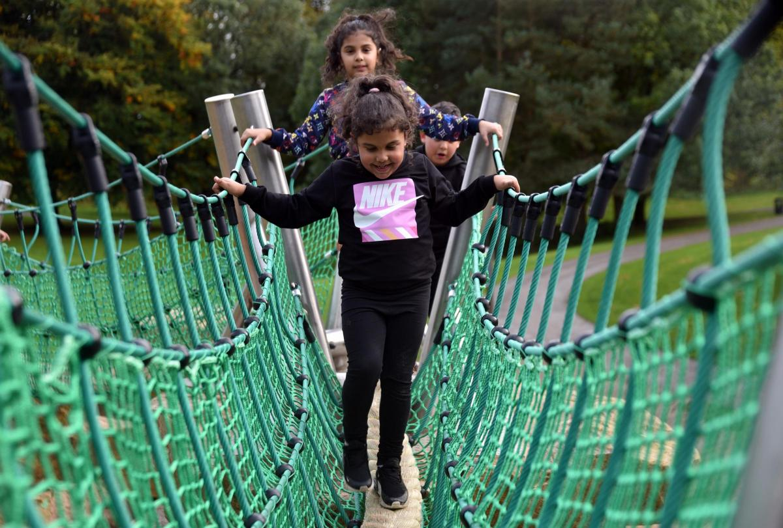
An adventurous play experience which captures imagination and excitement for children of all ages.
We created this challenging & creative area within a Green Flag heritage park.
Greenspace Developments
Peel Park Nature Play Area
Notes:
• The SOPARC audit tool registers the number of users, demographics (e.g. age group and sex) and their levels of physical activity (sedentary, light and moderate-to-vigorous).
• We conducted SOPARC audits in 9 BFD parks in June and July 2022. The protocol comprised 12 hours of observation per park distributed in two week-days and one week-day and four different times of the day (8-9 am, 12-1 pm, 4-5 pm and 6-7 pm).
• Of these parks, 4 will be developed in the following months (intervention parks) and 4 will serve as control parks. The audit will be repeated in 2023 to analyse the potential effects of the park interventions on the number of users and their levels of physical activity, with a special focus on teenagers.
• Peel Park use is also being monitored as part of another ongoing project.

Slide 7
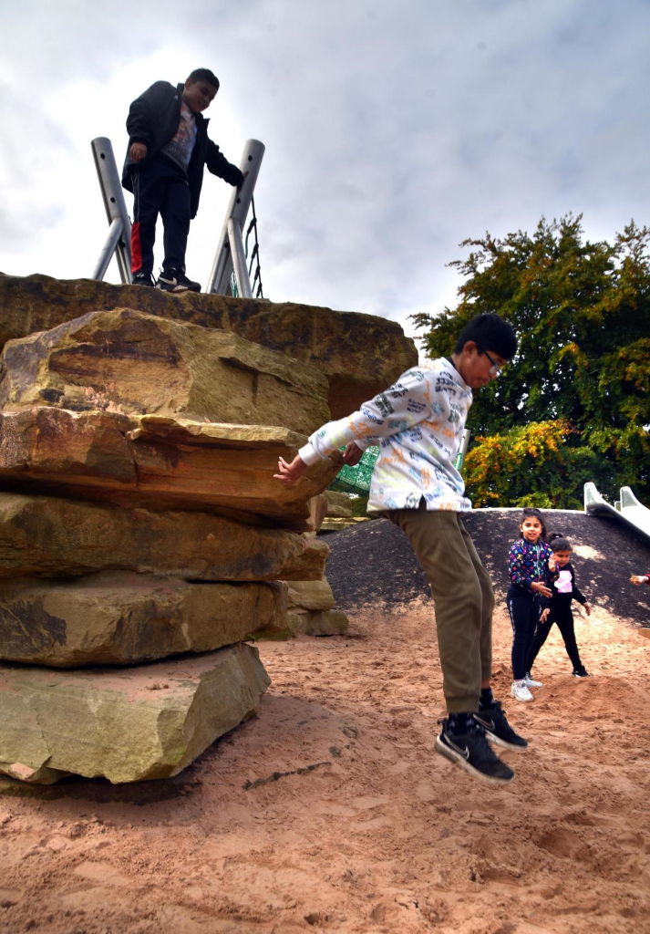
Insight
Positive response from community
Research shows nature play more active than traditional play
2022 - Make Space for Girls

Slide 8
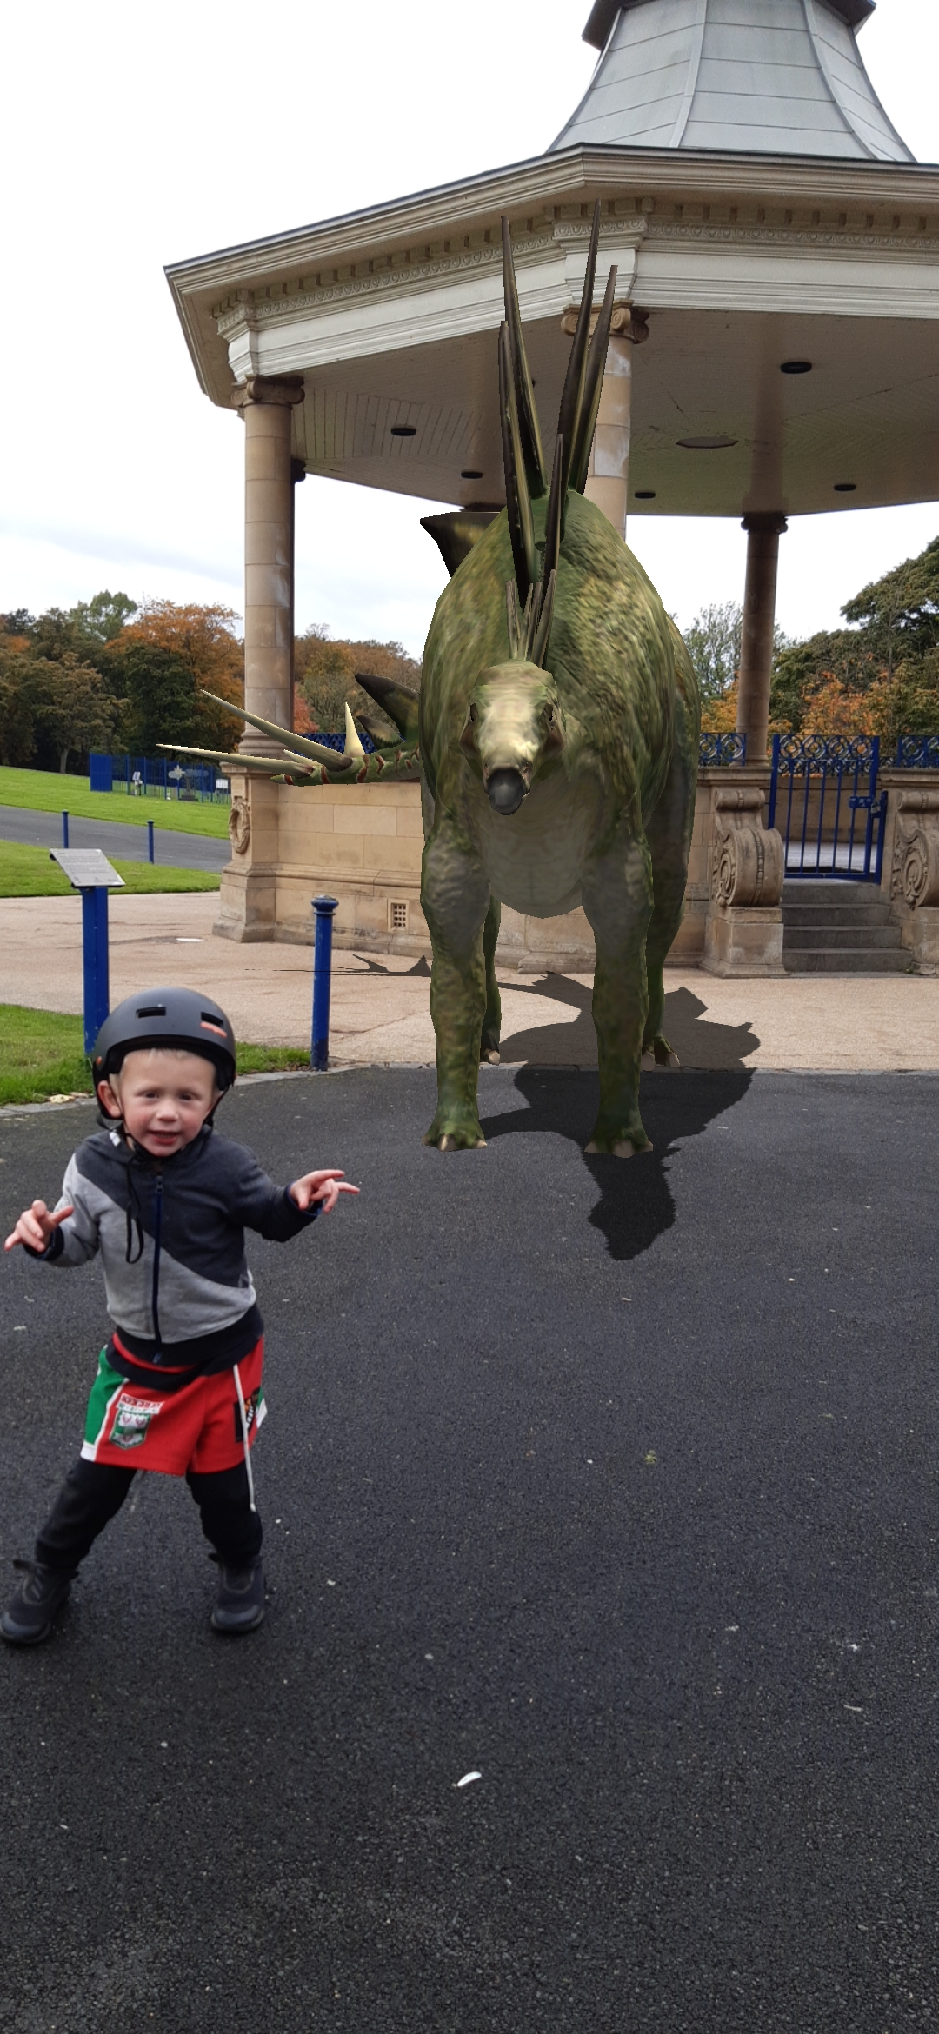
Active Playful Parks
Digital engagement through the Love Exploring App

Slide 9
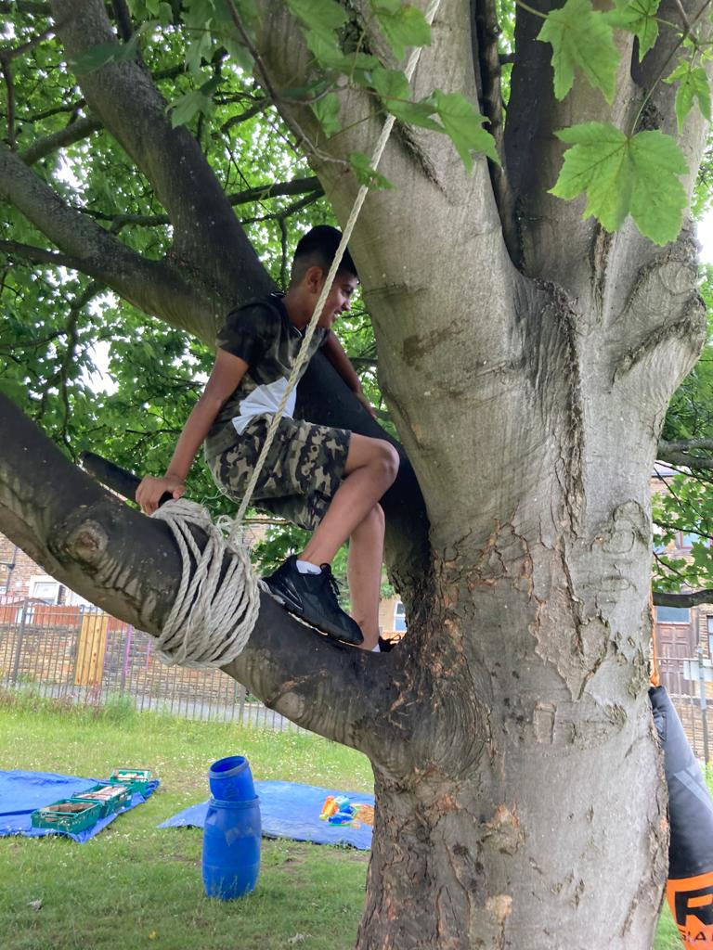


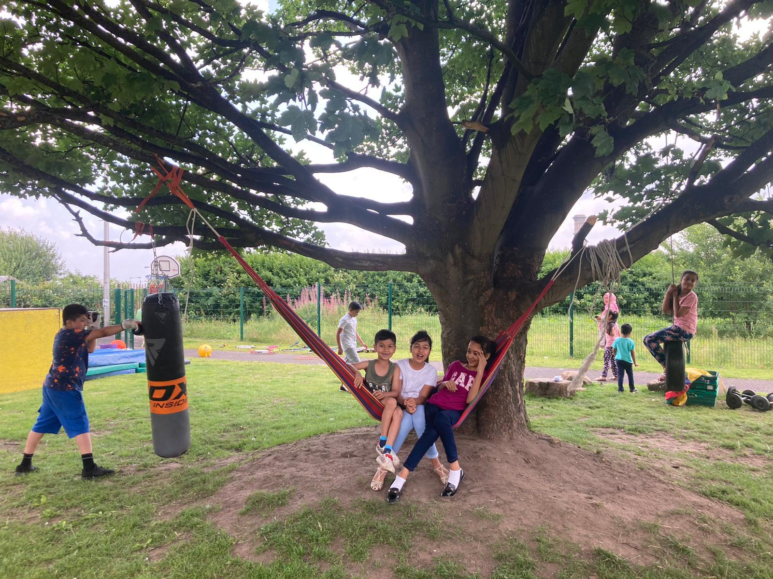
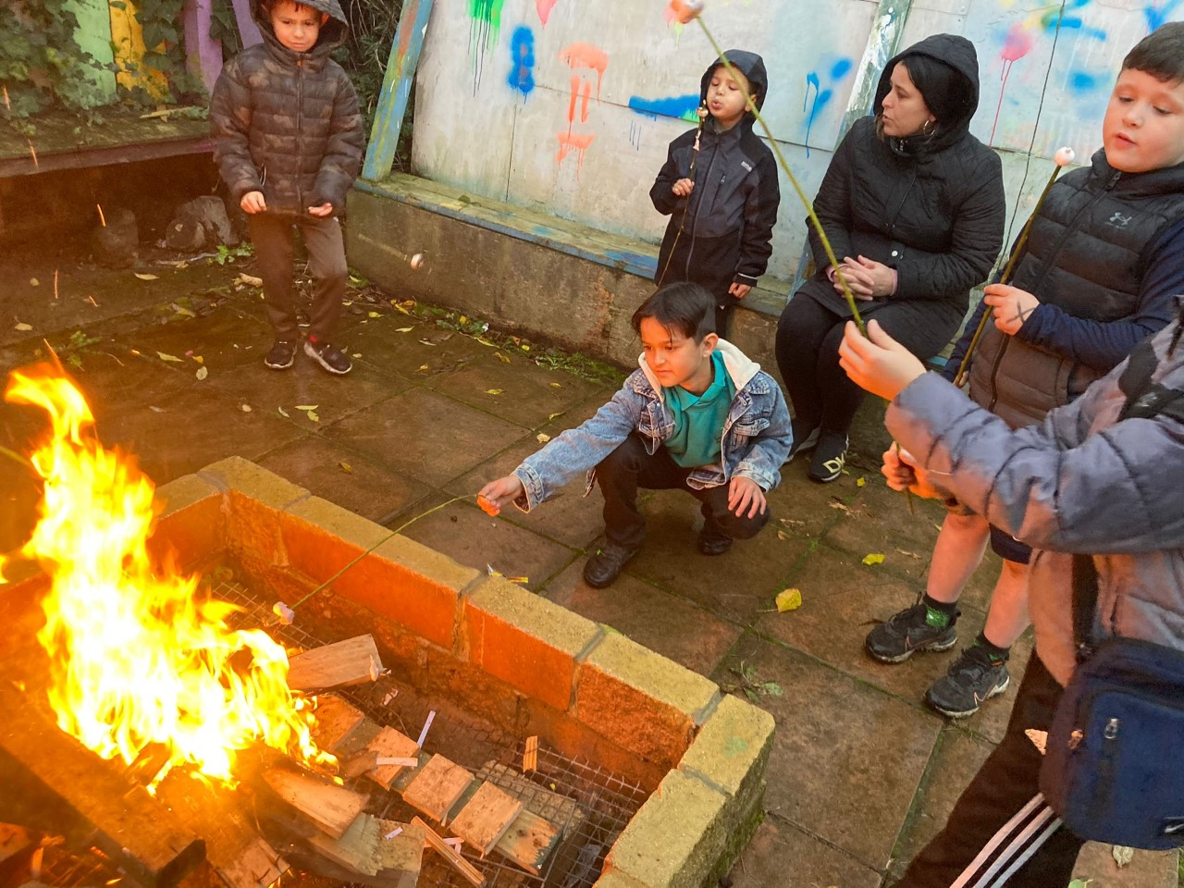
Delivery of mobile adventurous play MAP
Aims
To improve children’s opportunity to develop risk and resilience in their community
To develop confidence in parents and residents to take ownership and responsibility for play in their neighbourhood – provide adventure play training.
Notes:
across the city, coordinated for the main play hub The Big Swing Adventure Playground

Slide 10
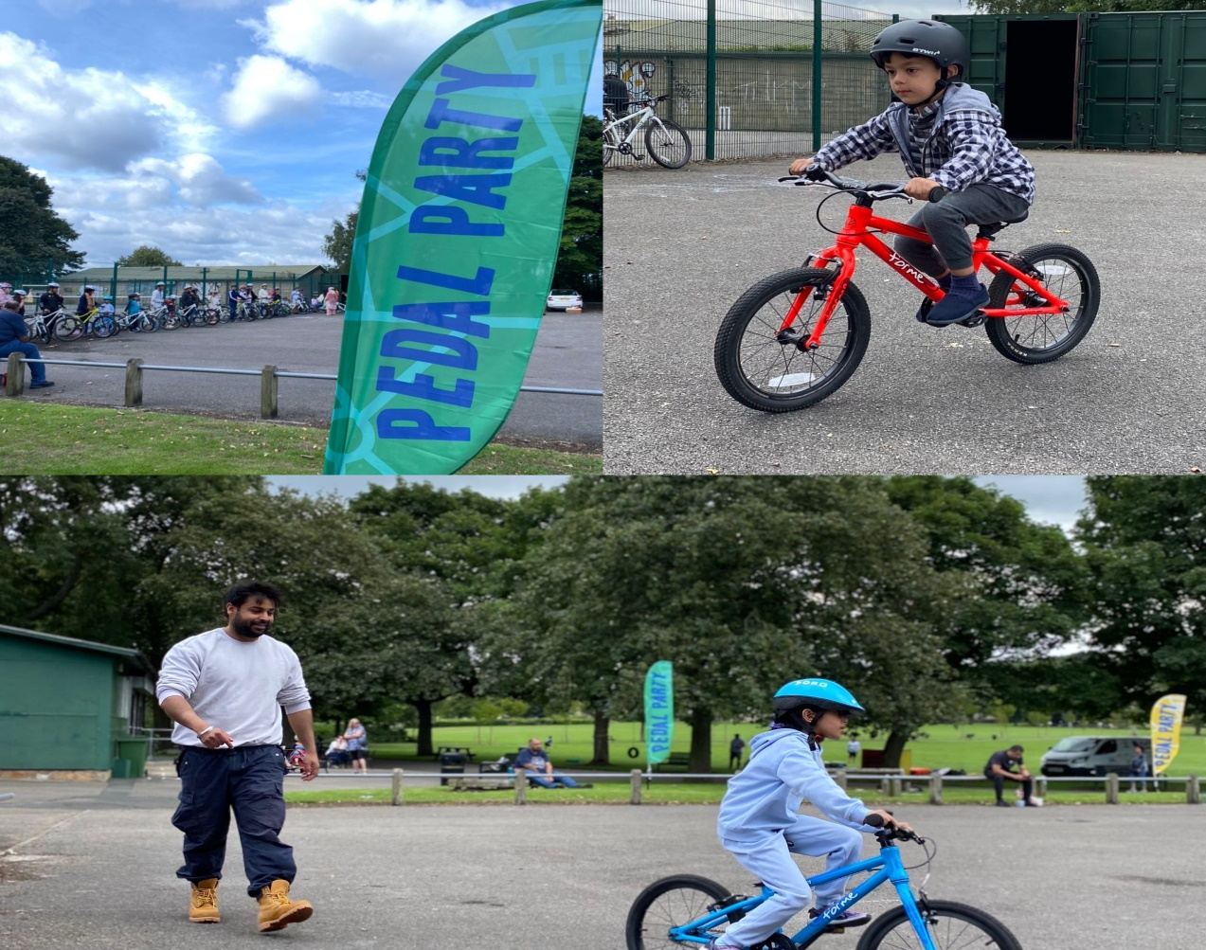
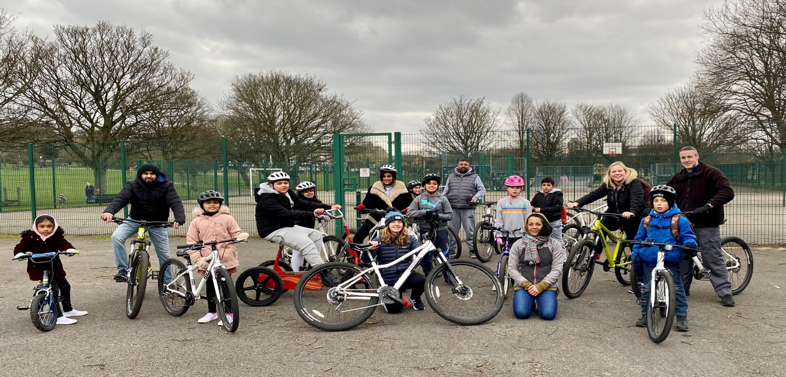
JU:MP Cycle Hub – Peel Park
JU:MP Cycle Hub delivered predominantly by Hop-On, with support from British Cycling.
Five local deliverers booked on coaching courses on Jan 23.
Over 400 people have utilised the Cycle Hub
Notes:
The JU:MP Cycling Hub at Peel Park will create a series of community-driven cycling programmes to engage a broad audience of young people and their families from the surrounding neighbourhoods.
• One of the project’s main objectives is to build strong partnerships with local organisations and to create a sustainable model that the local community can maintain.
• Current delivery- Saturday family sessions, midweek drop-in to learn to ride and increase confidence, half-term sessions, school delivery, JU:MP fun days and taster sessions at the BMX track.

Slide 11
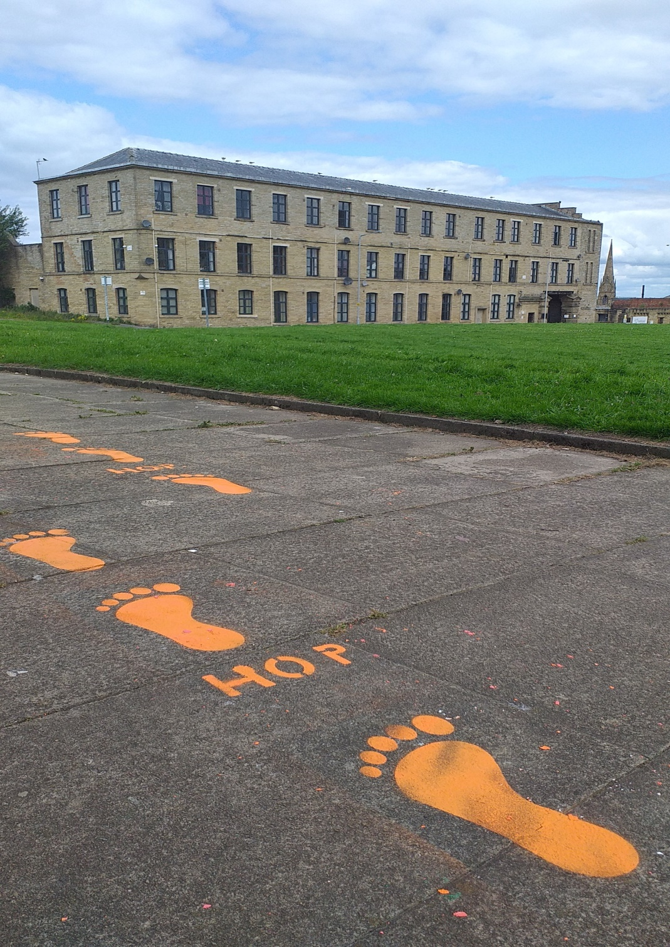
Chalk walks…
Encouraging families to discover their parks and greenspace
Simple “breadcrumb trail” approach

Slide 12
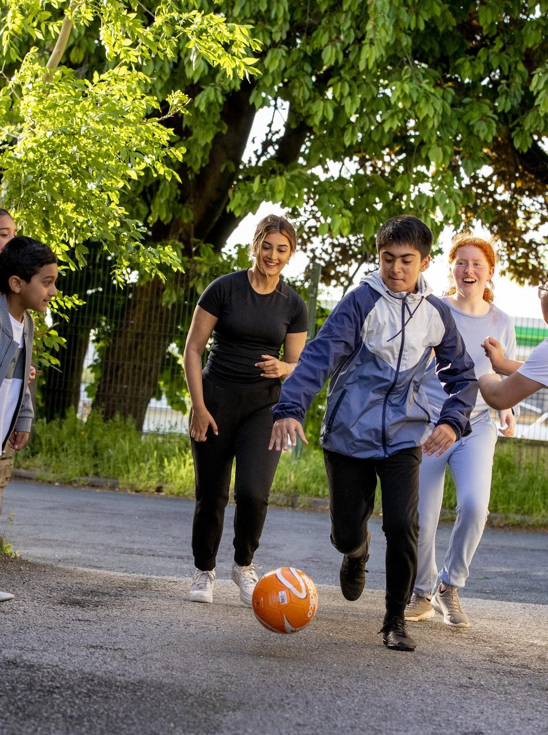
Over 9k family members in Bradford have joined the JU:MP movement!
Notes:
JU:MP’s social marketing is co-created with families and children and uses a ‘people like me’ approach to create social norms, capture attention, and spread awareness,
through creativity and emotion. It uses well established marketing techniques to educate families, raise awareness of the benefits of playing and being active, and shares local opportunities to be active. See slide – over 8,770 family members have joined the JU:MP movement which means we are now reaching almost a third of all families in the JUMP are. The shared aspiration is to reach over 50% by next summer!

Slide 13
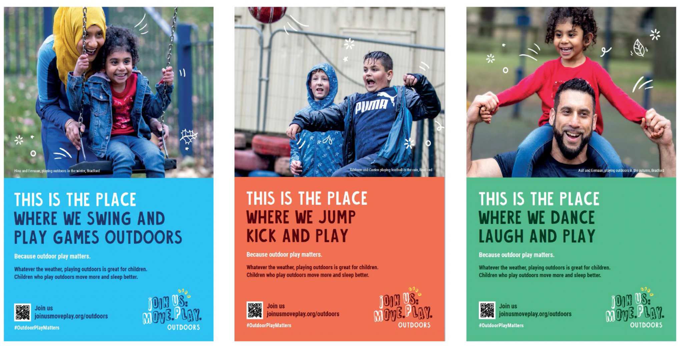

Slide 14
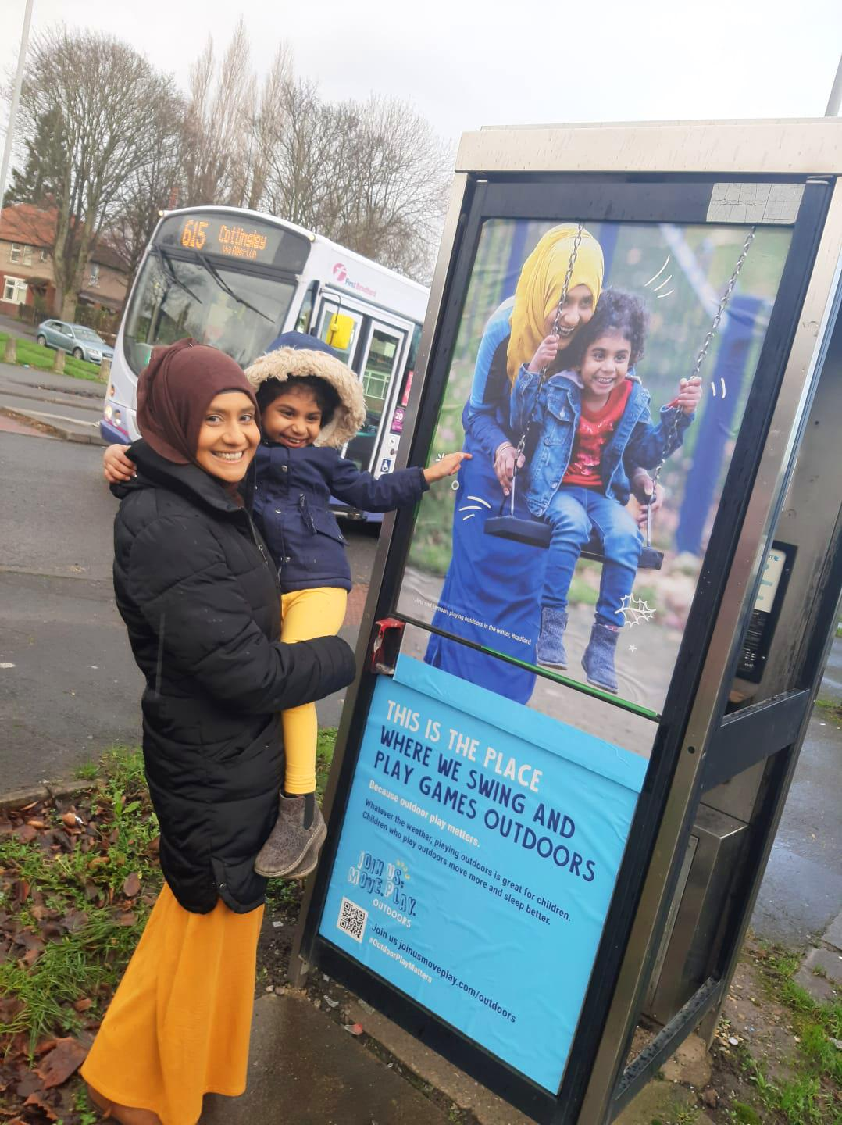

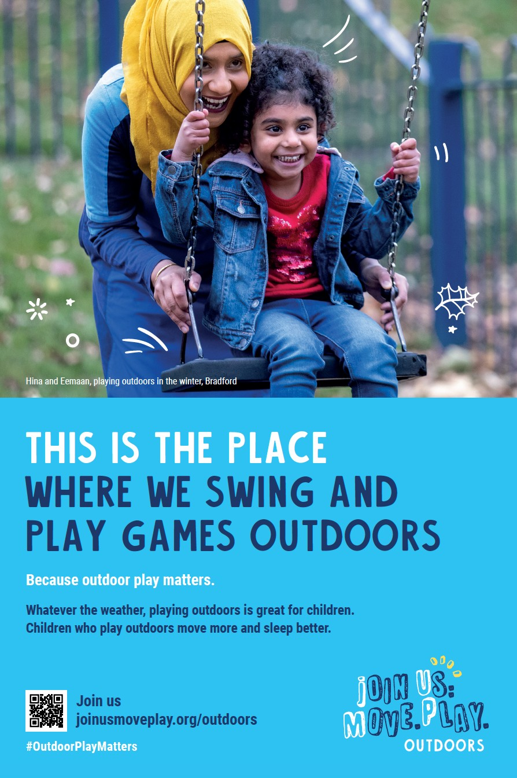
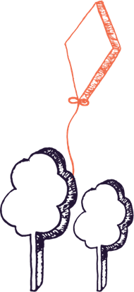
Notes:
our JU:MP champions who are all local people are the face of the campaign and actively involved in promoting the messages

Slide 15
Building the evidence… SOPARC
Audit tool registers the number of users, demographics and their levels of physical activity (sedentary, light and moderate-to-vigorous)
SOPARC audits in Bradford parks:
4 parks to be developed (intervention parks)
4 will serve as control parks.
Notes:
Follow up in 2023 to analyse the potential effects of the park interventions on the number of users and their levels of physical activity, with a special focus on teenagers.
• Peel Park use is also being monitored as part of another ongoing project.

Slide 16


BIB/JU:MP App
2023 onwards…
Digital engagement in PA and health
Digital platform capturing data for research
Gamification and behaviour change
Notes:
Also new and exciting for 2023! The JU:MP App is designed for children and Yp because our insight shows they really value their digital world and that they would be motivated to be active and get outdoors though an app. See slide
They can gain points for quests at home and outdoors, for number of steps, but also for attending a sports activity or going to the park – QR code technology

Slide 17
Key Learning:
Anti-social behaviour in parks/greenspace increased since covid, particularly quad bikes and motorbikes
No easy solutions despite best efforts and partnership working
Wider system and socio-economic issues

Slide 18
Key Learning:
A strong research-practice collaboration can help embed evidence-based practice to maximise feasibility, acceptability and effectiveness
Working at the neighbourhood/locality level can be effective and it’s often where the real, tangible change happens.
Strategic work needed to provide “top cover” and knit together local system change across district…a bottom up approach to a physical activity revolution

Slide 19
Workshop 2:
The role of parks and greenspace in whole systems physical activity working
• Reflections on what you have heard? How similar/how different?
• What’s worked well? What are the challenges?
• What have you learned? Solutions?

Slide 20

Sharing future plans on place-based approaches
Joel Brookfield – Strategic lead Local Delivery
Sport England

Slide 21




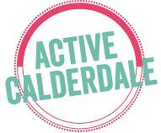


Summary - future workshops and next steps
James Brown – Yorkshire Sport Foundation

