Slide 1

Get Doncaster Moving
Health & Care Theme
Snapshot of Progress
Andy Pattinson
GDM Team

Slide 2
Inactivity in Doncaster
Inactive Adults*
Inactive Children**
33.3%
(England 25.8%)
31.1%
(England 30.1%)
Inactivity varies across Doncaster – in communities where residents face the greatest levels of inequality, inactivity increases, e.g. for adults:
Edlington
65%
of adults are inactive
*Doing less than 30 minutes of moderate intensity PA each week
**Less than an average of 30 minutes a day.

Slide 3
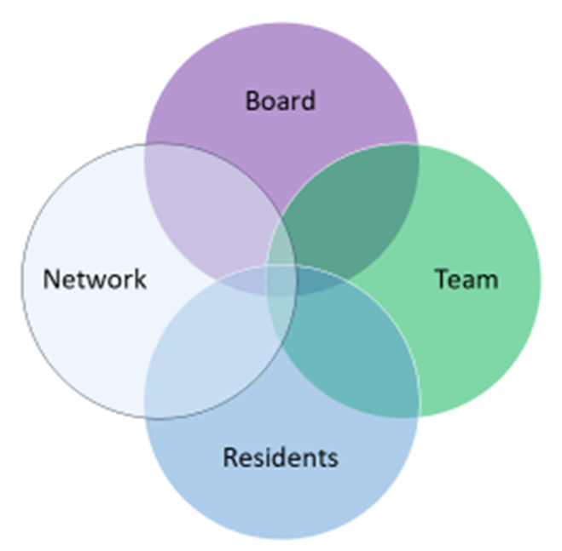
Get Doncaster Moving
Get Doncaster Moving (GDM) is the name of Doncaster's partnership approach to tackling inequalities in physical activity (PA) to achieve the vision of:
‘Healthy and vibrant communities through movement, physical activity and sport’
GDM Network
Includes any individual, group, business or organisation who is committed to playing their part in supporting Doncaster residents to access PA.
GDM Team
A small central team, based within the City of Doncaster Council’s Public Health Directorate – works in partnership to create the connections and conditions to make PA an easier choice for all residents.
Doncaster is one of 12 Local Delivery Pilots (LDPs) funded by Sport England to achieve a sustained reduction in population PA levels by:
  Influencing local policies, places, spaces & people to work coherently as a ‘whole system’.

Slide 4
Health & Care Theme
Overall Ambition
Physical activity (PA) will play a major role within health and care (H&C) systems – through policy, process and practice – so that everyone in Doncaster can enjoy more healthy years of life.
Priority Actions
Develop new and strengthen existing relationships between health & care colleagues
Embed PA into health & care clinical pathways - prehabilitation, rehabilitation & treatment
Support the health & care workforce to build strength based conversations about PA in to their practice and how to signpost to local and accessible opportunities
Embed movement, PA and sports opportunities in Social Prescribing
Embed PA within health & care research
A relatively underdeveloped theme, but a greater priority over the past 6 months…

Slide 5
Recent Activity
Scoping the Health & Care System
A journey to understand and connect the H&C system:
  Policy, projects, people & organisations
…and how this fits within the whole system that influences local people’s motivation and capability to be active – e.g. levels of deprivation and inequalities
Identifying opportunities for collaboration
  Within & across organisations around common goals – locally through to nationally
  Locally: e.g. GDM Network & Integrated Care Board (Place)
  Regionally: e.g. Office for Health Improvement & Disparities, Yorkshire Sport Foundation, ICB (South Yorkshire system)
  Nationally: e.g. Sport England
  Attending meetings, events, workshops
Identifying PA advocates in health and care
Understanding where PA is already embedded…and what’s in the pipeline
Looking at good practice elsewhere – e.g. the other 11 LDPs

Slide 6
Recent Activity (2)
Responding to demand for PA support
Many opportunities emerging from within the H&C System
Reflecting a growing recognition that PA:
Should be better utilised within and alongside H&C practice and population health management - as part of an integrated, whole systems approach.
  Can reduce immediate pressures in the system, e.g. on NHS waiting lists.
  Can improve health outcomes from clinical pathways – through PA prehab & rehab
Supports the prevention of ill health – as inactivity is key risk factor
An appetite to explore:
How to help co-create the local conditions to support common goals – particularly through community based services as alternatives to clinical settings, where appropriate.

Slide 7
Examples
Demand for PA support from different parts of the health & care system
PA Support
Cancer Prehab
Pilot
Breathing Pattern Disorder
Patients
Falls Prevention
Supporting
the H&C workforce to discuss PA
‘Green & Blue’
Social
Prescribing

Slide 8
Residents’ Views
About the role of PA in the treatment or rehabilitation of health conditions
Residents’ Panel survey in July 2023 - 184 residents completed it
75% think medical professionals should promote non-medical interventions like PA
81% would take part in PA if they were referred by a doctor
Only 18% without a disability have had a conversation at their doctor’s about PA.
It is 55% for those with a disability.
78% think there are additional benefits of undertaking PA in community settings
55% would be more likely to undertake PA in a community setting compared to a clinical one
A barrier is confidence engaging in PA
32% believe people who lead PA sessions in the community are appropriately qualified

Slide 9
Cancer Prehabilitation - Pilot
Partners
Objectives
Progress
Next Steps
Led by: Doncaster & Bassetlaw Teaching Hospitals NHS Foundation Trust (DBTH).
Core Team: 2 Allied Health Professionals (job share); Band 4 Therapy Assistant; Nutritionist (2 days a week)
Funded through SYB Cancer Alliance.
Explore how PA, diet and overall wellbeing support:
before colorectal cancer surgery & for those having adjuvant therapies can improve outcomes for the patients.
Scope and plan a new service.
Pilot started 12th June for 6 months
Initially hospital delivered (Mexborough) - but looking at 2-3 other non-clinical sites as part of a phased expansion.
Site visit to Askern Leisure Centre 11 October 23 – run by Doncaster Culture & Leisure Trust (DCLT).
DCLT & DBTH joining SY ‘Active Together’ programme to:
unlock additional resources to extend the pilot
improve co-ordination of support for patients
GDM to continue to help connect partners & coordinate meetings
Will be an evaluation after the pilot.

Slide 10
Breathing Pattern Disorder (BPD) Patients - Pilot
Partners
Objectives
Progress
Next Steps
Led by: the Pulmonary Rehabilitation Team at DBTH.
Delivered by: Darts - Doncaster Community Arts.
GDM brought the two key partners together.
Funded by: NHS England transformational monies.
Breathing control retraining – exploring how ‘Breathe & Connect’ courses provided by darts can help (e.g. breathing, relaxation & gentle movement).
To enable DBTH to focus on more chronic respiratory conditions & reduce waiting lists.
A respiratory consultant will initially refer patients for BPD support.
Patients will then be assessed by qualified DBTH physio staff to confirm suitability for darts - group programme running for 7 weeks with 10 patients per group.
DBTH provided training to darts team so course tailored to patients’ needs.
Pilot expected run from to June 24.
Outcome measures based on two questionnaires – both used pre and post the course. To include a question about PA.
For those that aren't active it will facilitate their return to PA.

Slide 11
Falls Prevention
Partners
&
Funding
Objectives
Progress
Next Steps
Led and funded by: Integrated Care Board – Doncaster Place.
Other partners: Public Health (e.g. Ageing Well leads and GDM), DBTH, Rotherham Doncaster & S. Humber NHS Foundation Trust (RDaSH); Yorkshire Ambulance Service.
Kick-start and re-energise falls prevention – particularly in relation to PA support in communities.
Understand, connect & communicate what’s available – and establish what else is needed.
Task & Finish group established with support of GDM.
Action Plan in place.
Communications plan, e.g. supporting Falls Prevention Week .
Mapped support provision for the older population.
Improvements made to on-line information – ‘Your Life Doncaster’
Deep Dive – into a target community to better understand the current conditions for falls prevention - scoping phase.
Darts in discussions to run a falls prevention pathway pilot, incorporating ‘Dance On’ sessions – funded by GDM.

Slide 12
Social Prescribing – ‘Green & Blue’
Partners
Objectives
Progress
Next Steps
Doncaster Social Prescribing Service (Delivered by SY Housing)
Sheffield & Rotherham Wildlife Trust – delivering the SY Green & Blue SP pilot
Don Catchment River Trust – delivering ‘All hand on the Don’ Programme
Doncaster Future Parks
Greenspace Network
Develop a more coordinated approach to the Green & Blue SP pathway to: engage more inactive people in green and blue spaces.
Improve the: quality of initial conversations in the pathway (e.g. GP, Health Coach); the availability of support information; the signposting process; the quality of the opportunities available.
Recently started.
Initial meeting to discuss collaboration opportunities.
Action planning meeting October/November.
Consider connections to related work, e.g. Support for H&C workforce to discuss PA; Active Travel SP pilot; SP by PCNs.
Learning from this project will be applied to other SP pathways.

Slide 13
Supporting H&C Workforce to discuss PA
Partners
Objectives
Progress
Next Steps
Primary Care Doncaster (PCD)
GDM.
DBTH
Care Homes.
Support the H&C workforce to have conversations about PA with patients:
  The benefits of PA to health and wellbeing.
  Practical ways to discuss this with patients.
  Signposting to tailored community-based support.
GDM presented at 2 GP TARGET sessions in April 23 to help:
  Integrate PA promotion in routine practice, e.g. using Moving Medicine online resources; promote local opportunities, e.g. walking, being active at home.
  Training sessions in care homes with activity coordinators – provided by DBTH for South Yorkshire.
  GDM to agree Action Plan with Primary Care Doncaster for next phase of PA promotion.
  Monitor regional/national resources to support PA promotion.
  Support proposed additional, bespoke training in Doncaster care homes

Slide 14
Learning so far
Realism - easy to get overwhelmed trying to navigate the health & care system.
  Structures are often complex and segmented.
  Nothing to something and something to more – is OK as a starting point.
Match Motivation – go where the energy and demand is to make progress.
  Don’t wait for a ‘top down’ route map or the policy ‘stars’ to align.
  Need to find out what works in communities.
  …progress may require helping create the energy and ability for change.
Brokering role - not just about technical knowledge:
  Helping to connect people and organisations who want to do something, with people who can help them do it.
Core objective - don’t lose sight of tackling inequalities in PA.
PA Offer - have the local support offer ready to share – at least the key providers.
Patience - what may appear wasted work may just be a matter of timing until:
Intent
(Motivation & Mandate/Authority)
Capability
(Specialist skills, resources)
&
Connectors
(Of communities & organisations)
Experience
(Of the issue being addressed)
Meets
Shaped by

Slide 15
The Bigger Picture
As demand grows for PA support, can the supply of quality opportunities match it?
Can we anticipate and mitigate any ‘pinch-points’ across the system?
Demand
Resident-led
Commissioning
Supply
‘Your Life Doncaster’
Website
Club Doncaster
Darts
(Doncaster Community Arts)
Social Prescribing
From Clinical Pathways
Doncaster Culture &
Leisure Trust
Etc.
Etc.
GDM Coordination (‘Backbone Support’)

Slide 16

Scanning the horizon
What is driving PA demand in the system?
What support is available to help understand and respond to this?
National Imperatives
The need to reduce waiting lists and overall NHS demand
Getting people back into work, recognising key conditions keeping people out of work: MSK & Mental Health
National Policy
‘Get Active: a strategy for the future of sport and physical activity’ – August 23.
Plans to publish a Major Conditions Strategy
Regional & Local Policy
ICB Strategy & Implementation Plans (including commissioning cycles).
Doncaster Health & Wellbeing Strategy (being drafted).

Slide 17
NHS Horizons
Supports innovation to deliver large-scale change.
National PA & Healthcare Collaborative Group aim:
  To make PA a norm for the prevention and management of Long-Term Conditions in the health system
Where action is being taken
Found 30 NHS programmes where PA is part of the narrative.
Is supporting OHID and SE to increase PA across the NHS as part of Moving Healthcare Professionals Programme.
Aligning internal NHS England
programmes with other national agencies
Envisioning the future role of PA
in delivering NHS priorities
Strategically positioning PA
within the development of ICSs
Aligning with local systems & places in the deliver of PA for health improvement
A slide from the Webinar: Moving Healthcare Professionals Programme: What next for NEY? 20.4.23

Slide 18
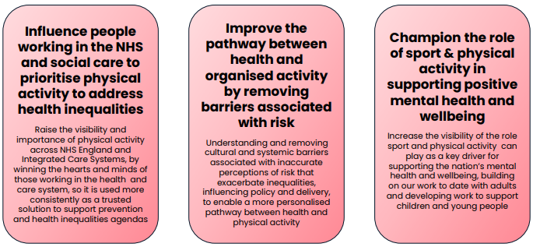
Sport England
Health & Wellbeing Advocacy
Blending local and national action to support collective ambitions
What are the opportunities to connect more strongly with this work?
Key Opportunities for Change
2022-25
Active Partnerships
Core systemic role: creating the right conditions at place, for a healthy, active nation - supports Sport England’s Key Opportunities
Opportunity to build on the already strong working relationship with YSF

Slide 19
What Next?
Continue to support the work underway:
  Pilots and projects
  Making connections & providing co-ordination
  Collaboration Opportunities:
  Mental Health; Social Care; Pain Management
  Work with Rotherham Doncaster & S. Humber NHS Foundation Trust (RDaSH)
  Supporting local providers:
  e.g. DCLT to meet demand for PA support.
  Harnessing System Change Enablers:
  Development of a Doncaster community preventative model.
  Sense-making:
  Are we seeing an impact on inequalities in PA?
  Is PA contributing to change in the H&C system?
  If so, what conditions and pathways are supporting this?
  Taking Stock:
  Prioritisation of opportunities!

Slide 20
Thanks for Listening

Slide 21

Further Information
Get Doncaster Moving:
https://getdoncastermoving.org/
Doncaster ‘Breathe & Connect’ Programme:
https://wearedarts.org.uk/breathe-connect/
‘Your Life Doncaster’ Website:
https://www.yourlifedoncaster.co.uk/
Active Together
https://www.yorkshirecancerresearch.org.uk/research-story/active-together

