Slide 1




Taking a Collaborative Approach at Place to Reducing Physical Activity Inequalities
Anthony Whittaker
&
Rebecca Antcliffe

Slide 2
Community Engagement
Identify & Connect With Assets
Influence & Embed Physical Activity Promotion Into Assets
Quarterly Partnerships Encouraging Collaboration
Build Projects Across System Areas
Monitor, Track, Evaluate
Community Led Approach
Our Process

Slide 3
Our Principles
Targeted
Codesigned
Collaborative
Sustainable

Slide 4
Working to Support Assets Individually
RVE Model
Recognise
Value
Embed
Redesign Course
A codesign course that builds physical activity promotion into assets

Slide 5
Working With Individual Assets
St Augustine’s Centre
Built capacity via Activities Coordinator
Active conversations with centre members
Posters/leaflets around the building
New provision
Staff have access to active resources
Connected to the system
Women’s Activity Centre
Invested in physical activity session
Active conversations with centre members
Posters/leaflets around the building
Connected to the system
Social Prescribing Service
Active conversations with patients
Included physical activity question in initial assessments
Staff encouraged to be active as part of their working day
Connected to the system
The People’s Park
Improved infrastructure
Thinned out foliage improving perceptions of safety
Included active routes
Introduced activities
Included physical activity in People’s Park festival
Connected to the system
Project Park
Built capacity over multiple roles
Active conversations with members
Invested in physical activity sessions
Connected to the system
Calderdale Cancer Awareness Team
Active conversations with residents
Staff have access to active resources
Connected to the system

Slide 6
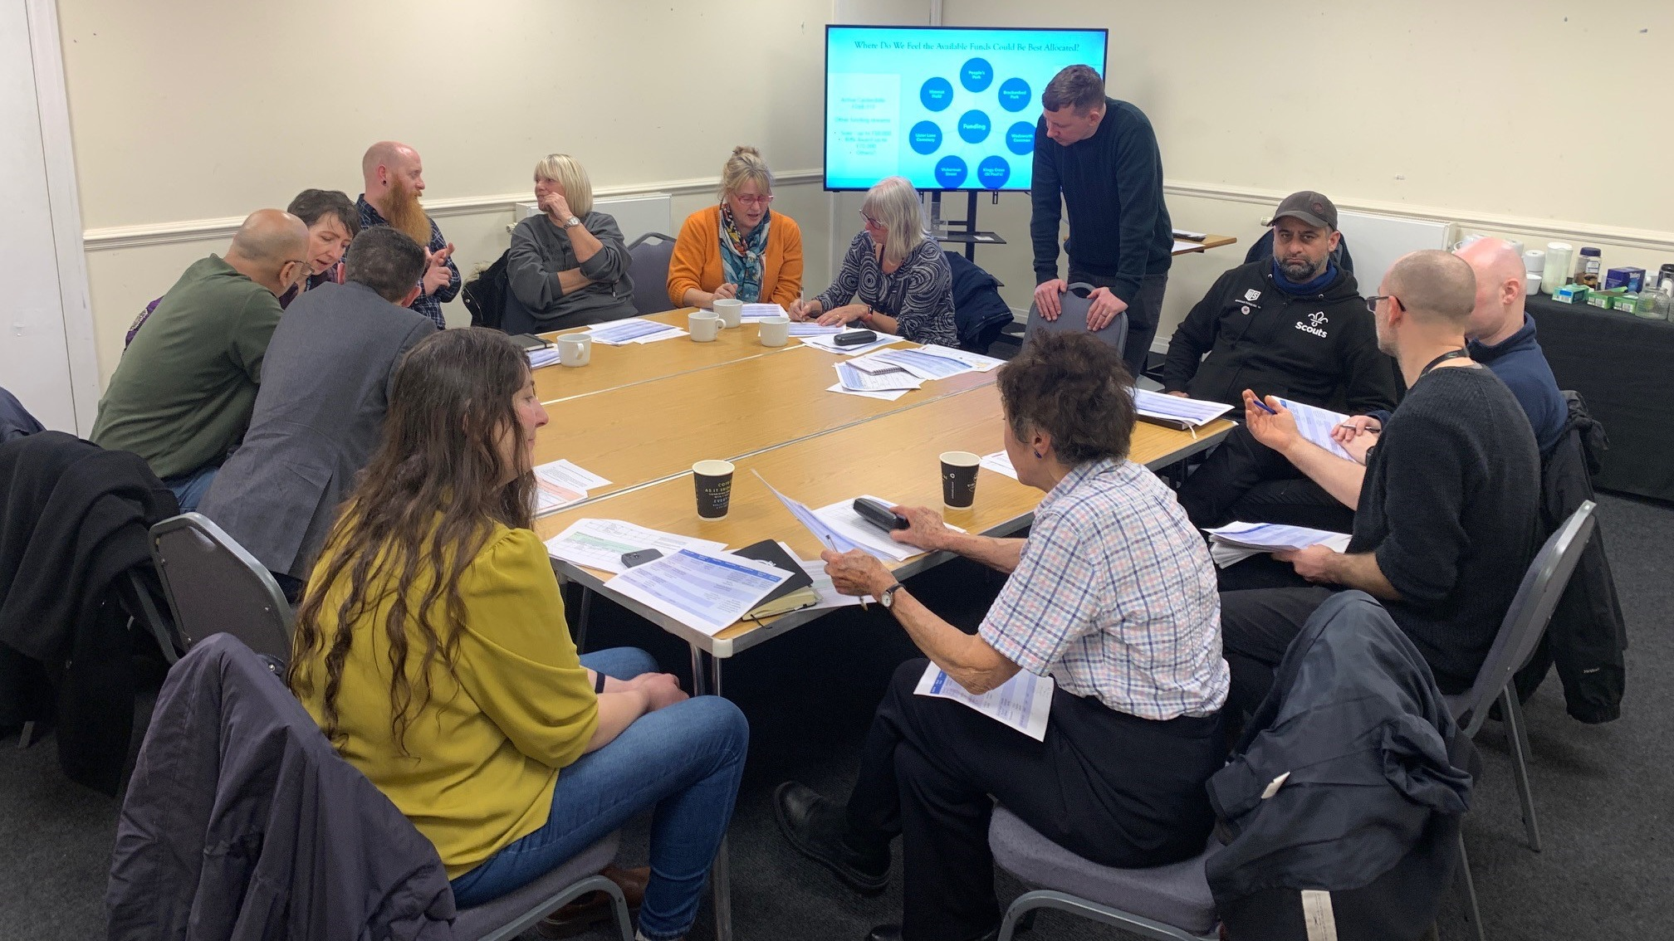
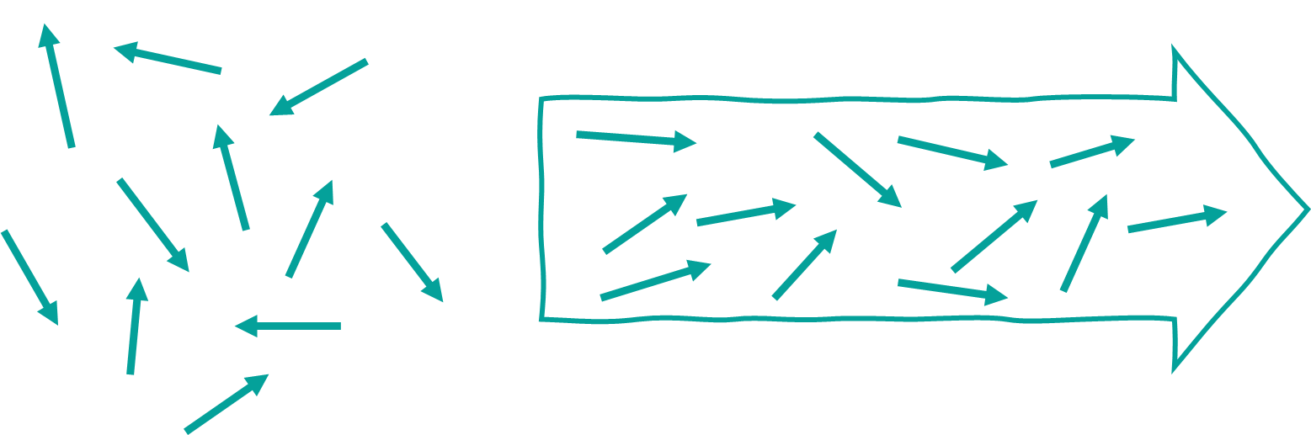
We’re All Active Calderdale Partnership
“Our role involves linking patients with services, so we’re lucky to have strong links to the We’re All Active Calderdale Partnership and an awareness of local physical activity providers.”
Jenna McAdam, Social Prescribing Link Worker

Slide 7
Building Projects Across System Areas
Project Park
Unique Community Hub
Healthy Minds
Older Adult Social Services
St Augustine’s
Centre
Vita Health Group
People’s Park
Women’s Activity Centre
SPLW
Local Schools
Calderdale College
West Yorkshire Police
Spring Hall Surgery
Physio MSK
CHFT
Key:
Businesses (red)
VCSE (orange)
Parks/Greenspace (green)
Health & Social Care (brown)
Education (purple)
Community Street Wardens
Local Women’s Clothing Shops

Slide 8
The Power of Collaboration
Junior Parkrun
Collaboration
125 new participants
Calder Community Squash
Collaboration
112 new participants
People’s Park
Collaboration
Over 350 new regular visitors
Calderdale Wheelchair Basketball
Collaboration
9 new participants
“Collaborating with others keeps us connected to the local and wider community. It means that we can support, encourage and promote each other's services.
It also means that we know what's going on.
Being connected and working together helps us to reach further, and for others to reach us.”
Marie, Centre Manager, Women’s Activity Centre

Slide 9
A Summary of Our Collaborative Approach
What?
Understand the barriers and enablers of residents to being active locally
How?
Through surveys, focus groups and 1:1 conversations, utilising local assets
What?
Embed physical activity promotion into assets as part of what they do
How?
Using the RVE model and our redesign course
What?
Connect the system to more of itself
How?
Via quarterly ‘We’re All Active Calderdale’ partnerships
What?
Build collaborative projects to improve conditions, based on local context
How?
By bringing assets together and building collaboration as a requirement to our funding

Slide 10
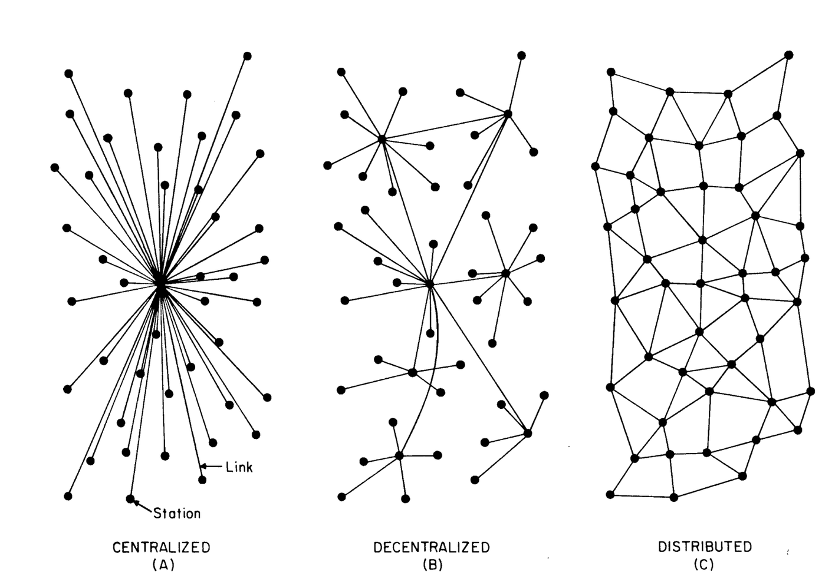

leadingthemovement.org
Notes:
Common purpose or shared purpose is vital in systems work because it serves as the foundation for alignment, coordination, and collective action across diverse stakeholders in complex systems. In systems thinking and complexity science, systems are often made up of interdependent elements with multiple actors and goals. Without a shared sense of purpose, these elements can easily drift apart, leading to inefficiencies or conflicting actions.
Here’s why it’s important:
Alignment of Efforts: In complex systems, different actors (e.g., organizations, communities, individuals) often have their own objectives. A shared purpose helps align their efforts toward a common goal, ensuring that actions taken by different parts of the system support each other rather than working at cross-purposes.
Collaboration and Collective Action: Systems often require cooperation across multiple stakeholders. A common purpose creates a sense of unity and motivates collaboration, especially when the challenge is difficult or long-term, such as addressing physical inactivity or public health issues. When people and organizations understand how their individual actions contribute to a larger goal, they’re more likely to work together effectively.
Adaptability and Resilience: Systems are dynamic, and they often change in unpredictable ways. A shared purpose provides a clear guiding vision that can help the system stay focused and adaptive, even as individual elements within the system evolve. This flexibility enables the system to respond better to emerging challenges.
Motivation and Engagement: A compelling, shared purpose can be a powerful motivator, creating engagement across diverse actors. It fosters a sense of belonging and ownership, where each stakeholder feels that their efforts are meaningful and contribute to something larger than themselves.
Reduced Fragmentation: In systems that lack a common purpose, fragmentation often occurs, where different elements work independently and inefficiently. A shared purpose creates coherence, reducing the likelihood of disjointed or counterproductive actions that fail to address the system’s needs.
How to Develop Common Purpose in Systems Work:
Inclusive Dialogue: Engage stakeholders early and often. Invite input from all actors in the system, whether they are community members, policymakers, local organizations, or others who are impacted by or contribute to the problem. Their involvement helps build trust and ensures the shared purpose is grounded in their needs and perspectives.
Clarifying the Goal: Ensure that the shared purpose is clearly articulated and understood by all involved. This might involve framing the purpose in terms of the broader social impact (e.g., improving public health, reducing health inequities) and how each actor's contributions are integral to achieving that purpose.
Building Trust and Relationships: Trust is crucial for systems work. Building strong, trusting relationships among stakeholders ensures that they are committed to the shared purpose and are willing to cooperate, share resources, and make decisions together. Creating spaces for genuine dialogue and problem-solving fosters collaboration.
Shared Decision-Making: Engage in participatory decision-making processes that allow for joint ownership of the purpose and the actions required to achieve it. This helps create a sense of shared responsibility.
Ongoing Reflection and Adaptation: In complex systems, conditions can change rapidly. Developing a shared purpose should be an ongoing process of reflection and adaptation, where the purpose is revisited regularly to ensure it remains relevant to all stakeholders.
It would be great to share here an example from your work in a place/system.

Slide 11
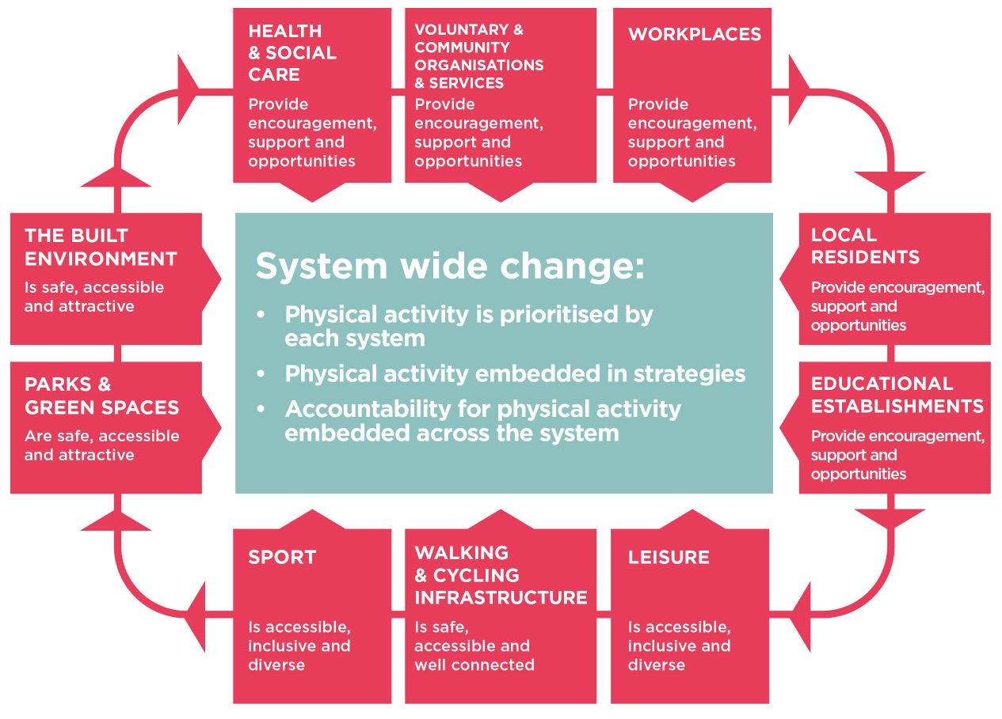

Slide 12













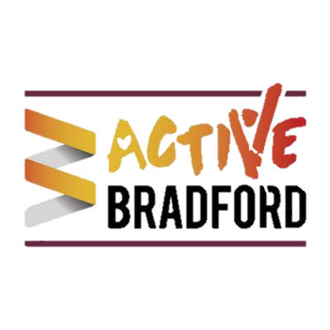






neighbourhood approach;
codesign and delivery of local action plans
Kammy Siddique - JU:MP Delivery Manager
Notes:
Jan

Slide 13
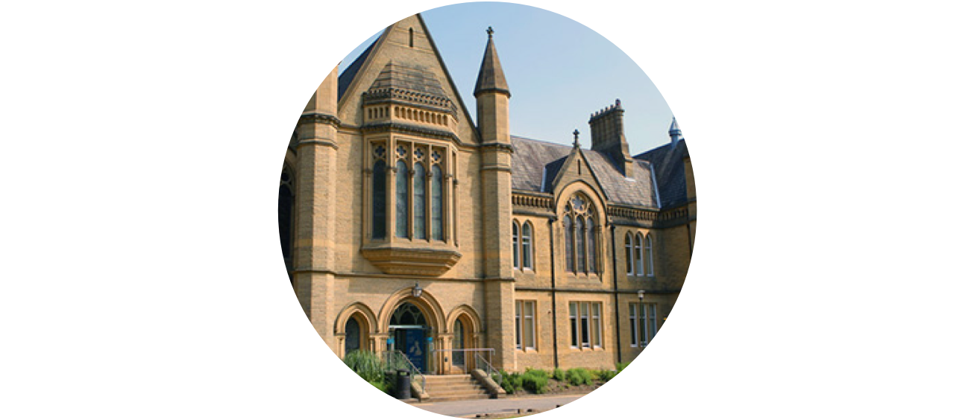
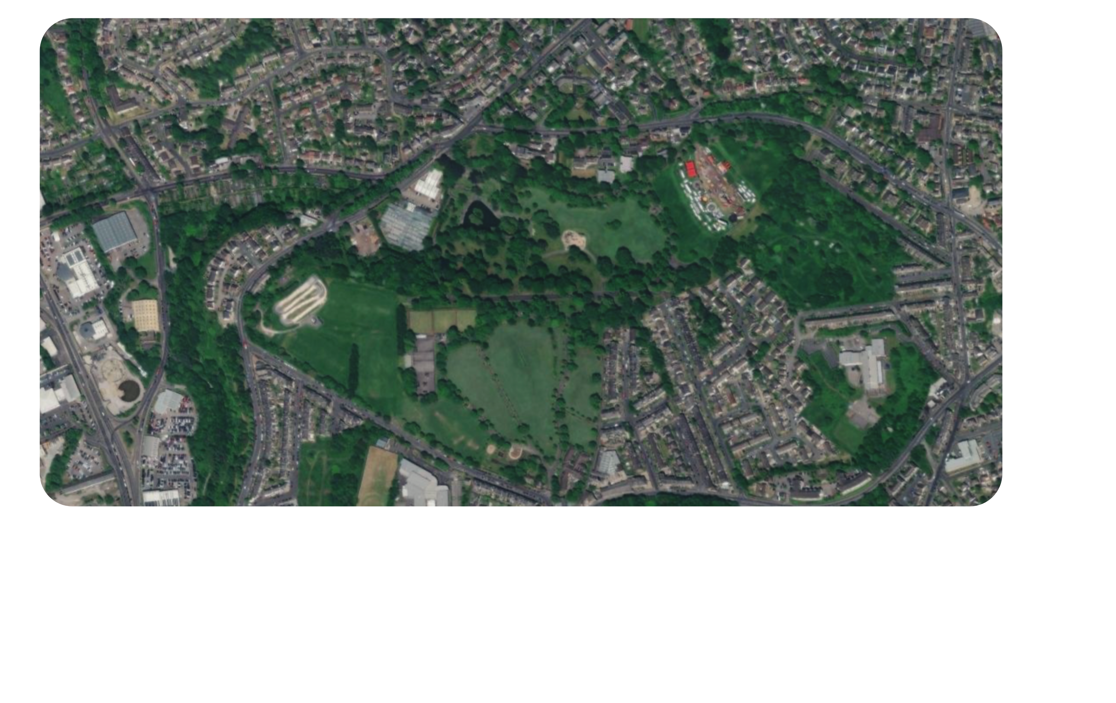
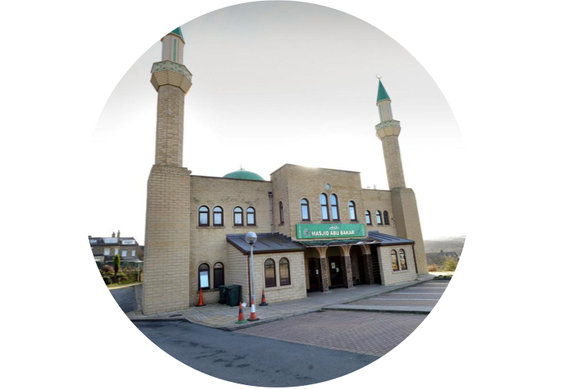







JU:MP neighbourhood Approach
ACTIVE
FAITH SETTInG
CREATInG
ACTIVE SCHOOLS
ACTIVE STREETS
ACTIVE PLAYFUL
PARK/GREENSPACE
ACTIVE STREETS
ACTIVE
PLAYFUL STREETS
PLAYFUL STREETS
COMMUnITY
ORGAnISATIOnS
Community Engagement Manager - Ju:MP Connector - Social Marketing & Communications
Notes:
Jan

Slide 14

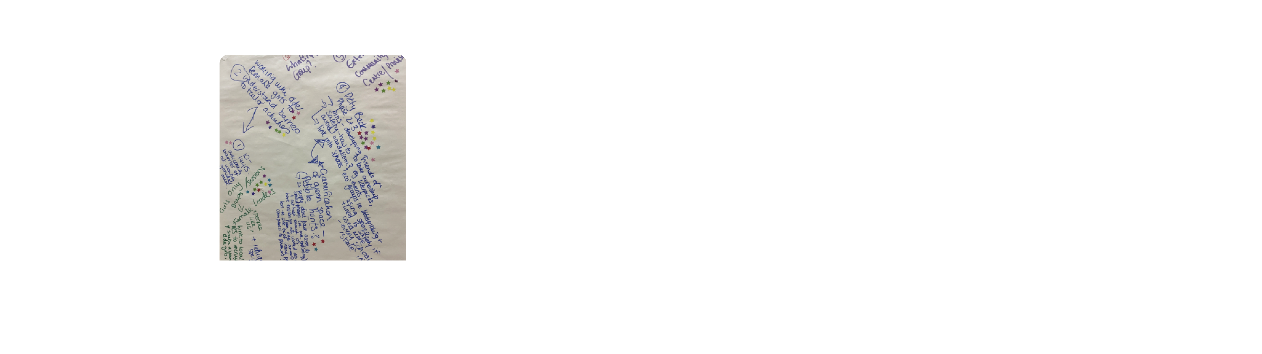








Three ‘co-design’ workshops
to develop local action plan
In between
workshop 2 & 3:
Rapid reviews of evidence, completing proformas
Workshop 1
Workshop 2
Workshop 3
Understanding the
local context
Idea generation and prioritisation
Refinement & agreement of ideas for local action plan
Notes:
Jan

Slide 15


1
Workshop 1
Building trusted relationships and motivation
Key mechanisms for whole systems working around physical activity
INTRODUCTIONS ACTIVITY:
Group share name, role and one way they enjoyed being active as a child
BUILDING KNOWLEDGE, MOTIVATION AND MODELLING ACTIVITY:
In pairs group share as many of the benefits of being physically active they can think of. Then they feedback actively standing in a circle throwing a ball round the group and each sharing benefits of being active
Notes:
Jan

Slide 16
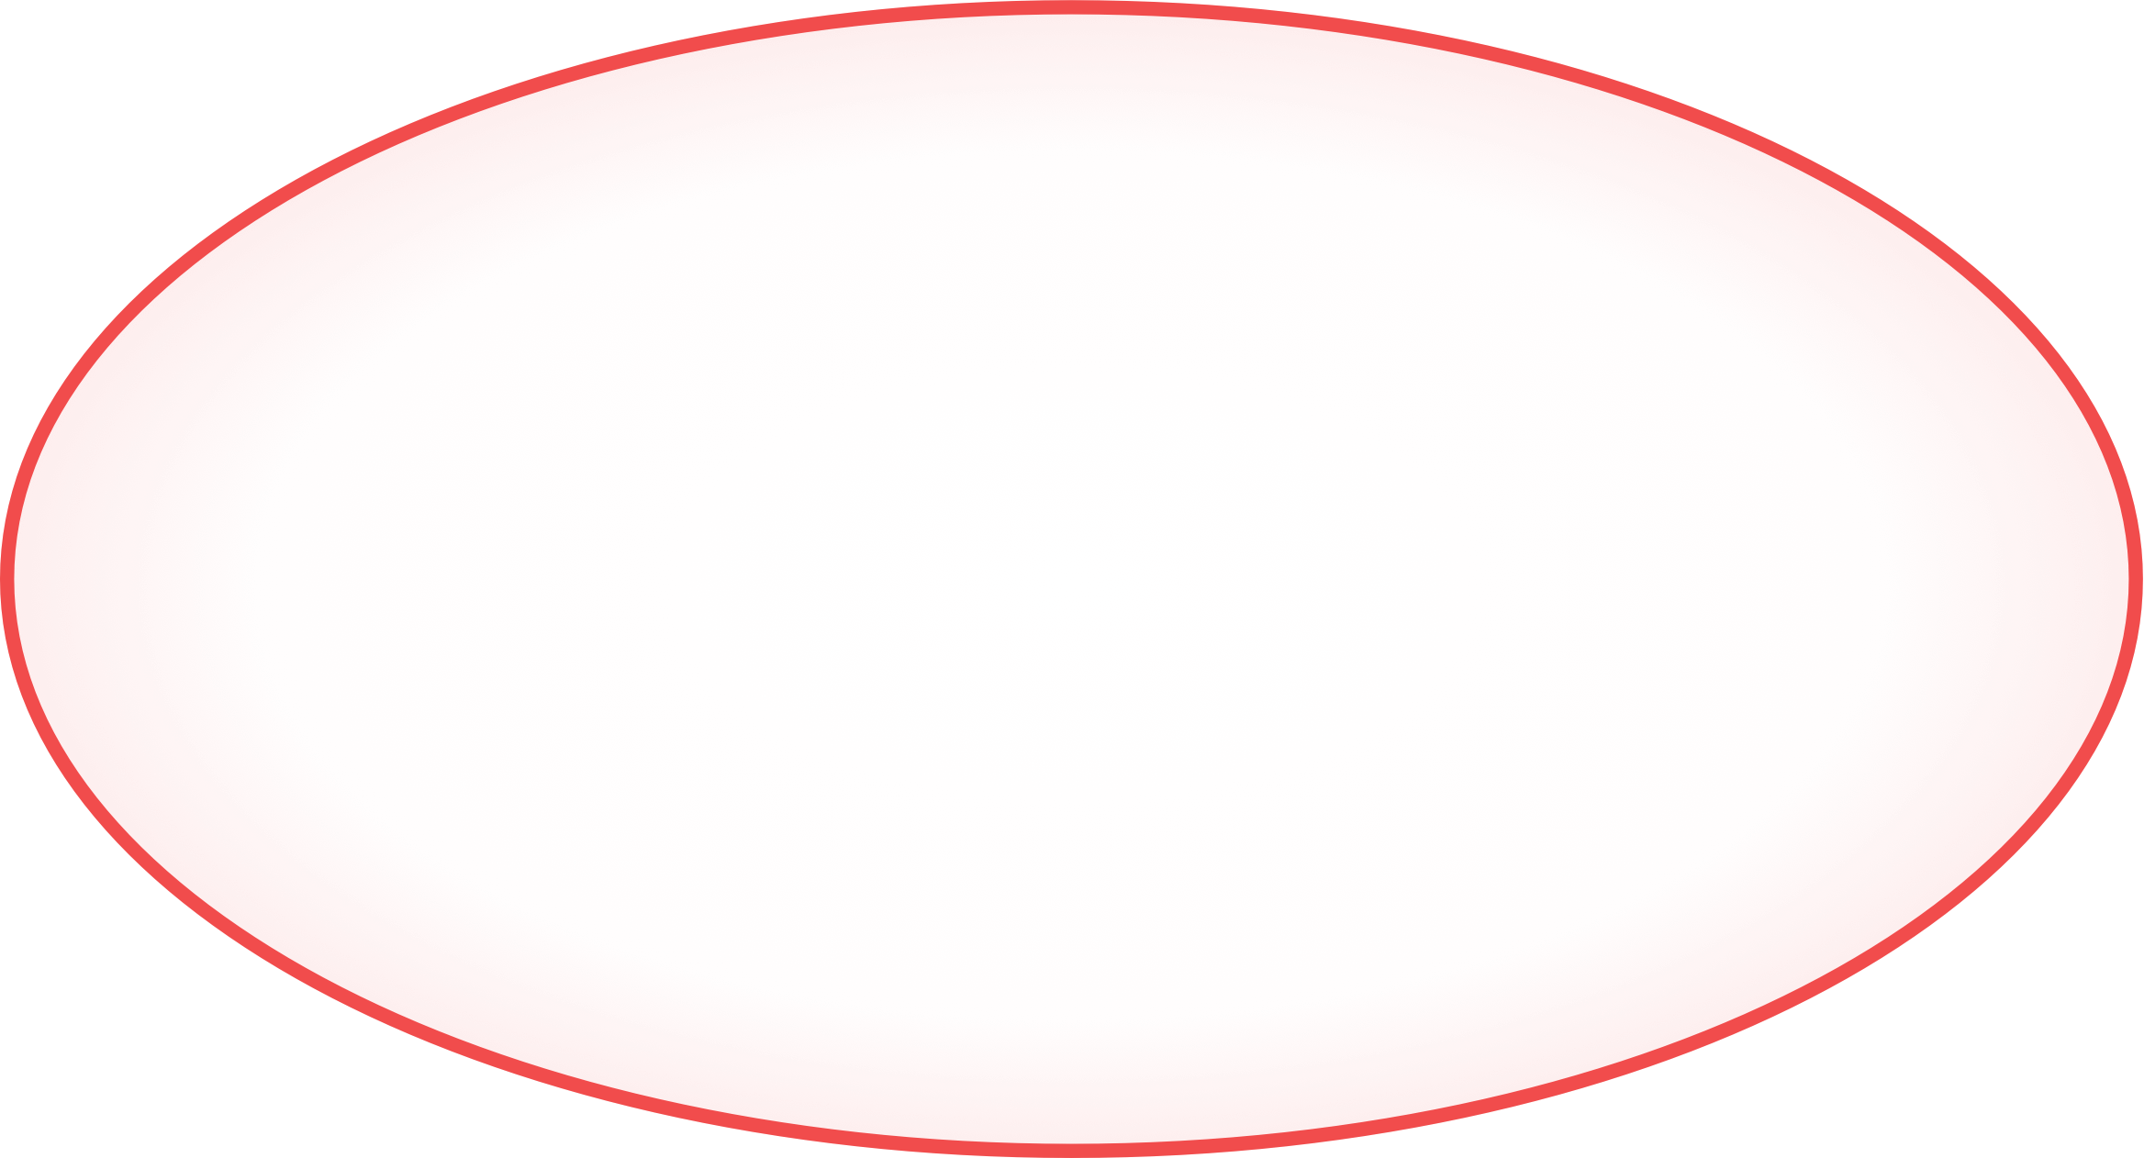

1
Workshop 1 Identifying barriers and enablers
Sharing a solution focussed approach
CIRCLE OF COnCERn
CIRCLE OF influence
What helps us be active?
What are the barriers to us being active?
Notes:
Jan

Slide 17





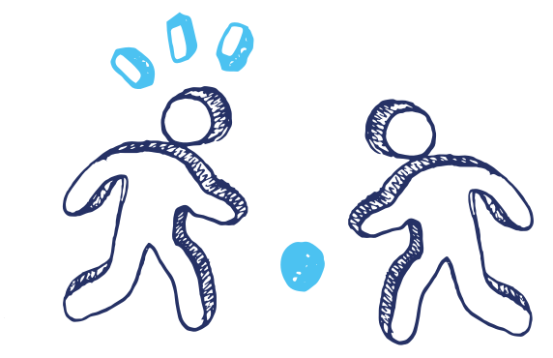
2
Workshop 2 Gaining a shared understanding
of behaviour change approach
BEHAVIOUR CHANGE THEORY
CAPABILITY
The COM-B model explains current behaviour and can be used to encourage behaviour change.
Capability, opportunity and motivation are all needed for behaviour (change) to occur.
MOTIVATIOn
BEHAVIOUR
OPPORTUnITY
Notes:
Jan

Slide 18























Workshop 3 Evidence-based development
and collaborative decision on action plan
3
APEASES FRAMEWORK
Affordability
practicability
effectiveness
acceptability
safety
equity
sustainability
Notes:
Jen

Slide 19


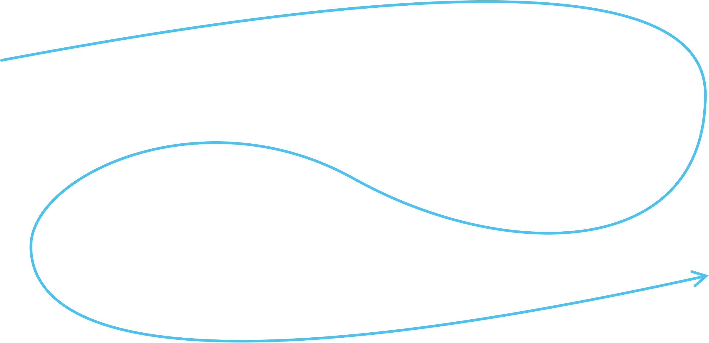



neighbourhood process Evaluation
Rapid reviews of ideas
JAG 3
observation
Surveys and interviews (6 months)
JAG 2
observation
Finalise local action plan - commence delivery
JAGs continue 6x per year
Idea generation - proformas
JAG 1
observation,
baseline surveys
Ripple effects mapping
Ripple effects mapping
Balanced scorecard completion
Surveys and interviews (12 months)
Balanced scorecard completion
Ripple effects mapping
Ripple effects mapping
Balanced scorecard completion
Surveys and interviews (24 months)
Balanced scorecard completion
Notes:
Jen

Slide 20

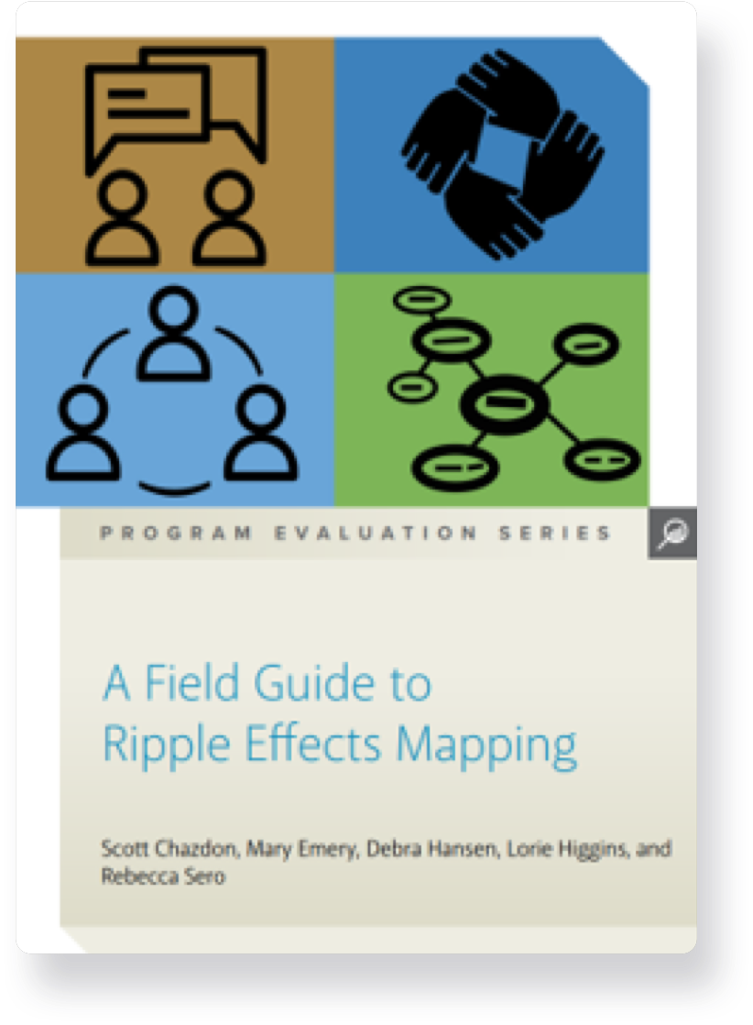
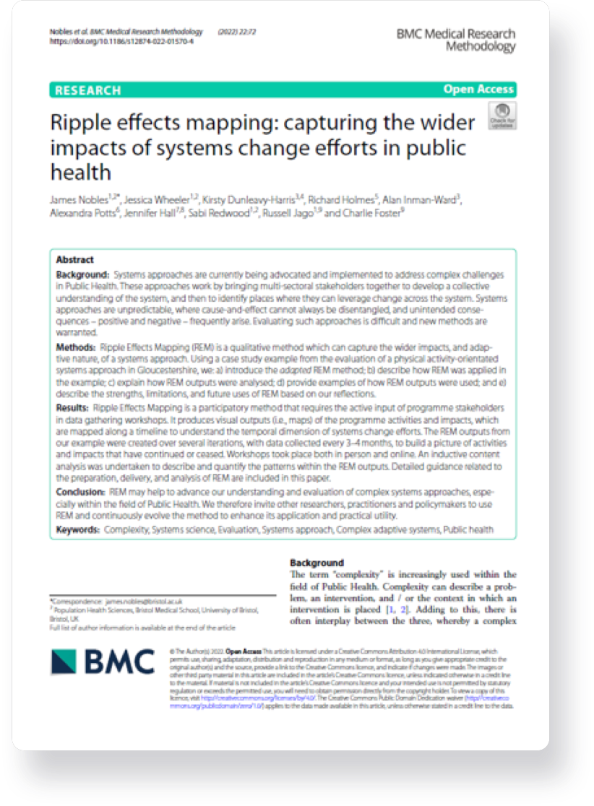
Ripple Effects Mapping
REM originated from Community Development work in America in 2015.
​
A way of understanding the wider, intended and unintended, impacts of a project or programme over time.​
A qualitative form of impact evaluation
focused on contribution.​
Takes a participatory approach - workshops.
Can be used alongside other methods (e.g., interviews, surveys, systems mapping).
Notes:
Jen

Slide 21
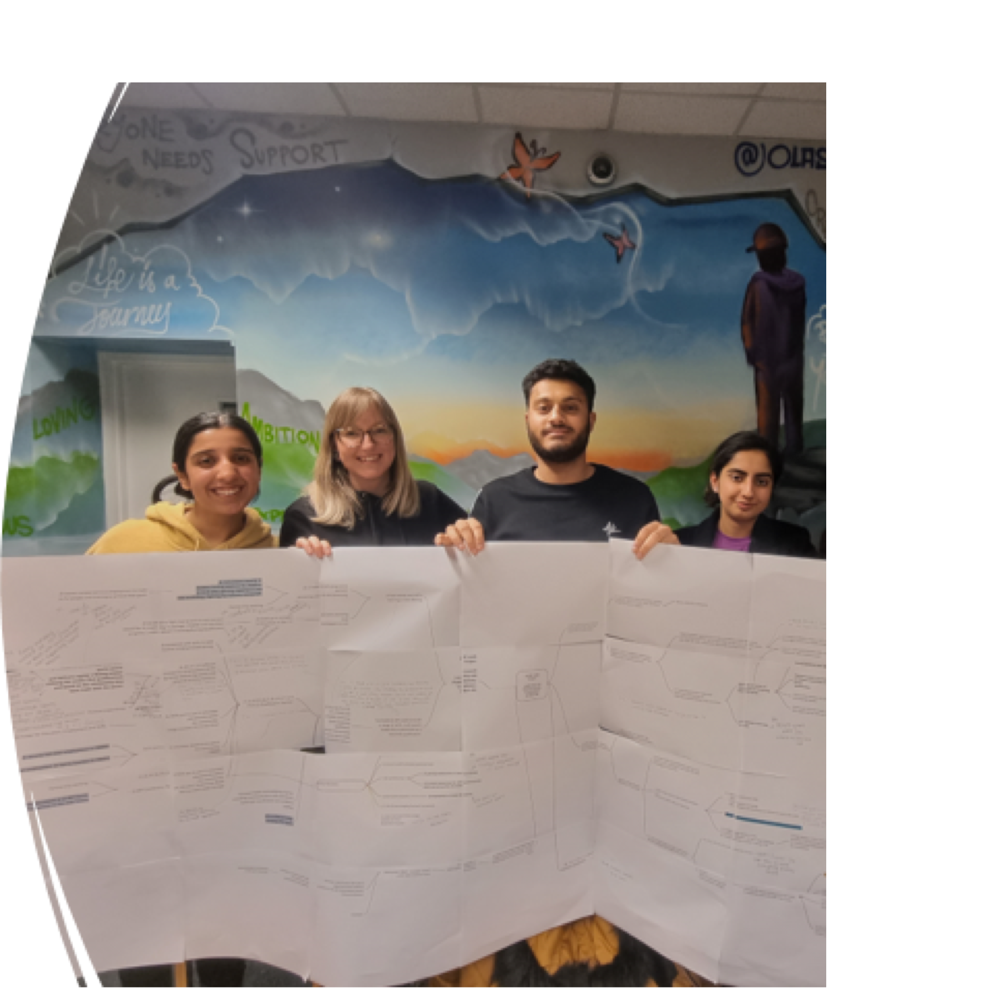


Ripple Effects Mapping can benefit project delivery
via:
​
​
Enhanced motivation and empowerment through realising and celebrating progress and successes​
Using maps to reflect on what is working well and less well and plan next steps
Notes:
Jen

Slide 22













JU:MP Action GROUPS Approach
FACE TO FACE & WELCOMING
nETWORKInG TIME
EMAIL UPDATE TO PARTnERS
EnGAGInG ETHOS
CELEBRATInG SUCCESS
SOLUTIOn FOCUSSED APPROACH
Notes:
Kammy

Slide 23







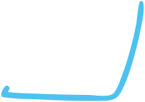












Delivery of Action Plan Key Ingredients
REGULAR MEETInGS
COMMUnITY OF
LEARnInG EVENTS
BALAnCED SCORECARDS
RIPPLE MAPS
RAG RATED ACTIOn PLAn
ACCESS TO RESOURCES/FUnDInG
Notes:
Kammy

Slide 24

Sustainability
Behaviour change approach
Build capability of local people/organisations
Encourage sharing skills/resources across the group
EMBED AND SUSTAIN PHASE
Build capability to apply for funding
Final meeting celebrate successes
Share an ongoing universal offer
Partners pledging to ongoing commitment
Notes:
Kammy/Jan TBC

Slide 25
Benefits of a codesign approach
OUR LEARNING
Built a shared understanding for partners across system of the importance of physical activity
Gained buy in across different levels and parts of the system
Fostered a ‘shared responsibility’ across the system
Built better connectivity and collaboration for the long term
Embedding an evidence-based approach
Notes:
Jan

Slide 26


THAnK YOU!
Kammy Siddique
JUMP Delivery Manager
kammy@activebradford.com

