Slide 1







Sharing the Learning Series
Whole Systems Physical Activity:
Locality approach and the role of greenspace

Slide 2
Aims:
To bring regional partners together to share learning on whole systems physical activity on:
      A locality/neighbourhood approach
The role of parks and greenspace
Overview:
Three presentations on WSPA Locality working approach
Workshop and discussion
Walking tour of JU:MP Scotchman Road Neighbourhood
12.30 – 1pm Lunch and networking
Two presentations on role of parks and greenspace in WSPA
Workshop and discussion
Sport England; Sharing the future plans on place based
Summary and next steps - networking

Slide 3
JU:MP
An Active Bradford Programme
Delivered by Born in Bradford
Jan Burkhardt, Sally Barber and Jen Hall
Notes:
A reminder on what is JU:MP

Slide 4

JU:MP
The Bradford Local Delivery Pilot
Approach:
Whole systems, collaborative, asset-based, sustainable, behaviour change
Test and learn research programme
Outcomes:
Better Health
Better Skills
Safe, clean, active communities
Aim:
Step change in physical activity levels of children aged 5 – 14 years and their families
Notes:
Active Bradford – lead LDP Exec Board
Delivery and research by BiB on behalf of Active Bradford
Overview slide
Population

Slide 5
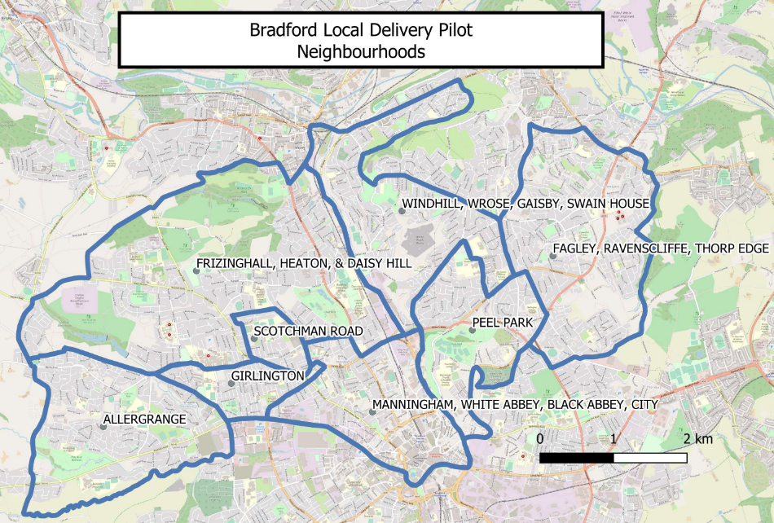
MAP
Direct Delivery Neighbourhoods
Pioneer Neighbourhoods
Commissioned Leadership Neighbourhoods
Notes:
The area – cut this if you like

Slide 6
Context:
Research & Evidence
Social, political, economic factors
community voice
Local assets
Programme evolution
Policy & Strategy
Environment
Communities
Organisations
Children & Families
Behaviour change theory
Evidence
Co-production/
co-design
Population level change
Work stream development
Young leaders
Social Marketing
JUMP digital
Active Faith Settings
Local action plans
Fun days
Communicating what’s on
People development
Active playful parks
Creating Active Schools
Sustainable sport and PA
JU:MP Connectors
Active Travel and streets
Green space development
Strategic influence

Slide 7
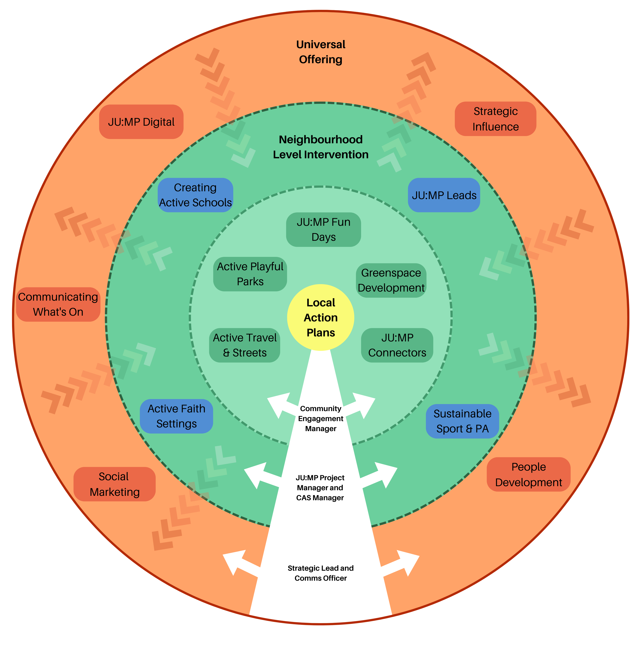


Slide 8
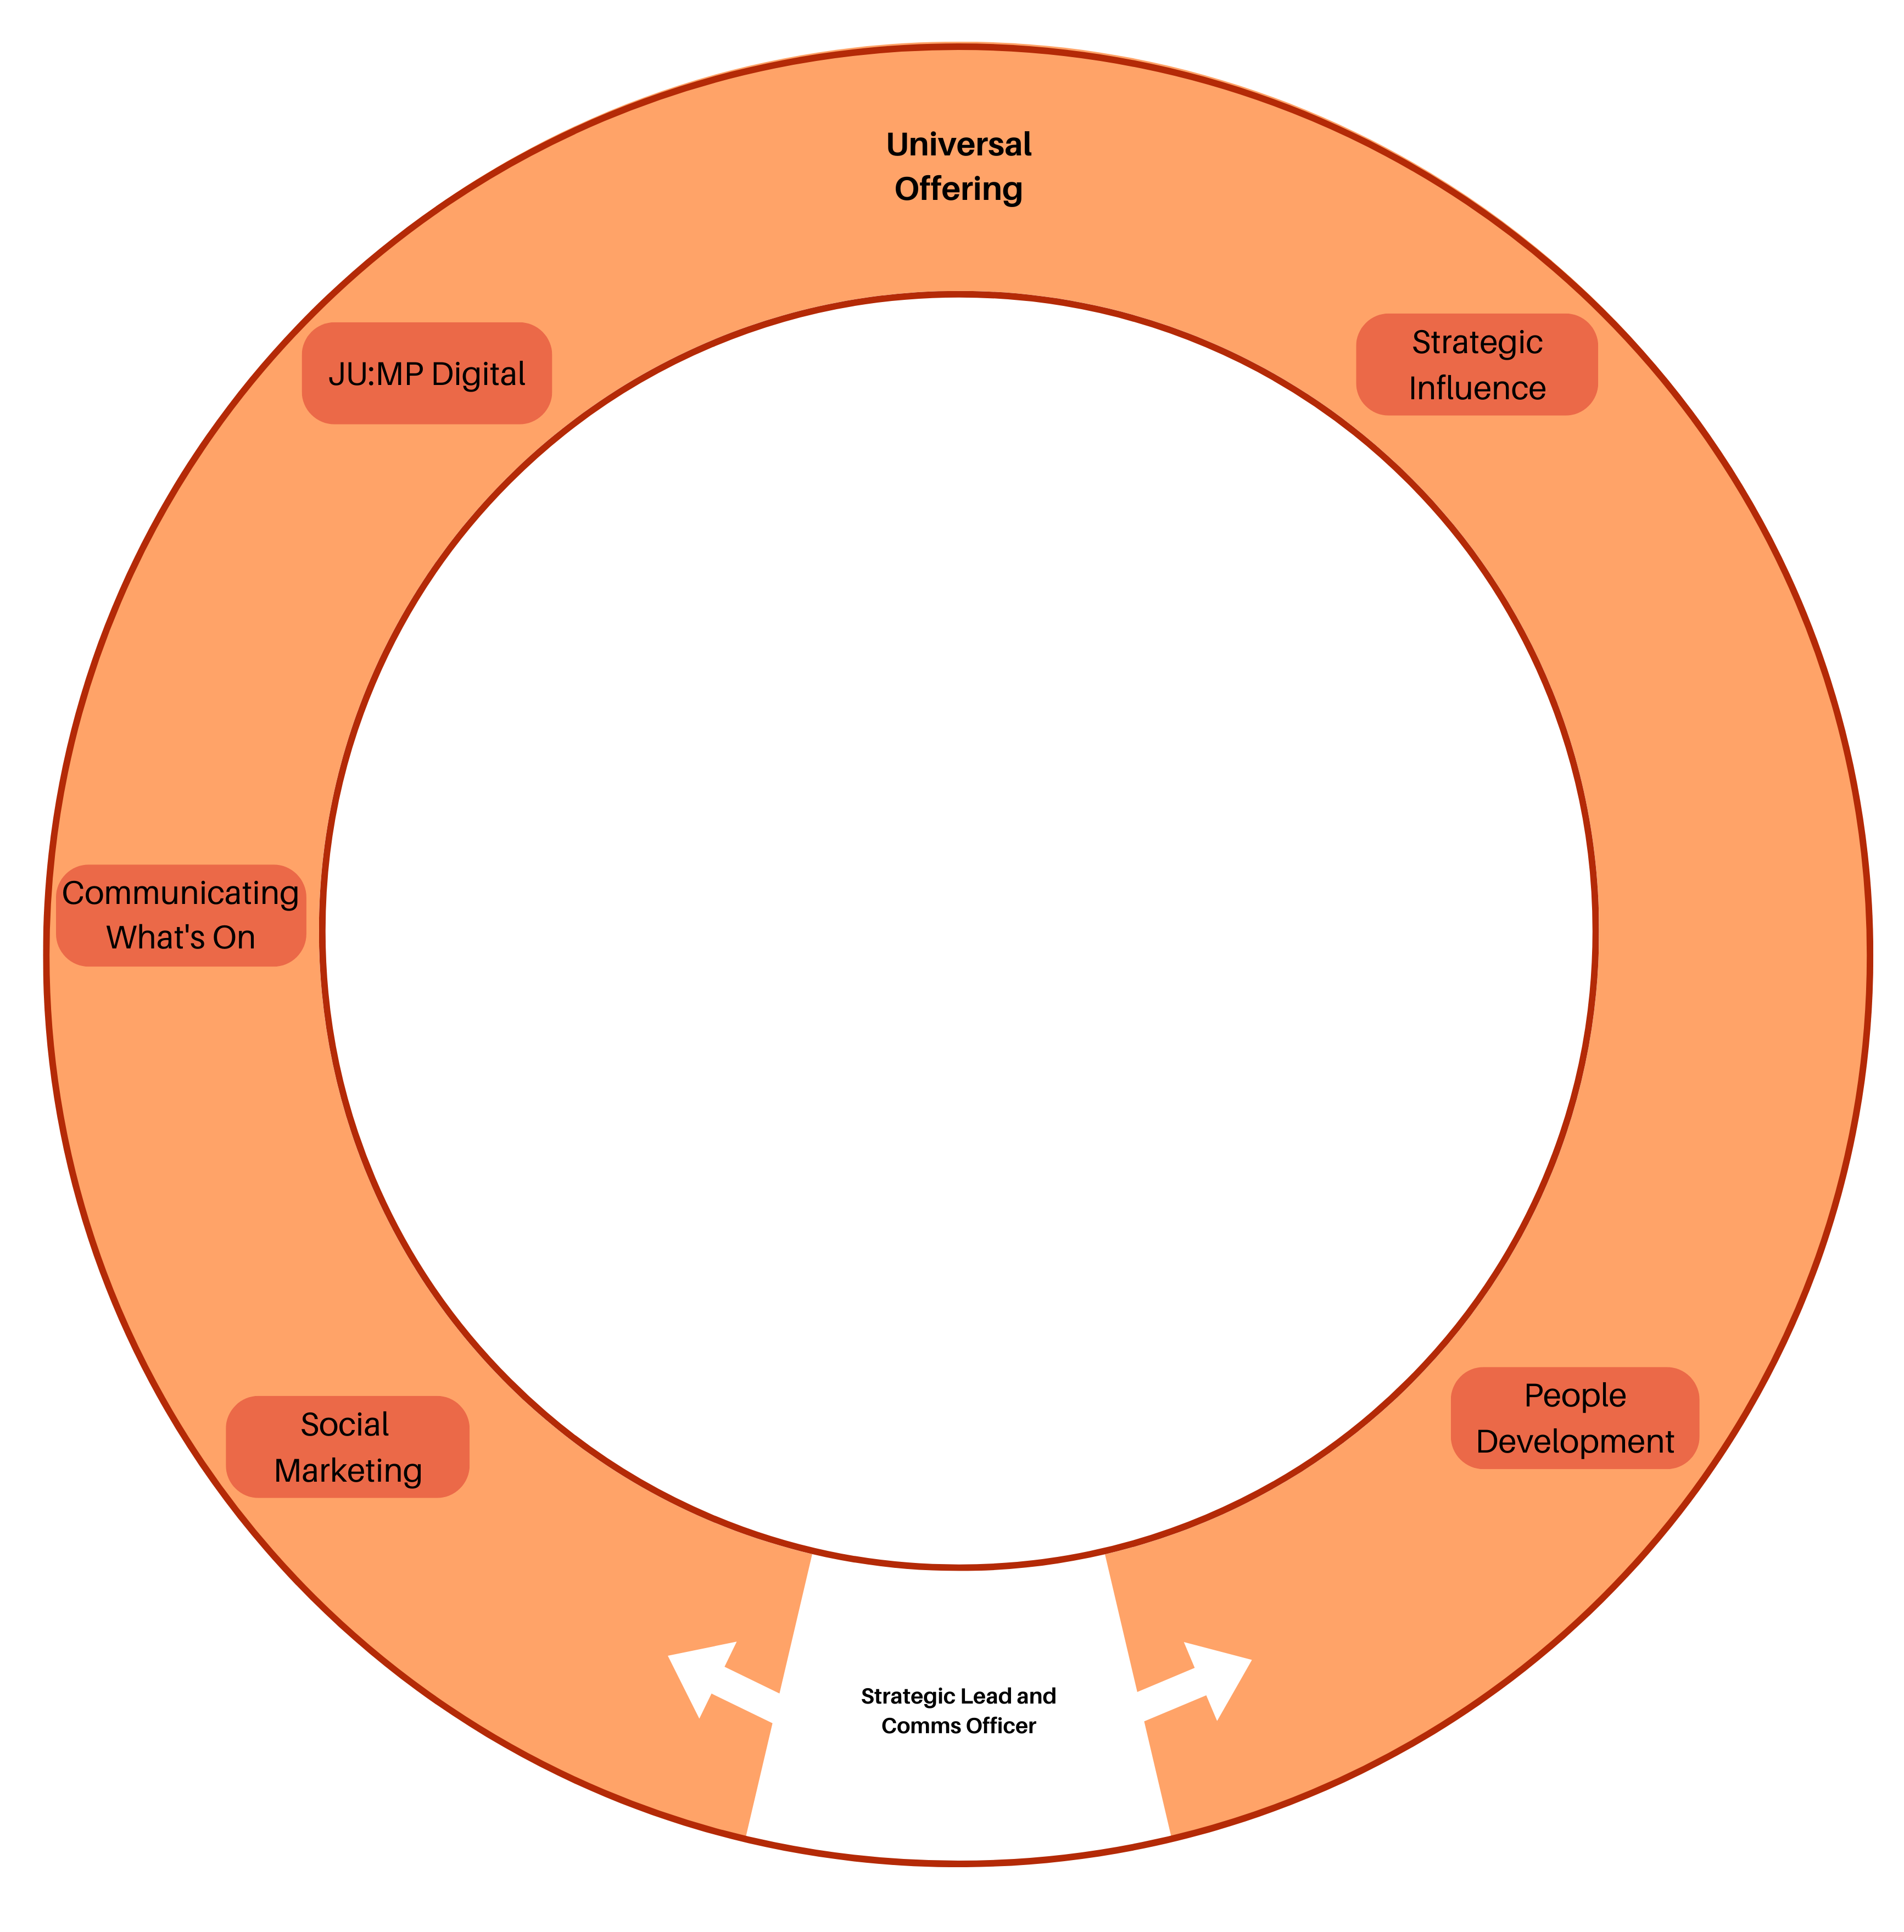

Slide 9
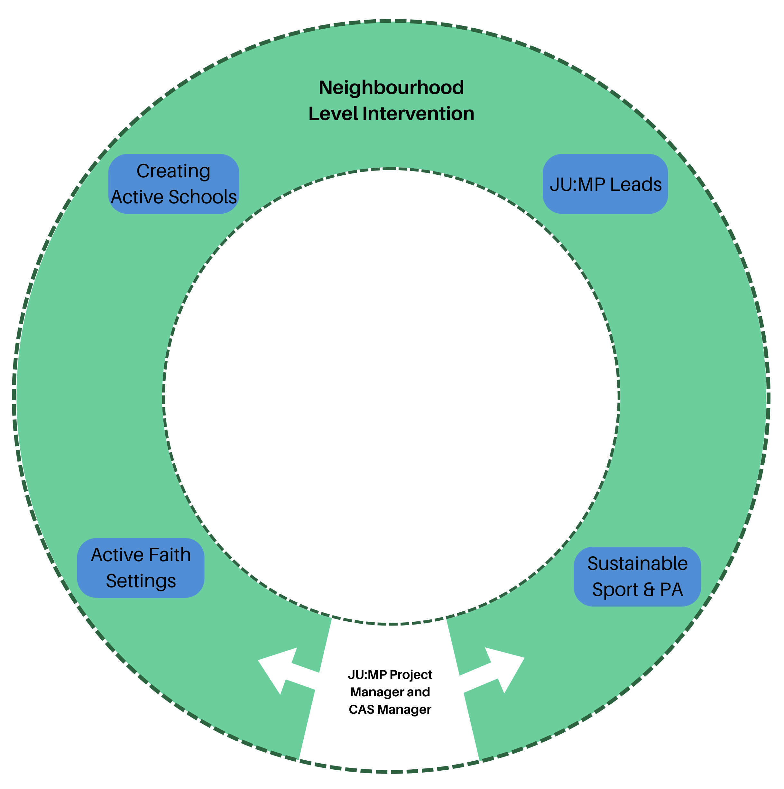

Slide 10
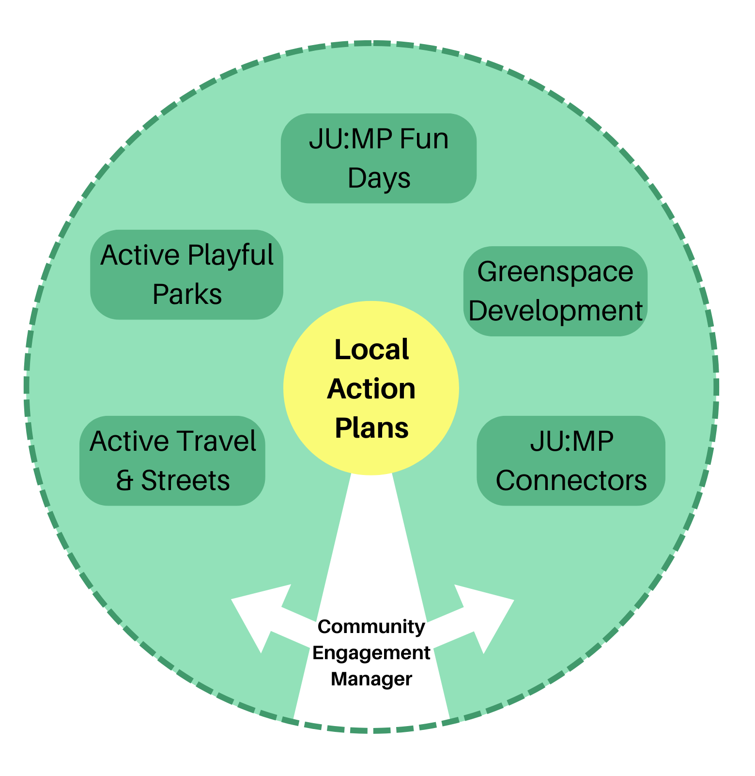

Slide 11
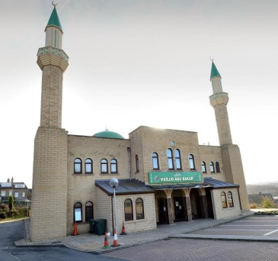
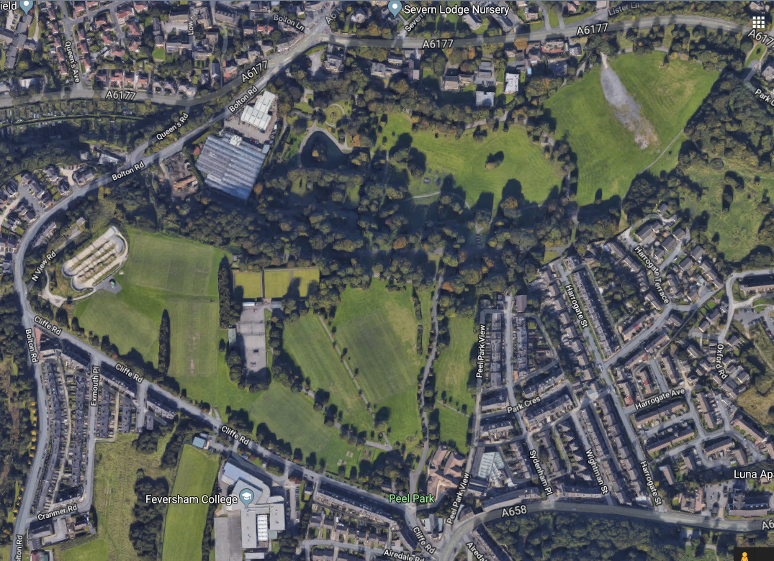
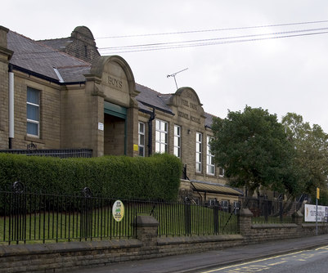
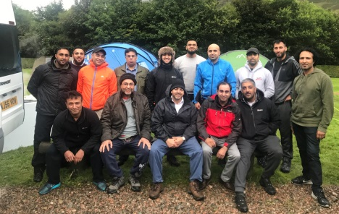
JU:MP Neighbourhood Approach
Whole system working for active children and families
Creating Active schools
Active Faith Settings
Active streets
Active streets
Active Playful
Park/greenspace
Playful streets
Playful streets
Active community organisations
Community Engagement Manager
JU:MP Connector
Social Marketing & Communications
Notes:
Jan

Slide 12
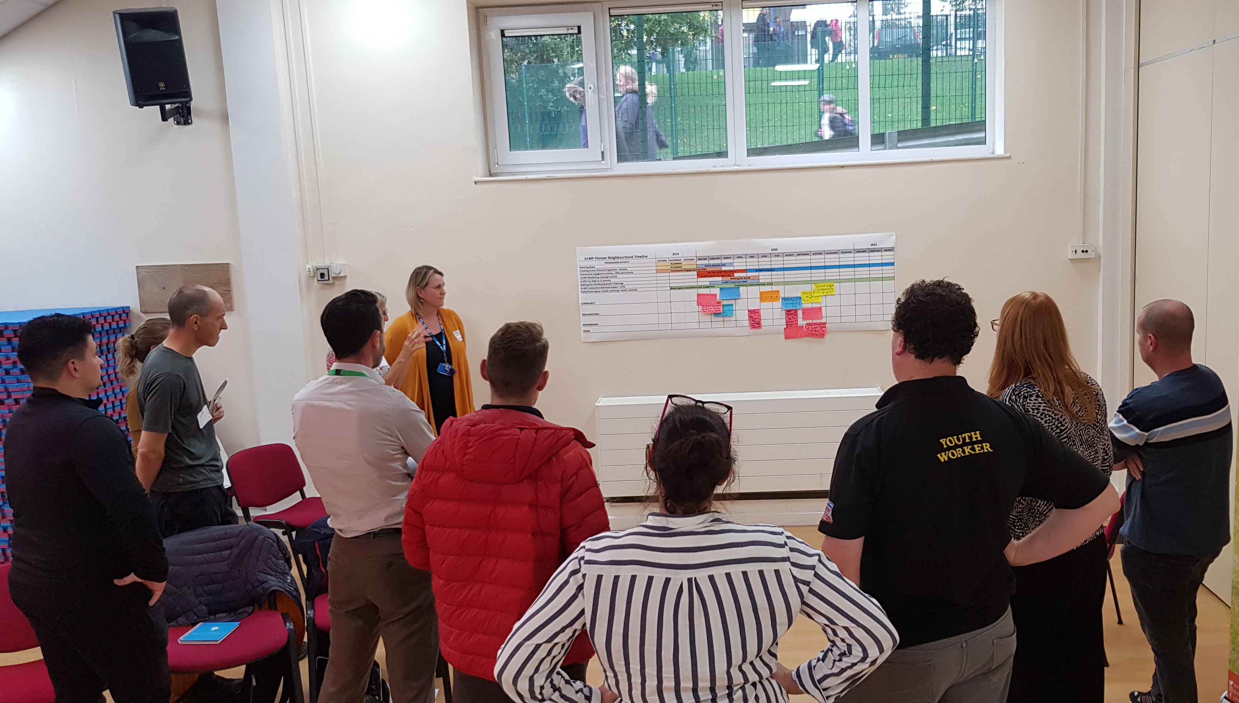
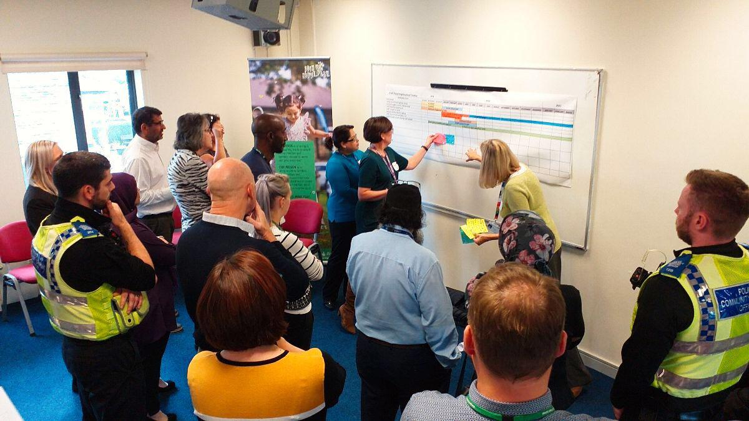
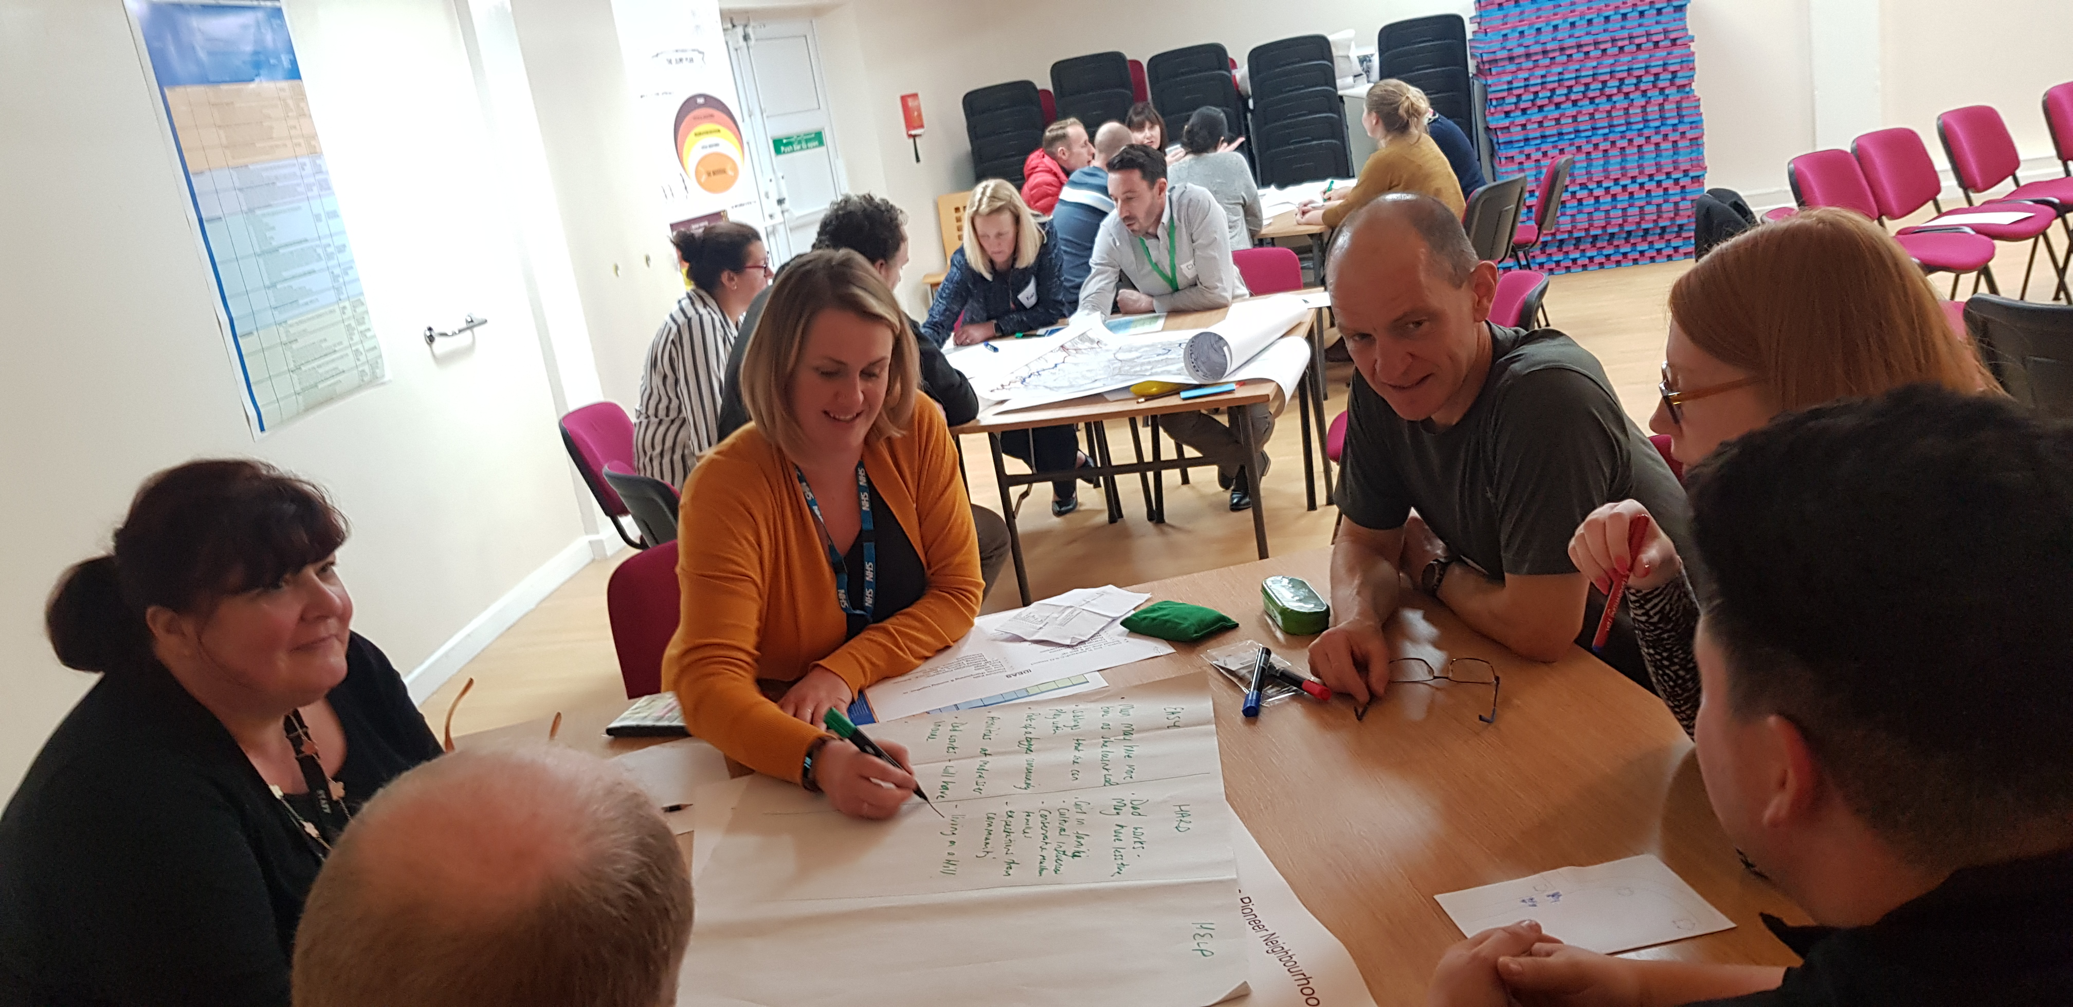
JU:MP Action Groups
8 JU:MP Action Groups
8 co-designed Action Plans
JAGs meeting every 6 weeks
Notes:
Briefly share what has been achieved by the schools and wider partners working together – see slide

Slide 13
Research-practice approach to local action plan development and delivery

Slide 14
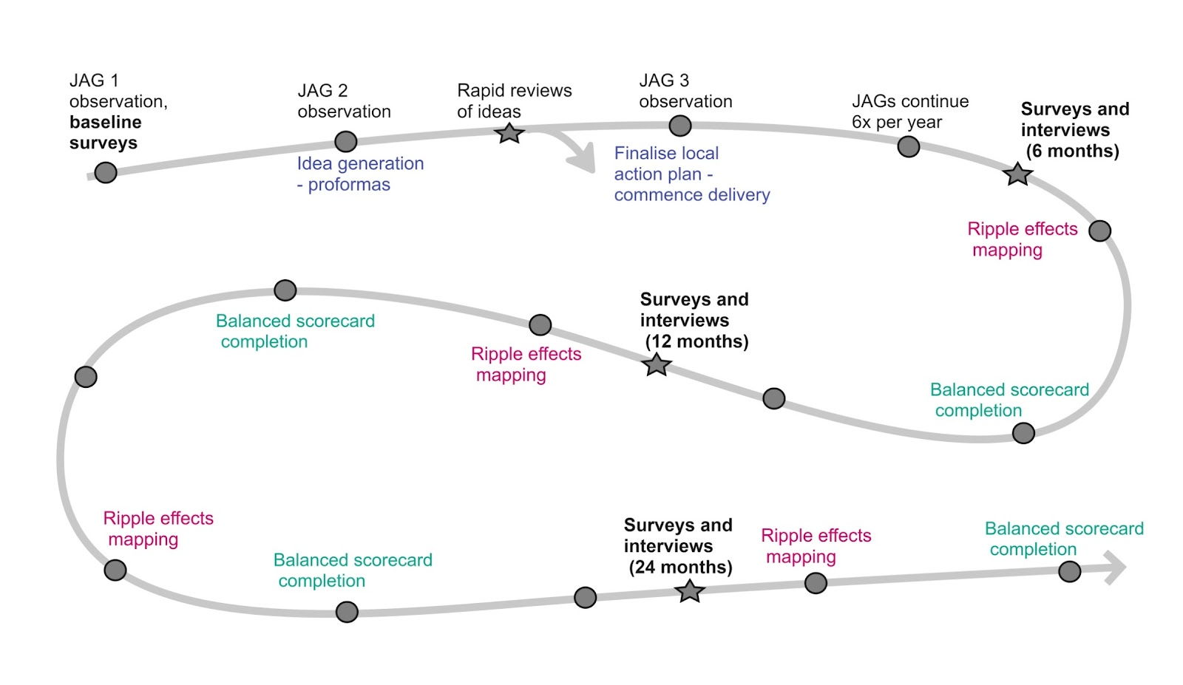
The neighbourhood delivery process

Slide 15
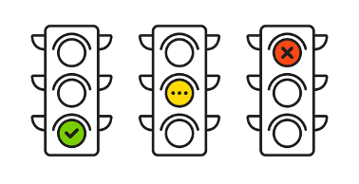
Developing local action plans
Workshop 1: exploring barriers and opportunities to increasing children’s physical
activity in the neighbourhood
Workshop 2: generating ideas for the local action plan
*Rapid reviews, and proforma’s completed*
Workshop 3: finalising the local action plan
Proforma:
Part A – describing the idea
Part B – appraising the idea, APEASES
Part C – traffic light rating and recommendations
APEASES
Affordability, practicability, effectiveness, acceptability, safety, equity, sustainability
Notes:
Emphasise the rapid review by JUMP Coordinators. Possible without a research institute if resources don’t allow for this

Slide 16
The neighbourhood delivery process

Slide 17
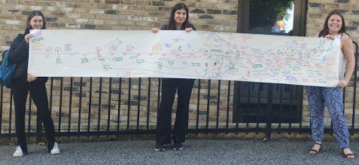
Implementing local action plans
Balanced scorecard
      What progress have you made on delivering the item?
  What impacts have you noticed?
  What has influenced delivery and impact?
  Learning and next steps

Slide 19
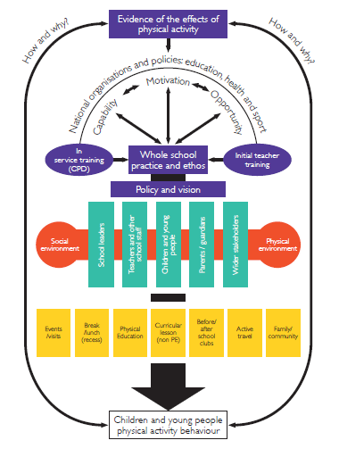
Creating Active Schools
36 JU:MP schools
Policy
Environments
Stakeholders
Opportunities
Notes:
“Creating Active Schools uses an evidence-based behavioural science approach to facilitate organisational change to enable all primary school pupils to be active for at least 30 minutes every day. Through in-person and online support which profiles existing prov “Creating Active Schools uses an evidence-based behavioural science approach to facilitate organisational change to enable all primary school pupils to be active for at least 30 minutes every day. Through in-person and online support which profiles existing provision, key impact areas are identified to help schools plan for the short, medium and long-term to create impactful and sustainable change.”ision, key impact areas are identified to help schools plan for the short, medium and long-term to create impactful and sustainable change.”

Slide 20
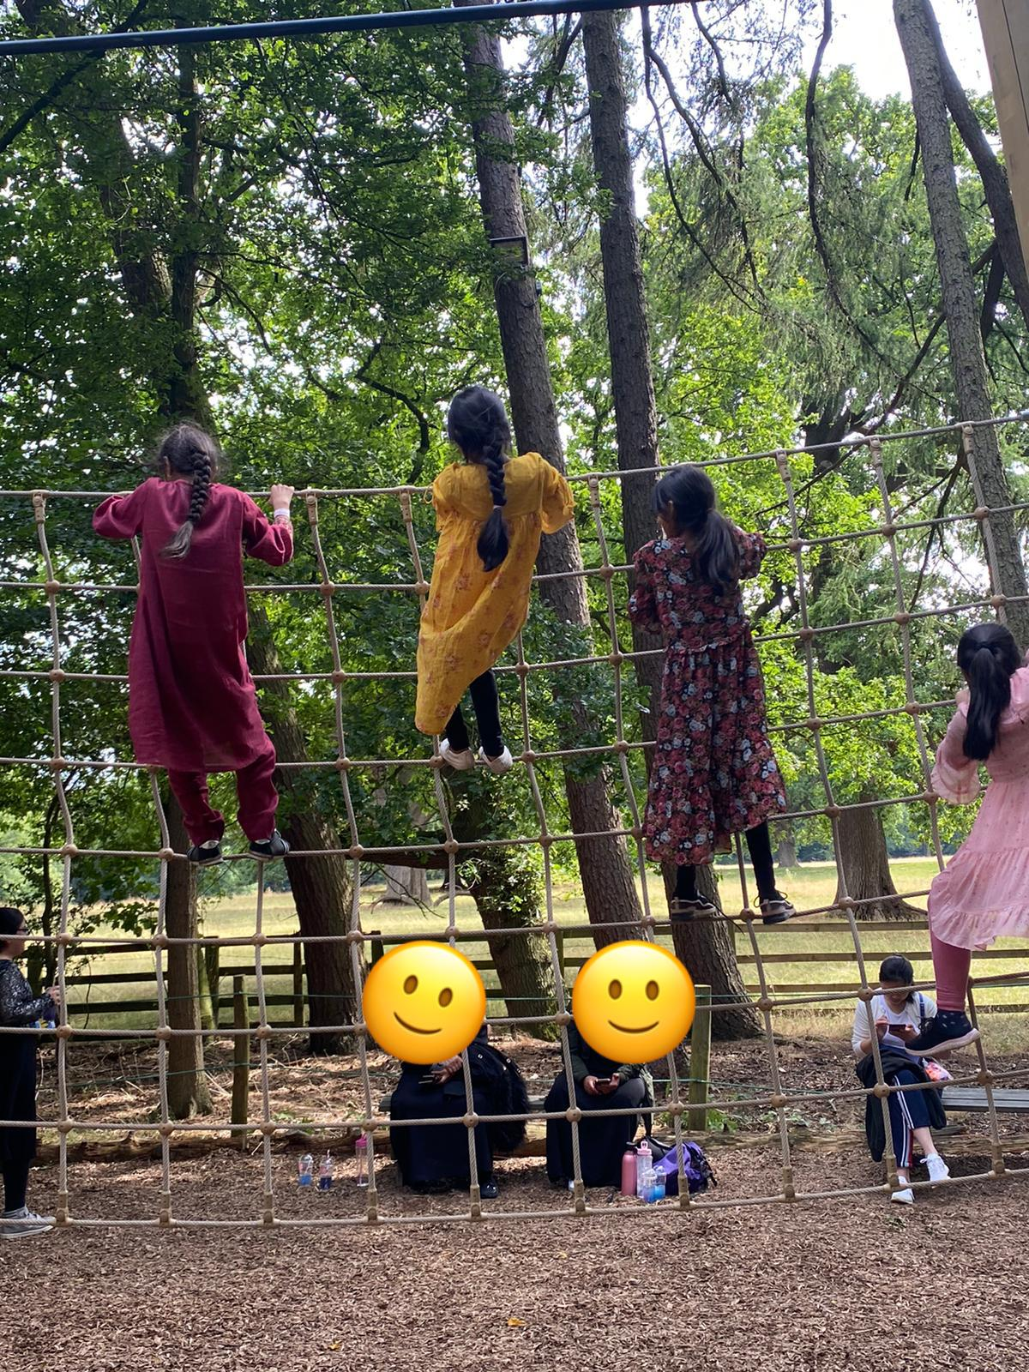
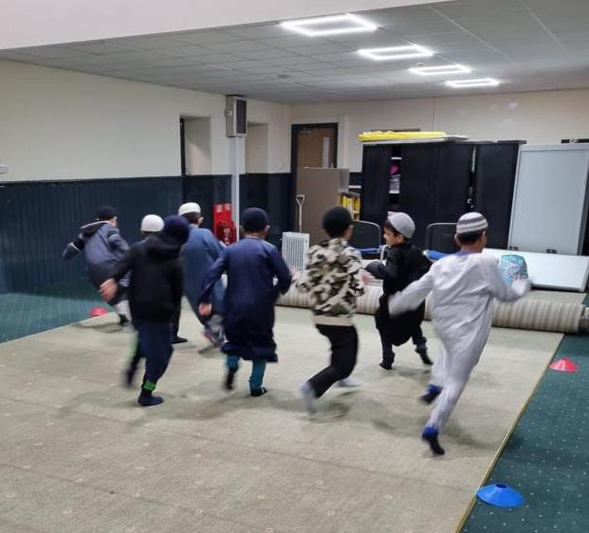
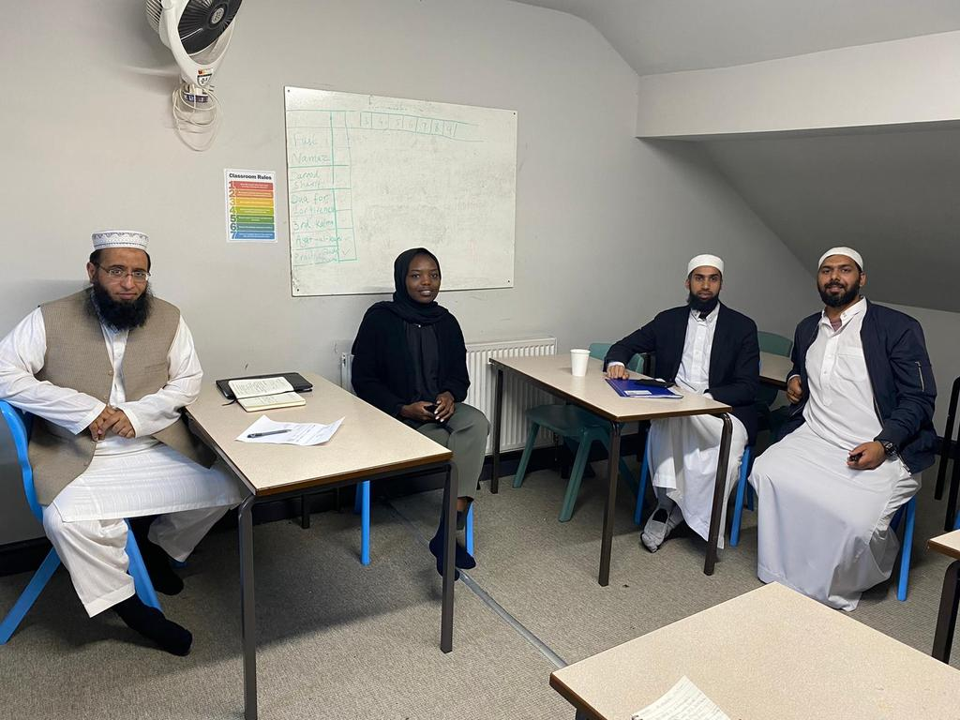
Active Faith Settings (IRS)
JU:MP/Faith in Communities
17 Mosques/Madrassas engaged

Slide 21
Key Learning:
Community engagement and co-production are essential for whole systems locality working. Needs to be meaningful and takes more time/resource than predicted. Working with locally trusted organisations can help.
Upskilling and development of the workforce across different settings is required: e.g. understanding behaviour change approach.
Connecting up the system is key but capacity is an issue, not yet clear how best to do this. Connecting people face to face matters alongside digital connection.

Slide 22
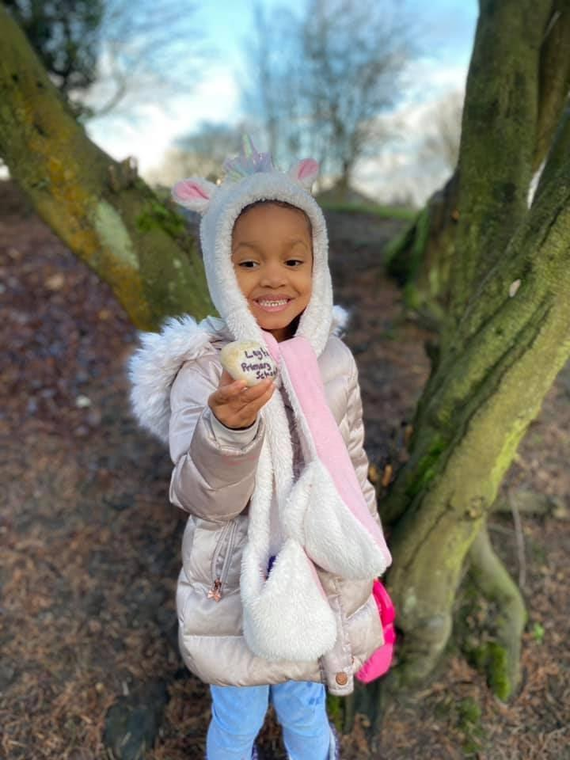
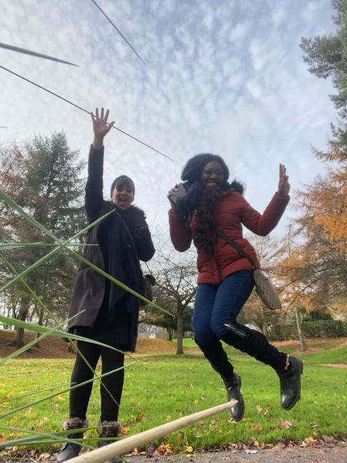
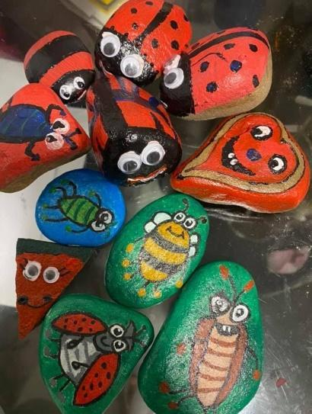
14 JU:MP Connectors
Delivered by VCS organisations
● Build the skills, confidence and motivation of less active families to be active together and independently
● Join up community, schools and greenspace
● Support the delivery of the local JU:MP Action Plan.
Notes:
JU:MP Connectors the aims here:
Taking a behaviour change approach to create sustainable change where possible
Hand over for case studies

Slide 23
Key Learning:
Organisation and community cultural norms have to change and this change can only happen with support from leaders e.g head teacher or Imam
A strong research-practice collaboration can help embed evidence-based practice to maximise feasibility, acceptability and effectiveness.

Slide 24
Workshop 1:
Taking a locality/neighbourhood approach to whole systems physical activity
• Reflections on what you have heard? How similar/how different?
• What’s worked well? What are the challenges?
• What have you learned? Solutions?

