Slide 1


Brought to you by

Slide 2

The
Active Withernsea
Journey
Working together to create
a happier, healthier, more
Active Withernsea
Emma Kelly
Active Withernsea Lead
El Wilkinson-Cunningham
Evaluation Co-Ordinator
Notes:
Emma

Slide 3
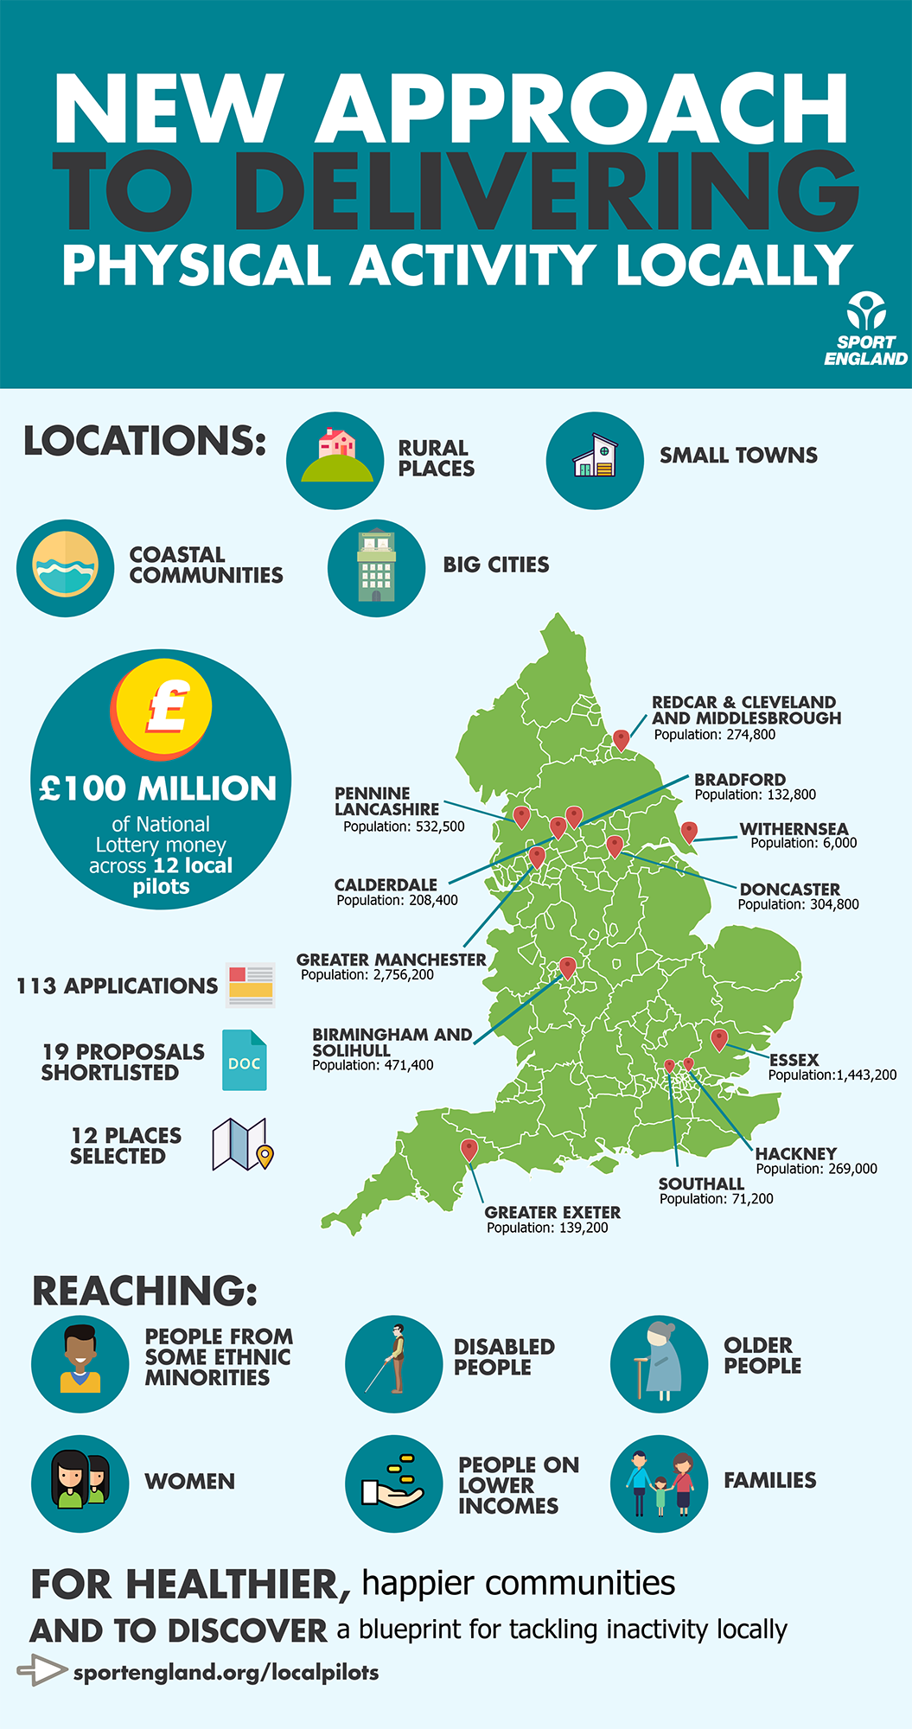
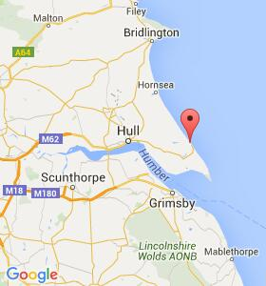
Population: 6,000 winter, 12,000 summer
Location: 20 miles to Hull, the nearest city
Notes:
Emma

Slide 4

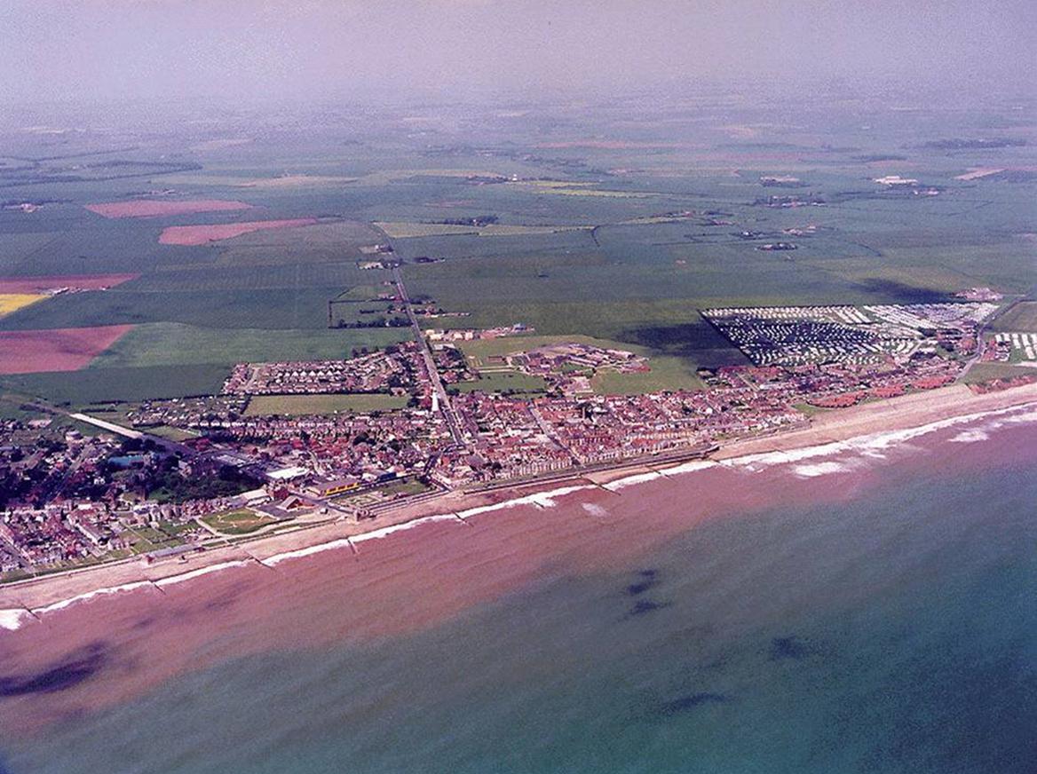
Why Withernsea?
Traditional seaside town
Rural, coastal and isolated
Poor transport infrastructure
Deprivation - top 4% and limits life choices
Economy - seasonal, low skill, low pay jobs
Health & lifestyle:
  1 in 5 adults are in poor health
  30% of adults and 23% of young people are obese
Housing - large numbers of caravan park dwellers
No partnership view of physical activity
Less physically active
Notes:
Emma

Slide 5


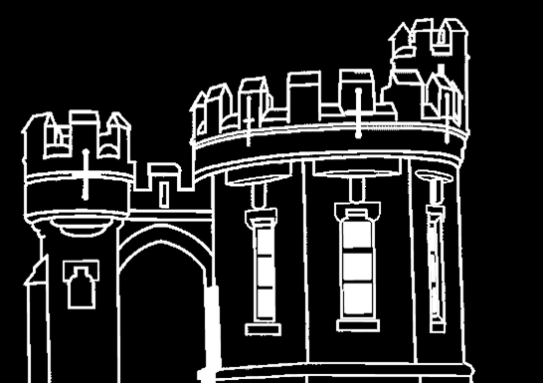
Where did we start
Notes:
Emma

Slide 6
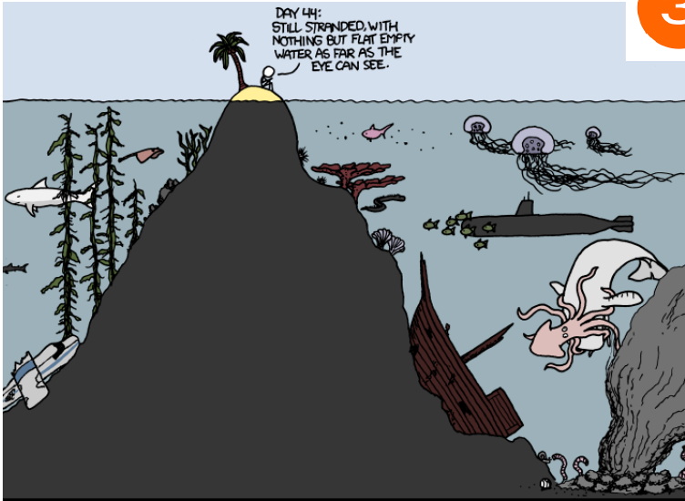
What did we know
Notes:
El- We realised quite early that we needed to dig deeper to understand what some of the issues were within the town, we would hear things such as there needs to be a train/MacDonalds in the town, which wasn’t something that was within our power to influence even if we wanted to, however we picked this out further to realise that there was a sense of isolation within the town and a sense that there wasn’t a place for people to come together (Macdonalds)

Slide 7
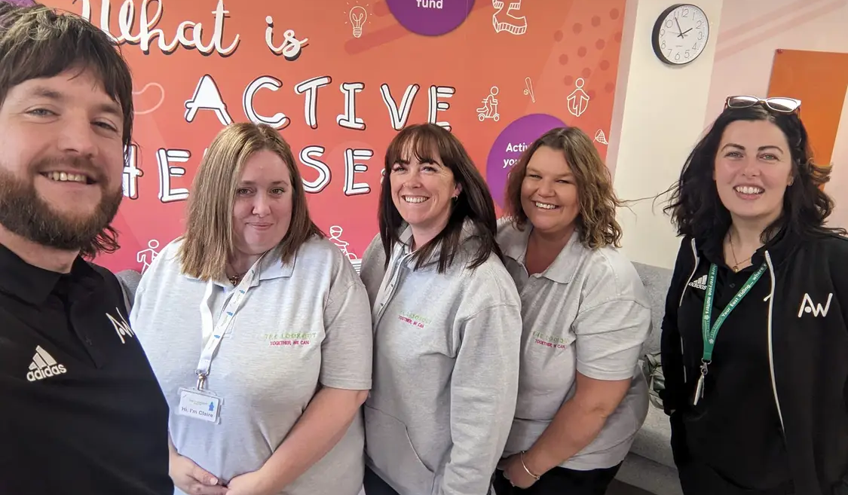
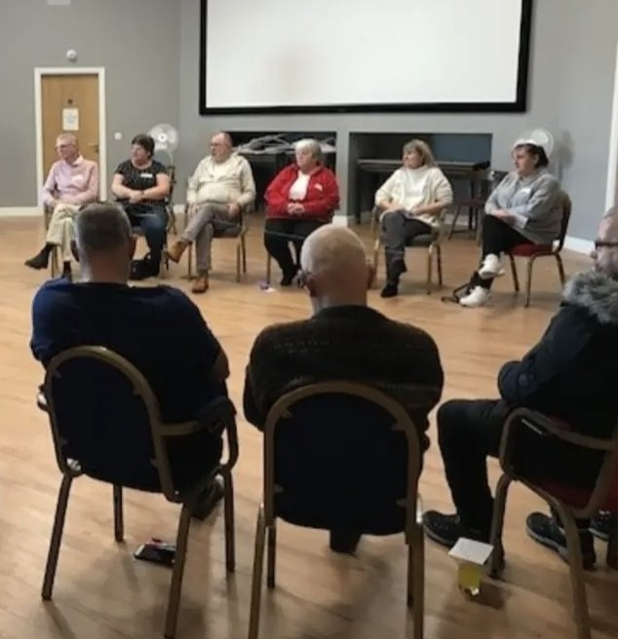
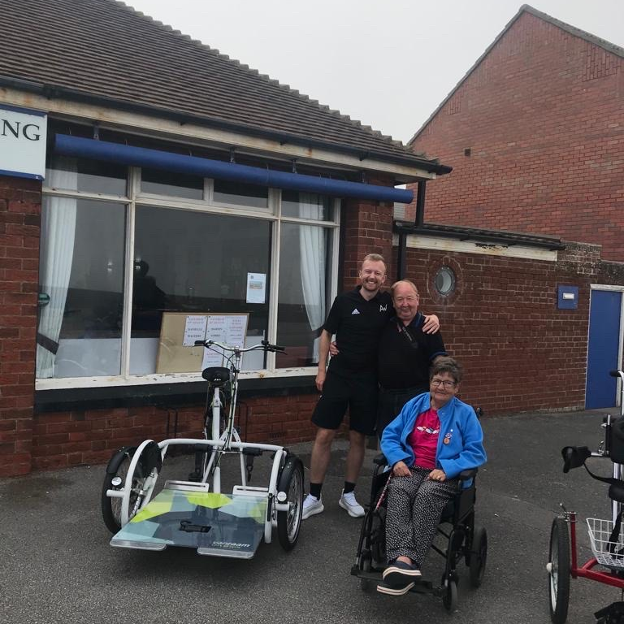
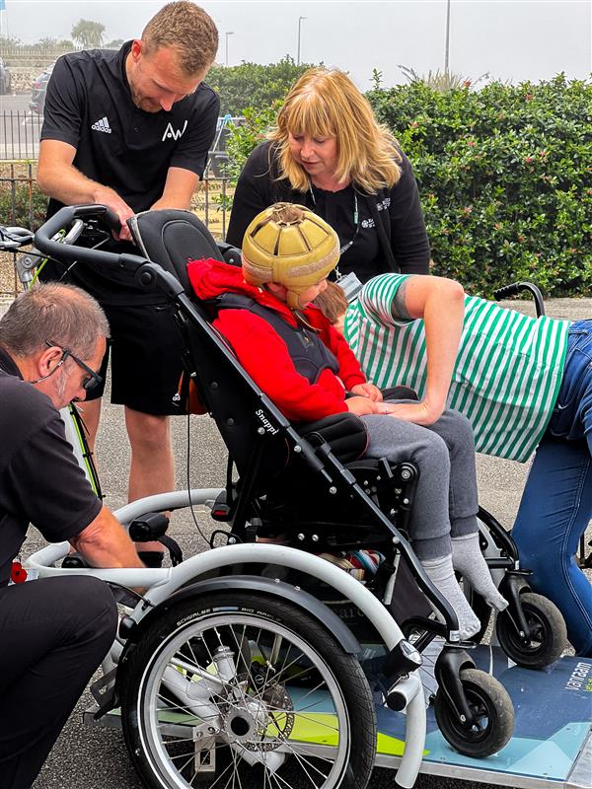
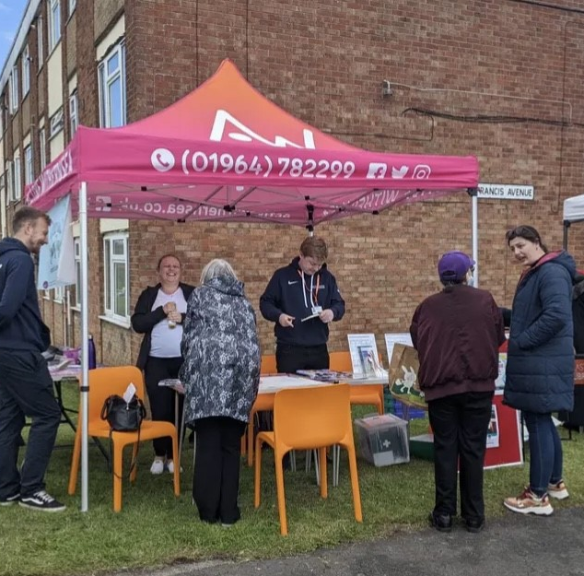
How did we engage?
Notes:
El

Slide 8
Engagement
2019/20
1 year engagement in the town
PharmOutcomes
(holding bay for the raw data)
Nvivo
(qualitative analysis software produced flags and themes
Deep Themes
Broad open questions
“What is important to you?”
“What would you like to see happen in the town?”
Surface level responses were coded into deeper underlying themes. Sense checked and explored with Withernsea residents to gain a deeper understanding.
Notes:
El- in them first couple of years we did a lot of listening, listening to the community and understanding where that energy was and what the town wanted, got a lot of surface level response which allowed to theme into the deeper area- going back to what is under the surface for people.
What process led us to the deep themes?
How we engaged- going into the groups ect using following principles
Behaviours and ways of thinking
Perspective taking
Listening to understand
Listening to empathise
Reflection
Oppositional thinking - being able to hold and interrogate opposing ideas
Being conscious of your own biases
Making space for differences to be explored
Reflecting on your own perspectives
Being willing to shift you own position
Openness
Where are the levers in the system that can really make a difference?
Embracing complexity
Tackling inequality
Connections – who is connected to whom
Boundaries – the scope of a connection
Whole-part – which parts of the system are engaged; do some parts not get involved or considered?
Perspectives – what ideas are prevalent, dominant and the minority views within the system

Slide 9
Deep Themes
Aspiration
“Why should I learn to read? I’m only going to end up in prison like my dad.”
Connection/ Communication
‘I don't always know what's going on and often find out about things too late.’
Perception
“Withernsea is a bit of a problem-place…why would anyone choose to live there?” From someone living outside of Withernsea
“I don’t feel it’s safe for my children out on the streets of Withernsea” From someone whose lived in Withernsea most of her life
Life Skills
‘[Teacher] asked for the SMASH scheme (from high school) to be made available for primary school children. She was concerned in the lack of life skills that children have, from reading and brushing their teeth through to manners.’
Notes:
El- From listening to the community we were able to identify 4 deep themes which seemed to be consistent within the town these were ^^ (described what they are) These became one of the way that we are then able to plan our work and projects, aiming to try and make an impact of these 4 areas.

Slide 10


Engagement learning
System/place maturity for some of ideas/ processes
Talking about physical activity put people off
Be willing to change things
Needed to develop trust
Money brings expectations
Holding your nerve
Working in a 'small' place – Can't hide or move on - had to sit in the uncomfortableness “hiding from the lions”
Word of mouth can be friend or enemy- Dave said it was crap so everyone he knew thought this
Notes:
El-

Slide 11
Implementing the Pathfinder
Notes:
Emma

Slide 12
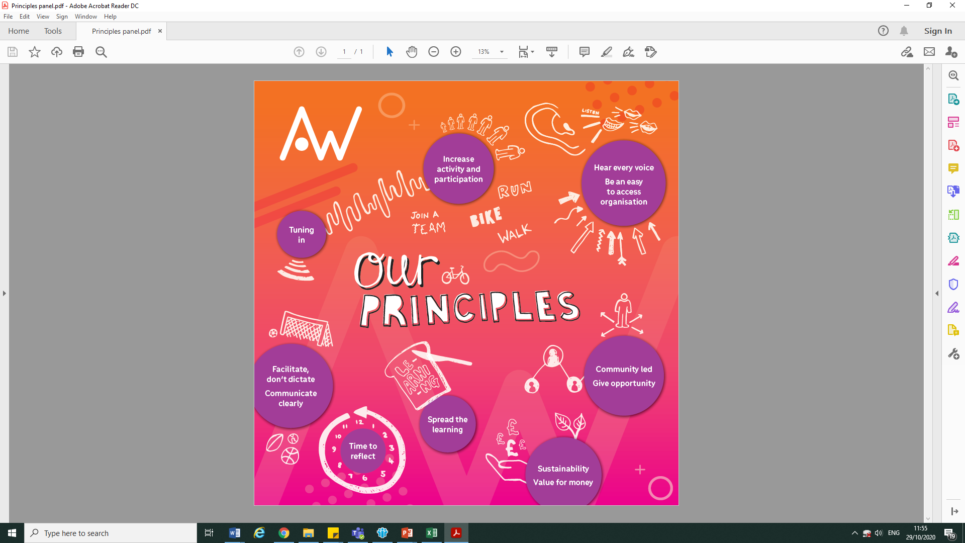
Tuning in
Community-led
Increase activity/ participation
Improve communication
Give opportunity
Facilitate only
Sustainable
Spread the learning
Hearing every voice
Time to reflect
Practice what we preach
Target the hard to reach
Value for money
Notes:
Emma
Bridge between academic work and community developed through learning which we still stick to this day- our values which remain when

Slide 13
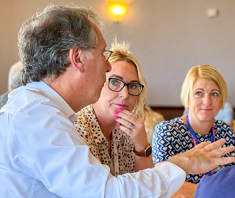
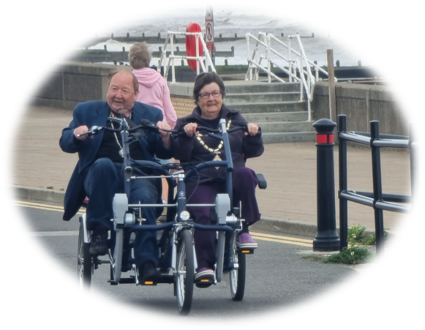
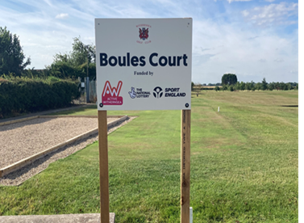
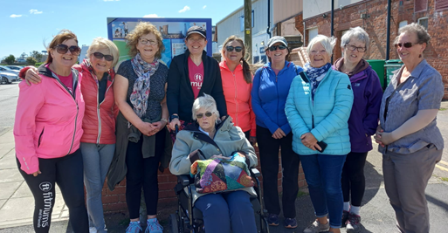
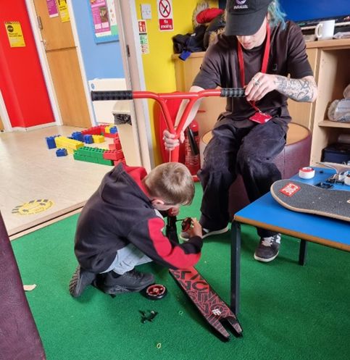
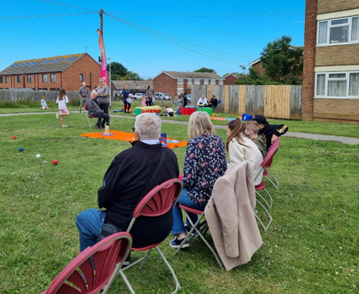
Our Pathfinder
Young People
Open Spaces
Walking and Cycling
Community Shaper Capacity Building
Get Going investment fund
Life course
Inequalities
Sport
Notes:
Emma
Being flexible and adapting – how these have changed.

Slide 14
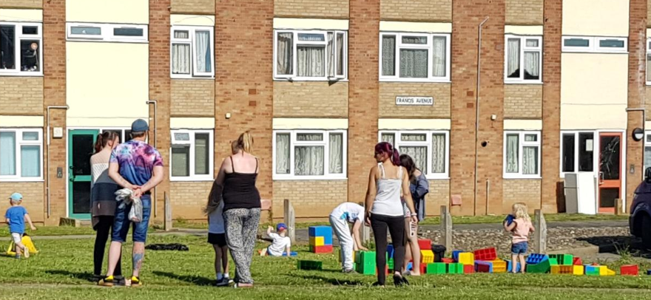
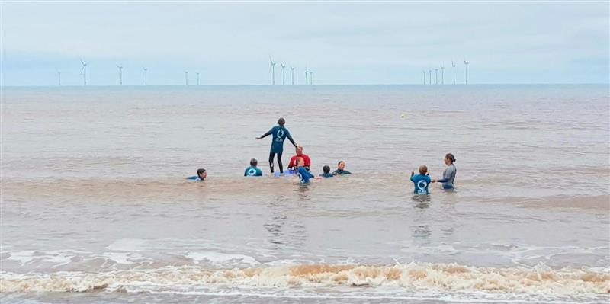
Withernsea is changing
From strategic system change to active participation
Scaffolding the development of new Withernsea-led opportunities to be active
Brokering resource into the town
Neighbourhood-based projects
Facilitating system change
‘Get Going’ grants
Notes:
Emma
Hybrid teacher, redeisgn of playground, doorstep sports
Cycling, road safety team
Lifecourse – Active Kirkfield
System change – public health, leisure, school, heath
Grants – individuals, new groups, established orgs expanding

Slide 15
Implementation learning
Recruitment challenges
Trusting the process
Managing expectations
Helping people to doing the work themselves rather than parachuting in
Not over promising - sticking to our word to build trust
Easy to fall into old ways of working
Be adaptive and willing to change-link back to pathfinder
Needed to reframe to bring physical activity back into line of sight- need to be careful about mission drift
Boxing example
Notes:
El

Slide 16
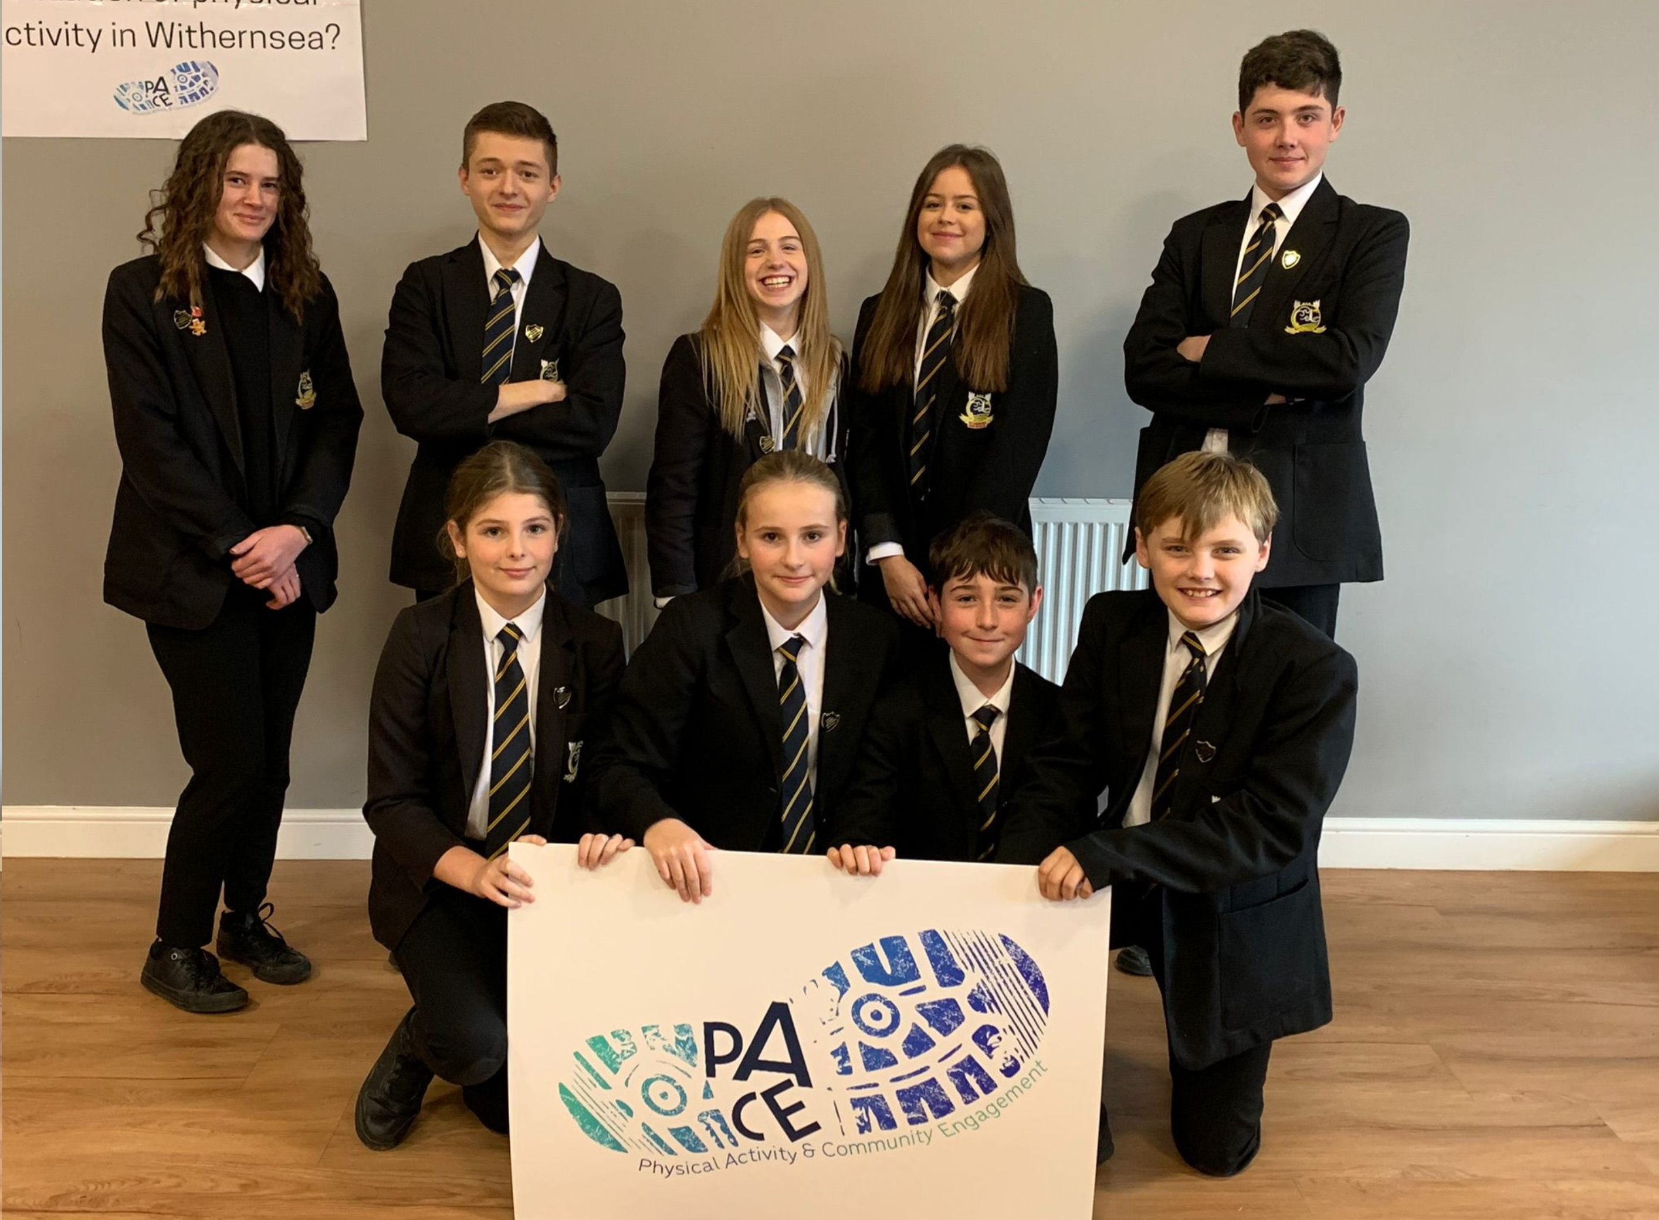
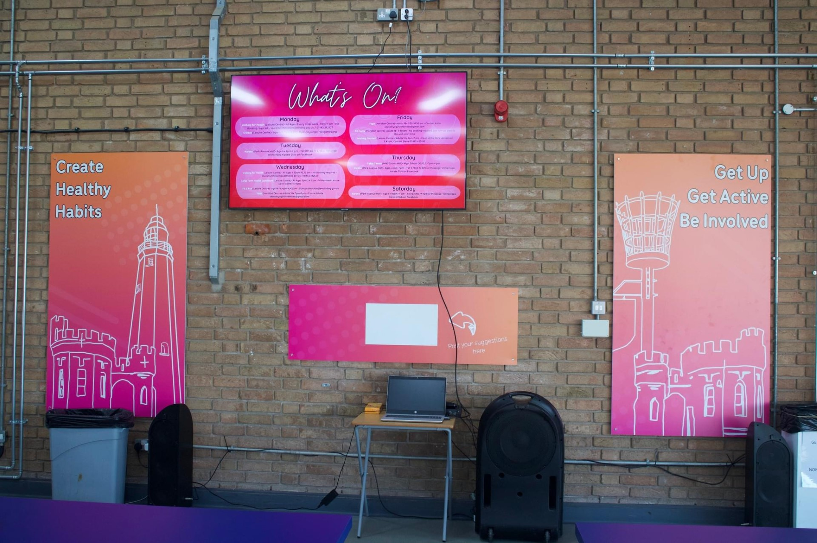



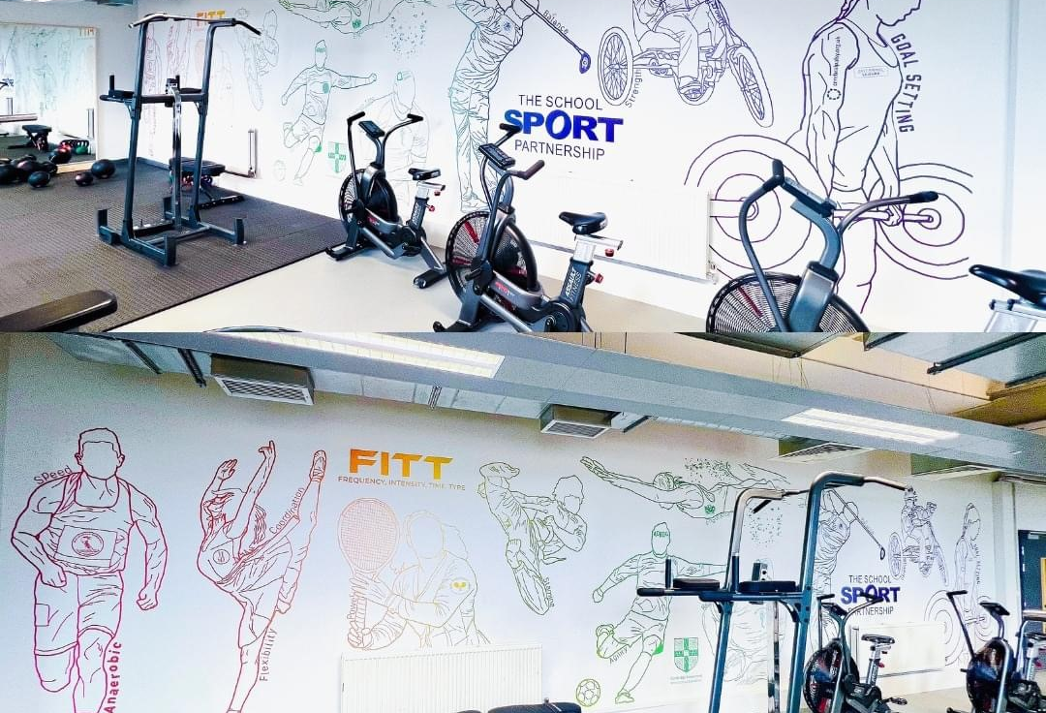
Withernsea High School
Always listening, it never stops
Be bold and prepared to try something different
Ready to fail and take the learning (but this didn’t!)
Building relationships are key to enable opportunities
Be quick to act when opportunity appears (going where the energy is)
Notes:
Emma to do the journey, El to do the learning
In the town long enough for people to know who we were and what we were doing, wanting to work with us but unable to- so links back to Listening about what the real barriers are- school understand impact of PA, but due to coming out of COVID, wasn’t the capacity, however by working together, being proactive and listen developed the role… talks about nicks role (Kumu change)
Emma to do background
El to do learning/outcomes

Slide 17

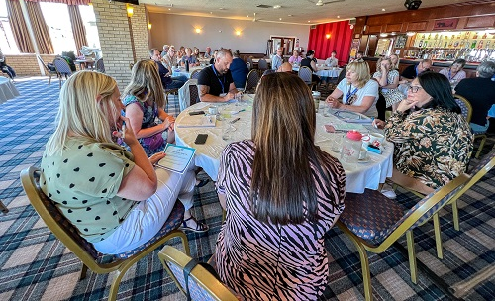
Systems Change
Governance
May 2022 Time to rethinking Active Withernsea's governance structure
July 2022 PACE network launched
Regular PACE workshops
January 2023 Sticky Issue subgroups
October 2023 PACE workshop – The Journey towards Sustainability
The future intention: The PACE Network will evolve and exist beyond the AW funded period, enabling the members/community to continue to lead physical activity into the future
Notes:
Emma

Slide 18
PACE learning
Bottom up not top down
Needs culture to be right and have clear vision
It’s often the same people taking on roles, so frame it as “what time can you give” and not expectation of more roles
How we onboard throughout the journey to keep open boundaries- we are still struggling this
It takes time
Word of mouth- creates culture of positive talk
Network does need to see actions to have buy in
Need resident voice, not just partners
Partnerships based on money don't work, need commonality
Notes:
El

Slide 19


How do we evidence change?
Kumu
Participatory Theory of Change
Explanatory Frameworks/Accounts
Case Studies
Social Value Engine
Process chats
Survey measuring physical activity levels
System change conversations/Flash cards
Notes:
El-Tools of which we use

Slide 20
Evaluation learning
Numbers don’t tell full story- meeting system where is at needs a mix of quant and qual. The story is just as important as the number/outputs.
Numbers are needed for funding.
Trying different tools and approaches- sense maker- needed lots of numbers and space was too small, labour intensive, felt constricting- didn’t fit any more (no link to PA).
Needs to be usable and relatable to everyone- strategy, staff team and residents in the place.
Challenges of using mix methods approach is how is this passed skills and learning on to the Place
Notes:
El

Slide 21
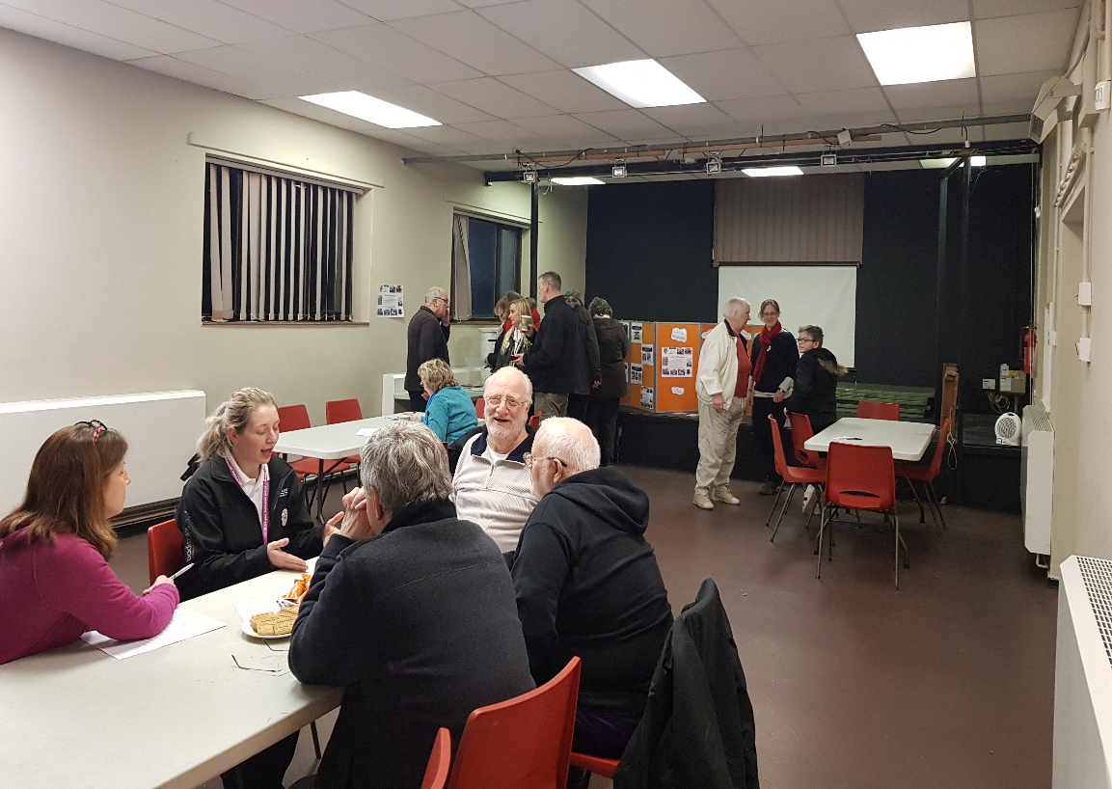
Key Challenges
Measuring success
Managing expectations – not always visible
Deep listening
Doing ‘with’ not ‘to’
Independence not dependence
Recruiting
Embedding PACE
Political direction
Sustainability & legacy
Fundamental culture change
Notes:
Emma
Measuring the success of a sustainable community with coastal inequalities using non-traditional measures. Numbers are traditionally seen as a success.
Embedding PACE as a community led network with distributed leadership. We’ve come a long way but we’re still on the journey!
Doing ‘with’ and not ‘doing to’. People are used to being ‘done to/ done for’ and expect it.
Creating independence not dependency. Whilst we attempt to co-produce and empower, Active Withernsea are still seen as a key pillar in the town.
Deep listening doesn’t happen on the first conversation. It takes time to build trust and understanding.
Recruiting from within the place.
Managing expectations - not always being visible. People expect to ‘see things being done’ but often Active Withernsea are facilitating and holding space, supporting those in the community, and not always seen to be visible.
Fundamental culture change in a community takes time – impact is not generally instantaneous, and we must meet a community ‘where it is at’, not where we want it to be or think it is.
Political direction to embrace this approach as ‘business as usual’ and replicate it across other areas of the East Riding.
Determining the sustainability and legacy of Active Withernsea beyond 2025 and working with key partners such as Active Humber to determine a model.

Slide 22
Withernsea is changing
What a difference 5 years makes!
Local people are trying new activities and being active in a different way
Local people are developing their own projects from the ground up
Local groups are accessing funding and support for the first time
Equality, inclusion and diversity sit at heart of approach
System change/ cooperation and traction locally and regionally - more connections and better perspective taking, boundaries moving and parts of the system flexing to allow new people in.
Lone voices are connected
Partners are talking, listening and collaborating
Perspectives are changing - Putting the wider community first
Change is driven by the community
We have a clear line of sight and a legacy - PACE
Feel the energy!!
Withernsea is getting active and connected!
Little recognition of PA role in reducing health inequalities
Paternalistic ‘parachute services in ‘ approach
No wider system recognition
Lone voices - little community energy for PA
Inertia - little community engagement in PA
Little partner collaboration around PA
Silo working
No strategic focal point for sport and PA
No shared agenda for bigger picture/community good
Little funding to support groups
Little future planning, resilience or legacy
Notes:
Emma and El

Slide 23
Brought to you by

Slide 24

Systems Working to influence place based delivery
Sam Allum
George Cull

Slide 25
Context
Outdoors are our greatest assets (2 football pitches per person)
Perceived affluence of North Yorkshire – hidden inequalities
Challenges with inequalities on the coast

Slide 26
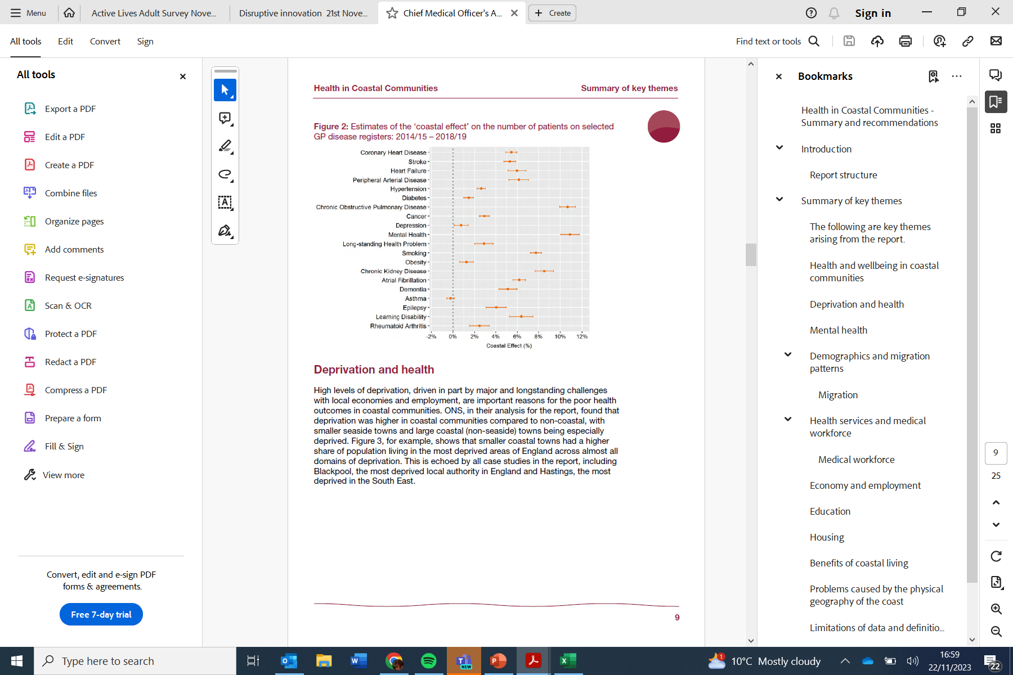

Slide 27
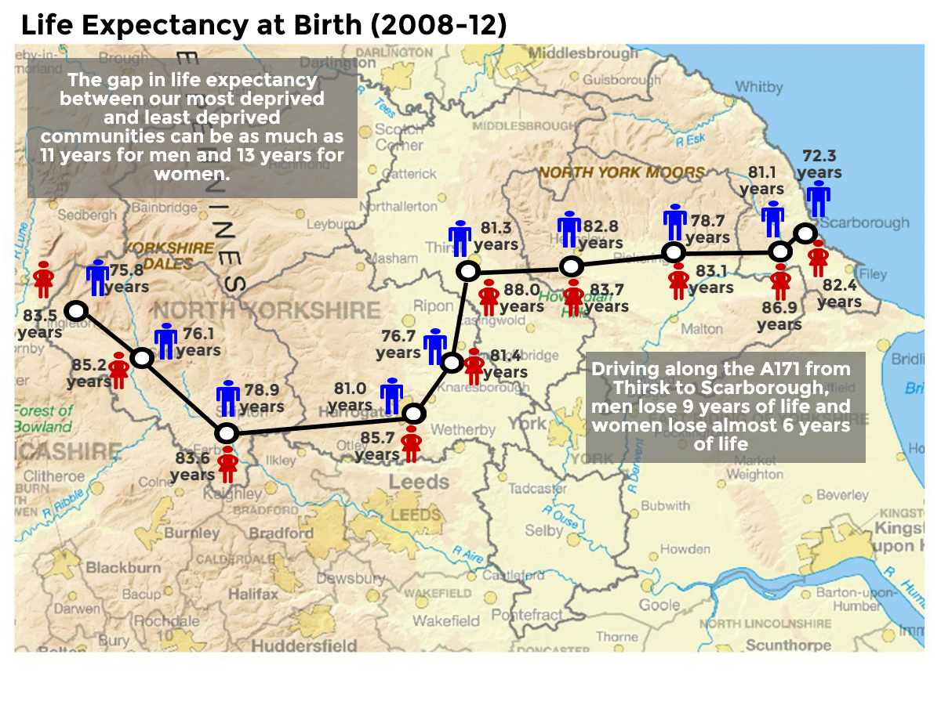

Slide 28
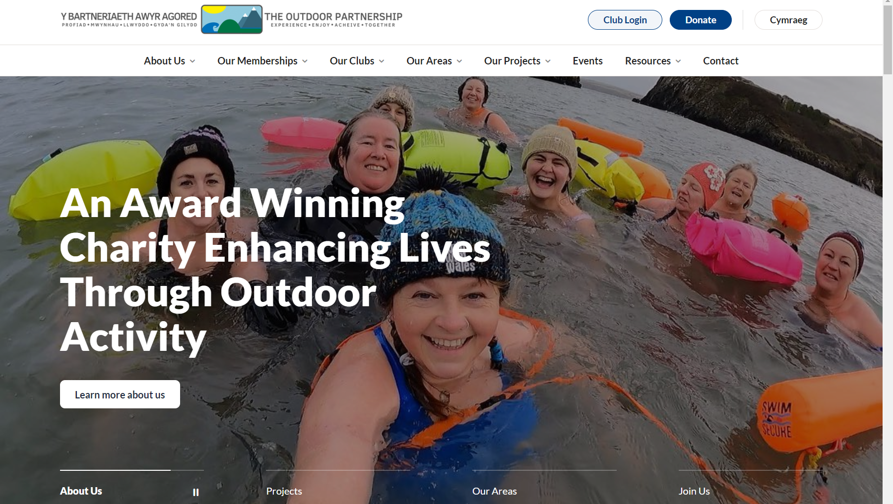

Slide 29
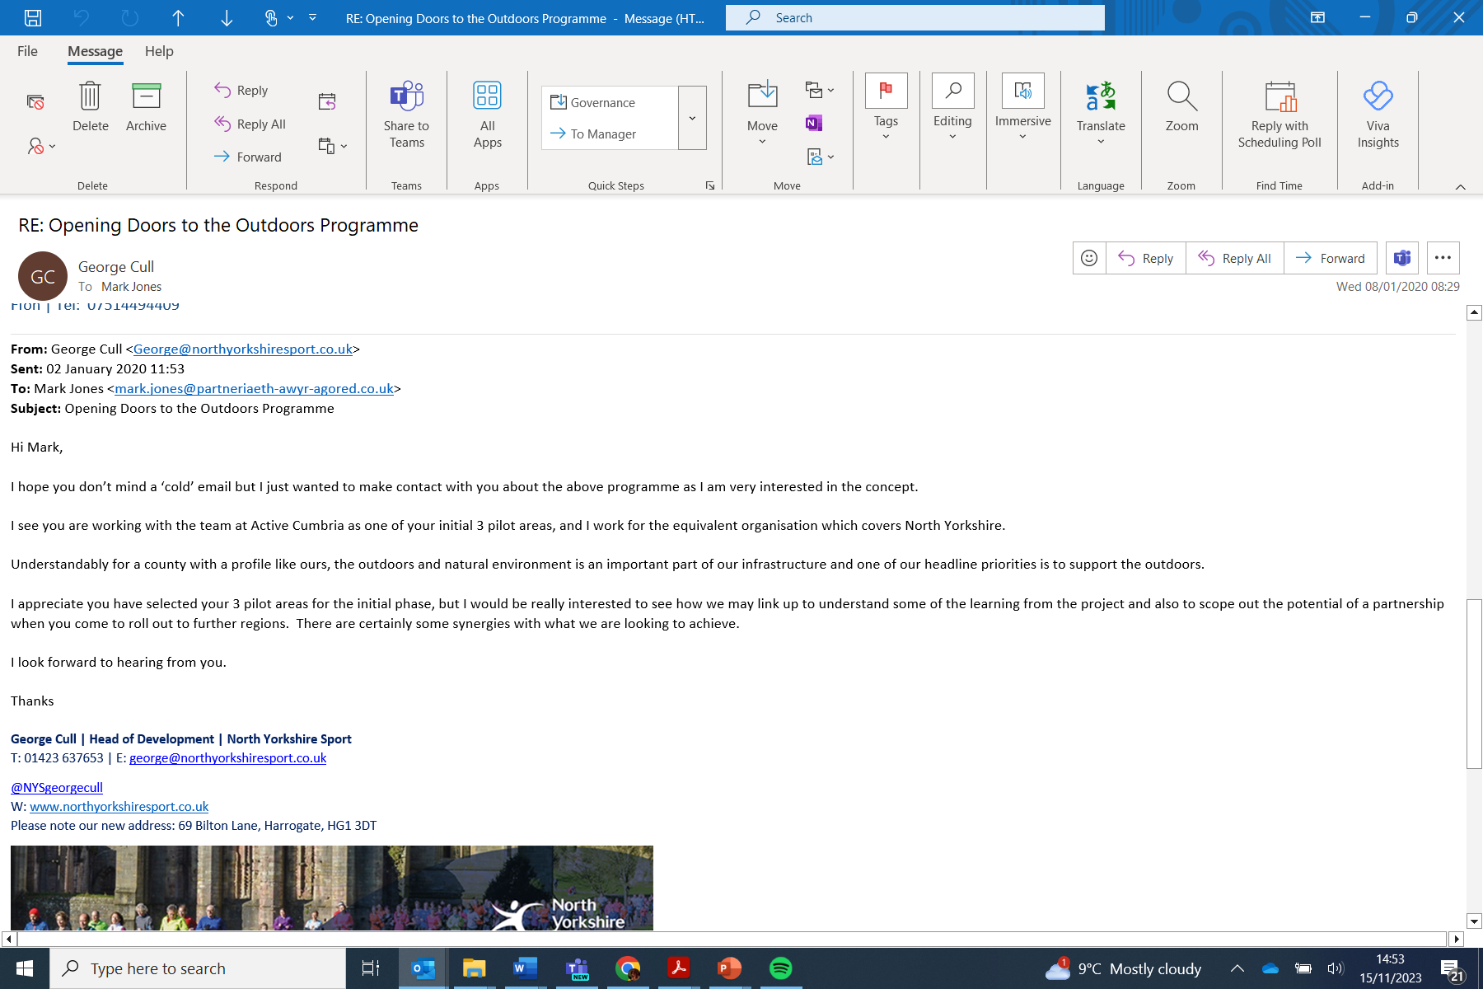

Slide 30
So, what followed
Covid!!
A bunch of partners in a room
Shared aspiration
Partnership funding
Applications vs trust
Fish and Chips
In January 2023 we appointed Sam to the role of Outdoor Activity Development Officer

Slide 31
What?
Went for a walk
  Notice boards
  Charity Shops
Created a list of all the groups I could find
Notes:
Blank map, barely any knowledge of the activities in the area, or the comms groups
Tesco notice boards, parish council boards, facebook groups, asked in a coffee shop in whitby whilst I was working from there.

Slide 32
Who?
Community groups & Charities
  C.I.C’s
  VCSE
  Conferences/Webinars
  Social Prescribing
  Education
Provision Providers
  Businesses
  C.I.C’s/Not for Profits
  Clubs
Notes:
CIC database
VCSE database, North Yorkshire connect, a lot of areas have a list of clubs, NYY sent me the old document they had. Blue book.
Lots of contacts were made at webinars and in person conferences
Social prescribers will have a list of groups they sign post to
Community Regen were very helpful
Anyone who provides, from the social prescribing walking group to the surf kayak coach
Clubs, I went through all the NGBs websites. I was lucky I had a list of sports that TOP support.

Slide 33
What?
Went for a walk
  Notice boards
  Charity Shops
Created a list of all the groups I could find
Had Tea
Went climbing, walking and canoeing
Networking events, even if only slightly relevant
Connected people through this whole process
Persistence
Notes:
Blank map, barely any knowledge of the activities in the area, or the comms groups
Finding organisation that people already engage with and seeing if they are wanting to offer outdoor activities.
Great list of tea room in Scarborough if anyone wants to know, expert on it now!
Stubborn human
Still trying to get in to talk to a provider in the area, I will, I’ve just got to work out a way
Tesco notice boards, parish council boards, facebook groups, asked in a coffee shop in whitby whilst I was working from there.
Went climbing with someone who now wants to set up a club, want walking with a great guy from NYMA, found out loads about the area, the relationships that are already there.

Slide 34
Questions
What do you currently offer?
What would you like to offer?
Where do you see yourself in 2 years?
What are your barriers?
How could I help?
What should I be aware of (community/norms/cultures/drivers/history)?
What resources do you have?
Who else should I be talking to?

Slide 35
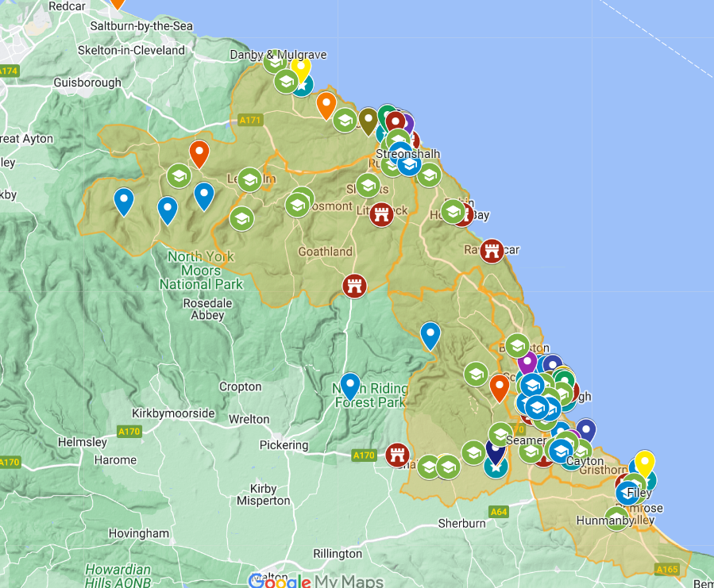

Slide 36

Questions?

Slide 37

Our approach to working in place
Laura Young
Lucy Psarias
Sarah Steph

Slide 38
Introduction
A new approach to how we work – change in mindset/focus – linked to the day to day
6 months into our journey – it takes time!
Learning from LDP’s
Context – budget and capacity
What does it mean for us?
Notes:
LP
The reality is we still do our day to day in terms of what we deliver but with ‘place’ becoming the driver
Whilst 6 month may feel like a long time our work is still at the very early stages which can feel slow / frustrating / feel like there is a lack of impact, but we recognise this work takes time!
The information shared by LDP’s has been really valuable but also quite overwhelming, so we have really had to think about it in context and what it means for us
With no set budget and a small part time team for a large geographical area we had to discuss what we wanted our PB work to be.

Slide 39
First steps
Discussions – our vision - what do we want to achieve
Place based / Whole Systems Approach
It’s a way of working not a role!
Supporting residents to become more active and to enjoy the health, social and environmental benefits
To Support in the creation and maintenance of CONNECTED and ACTIVE communities
Capacity
Behaviour change / Advocacy for PA / Influencing / Inspiring / Leading
Community centred / led approach – building power
Notes:
LP
We sat down as a team and tried to establish what our vision was and what we wanted our place-based work to achieve

Slide 40
Identifying our places
Mapping
Our existing work
Data and Insight
Colleague knowledge
Partner knowledge
What’s already happening
Inequalities
Community assets
Who is in the place? – YP, older people etc
What is the community offering – transport, health systems, education, workplaces etc
Steering away from it just being IMD
Notes:
LP

Slide 41
Our places
Hyper local areas
Selby (Town):
  Index of Multiple Deprivation ( 3rd decile )
  Existing networks
  Current and previous work
Broughton Road
  Cultural Diversity.
  Barriers such as social isolation and segregation.
  Conversations with sporting contexts/partners to assist reduce barriers.
  Anti Racism pledge with the clubs.
  Influencer within community to drive activity (Ruksana.)
Notes:
LP
Following identifying the places in general we have then
Generally needs expanding in terms of our reasons behind the selection of places
What stood out to us and why – no one was talking about central (add for Colburn and Selby/Broughton rd)
Selby Town – Chosen as Linked to existing networks and identified priorities. Need to focus on place stems from multiple indications of need from both a demographic and socio-economic perspective. The first indication of need arises from the Index of Multiple Deprivation (IMD) status of our targeted area, which is in the 3rd decile. This places the area within the 30% of the most deprived Lower Super Output Areas (LSOAs) in the country. In addition, existing networks are historically strong including links to Primary Care Network, schools and colleges ( ‘Stepping Up’ programme delivery ), Youth Engagement events plus linking to Refugee and Asylum Seeker provision.
Broughton Road – Chosen as it builds on existing work. Good to have an influencer ( Ruksana ) to help drive/steer activity. Broughton Road is a community in Skipton. The area is considered more ethnically diverse than your average street in the UK, where by 39% of the community are white as opposed to 86% ( UK average.) The dominant ethnic group is Pakistani and religion is Muslim. Issues include lack of sporting/PA opportunities and feelings of social isolation and segregation to access local sports provision. NYS, police and stronger communities were involved in wider conversations with local sports clubs with a focus on how to remove barriers. Conversations evolved around how to assist to reduce micro aggressions and help shape the culture in local sports clubs to be more open and welcoming to all. Bridging gap around perception v reality.

Slide 42
Our places
Scarborough:
  Coastal area of opportunity
  IMD
  Seasonality
  So why Central ward?
Colburn:
  Previous work
  Military
  ASB
  Current work of NYS (FEAST/OSF/Military Families)
  Opening School Facilities
Notes:
LY
When discussions happen around Scarborough quite often the focus is around Eastfield and Barrowcliff, There are lots of interest in these areas and resources being foccussed on these areas (and rightly so). But there are also challenges faced by communities in other communities within the geographical area, but with fewer resources being focussed here we felt it was important that these voices are heard and supported. Not a case of who shouts the loudest.
More of the county’s LSOAs now fall within the lowest quintile (most deprived 20%) in England in the Index of Multiple Deprivation, increasing from 18 in 2010 to 23 in the 2015 dataset. The increased number covers parts of Colburn
5 and falls within the Worst 41 to 60% in England

Slide 43
Starting our work in place
Speaking to people!! (organisations and community members)
Learning, getting to know the place (organisations and community members)
Identifying needs / gaps / issues / barriers
Are there any crisis points
This will be ongoing…..
Notes:
LY
How we went about starting our work in the identified places. Once our ‘places’ were identified our initial
Spending time speaking to as many people as possible – important to note that you might get a different story depending on who you are talking to.
All communities are different and getting to know the ‘place’ is a vital foundation for the work we want to do. We have tried to find ways to get close to the ‘people’ because they are the ones who have the knowledge.
They are the ones that can tell us about day-to-day issues they face, they can tell us what is stopping them from being active.
Again, it is important to get more than one side to the story to build a proper picture.

Slide 44
Who we have /will connect with
Volunteer centres
PCSO’s
Church groups
Family Centres
Using this learning
Building a picture
Mapping
Regen teams
Adult Services
Food banks
CIC’s
Town Councils
Carers plus
Youth workers
Social Prescribers
Age UK
Libraries
Network groups
MIND
Refugee Council
Fire Service
MWF Service
Parkinsons
YMCA
LA’s
Public Health
CAMHS
Housing orgs
NHS
Resident groups
Closer Communities
Early Help
Notes:
LY
Organisation aspect – still close to the community
Community groups – piggy backing on other work happening in the community with these groups – we are not yet trusted
PSCO’s – good because they sit across both aspects. They see the bigger picture in terms of issues but also speak to residents daily
We are using all the learning that we gather to build a picture for the place.
I have included mapping – some of the LDP’s have done great work on mapping but this has taken time and financial resource – at the moment for us our ‘mapping’ is more of a mental map
Our initial work has focussed on myself, Laura and Lucy as the AC team working in place, HOWEVER
In terms of what we are working towards as an organisation - the aim is for our team as a collective, to be mindful of our place-based approach in their work and visa-versa
We mentioned at the start of the presentation that we had limited capacity and no financial resource but as an organisation we successfully secured a sum of money through UKSPF.
We have been commissioned to manage the fund – we are using this as a tool in the process to support sustainable sport and physical activity in the community
Not just a grant giving fund – working developmentally with applicants, to ensure we can support the right ideas, with the right people in our ‘places’

Slide 45
Thank you

Slide 46
Brought to you by

