Slide 1






TRANSFORMING PHYSICAL ACTIVITY CULTURE IN SCHOOLS THROUGH A PLACE SENSITIVE WHOLE SCHOOL APPROACH

Slide 2

What is a whole-school approach?
One that supports organisational and cultural change for PA so that it is valued and prioritised throughout all areas of the school. This includes:
  physical activity embedded within school policy and practices
  the engagement of stakeholders across the whole school community
  supportive physical and cultural environments
  opportunities to be physically active across the whole school day and beyond
Policy
Stakeholders
Environments
Opportunities

Slide 3



Why this approach?
Organisational and cultural change
Single component
Multi-component

Slide 4
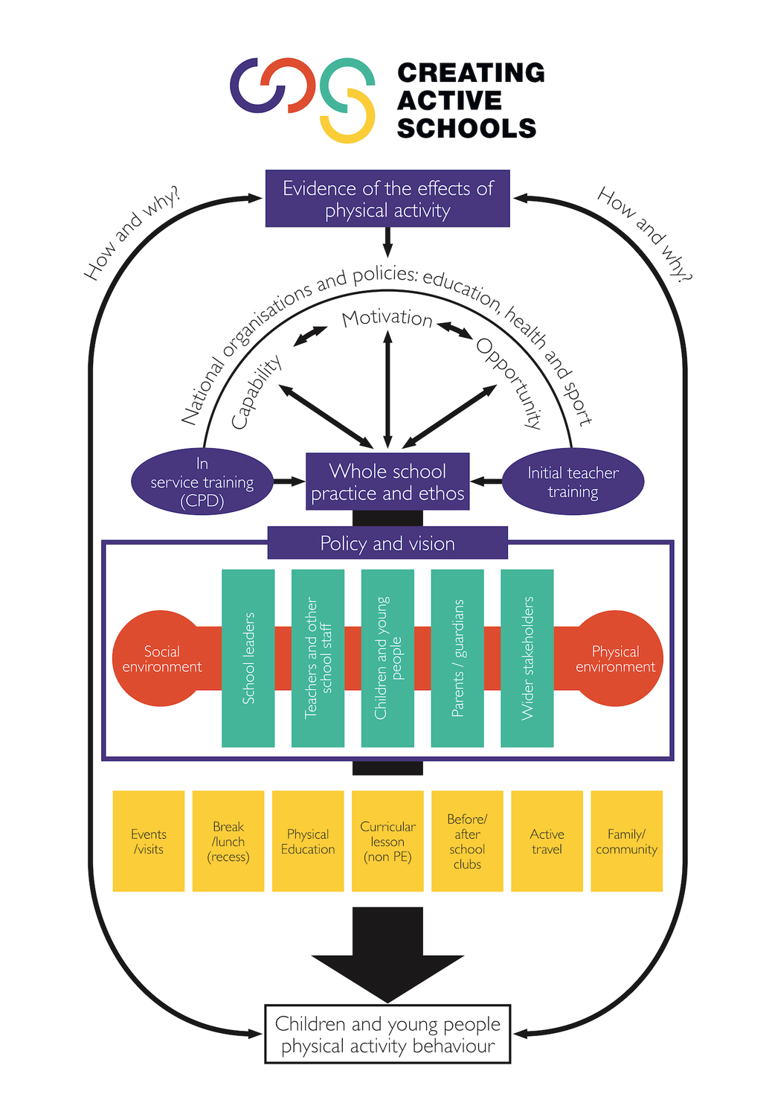

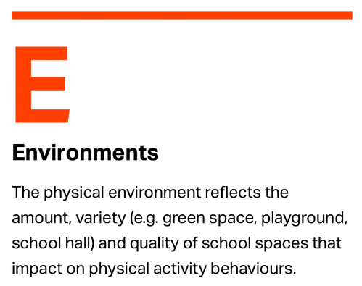



Slide 5

CAS ANNUAL CYCLE
1. Review
2. Action Planning
In-school CAS lead uses online profiling tool to assess current whole-school PA provision against four areas: policy, environments, stakeholders and opportunities.
In-school CAS lead completes CAS 'Planning for Change' using the APEASE criteria to identify evidence-informed PA initiatives.
May - July
June - Sept
ANNUAL CYCLE
4. Monitoring & Evaluation
3. Implementation
Ongoing
Sept - July
Champion support the implementation of school initiatives. Initiatives include: policy or environment changes, and training staff to support PA across CAS opportunities.
Schools evaluate the impact of chosen initiatives. These insights inform the next CAS profiling exercise, starting a new annual cycle.
Notes:
Currently, the CAS programme includes a 4-stage annual cycle.
1. Review- Profiling tool
2. Plan - Planning for change
3. Implement
4. Monitor & evaluate
OUR DATA COLLECTION TOOK PLACE BEFORE STAGE 4 HAD COMMENCED!

Slide 6




Creating Active Schools Core Team
Research and Implementation Leads and National Co-ordinator
Locality-based partnerships
CAS Champions
National
Support

Slide 7
The GM Moving Locality Model
CAS National Team:
CAS Strategic Lead, National Manager and Research Team. Representatives from University of Bradford, Yorkshire Sport Foundation and the Bradford Institute for Health Research.
GM Moving CAS Locality Leads:
GM Moving funding the implementation of CAS in schools & support of CAS Champions.
CAS Champions:
Individual borough Active Education Leads connected into GM place leads
20 primary schools
50% in IDACI band 3 or lower
1 SEND provision
1 Pupil Referral Unit
Notes:
Cascade system of support
Bottom up and top down
Different combination of delivery/support for schools across Bradford

Slide 8




Key CAS Impacts
Mindset shift from considering physical activity as solely the responsibility of PE leads.
Substantial increase in organised and structured activities during break times and lunchtimes.
CAS is an
recurring agenda item at every governor meeting.
Specialised governor engagement; linking community initiatives for all pupils
Changes to break times to allow more space for year groups to be active. ​
Improvements in Behaviour .
Collective awareness
from staff for the
need to incorporate
physical activity
into daily routines.
Linked CAS into performance management reviews
70%
Schools feel the culture for movement is improving.
Schools look to
design physical
activity into
their spaces outside
of playgrounds
and halls.
Notes:
Boxes coloured linked to the areas of the framework- most of the impact has been around shifting the social environment and culture in the school to support more opportunity for PA, not necessarily about adding more opportunities or making lots of big changes
Dark blue – policy
Light blue Stakeholders
Red – environment – physical and social
Yellow – opportunties

Slide 9
What we are learning
Start Small and Build Gradually
Make Use of Available Resources
Gain Whole-School Support
Tailor Activities to Suit All Students
Encourage Pupil Voice and Ownership
Challenge’s of implementing CAS
Top tips for implementing CAS
Time Constraints
Staffing Capacity
PA Knowledge
Competing Educational Agendas
Common contributions to success
Commitment by Schools
Engagement and Participation
Positive Feedback
Active Travel Plans
Community Engagement
Use of Technology

Slide 10
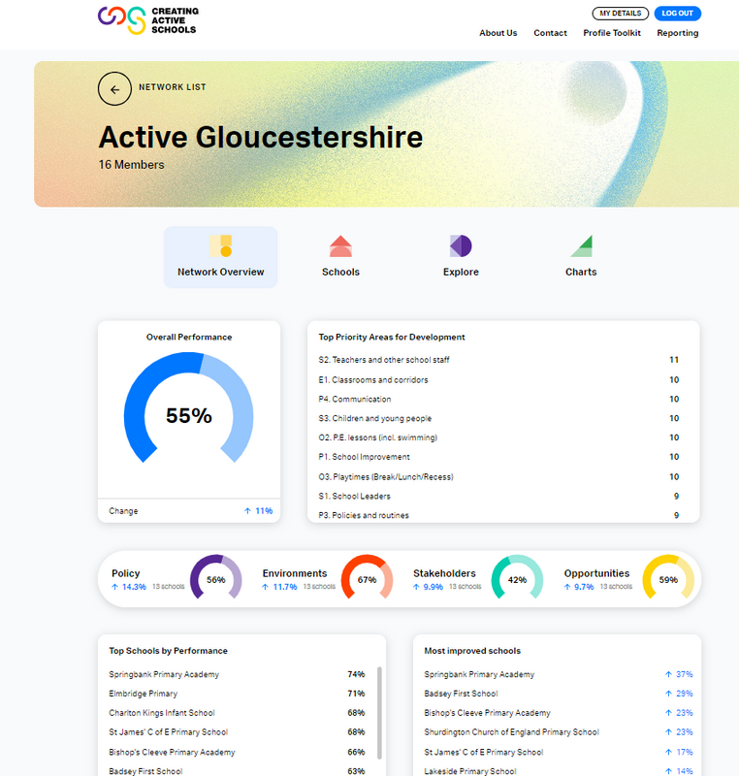
A CAS Digital Hub which supports implementation of whole school physical activity
We all know the most impactful and sustainable change is when evidence is used to inform decision making.
The CAS Digital Hub provides a way for schools and localities to gather insights that can inform change at the school level and at the pupil level.
Profile Action Plan Implementation Resources Evaluate Impact

Slide 11

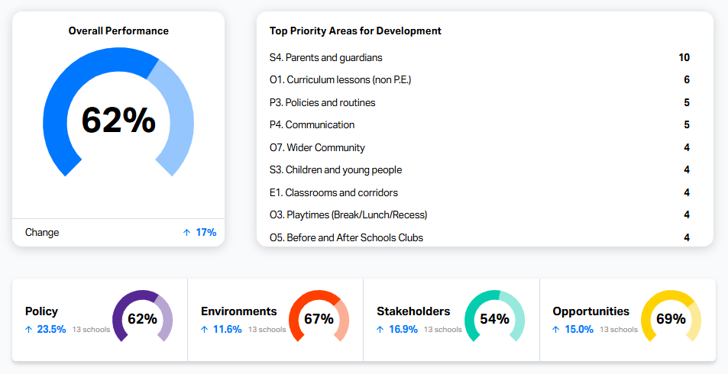
Doncaster Locality Data
17% increase across the network
23.5% increase in positive policy changes which align physical activity with whole school improvement
11.6% increase in school environments being adapted to support children to move more
16.9% increase in schools creating behaviour change amongst school stakeholders to support CYP physical activity
15% increase in more sustainable and varied opportunities for children to be active across the school day
CAS National Team:
CAS Strategic Lead, National Manager and Rsearch Team. Representatives from University of Bradford, Yorkshire Sport Foundation and the Bradford Institute for Health Research.
‘Parental engagement’ is the 24/25 data informed priority project for Doncaster CAS schools
Notes:
Cascade system of support
Bottom up and top down
Different combination of delivery/support for schools across Bradford

Slide 12
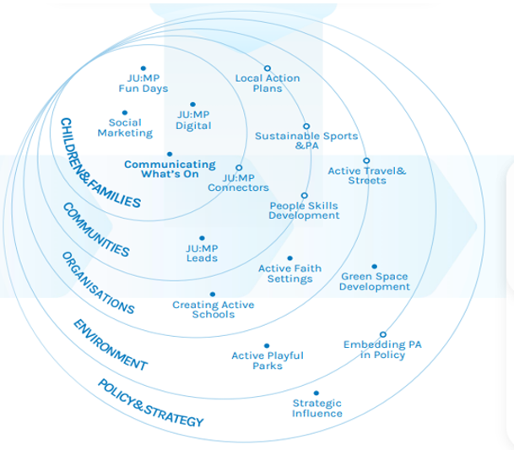

Slide 13

What is your sales pitch for each level?
Locality/ Partnership Organisations
MATS/ Local Authority/ Sport and REC
Schools
Leaders/ Governors
School Stakeholders
Teachers/ Assistants
Children/ Pupils

