Slide 1




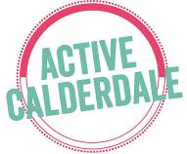


Sharing the Learning from workshop at Lister Mills,Bradford, 29th November 2022
Whole Systems Physical Activity:
Locality approach

Slide 2
What’s working well?
● School’s connecting into communities can be effective
● Exclusive focus on a target age group compared to all age ranges. Working across wider age ranges produces a space for intergenerational work
● Working at hyper local level - at street level
Incorporate into what already exists
● Embedding physical activity into day to day life
● Embed in existing services

Slide 3
Community engagement and co-production
Trust:
● Trusting local people to make decisions (community chest approach)
● LTO/workforce - capacity and skilled individuals
● Power of relationships
● Show communities what impacts are happening, showcases stories, builds confidence and trust
● How to ensure ‘seldom heard’ voices are part of the communication/co- production
● Tap in to community pride (or positive value)
Local ownership
● Involving people - shared ownership
● Ownership builds from using peoples own ideas
● Co-production developing for people in unique places, so everything is tailored, so people have ownership
● Voluntary sector organisations to hold money - to get funds into communities

Slide 4
Challenges - Resources and sustainability of impact
● You need a level of resource to get started
● Readiness of assets
● Short timescale of funding - needs at least a decade (for psychological and generational shift) to see sustainability
● How might this be replicated in different contexts/geographies? E.g. rural, coastal
Solutions
Taking Asset-based approach
Using ‘solution focused’ language (having a tea + chat) - as opposed to talking about “problems”
Taking Behaviour change approach
COM-B and Theory of change

Slide 5
Learning
● Sharing and showcasing the learning
● Importance of case studies and using social media/comms
● This kind of event is really useful. Speeds up process for everyone else as can learn

Slide 6



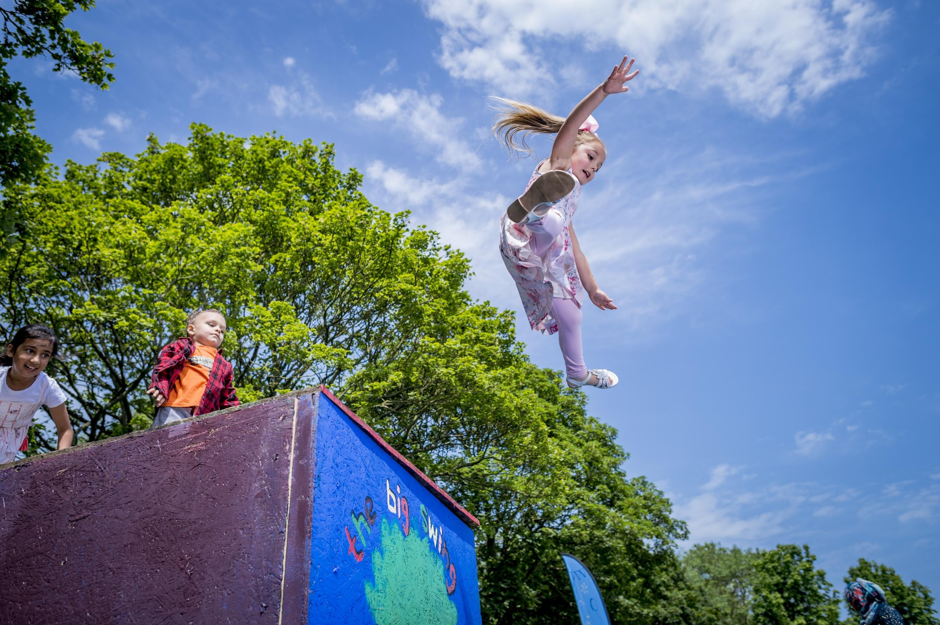
Thanks!
Notes:
CMO guidelines

