Slide 1

















Place-based whole system approaches to improving children’s physical activity
National Sharing Learning Event
Reaching children and families beyond school
Lead: Sonia Fayyaz
JU:MP Community Engagement Manager
(Scotchman Road | Manningham | Keighley)

Slide 2













JU:MP workstreams
JU:MP
Fun Days
Local Action
Plans
JU:MP
Digital
Social
Marketing
Sustainable Sports
&PA
Communicating
What’s On
Active Travel&
Streets
JU:MP
Connectors
People Skills
Development
COMMUNITIES
JU:MP
Leads
Active Faith
Settings
Green Space
Development
ORGANISATIONS
Creating Active
Schools
ENVIRONMENT
Embedding PA
in Policy
Active Playful
Parks
POLICY&STRATEGY
Strategic
Influence
Notes:
Overview of workstreams and where the connectors and fun days fit in to the bigger picture.

Slide 3
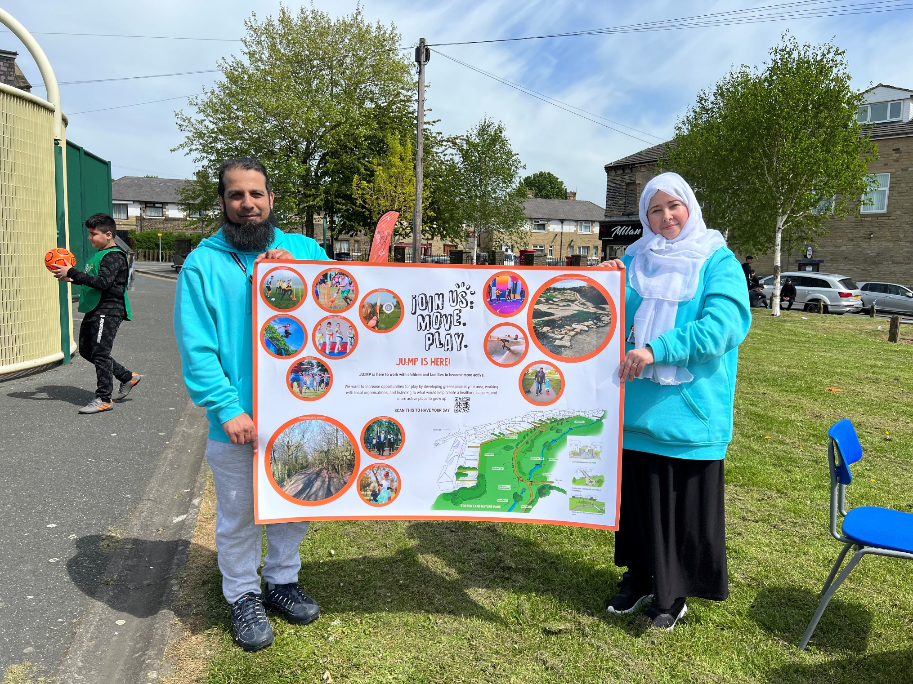
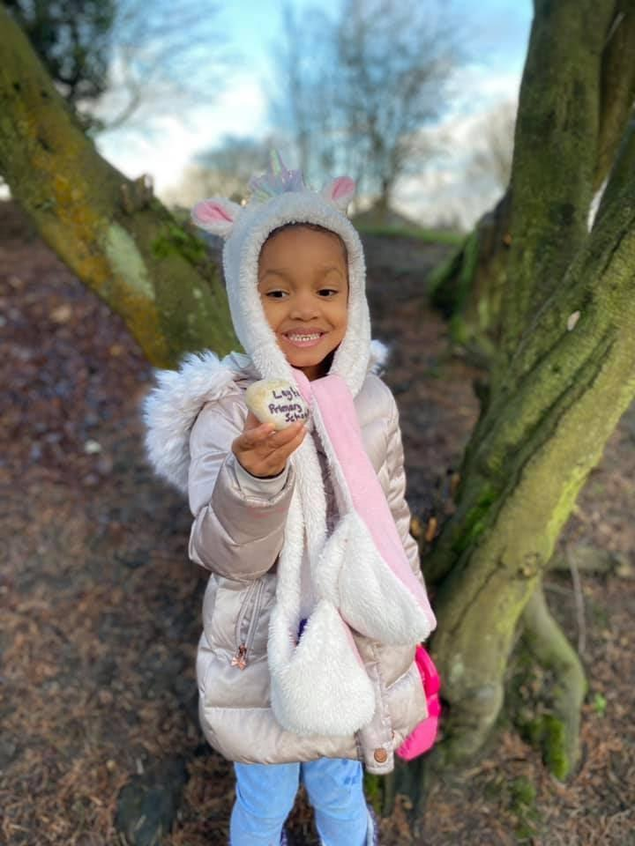
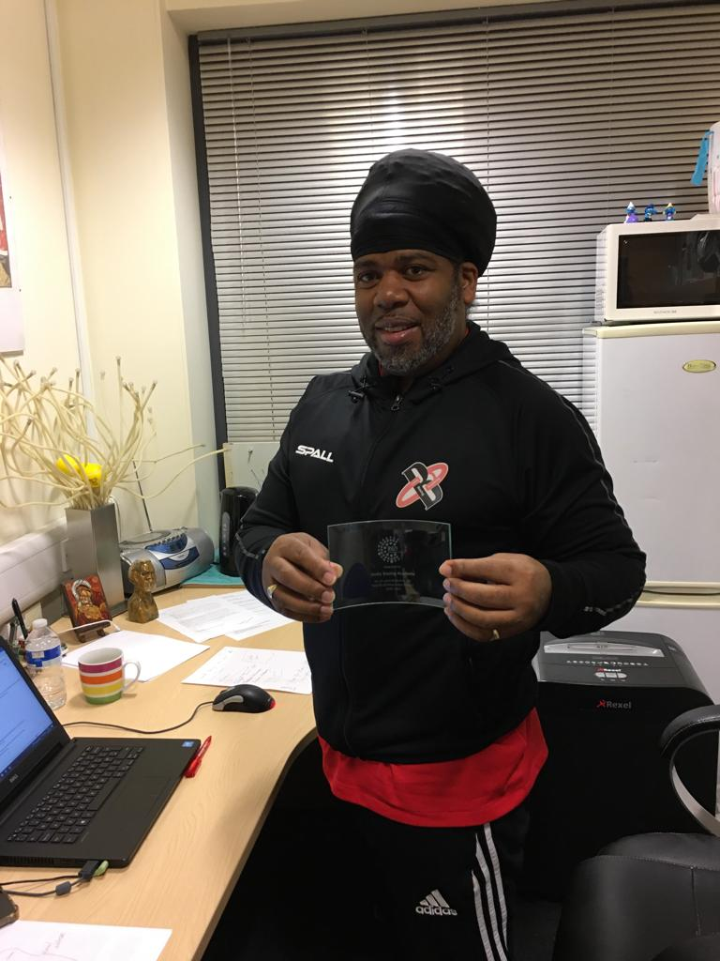

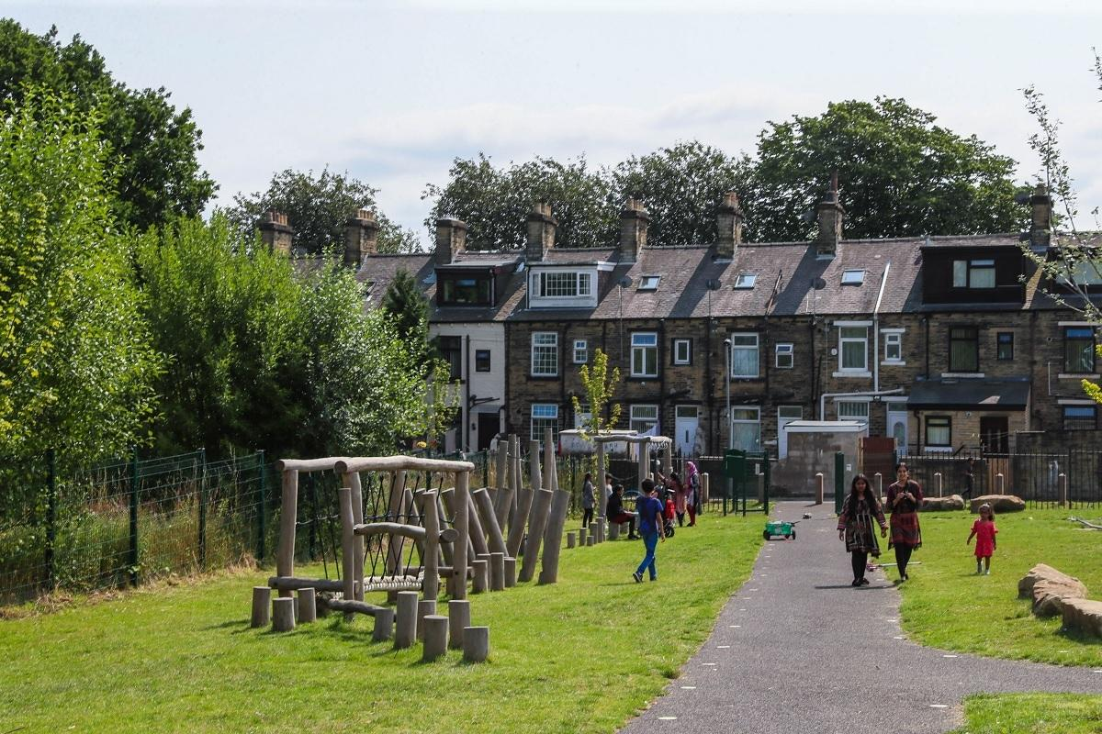
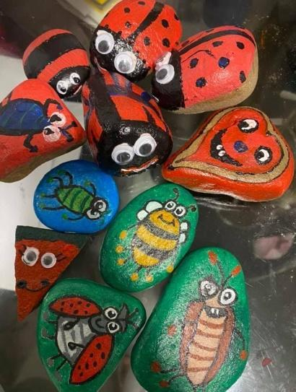

● Build the skills, confidence and motivation of families to be active
● Family engagement in local greenspace and school offering a range of activities
● Build links between schools, community and greenspace. Support the delivery of the neighbourhood action plan.
JU:MP Connector
Notes:
- PA Outside of school and links to school on evening and weekends
Engage organisations – schools, community and faith settings
Empower families – direct engagement in the communities
Facilitate use of local facilities in schools and sports centre for community use on evening and weekends
Identifying other opportunities to get physically active within the hyper local neighbourhoods.

Slide 4
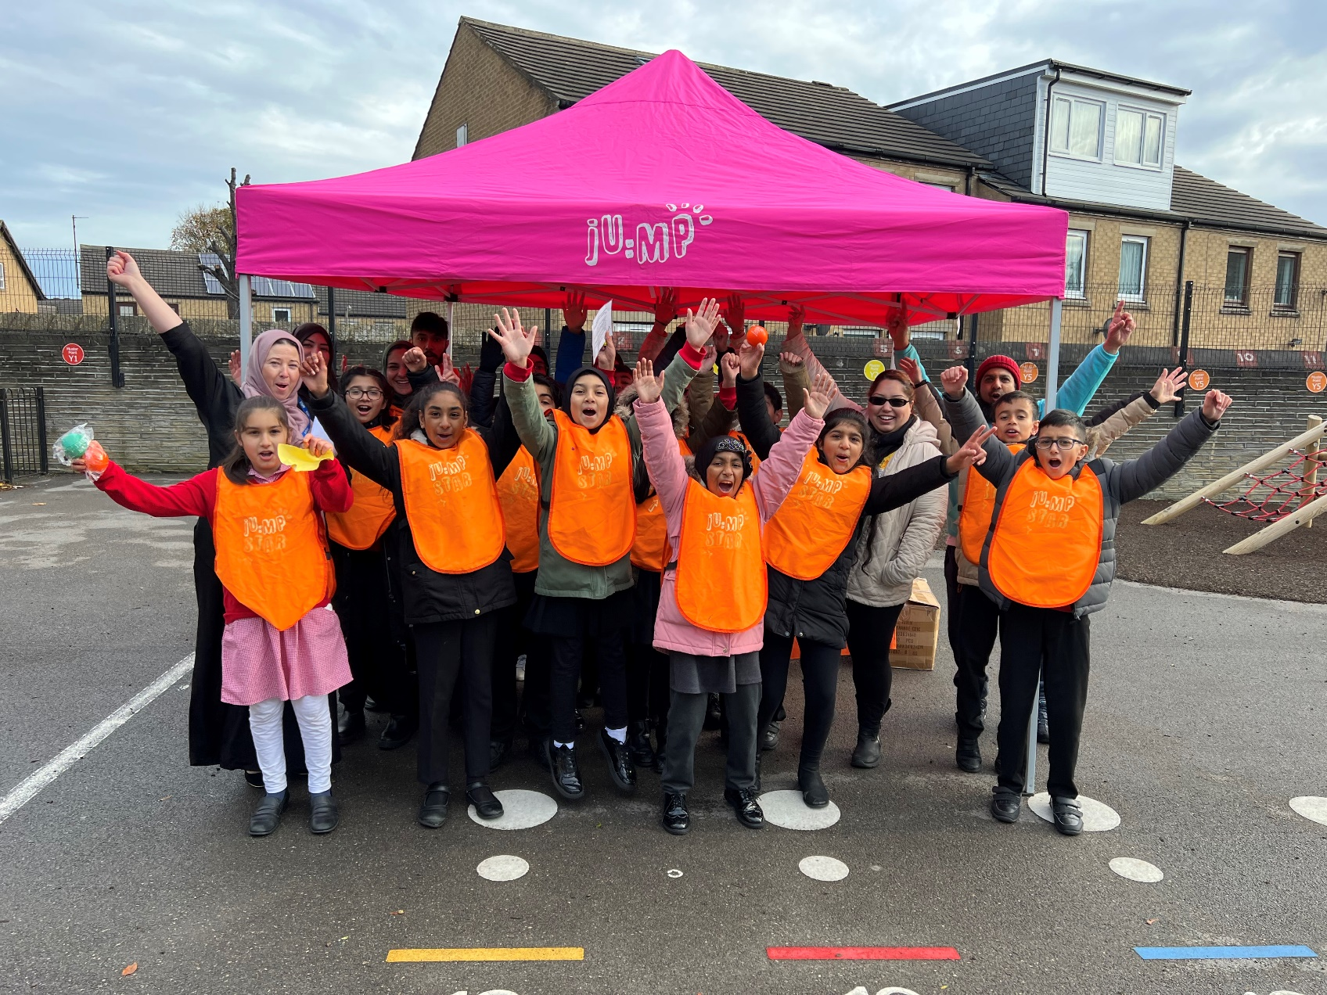
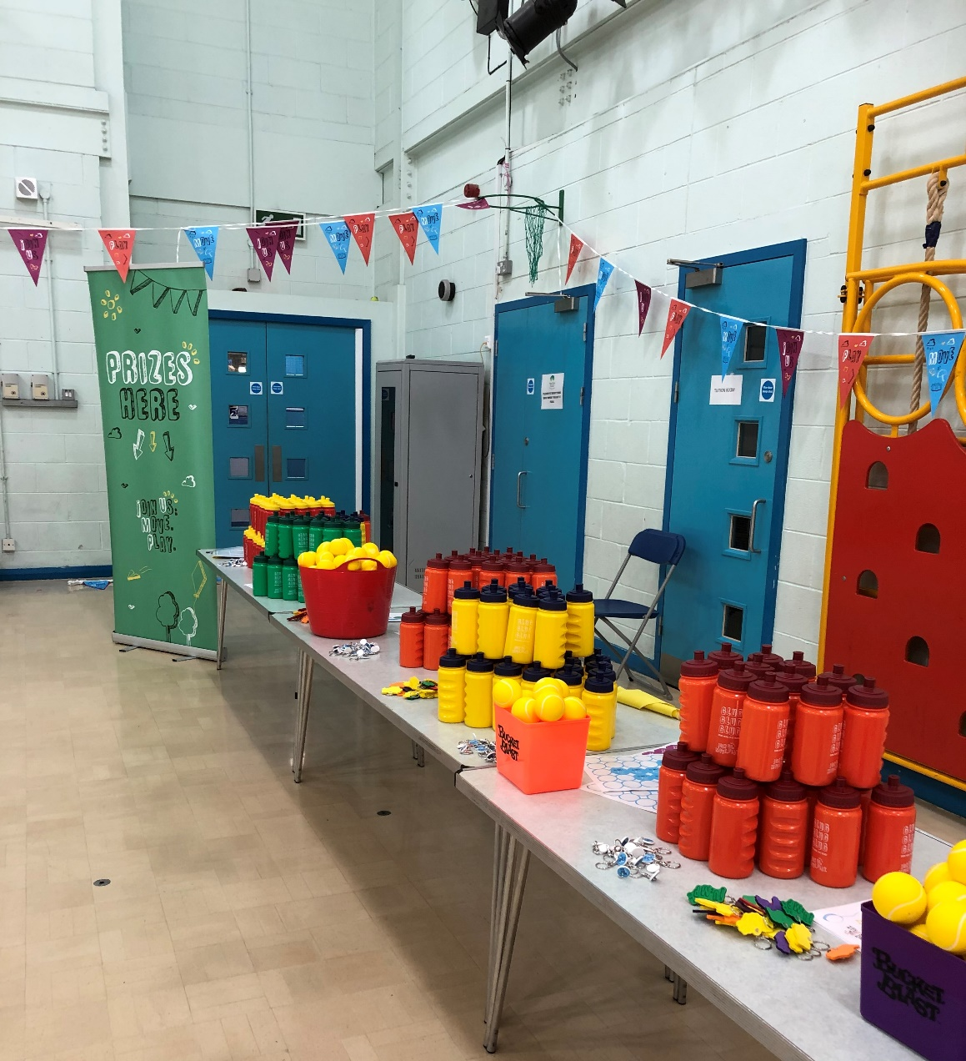
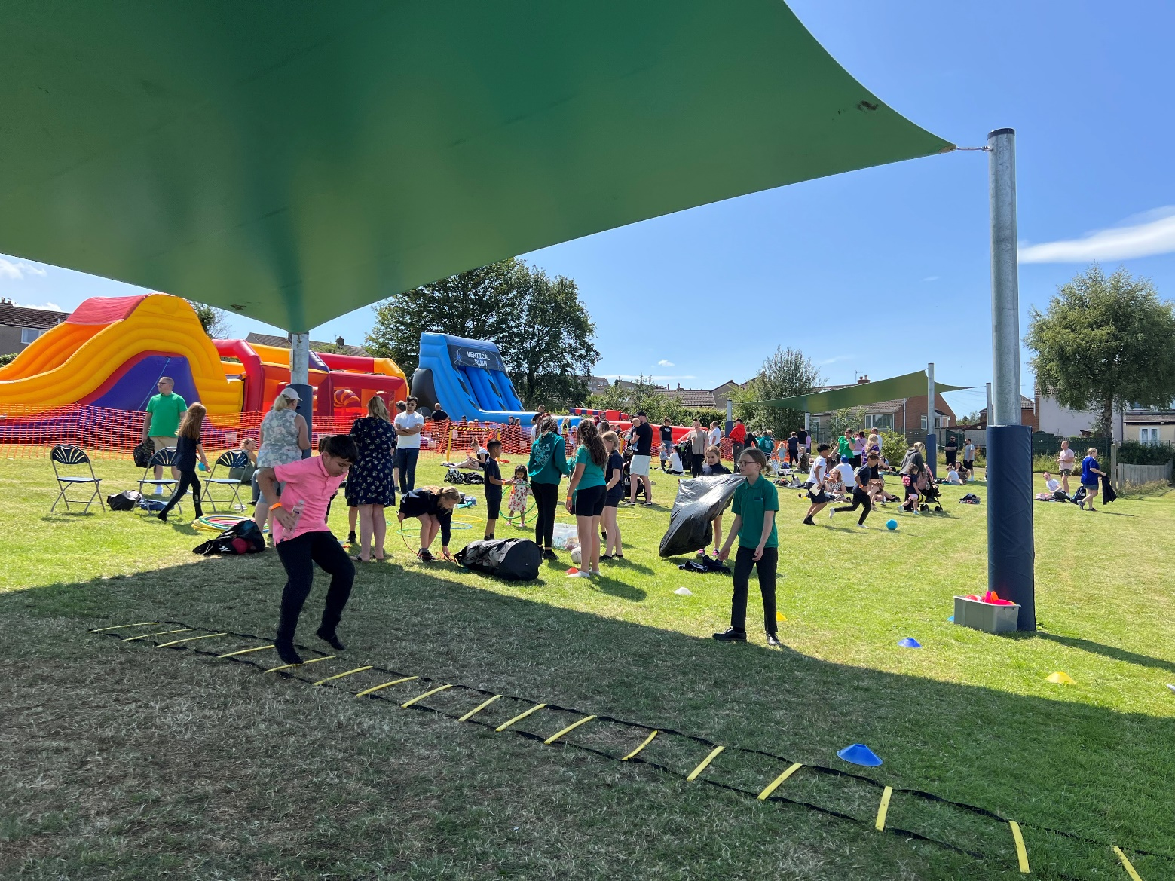
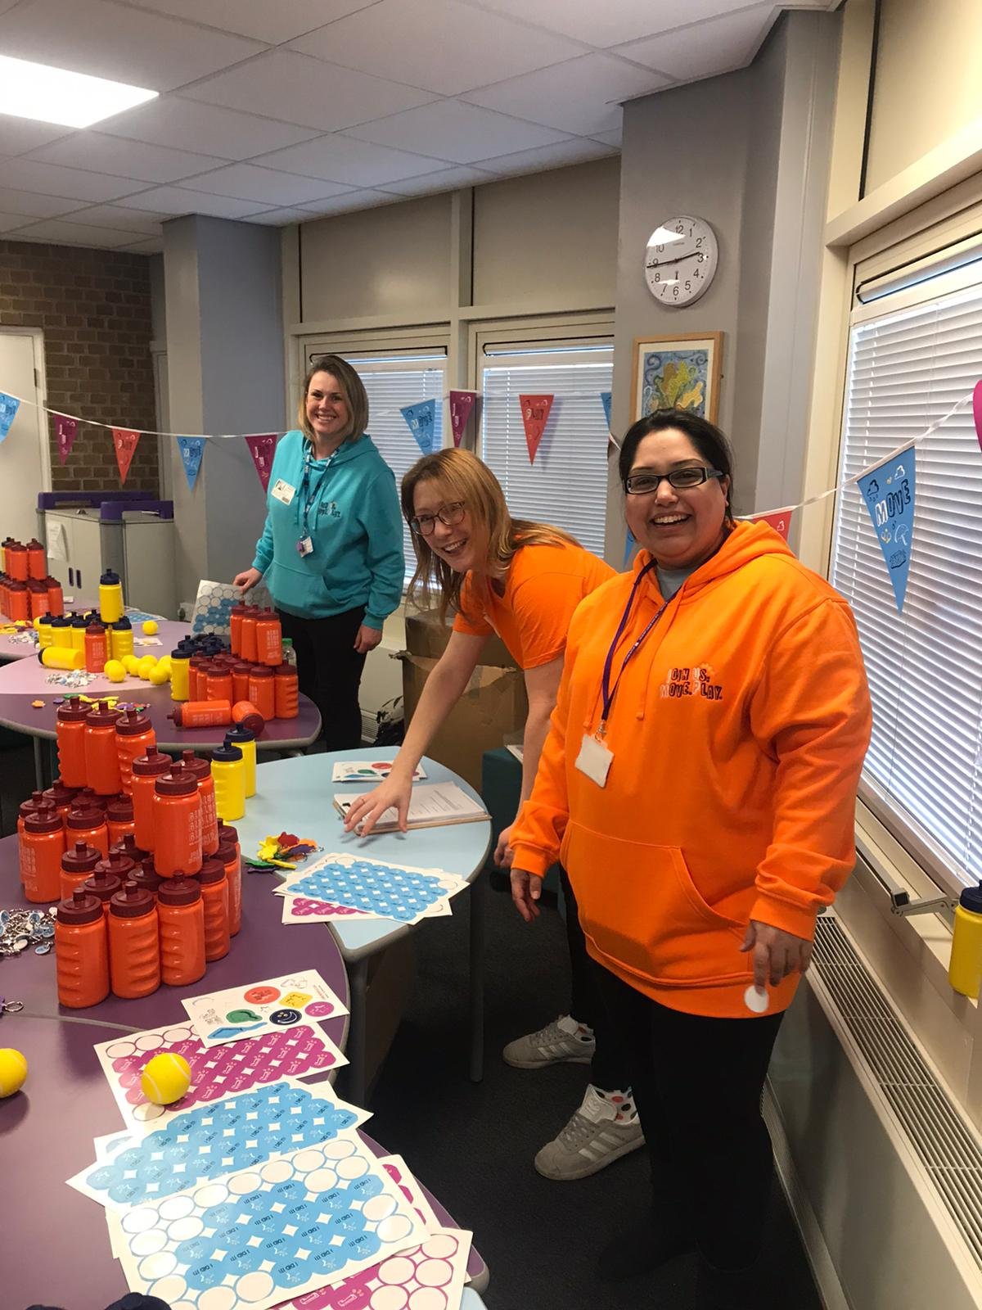
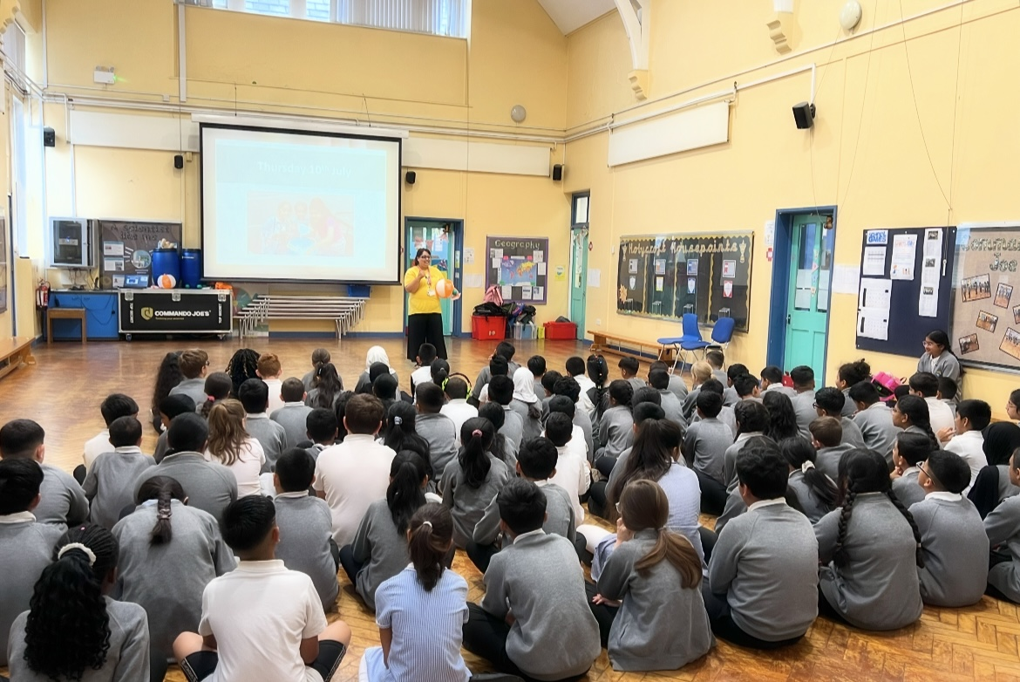
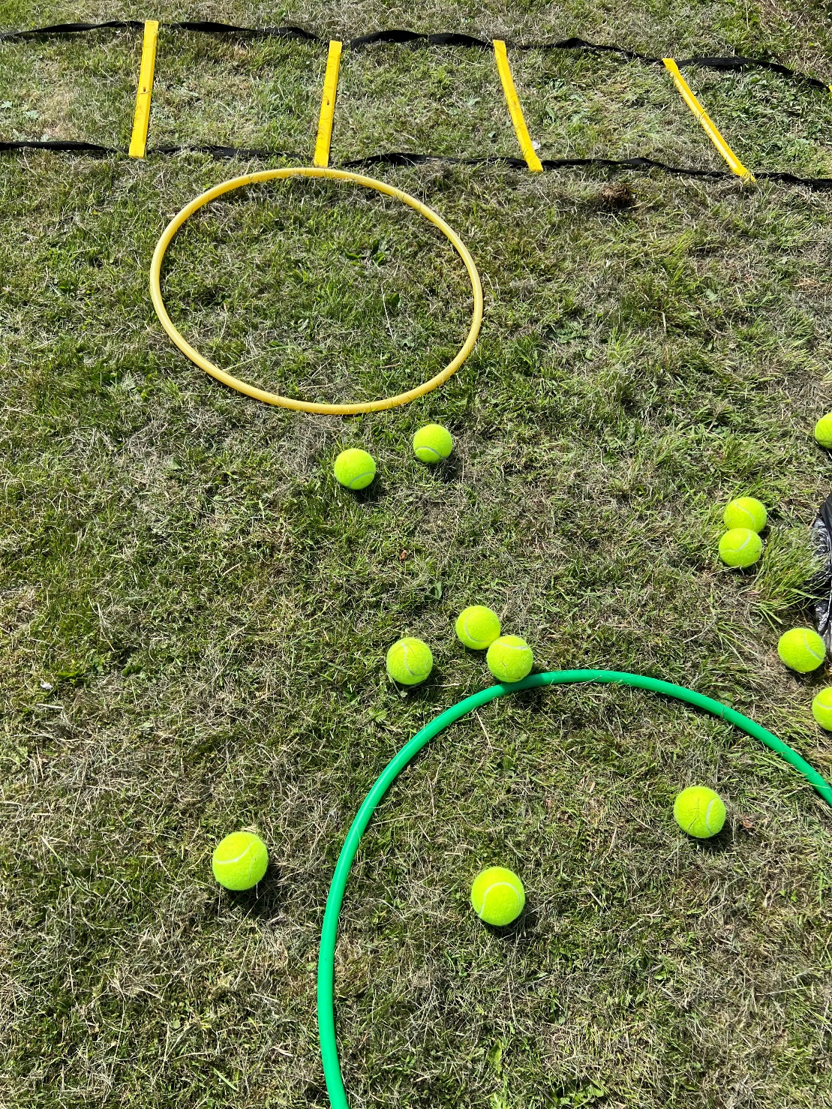
GREENSPACE
APPROACH
JU:MP FUN DAYS
Notes:
- Launch JUMP in different community settings
Engage children and families through schools and community settings
Sign them to the JUMP movement

Slide 5
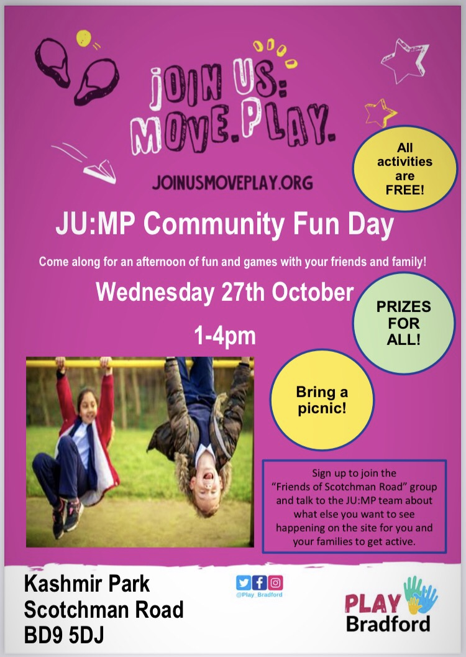
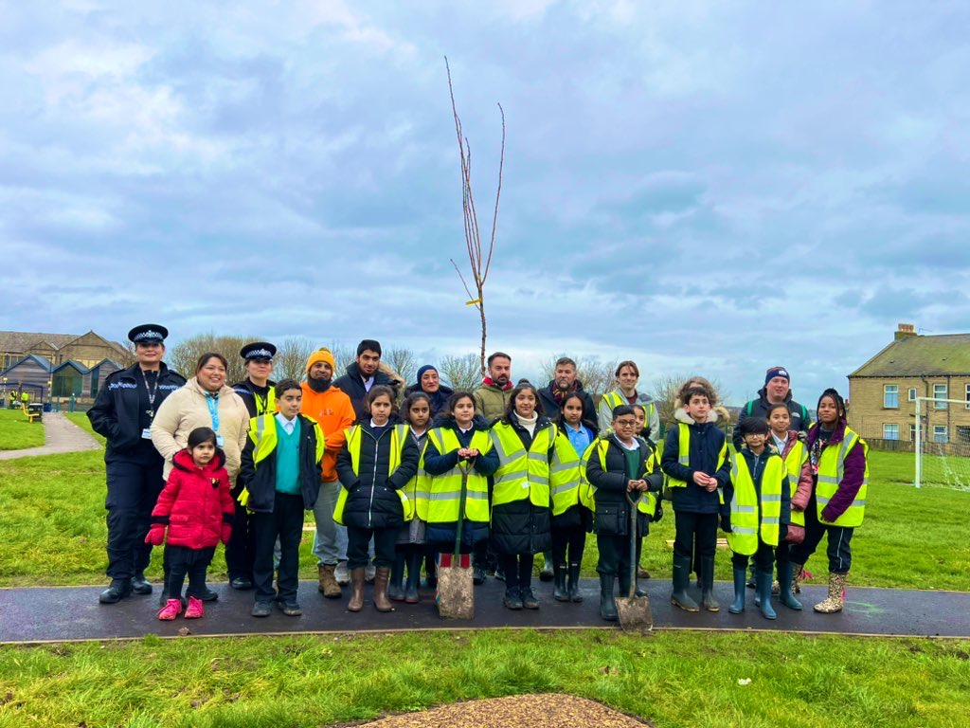
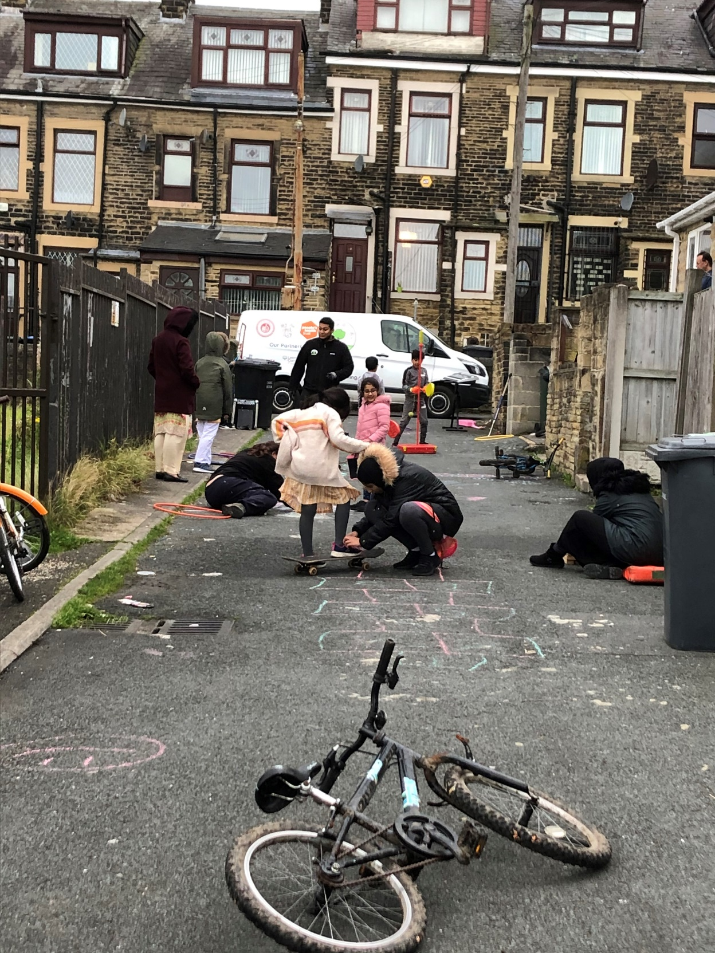
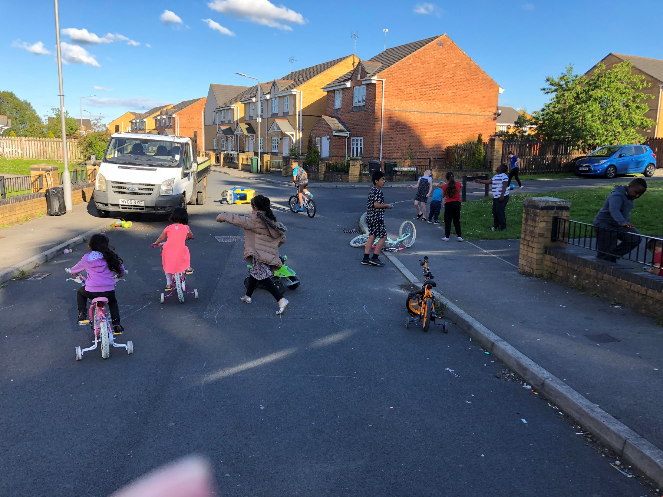
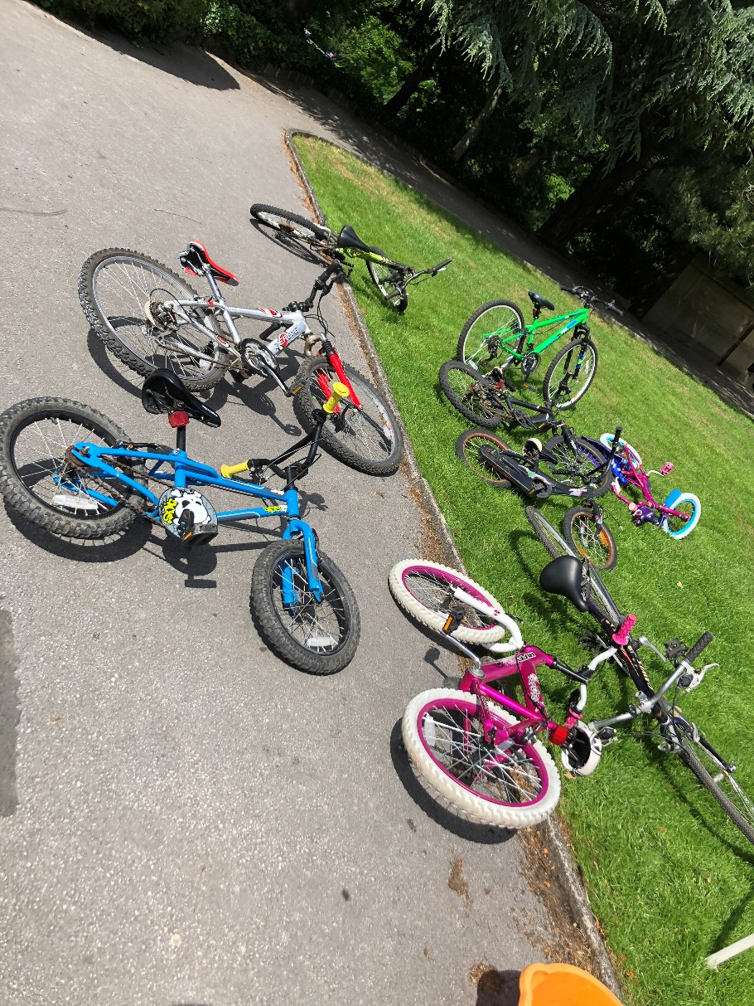
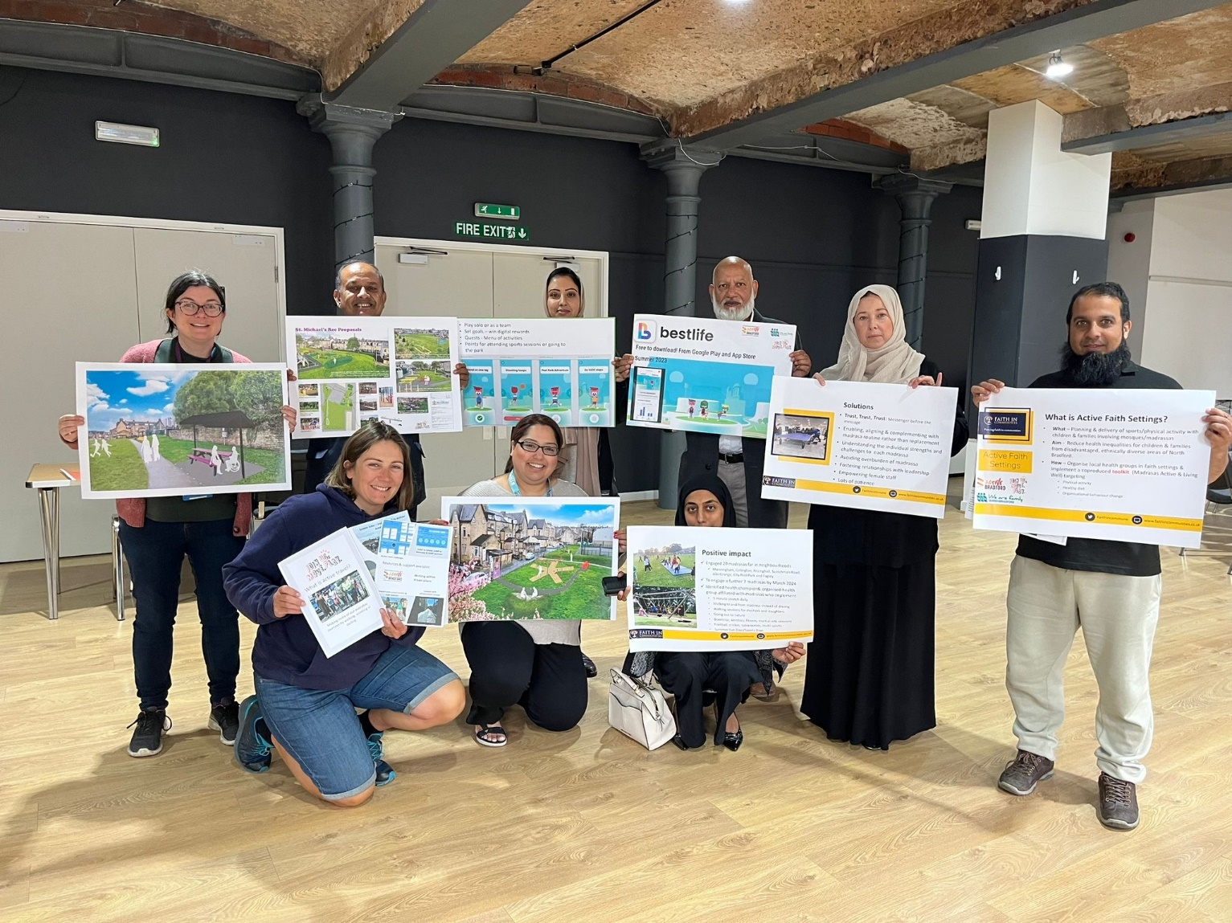
CONNECTORS
APPROACH
GREENSPACE ACTIVATION & COMMUNITY
Notes:
Active travel initiatives / Chalk walks / Community fun days / play streets / clean ups
Marketing campaigns – flag banners / electricity boxes
Connecting activities to campaigns – e.g. Get out whatever the weather, active travel week
Utilising local notice boards and system partner networks

Slide 6
Drummond Road
Recreational Ground
A Gender-specific greenspace development

Slide 7
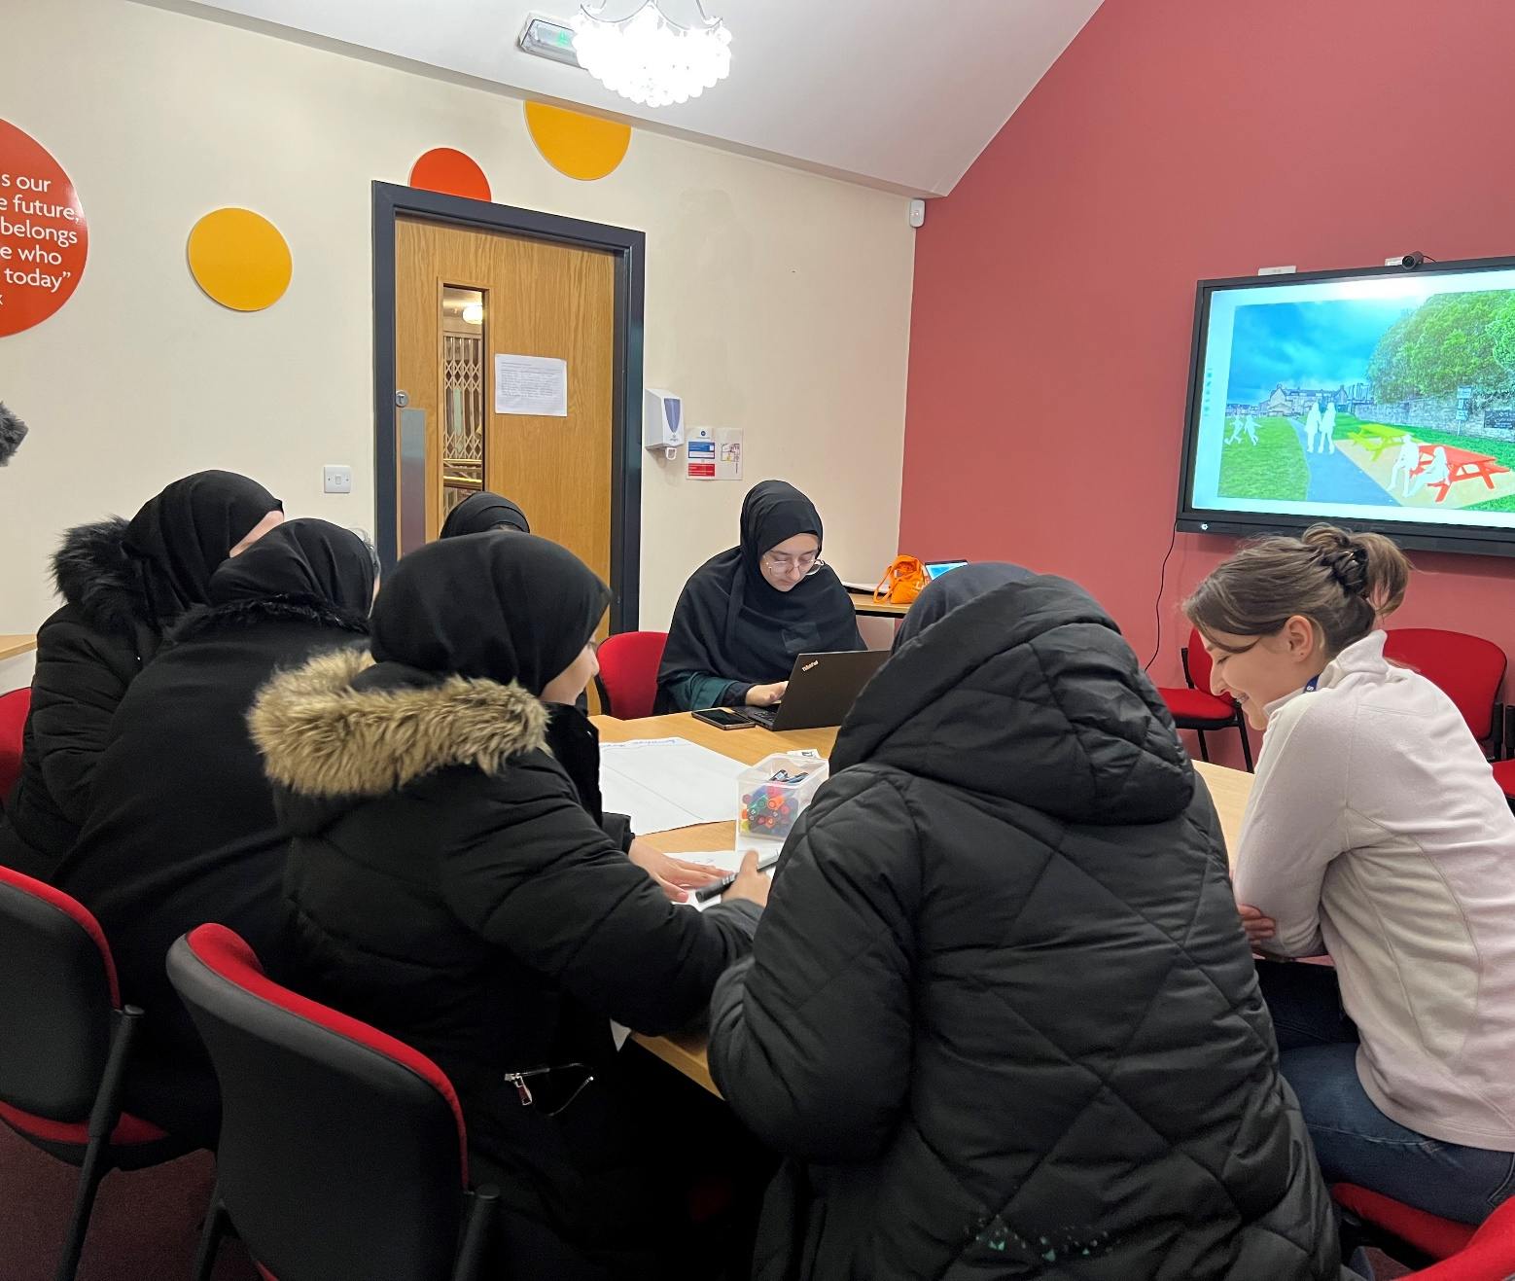
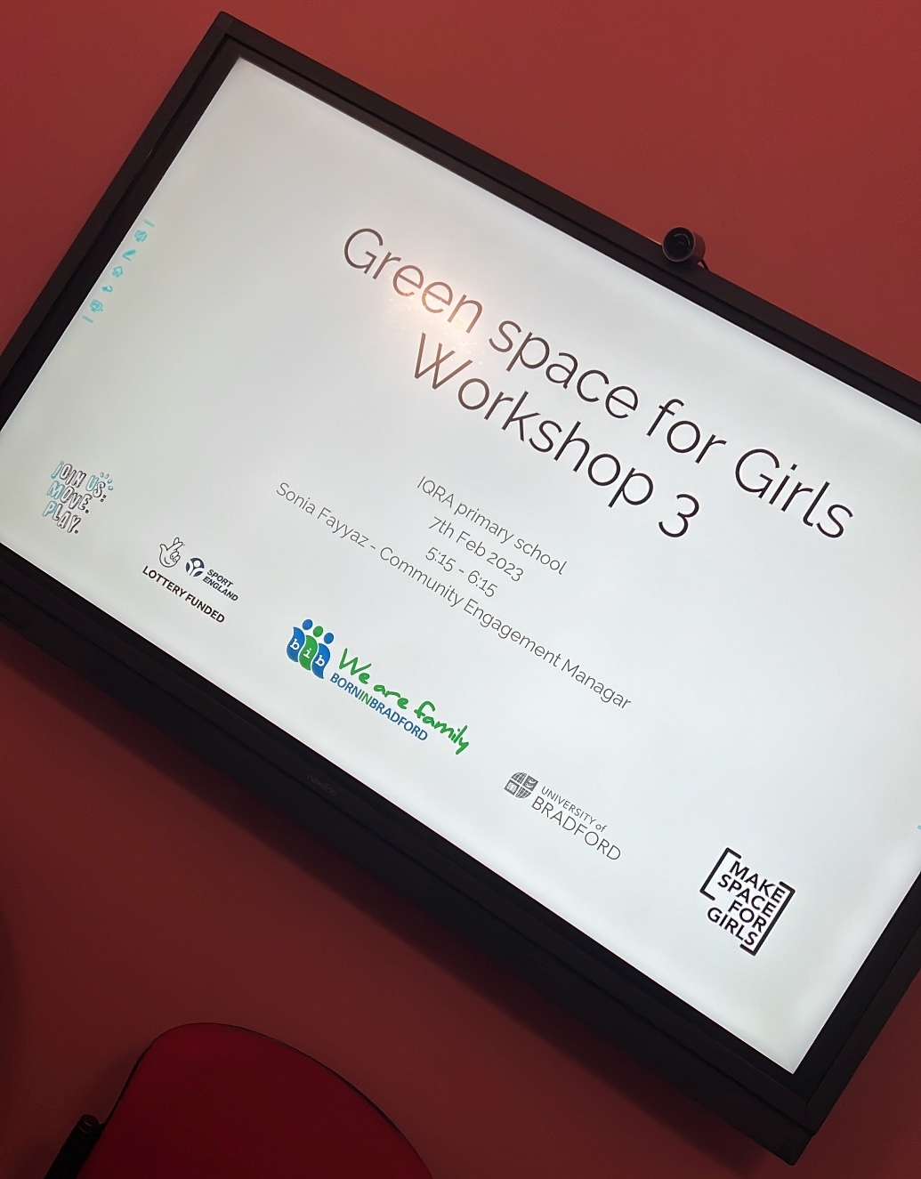
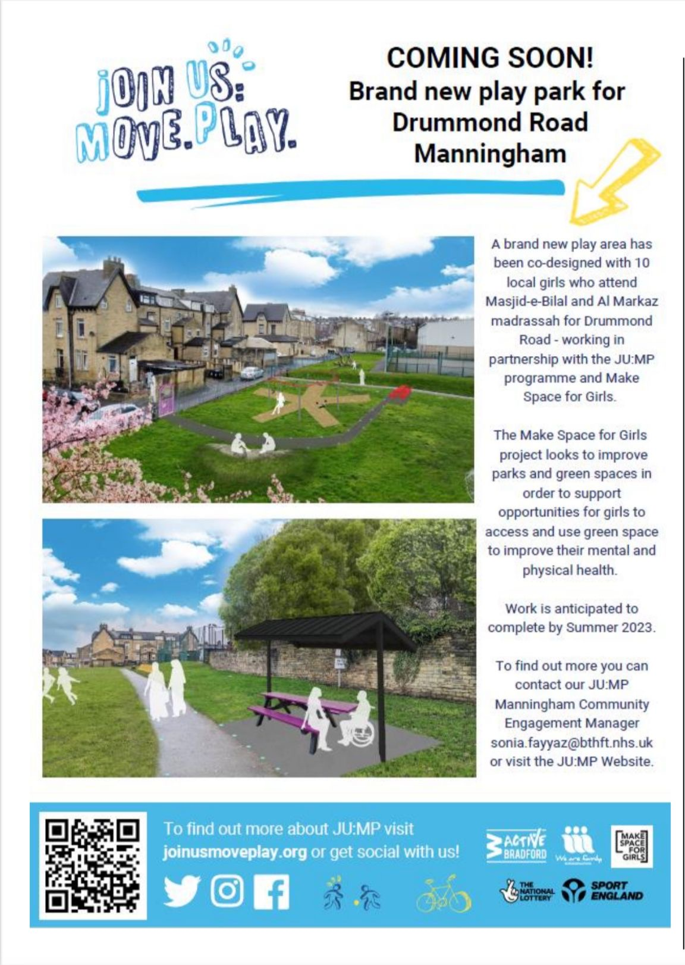
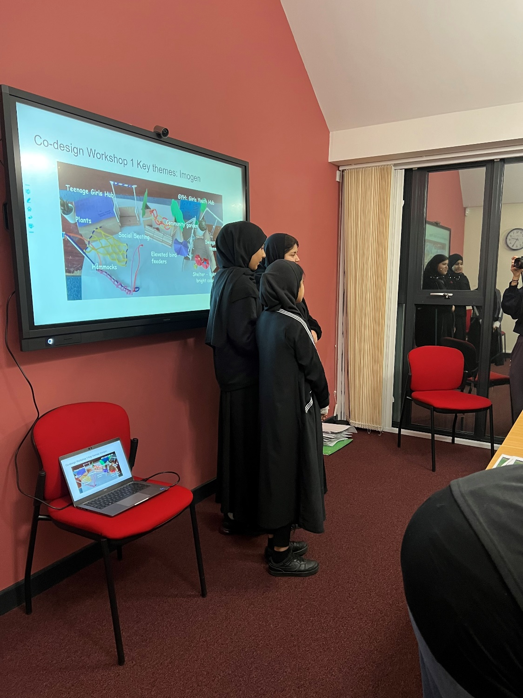
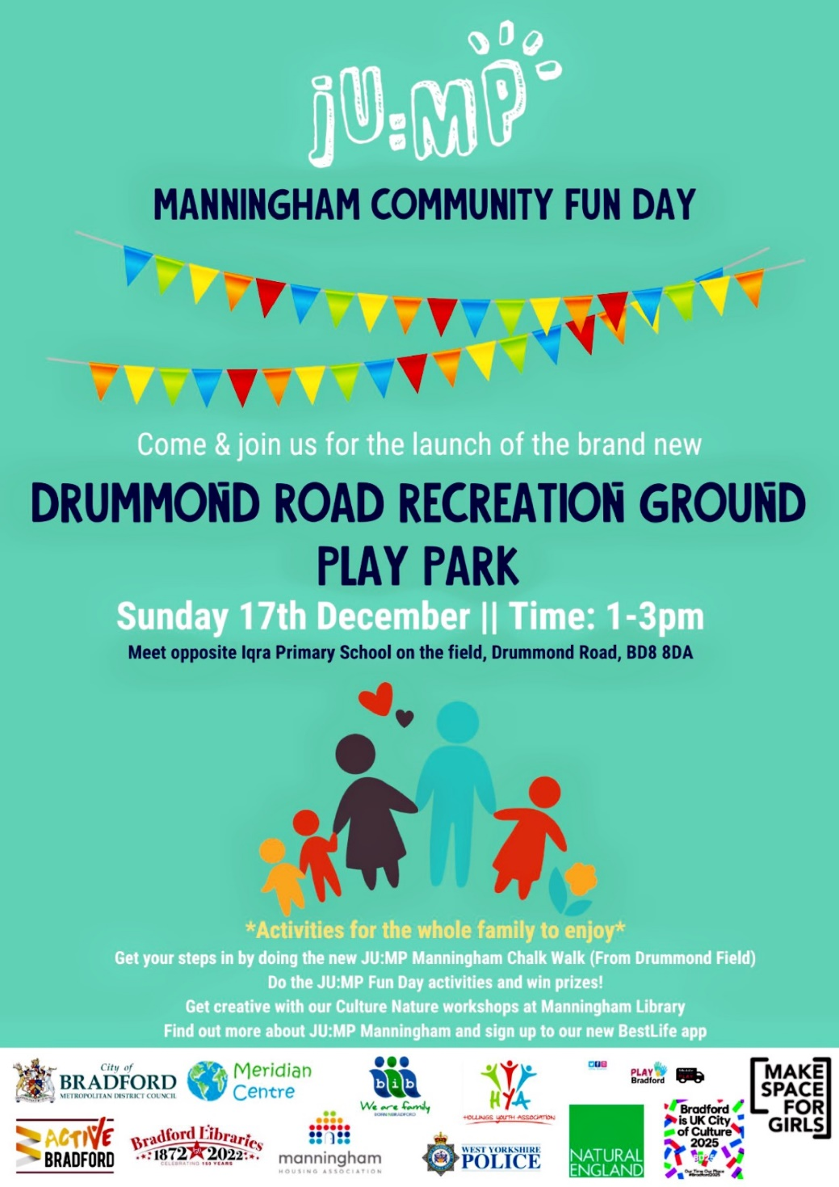
Gender-Neutral greenspace development | Community engagement & Co-design
Notes:
Co-designed with girls from local community, mosques and community organisation
Journey for co design
Activation / community engagement / legacy

Slide 8
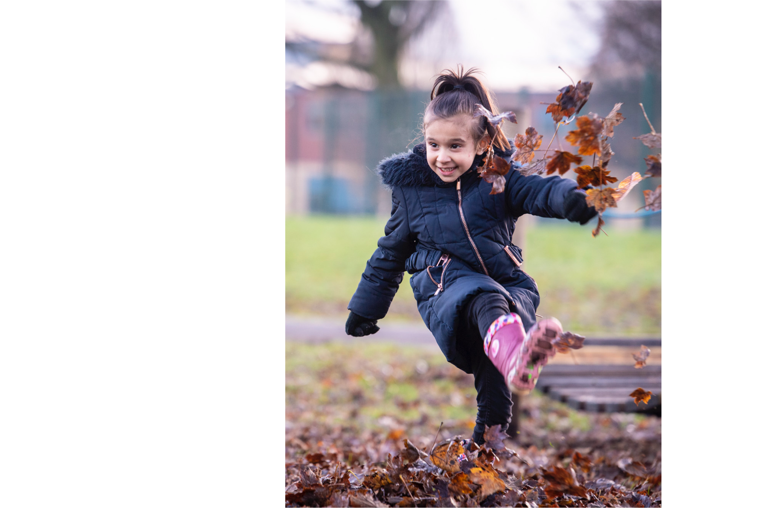
Approach Top Tips
Face-to-face working key for onboarding and maintaining energy
Having a physical asset based project (e.g a park or green space development) engaged partners and the community; the success was visible
Creating and sustaining the relationships between the local system partners
Inspiring the next generation and creating the champions of tomorrow!
Top Tops!

