Slide 1


















JU:MP
A Whole Systems Approach to Physical Activity for Children and Young People in Bradford
Sally Barber , Director of Physical Activity, Born in Bradford
Jan Burkhardt, Knowledge Mobilisation Lead
Born in Bradford
Notes:
Jan

Slide 2


















JU:MP whole system Place-based Physical Activity
AIM
APPROACH
Outcomes
Step change in physical activity for 30,000 children aged 5 -14 years and their families in socioeconomically disadvantaged area
Whole systems, collaborative, asset-based, sustainable, behaviour change
Test and Learn Research Programme
Better health
Better skills/attainment
Safe, clean,
active communities
Notes:
JUIMP Overview
Our aim was to make a step change in physical activity for 30,000 children from ethnically diverse communities, mostly British South Asian and White British. Two third of the children in our place were not active enough to benefit their health but when we looked at our data on gender and ethnicity the inequalities were stark. Only 6% of South Asian girls were active enough to benefit their health. So we knew we needed to really focus our efforts

Slide 3






Our Collaborative
Notes:
Brief Collab
Over to sally to explain how our journey began

Slide 4
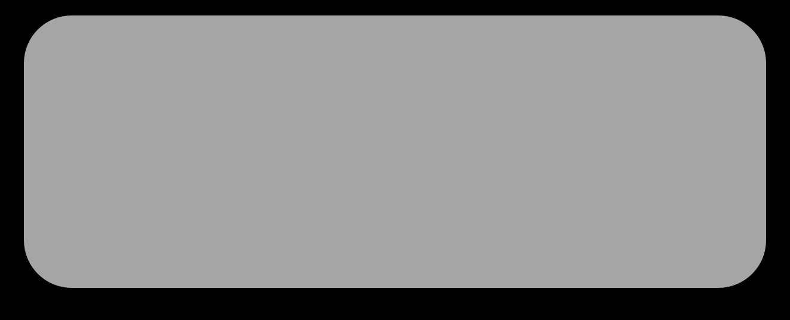


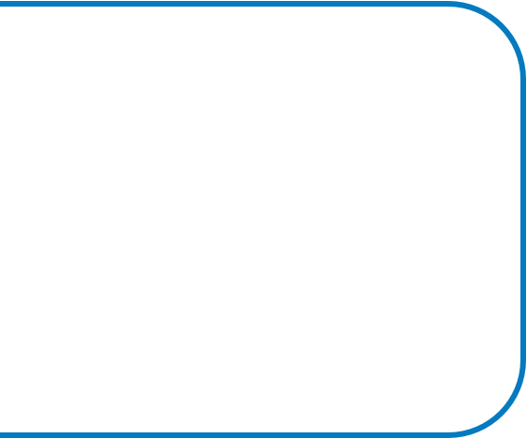



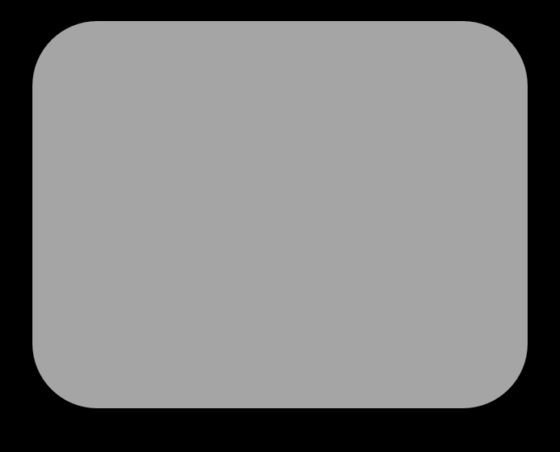



















Our Journey and the JUMP concept
PROGRAMME EVOLUTION
CONTEXT:
Local Assets
Community Voice
Social, Political, Economic Factors
Research&Evidence
JU:MP
Fun Days
Local Action
Plans
JU:MP
Digital
Social
Marketing
Sustainable Sports
&PA
Communicating
What’s On
Active Travel&
Streets
WORK STREAM
DEVELOPMENT
JU:MP
Connectors
Behaviour Change Theory
People Skills
Development
Evidence
POPULATION
LEVEL CHANGE
Co-production/Co-design
JU:MP
Leads
Test and Learn process
Active Faith
Settings
Green Space
Development
Creating Active
Schools
CHANGE
Embedding PA
in Policy
Individual behaviours
Active Playful
Parks
Community behaviours
Organisational behaviours
Environmental change
Strategic
Influence
Policy change
Unexpected changes
Notes:
Understand local assets: people, places, organisations, resources
Find out what children and families want and don’t want, what has worked or not worked before from delivery partners
Understand the social ,political, and economic factors from senior leaders across the system
Draw on local, national and international evidence about what works for CYP PA – ISPAH 8 investments and WHO global action plan
What fell out from that was that we needed to work across 5 levels of the system and we developed 16 workstreams which sat within/between these levels. We also worked to link up across the system.
We developed our 16 worktreams based on theory and evidence, working with children and families, communities and partners to co-design the individual interventions and crucially taking a test and learn approach, evaluating what was working (and not) for who and how – this enabled JUMP to respond to changes and challenges in the system and create sustained change at the population level

Slide 5
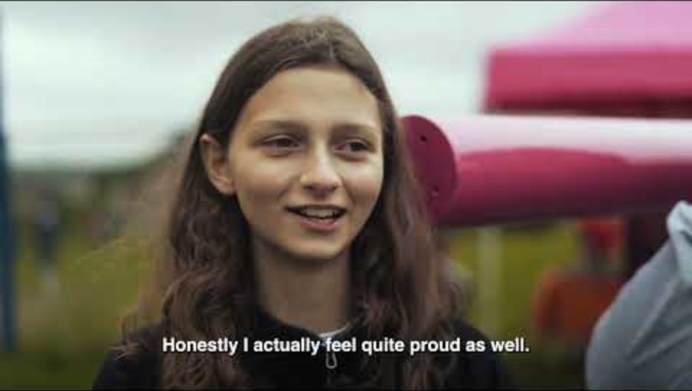

Slide 6
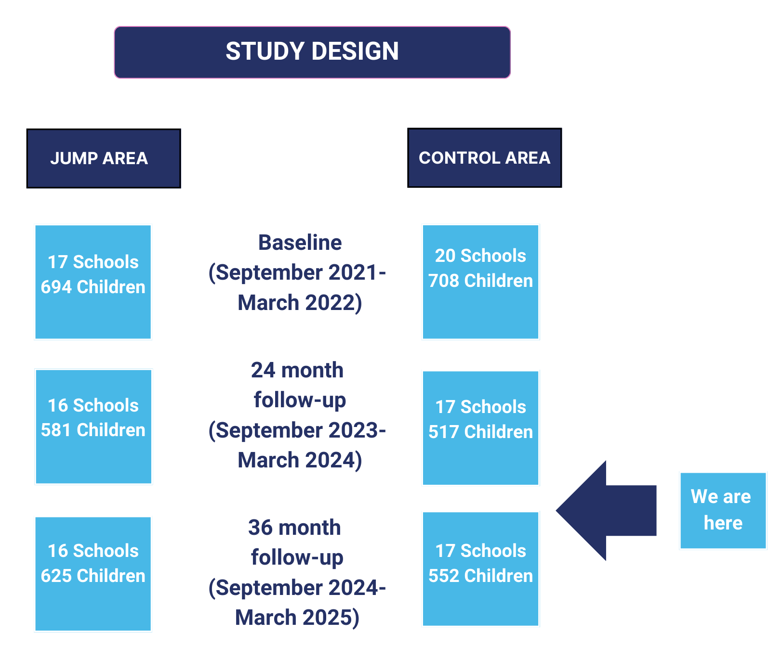

Research
A non-randomised control trial
Children aged 5-11 years old living in the JUMP area compared to a control group outside of the JUMP area
physical activity levels (measured by accelerometery) compared between the two groups:
at 24 months
at 36 months
16 schools
592 children
17 schools
501 children
Notes:
We have conducted qualitative research to understand HOW JUMP has worked and quantitative research to understand how effectiveness of JUMP. Today I’m sharing some of the findings from our effectiveness study whereby we compared physical activity levels, measured with devices called accelerometers, between children in the JUMP area to children outside of the JUMP area, our control group after the JUMP intervention had been running for 24 months.

Slide 7
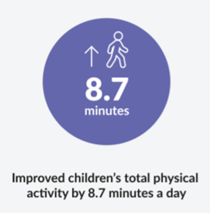
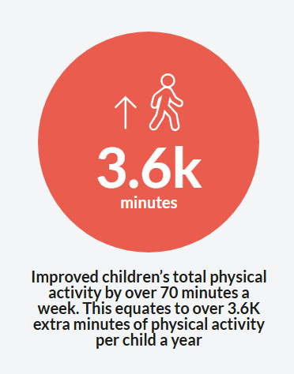
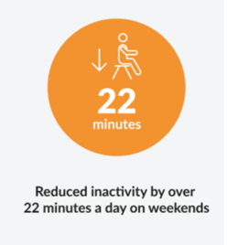
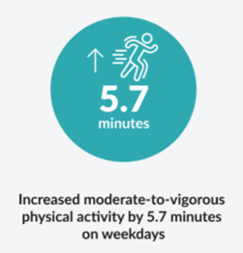
Headline results
Total physical activity
Moderate to vigorous (MVPA)
Sedentary (inactivity)
Light
Moderate
Vigorous
The Effectiveness of a Whole System Approach to Improve Physical Activity of Children Aged 5 to 11 Years Living in Multi-ethnic and Socio-economically Deprived Communities: A Controlled Before and After Trial | medRxiv
Notes:
I’m going to talk you through some of our headline findings, to find out more you can read the full paper here, and we are also planning to host a lunch and learn session later in the year where we will dive into the findings in more details.
We analysed the data looking at habitual PA, PA and week days and PA on weekend days, we looked at sedentary time, total physical activity MVPA – today I am going to share with you the most significant findings.
We found that habitual total PA increased by 8.7/day in the JUMP group compared to controls. When we looked at weekday and weekend day increases in TPA and added this together, we found a 70 min increase per child per week – which translates to 3.6K min increase per year
We found the biggest increase in MVPA on week days, an increase of 5.7 minutes
We found the biggest reduction in sedentary time on weekend days, 22 minutes less per day

Slide 8
KEY take-homes
More effective than single or multi-component interventions
Fostered longer term change unlike other interventions
Emerging evidence: importance of green spaces for improving children MVPA
1.
2.
3.
Notes:
We found that JUMP was more effective that any other single or multi-component intervention working with similar population, we think this was because it took a whole system, place-based approach, it fostered long term change, we think this was because of the cycles of improvement and the community ownership from co-producing. We are continuing to dig into the data to better understand the mechanisms underpinning the changes we have seen. New emerging data is showing how important changes in accessing the green spaces developed through jump have been for improving MVPA

Slide 9













JU:MP workstreams
JU:MP
Fun Days
Local Action
Plans
JU:MP
Digital
Social
Marketing
Sustainable Sports
&PA
Communicating
What’s On
Active Travel&
Streets
JU:MP
Connectors
People Skills
Development
COMMUNITIES
JU:MP
Leads
Active Faith
Settings
Green Space
Development
ORGANISATIONS
Creating Active
Schools
ENVIRONMENT
Embedding PA
in Policy
Active Playful
Parks
POLICY&STRATEGY
Strategic
Influence
Notes:
I would like to give a big thank you to the over 180 partners who made JU:MP happen. As you can see from the model we developed 16 workstreams much more than we can talk about today but I am privileged to have been funded to support new areas and am around for the next few years to share learning. I want to share a bit about the how – the approach

Slide 10
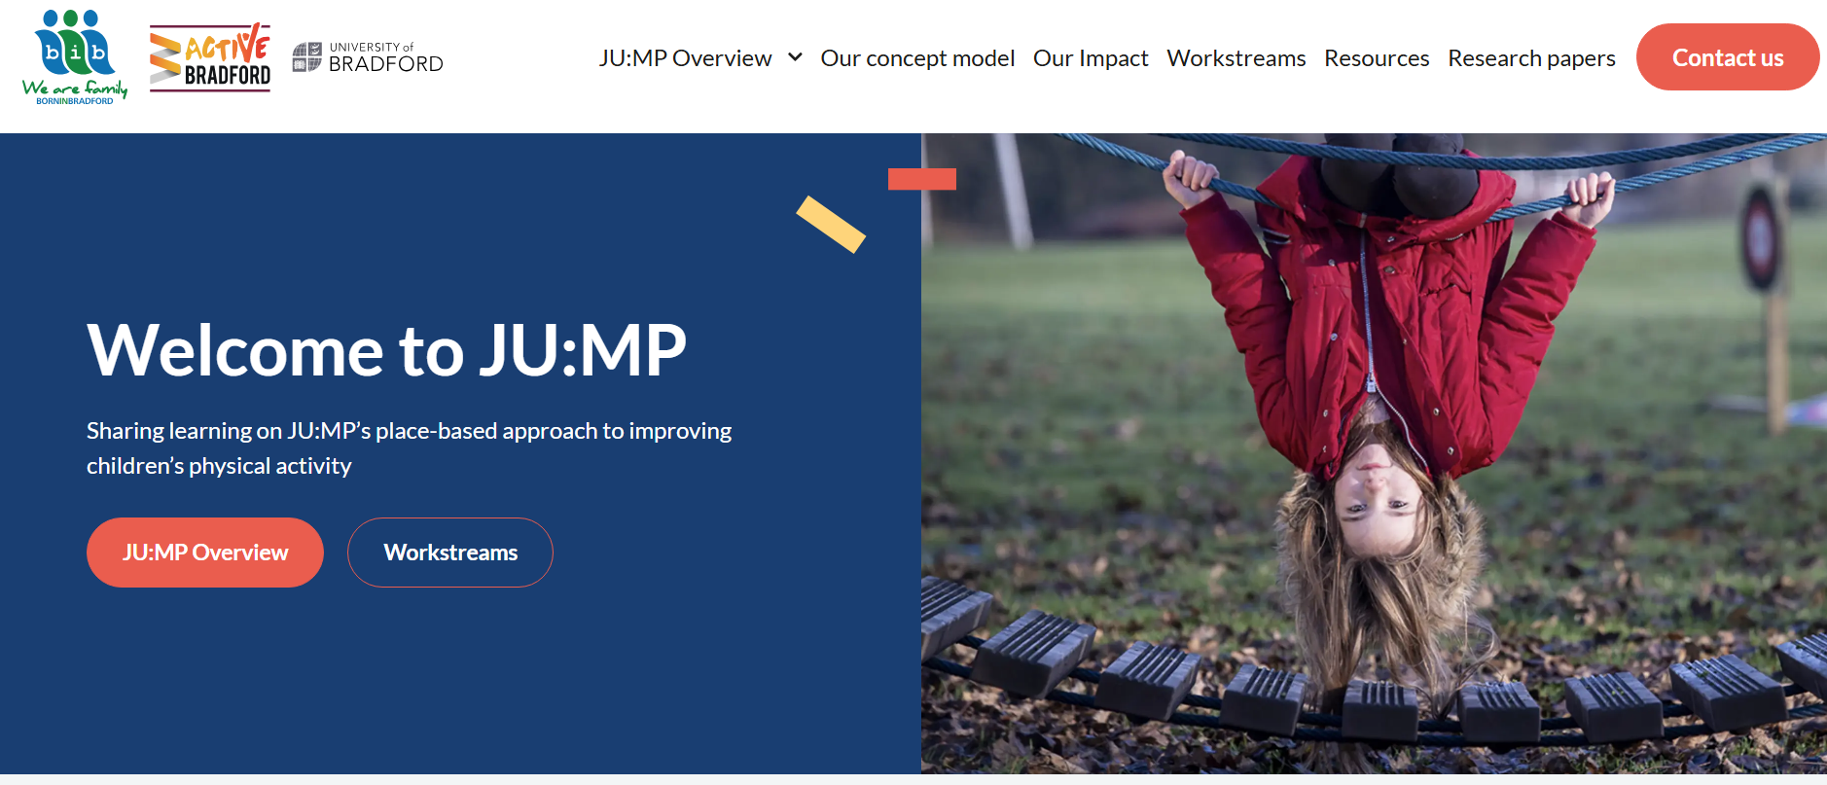
JU:MP Resource Hub
www.jump.borninbradford.nhs.uk
Notes:
In the meantime for more detail on the work and what we learned we have created a JU:MP Resource Hub – Feedback welcome
But in order to really fly with this place based approach the what and the how are both as important. And they need to work together

Slide 11
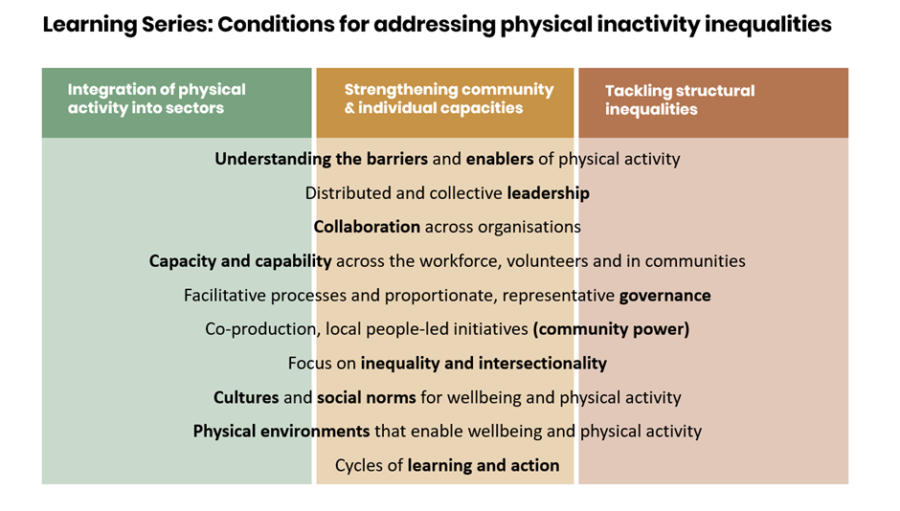
Notes:
You may have seen these conditions for addressing PA inequalities developed by NELP the national Evaluation and research partner which synthesises the learning about the approach from across the 12 local delivery pilots. It's an impressive feat but I still find it quite hard to see what that means in practice so I thought I would try to bring it to life.
So I will start with the task of integrating physical activity into sectors. Working at a strategic level is important and we built relationships with partners across many sectors including health planning, transport and children's services. We then brought our partners together through a series of collaborative workshops to codesign a physical activity strategy here

Slide 12





Every Move Counts!
Bradford – the Active District: creating a place where it’s easy for everyone to move and be active every day.
1.Active schools, children and young people
2. Neighbourhoods and Communities
3.Sport & active recreation
4.Health and social care
5. Workplaces and workforce
6. Greenspace
7. Built environment
8. Active travel
9.Communications & campaigns
Notes:
You can see if has 9 thematic areas and it takes a whole system approach and it took two years…. Now we could probably have written a similar strategy in a few months but it’s the process, the journey that really matters. By bringing people together and involving them in the design they felt ownership, they feel energised and inspired and responsible for making the change happen. This is distributed leadership. And PA can be your Super power in this! Physical activity meets multiple outcomes and involves more than 10 sectors its positive and energising. We found people wanted to get involved and saw it was an agenda to join up their system too.

Slide 13
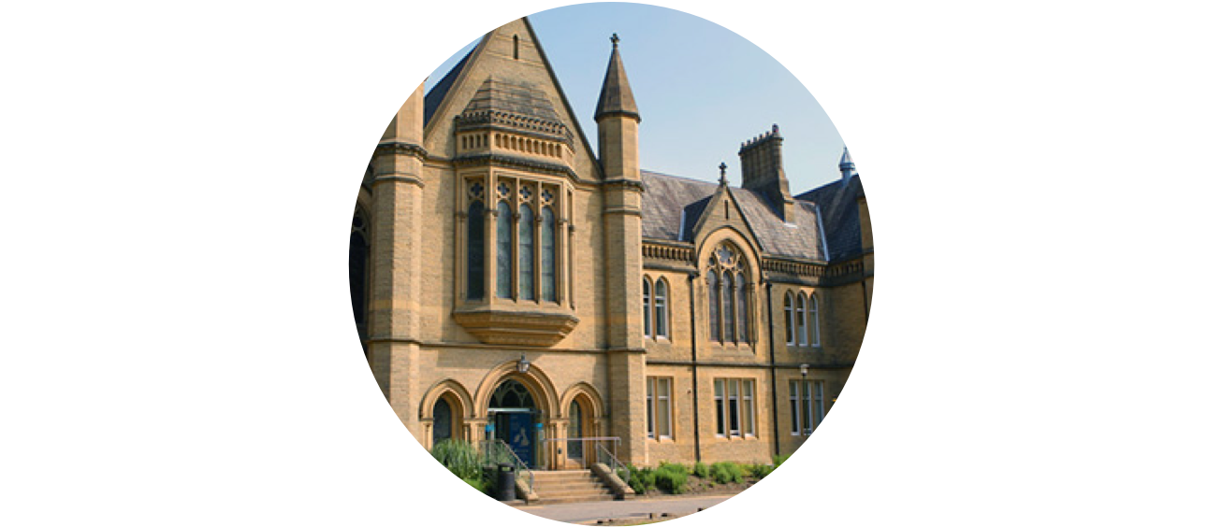
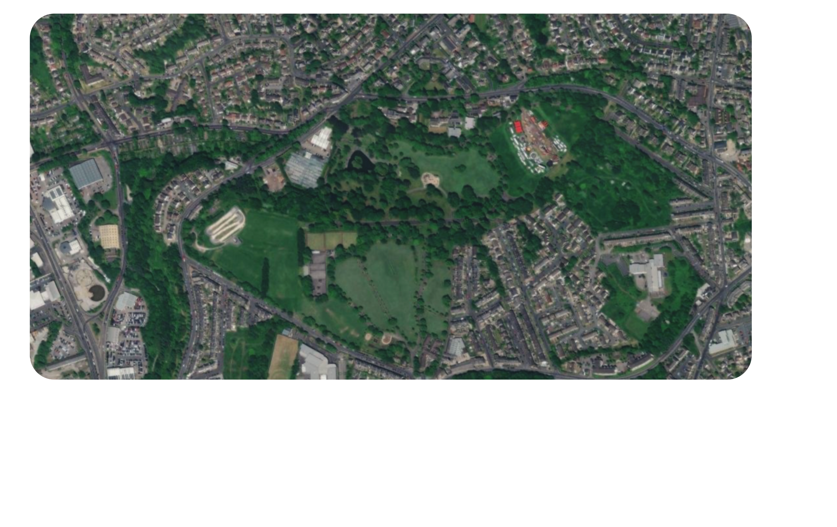
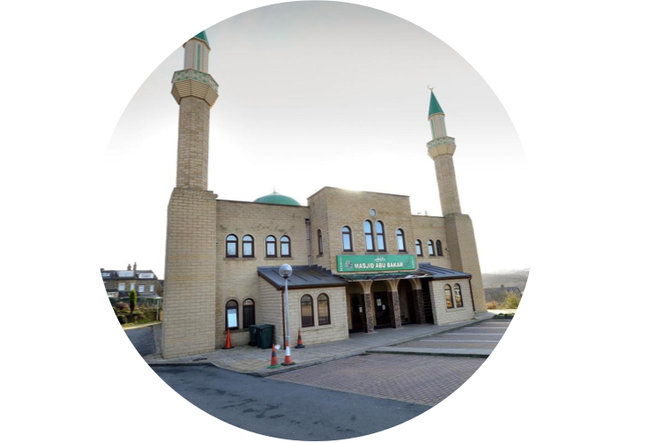







JU:MP neighbourhood Approach
ACTIVE
FAITH SETTInG
CREATInG
ACTIVE SCHOOLS
ACTIVE STREETS
ACTIVE PLAYFUL
PARK/GREENSPACE
ACTIVE STREETS
ACTIVE
PLAYFUL STREETS
PLAYFUL STREETS
COMMUnITY
ORGAnISATIOnS
Community Engagement Manager - Ju:MP Connector - Social Marketing & Communications
Notes:
While the strategic work is important and it provides that top cover, our findings are if you want to really tackle inequalities working at a hyper local level in places of greatest need is key. We worked in 8 neighbourhoods and brought together …etc green space at the heart. Green space really matters to people it helped bring people on board.

Slide 14

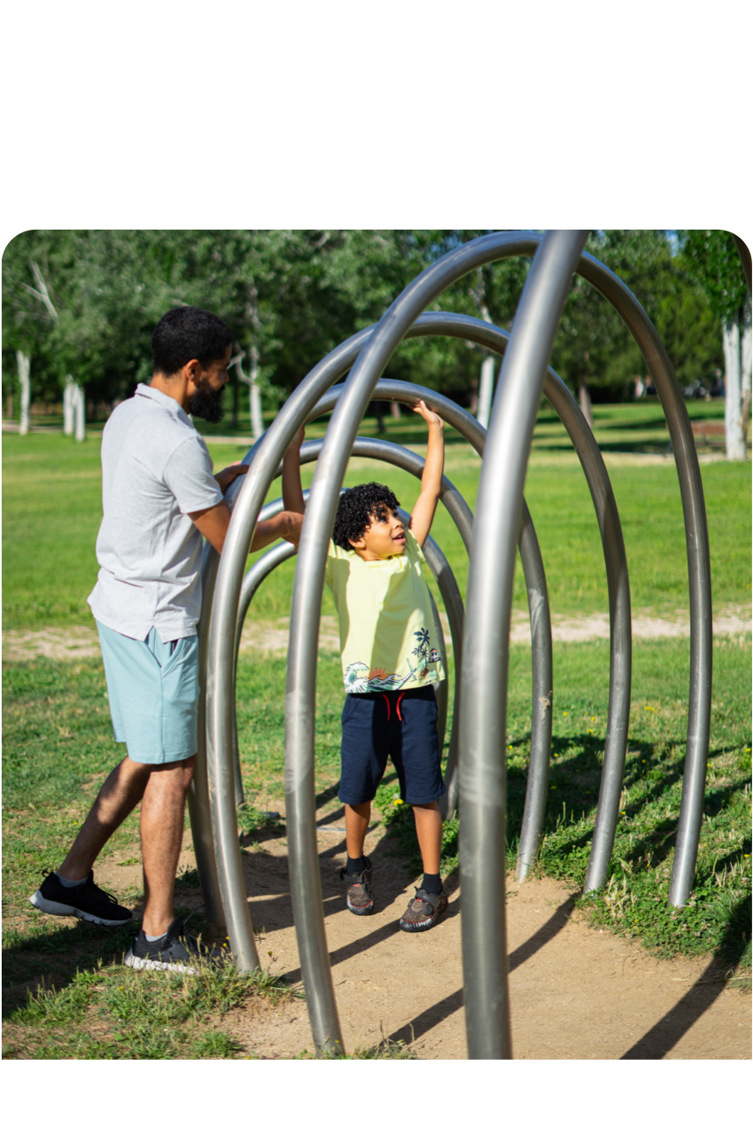
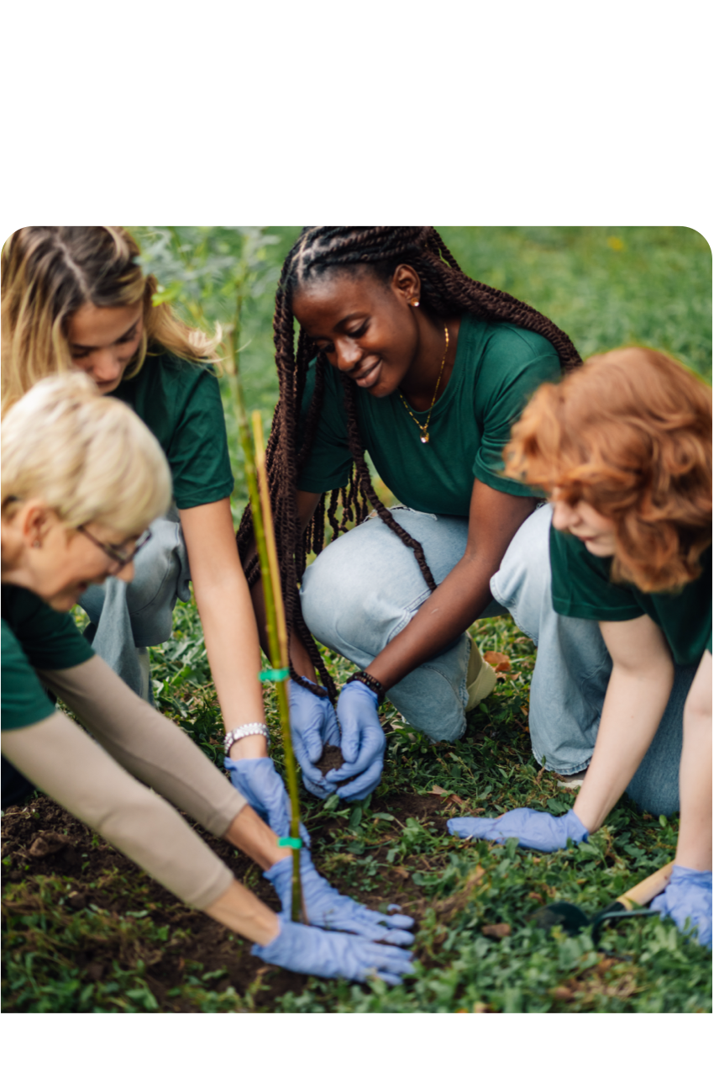
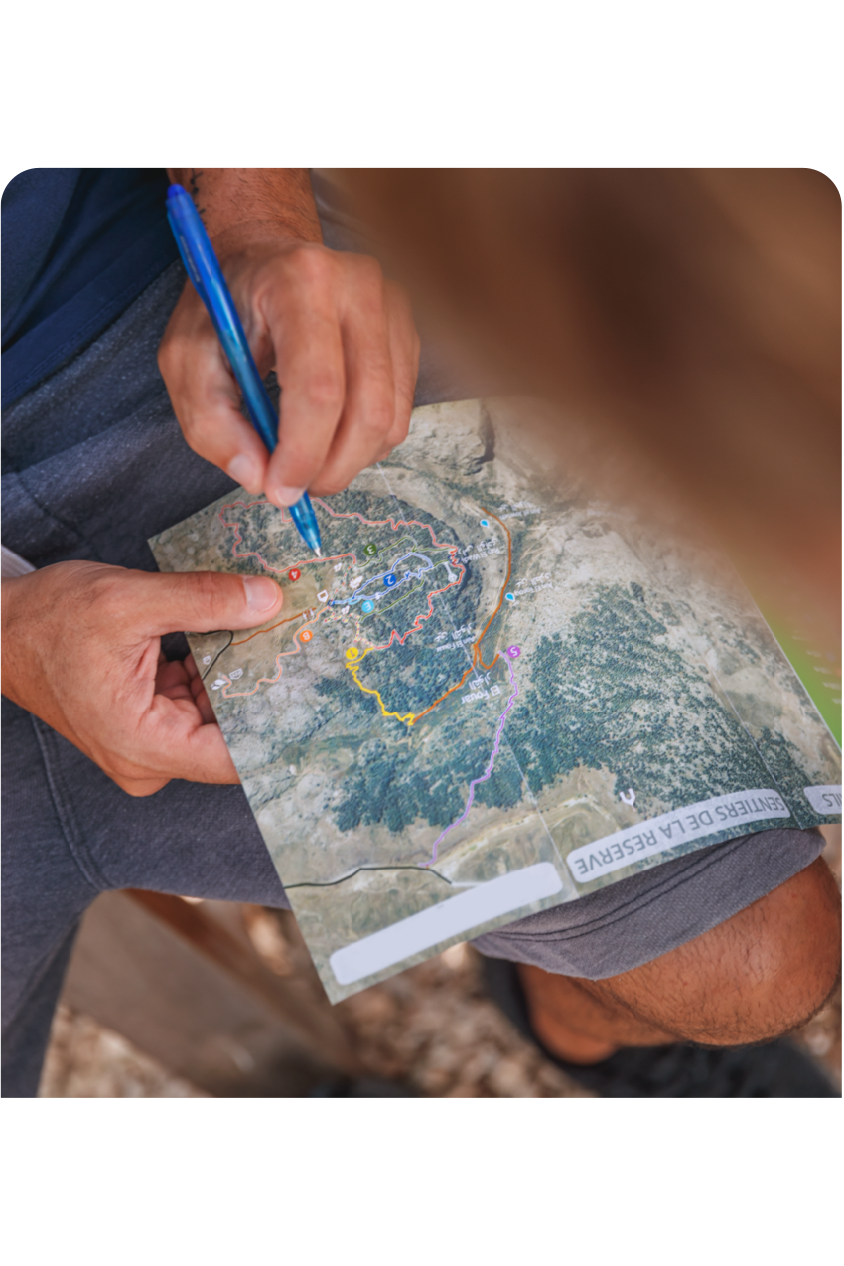






Setting the scene with mapping
and partnership building
MAPS
ASSETS
PEOPLE
Notes:
We mapped assets,

Slide 15

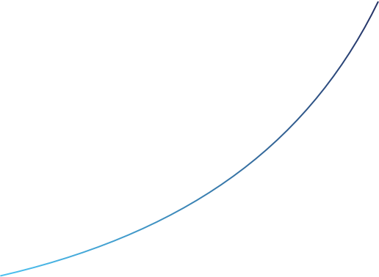
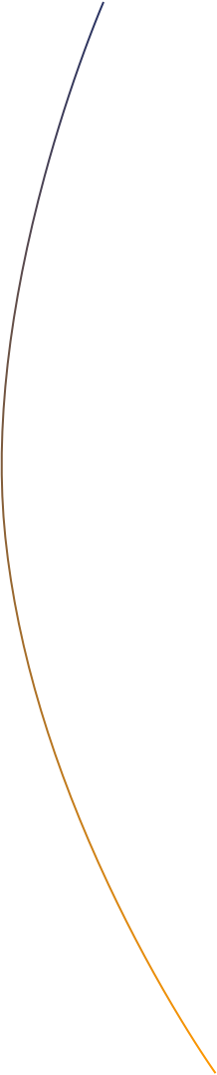

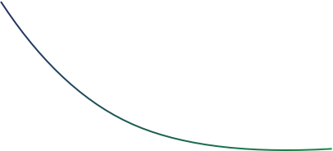
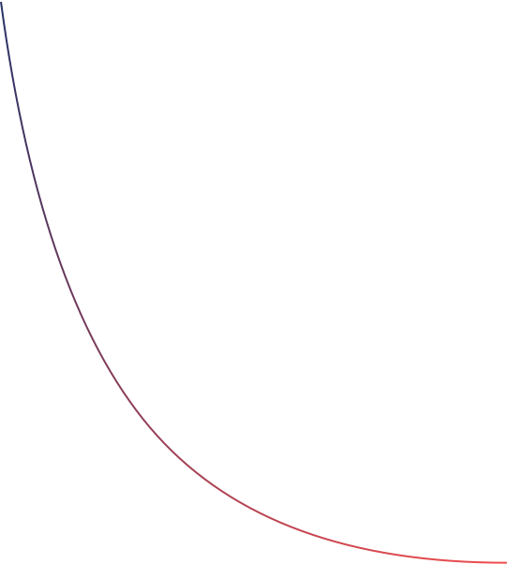

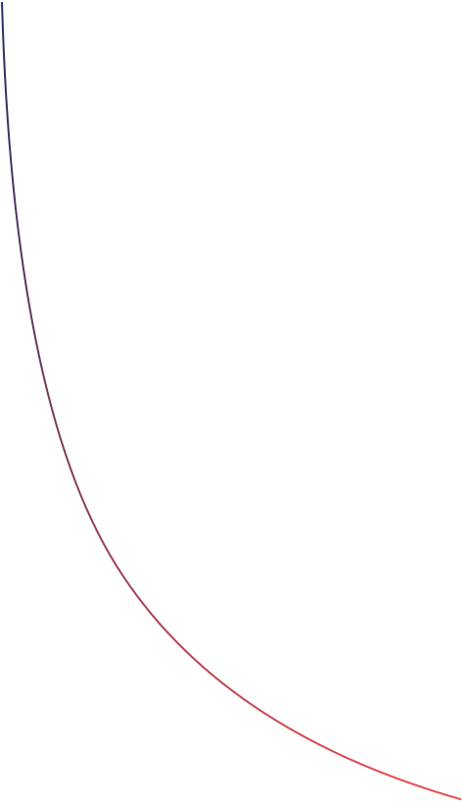

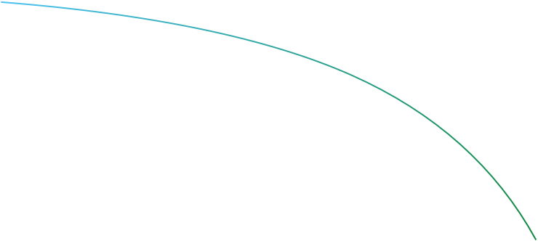
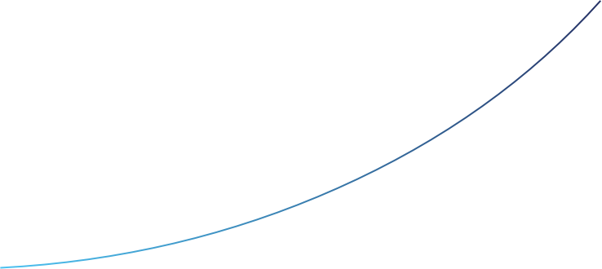
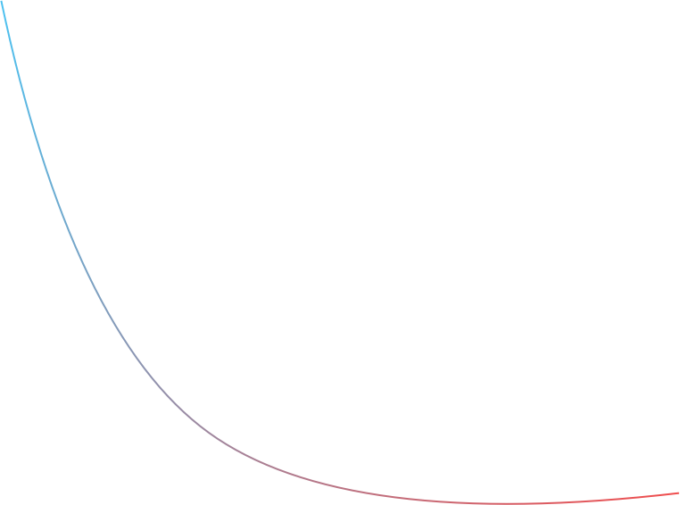
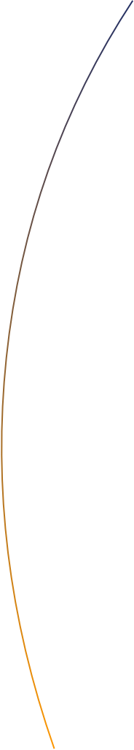
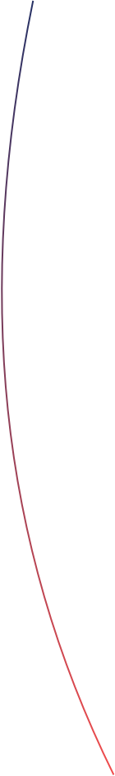
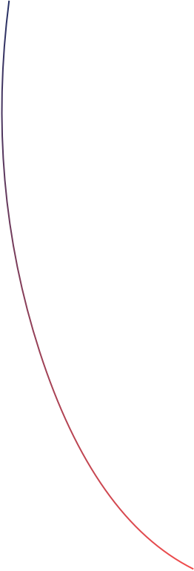
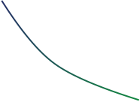
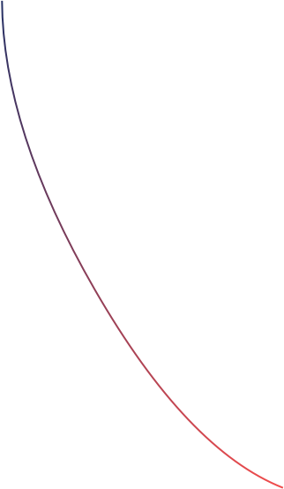
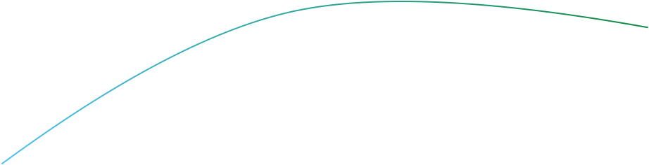
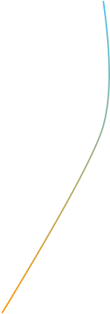
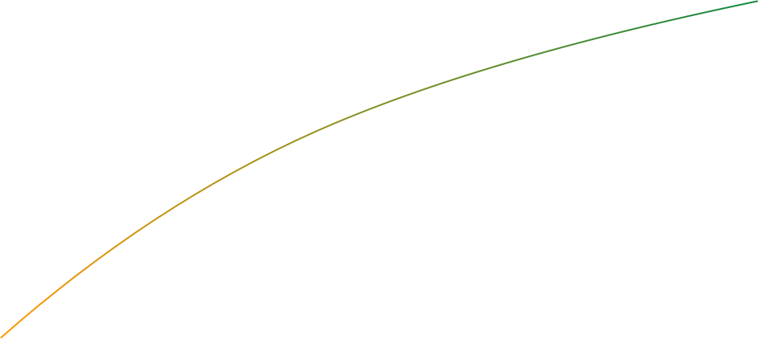
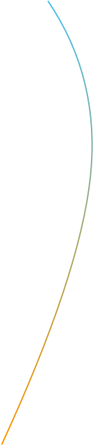
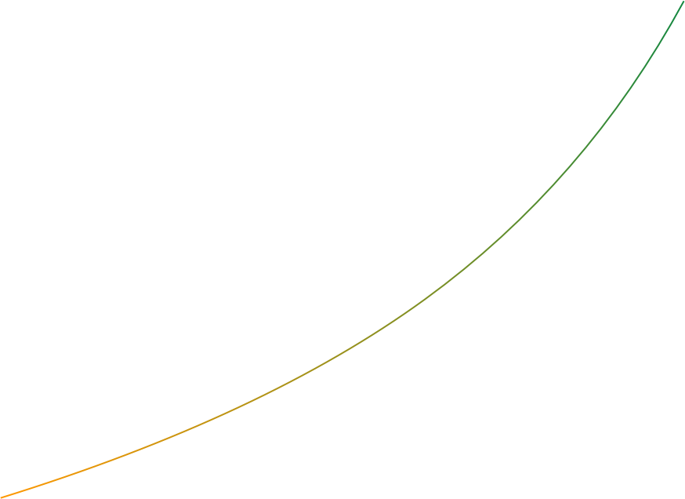
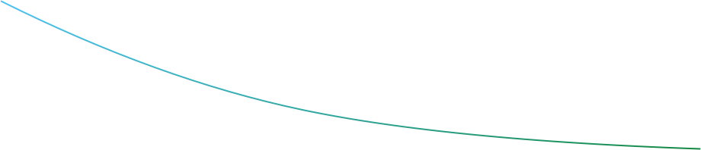
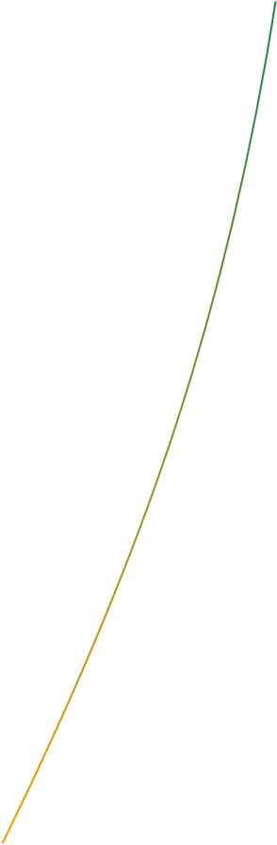
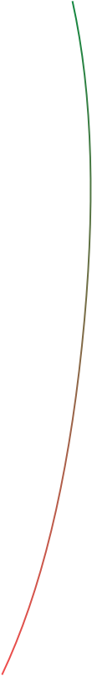


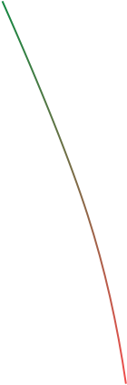


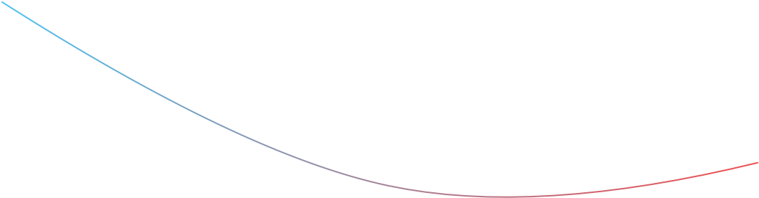
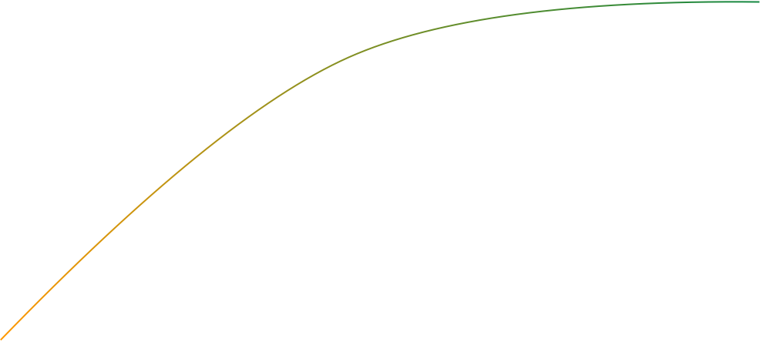
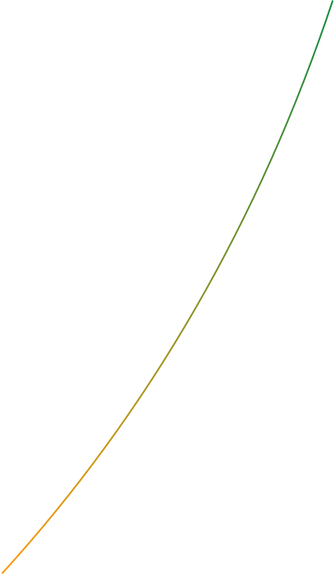
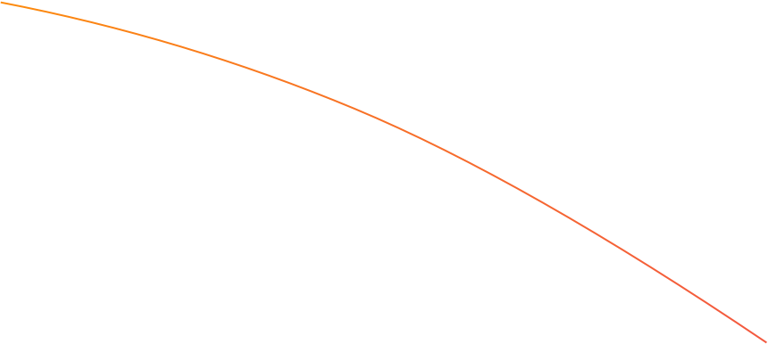


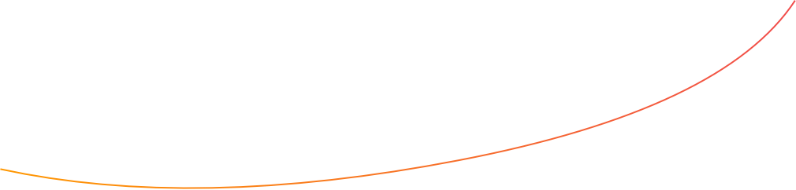
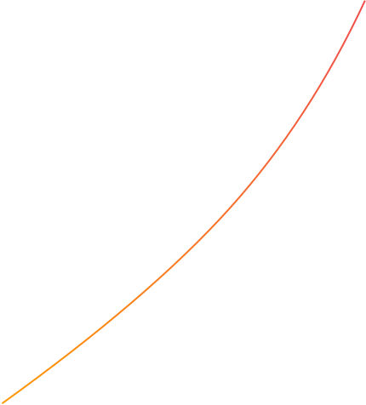
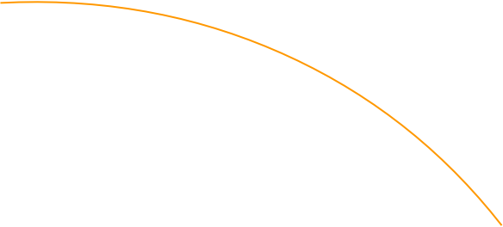
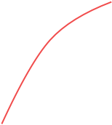
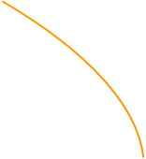
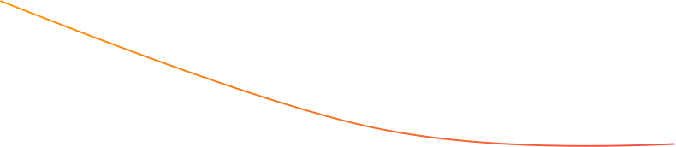
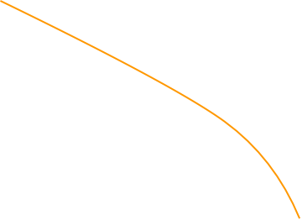




Interconnections Across The System
Strategic influance
Fun Days
Embedding PA in Policy
JUMP digital
Green space development
Social Marketing & Communication
Playful parks
Sustainable Sports
Creating Active School
JUMP connectors
Active Travel and Streets
JUMP young leaders
Active Faith Settings
People skill development
Local action plans
Notes:
The whole is a lot more than the sum of the parts – connecting up the system

Slide 16


JU:MP Connectors
Build the skills, confidence and motivation of families to be active
Family engagement in local greenspace and activities
Build links, connecting schools, community and greenspaces.
Notes:
Strengthening communities – Connectors - connect the system. Local mums or volunteers, no background in sports but really knew their community, cared and were trusted. We provided training to build their capability, to help them support families to be active in simple low cost no cost ways. Taking a walk, playing in the park, kicking a ball around. They connected local schools, to community centres and greenspace.

Slide 17

Creating Active Schools
56 schools
Policy
Environments
Stakeholders
Opportunities
Notes:
We couldn't have done it without schools – the CAS framework was a whole system helped approach within the wider whole system! The wider JUMP work helps schools recognise that reaching families beyond school was part of a whole school approach and we found ways to make it easy for them knowing how stretched schools are

Slide 18


Community engagement
And
Co-design
Notes:
Community engagement and co-design was key to JUMP’s work. Physical environment matters - share the story of Kashmir park
Densely populated no gardens, poor multi ethnic community. Greenspace – fenced off and fly tipping , cynicism about the community – they wont engage they wont care
Community engagement – 6 months. Worked closely with Landscape design unit

Slide 19

Scotchman Road neighbourhood
Notes:
Describe space

Slide 20



Community vote!
Notes:
2 designs – community vote
People had their say – they got involved
More people voted than in the local election!

Slide 21



Activation of new green spaces
Notes:
Here is Kashmir park
Simple space – nature play – low maintenance, a basic football area and trim trails, We animated it with fun days and an adventure play worker ran sessions for the first few months to make sure we established a positive, playful culture. The local people really value it they look after it they champion it. The friends of group is an informal whatsapp group. There is still no formal maintenance agreement but the community litter pick and the council cut the grass. The schools and community centre use it for activity.
This is social justice. This is tackling structural inequalities. Everyone should have access to greenspace - People care about their children however challenging their lives are.

Slide 22

Recommendations
Co-produce at all levels of the system
Invest in connecting up the system; “the whole is greater than the sum of the parts”
Ensure interventions are evidence-based
Embed cycles of learning and action so the work continues to evolve
Ensure national level advocacy and funding for whole system approaches

Slide 23

THAnK YOU!
Jan Burkhardt
jan.burkhardt@bthft.nhs.uk
JU:MP Resource Hub
www.jump.borninbradford.nhs.uk

