Slide 1


Slide 2
Welcome to
(Insert name of club)!

Slide 3
Making a difference

Slide 4


Slide 5


Slide 6


Slide 7
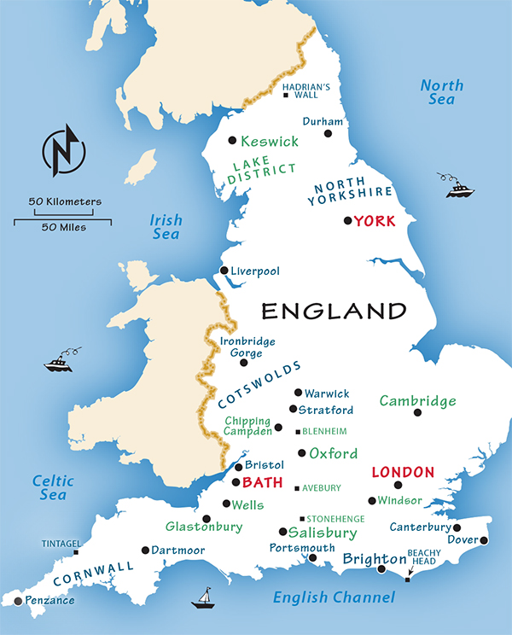

Slide 8


Slide 9
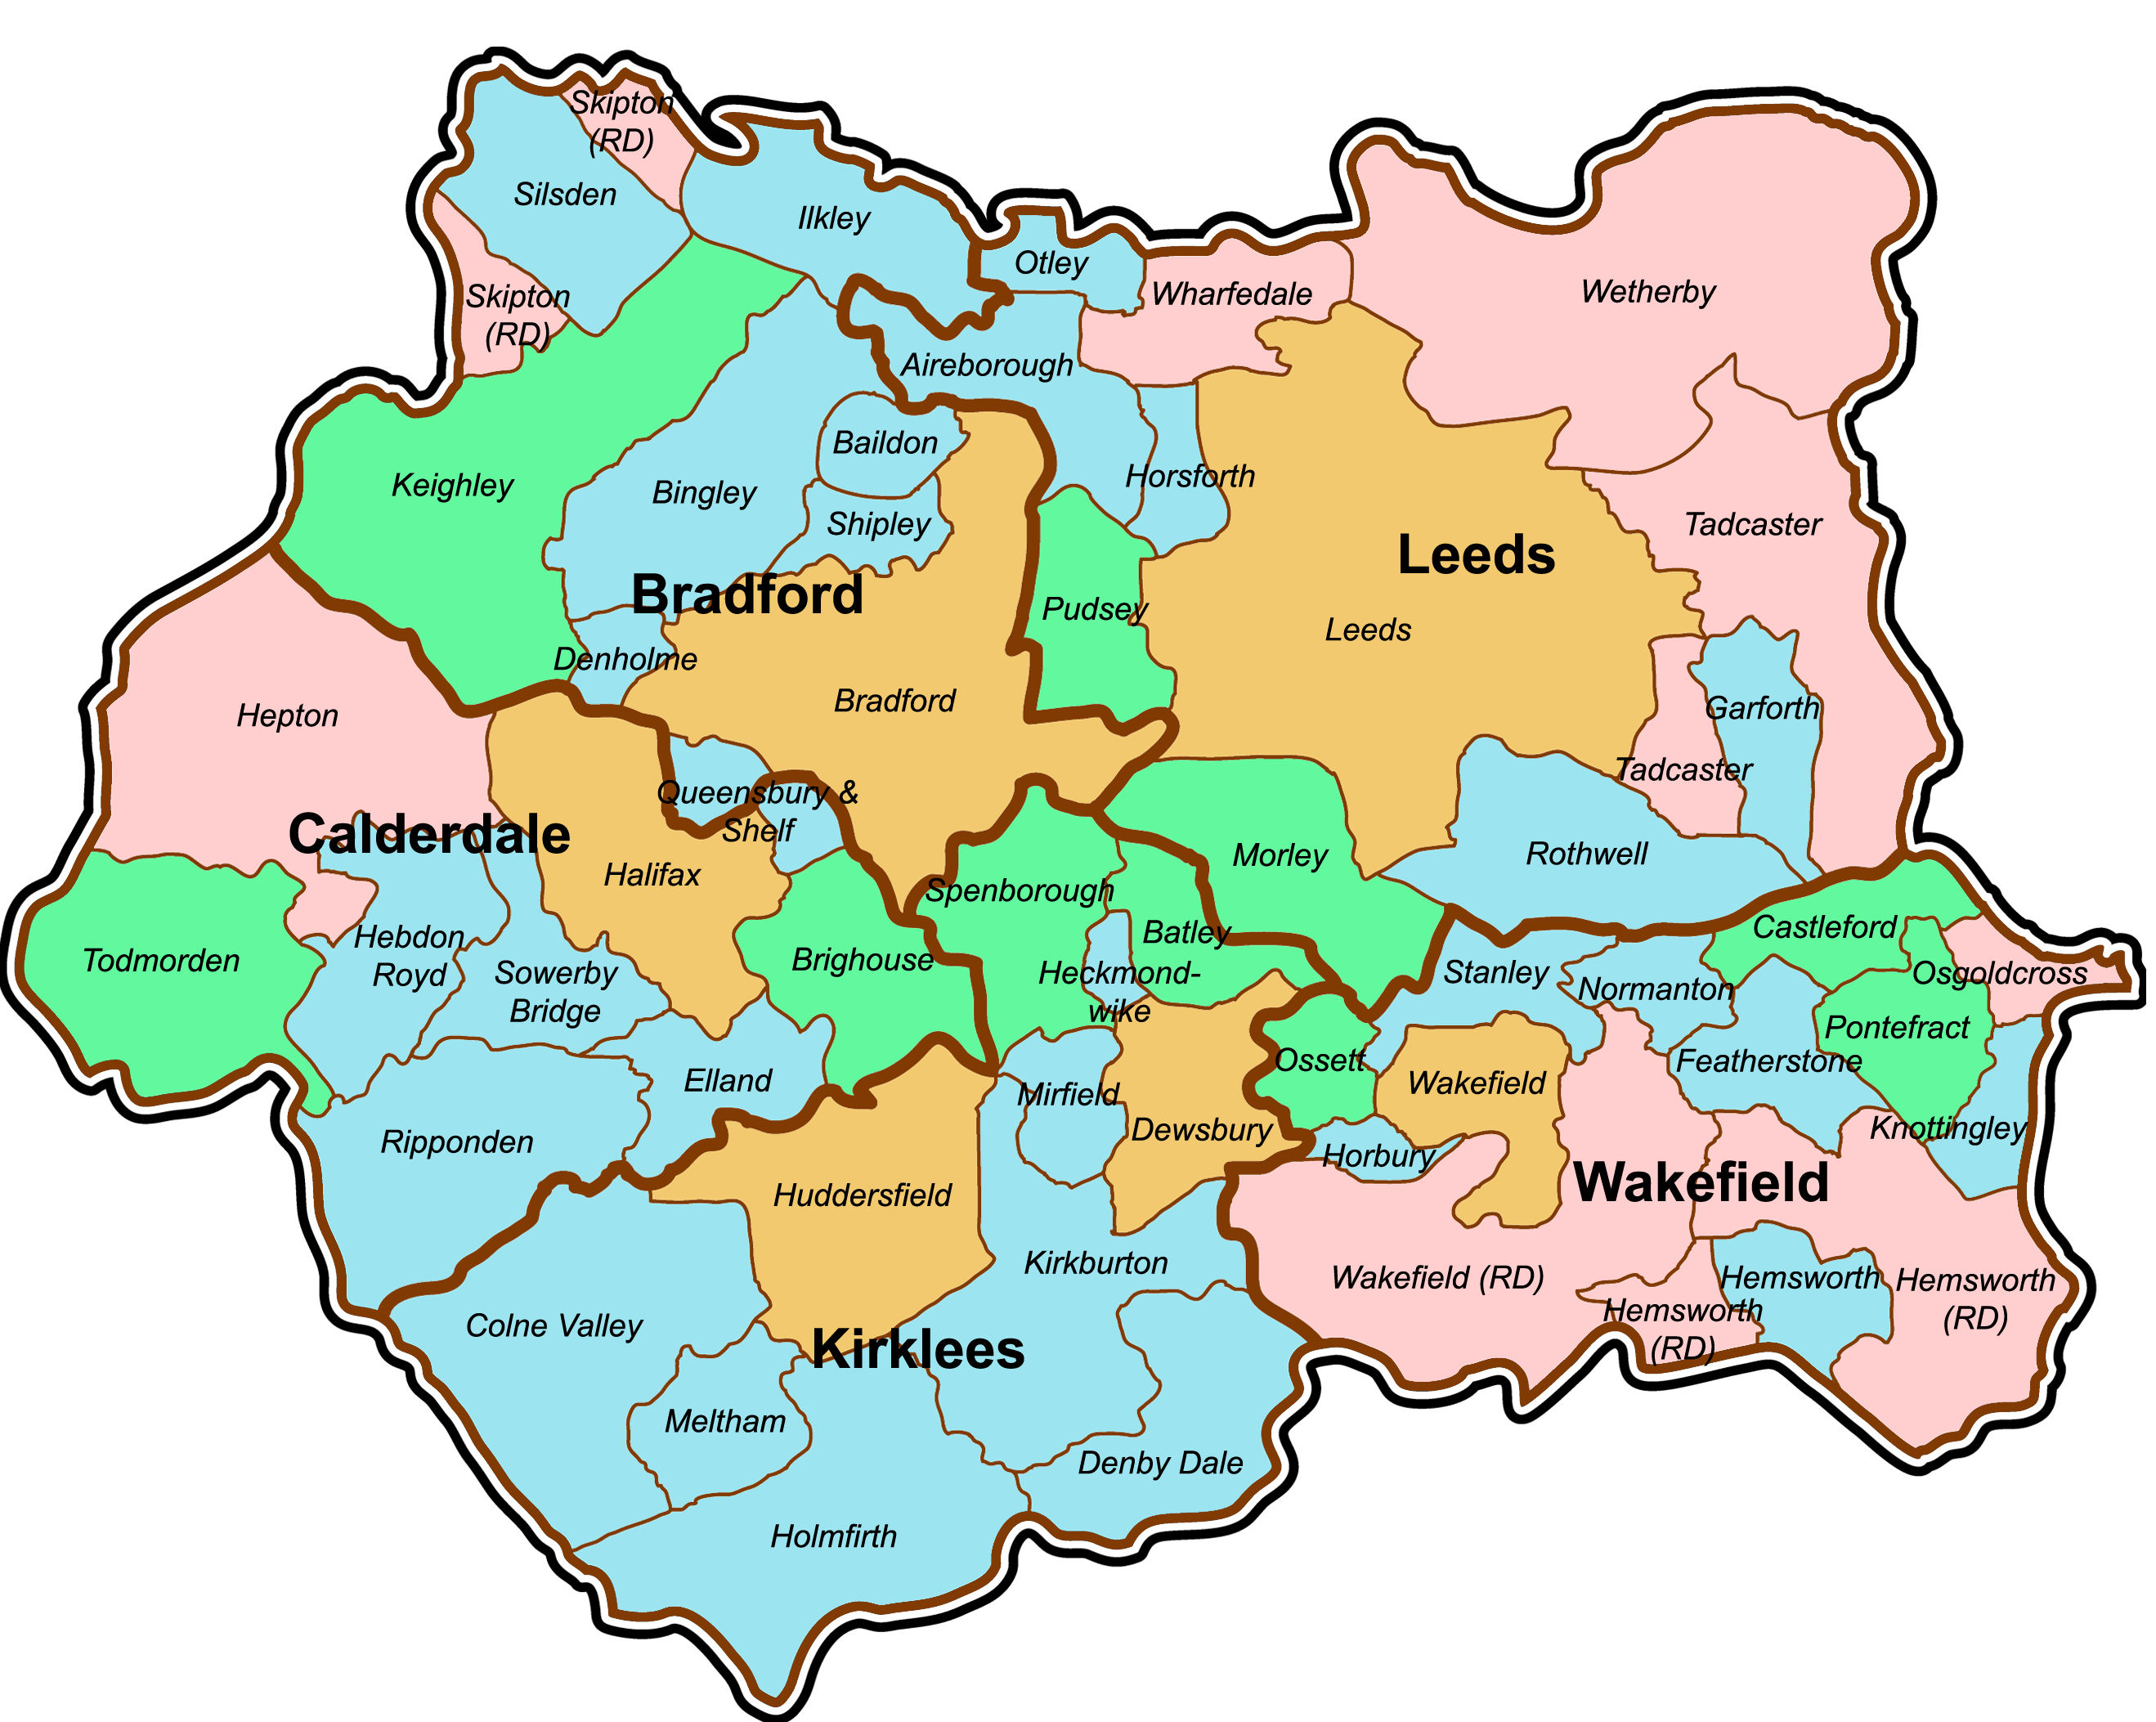

Slide 10


Slide 11
INSERT PICTURE OF
YOUR TOWN

Slide 12
INSERT PICTURE OF
YOUR CLUB

Slide 13


Slide 14


Competition time!

Slide 15
Let’s see our winning posters!

