Slide 1
Welcome
Helping People To Move More.

Slide 2
Who are Yorkshire Sport Foundation?
Yorkshire Sport Foundation is a charitable company limited by guarantee and is the Active Partnership for the West Yorkshire and South Yorkshire areas.
Our vision is for there to be ‘a vibrant, healthy, prosperous Yorkshire through everyone moving more’ and our role is to connect, influence and support organisations in doing so.
We believe in the power of movement, physical activity and sport to change people’s lives, bring us together and tackle inequalities. We want as many people as possible to enjoy all the benefits being active can bring.
Notes:
Introductions to myself
Introduction to the training, pilot and Partnership with ICB
Introduction to the wider work for YSF and the organisation

Slide 3






Group Agreement

Slide 4
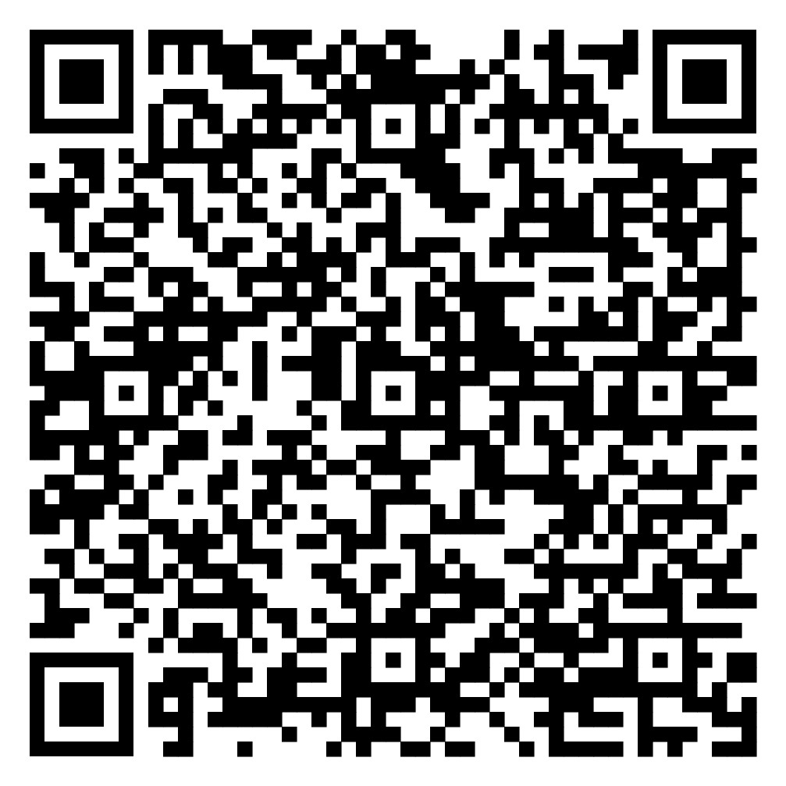
Resource Bank

Slide 5
Introduction
Welcome to this session, designed to help people working in health and social care to encourage the people they support to increase their movement and activity levels.
Supporting people to lead more physically active lives is not only great for health, but brings wider economic, social, and organisational benefits too. When you work in health and social care, you play a key role in helping people to unlock these benefits, but research insights tell us there are many challenges to face.
Today, our aims are to:
Recognise those challenges,
Break down the barriers that exist for people whether cultural, leadership or personal,
Explore solutions, and
Increase your confidence, skill and knowledge in approaching conversations with people about moving more and being more active.

Slide 6
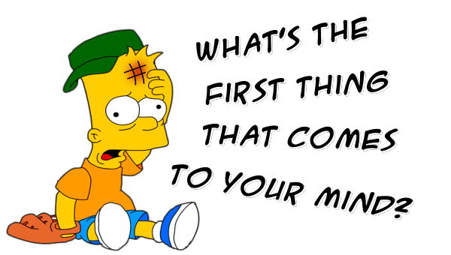
The Definition of Physical Activity
Notes:
Mentimeter to explore definitions and completed language in the world of health and PA.
Understand the space and purpose of training and dispel any myths related to the complexity of language choice and training.
Introduce Parking lot
Explore some definitions and introduce the simplicity of moving more

Slide 7
Exercise
Is typically planned, structured, repetitive and intentional movement.
Exercise is also intended to improve or maintain physical fitness.
Physical Activity
Any movement that is carried out by the muscles that require energy.
In other words, it is any movement a person does.
VS

Slide 8
British Gymnastics Foundation- Love to move programme
https://www.youtube.com/watch?v=1rAnMJkDlB4

Slide 9
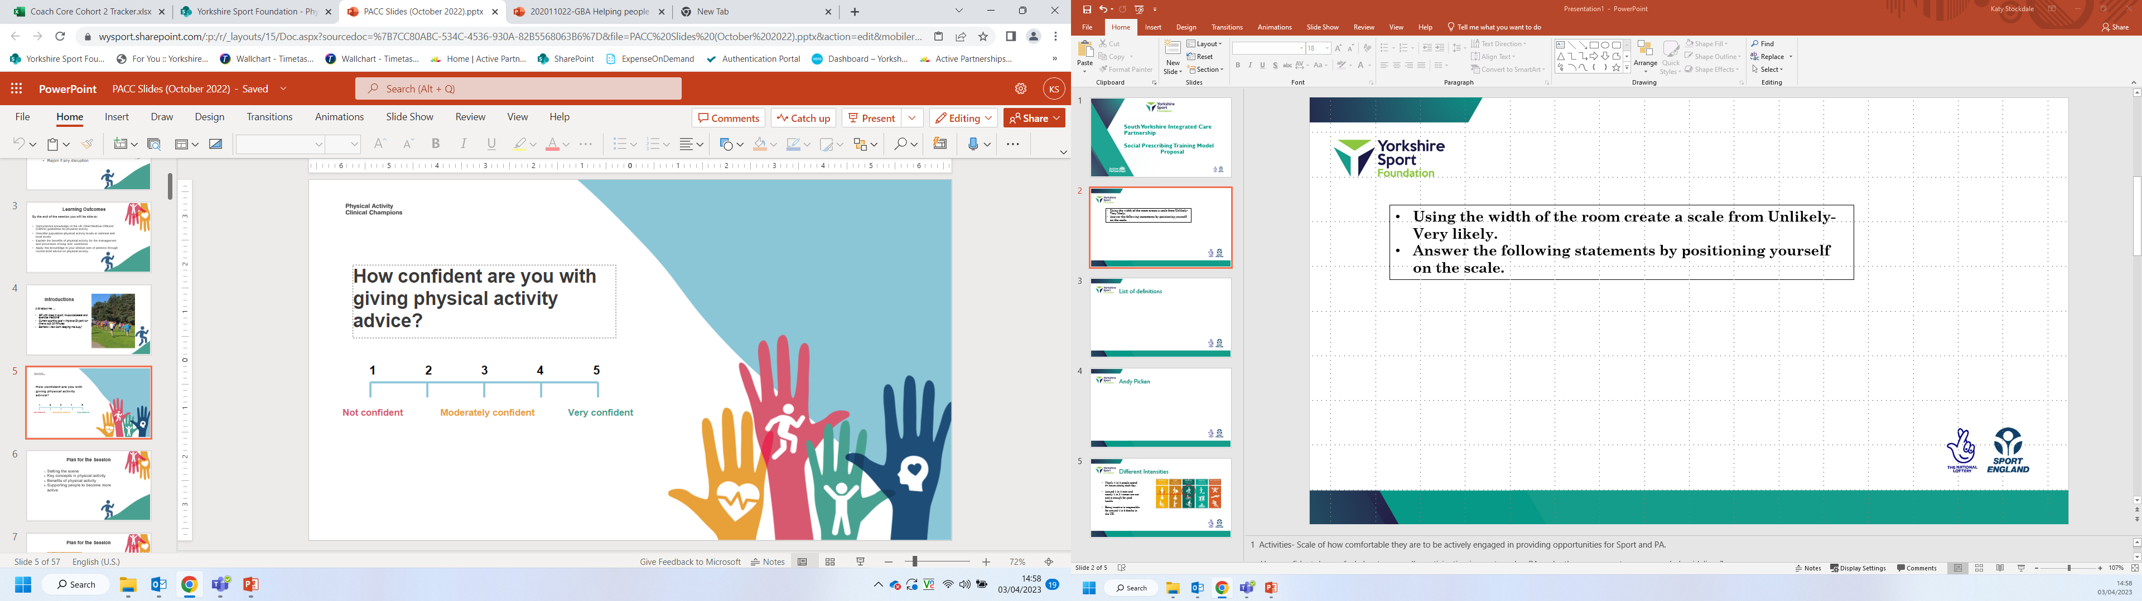
How confident are you in giving advice to benefits of moving more?
Using the width of the room use the scale to position yourself from not confident to very confident. Answering the following statements
Notes:
1 Activities- Scale of how comfortable they are to be actively engaged in providing opportunities for Sport and PA.
How confident are you in having conversations about being more active with others?
How confident are you in understanding the benefit of Sports and PA activity?
How important are having conversations about being active with others?

Slide 10
Quiz
1. What are the UK current physical activity recommendations per week for adults?
A. 3 times 30 minutes
B 2 times 60 minutes
C. Every day 45 minutes
D. 5 times 30 minutes
D. 5 times 30 minutes

Slide 11
2. What frequency are the UK recommendations on strength training per week?
A. 5 times 60 minutes
2 times 30 minutes
B. 2 times 30 minutes
C. 3 times 25 minutes
D. 5 times 30 minutes

Slide 12
3. What is the average time the UK population per day sit down?
5 hours
B. 9.5 hours
The same as a long haul flight!
B. 9.5 hours
C. 11.5 hours
D. 7 hours

Slide 13
4. People who don’t regularly exercise lose what % of muscle strength by age 65?
A. 40%
B. 25%
C. 80%
C. 80%
D. 60%

Slide 14
5. How many teaspoons of sugar does a large Starbucks white chocolate mocha contain.
A. 11
C. 18
B. 5
C. 18
D. 9

Slide 15
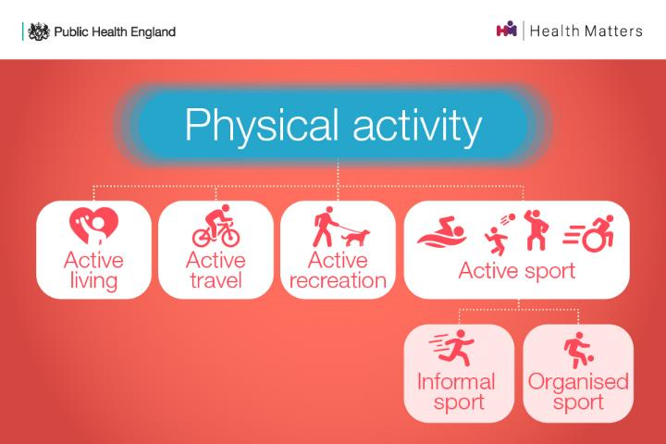
What is Physical Activity?
Notes:
General public Health recommendations to exercise and health
What could PA look like, i.e. travelling to work, household chores, or things we do just for fun.
We’ve circled active living as for many people this may be the most feasible option to incorporating physical activity into their lives
Those people who make being active a part of their everyday lives, they are most likely to continue with it and for it to be sustainable.
Reiterate message any movement. Every movement counts.

Slide 16
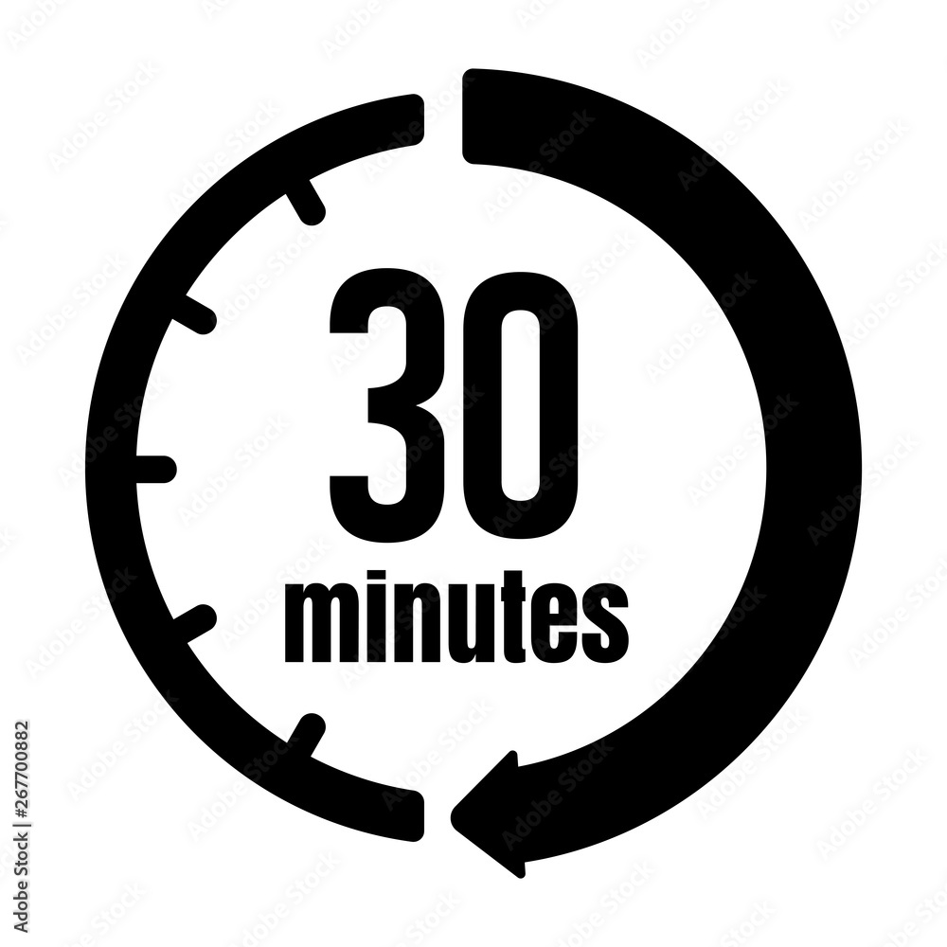
Making Physical Activity part of your life
There are 1440 minutes in every day.
Schedule 30 of them for physical activity

Slide 17
Why should we talk about this?
Improved quality of life by;
Enhanced cognitive function
Social interaction opportunities
Fall prevention
Empowerment and sense of achievement
Pain management

Slide 18
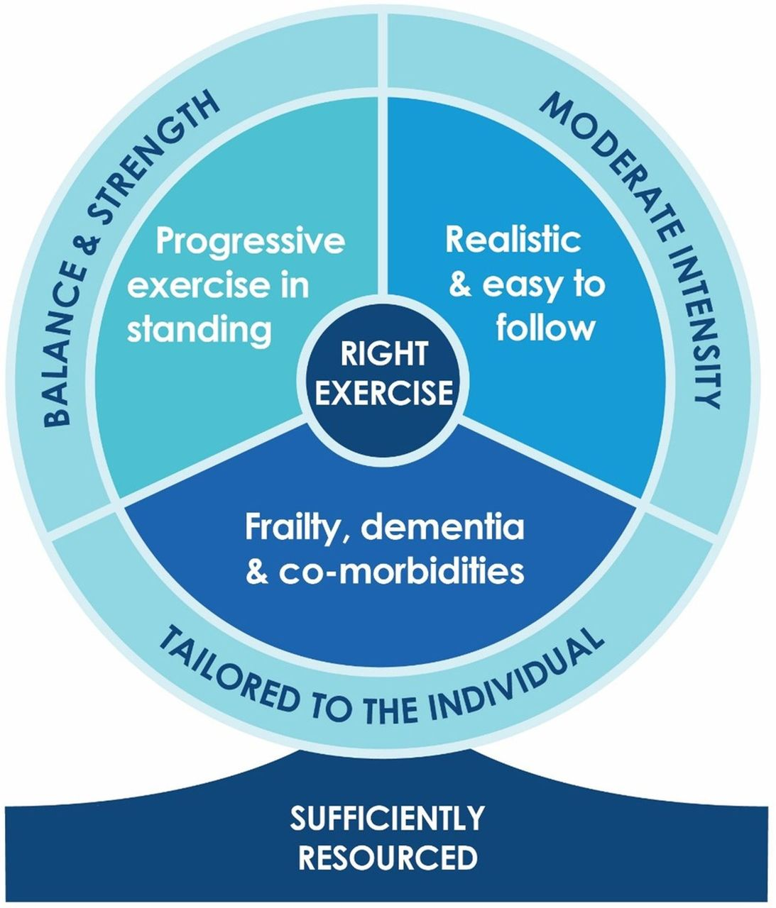
Falls prevention study

Slide 19
What could be included
General mobilisation exercises to improve fitness and mobility
Stretching exercises to reduce stiffness and improve range of movement
Musical exercise including dance and aerobics
Chair exercises, which can be done by people while seated
Think about daily movement opportunities – not always structured
Be creative and inclusive
https://www.youtube.com/watch?v=bs8gc9lg7M0

Slide 20
What do people say (residents)?
I think it’s amazing. I love singing and moving.
I LOVE IT, I love joining in, I love the music, I JUST LOVE IT!
My left arm has been stiff but since starting these exercises I feel it’s a lot better. I feel energised.
It makes me feel alive and happy. I love it because it lifts me. I have made new friends because more people come into the lounge to join in who usually wouldn’t sit in the lounge. I can also sleep better after I have done the exercises.
I can move my hands and feet better after doing the exercises, it makes me want to get up and dance.

Slide 21
What do people say (staff)?
We all appreciate the movement to music, it certainly brings a smile to everyone’s face. Please keep coming, many thanks from all of us!
I feel happy watching the residents smile and laugh. It is such a positive thing, it has given the residents more social interaction – you can see they are so happy, they talk about it all day, asking when you’ll be back! One of the residents has requested to do more chair exercises in a recent residents meeting. It has encouraged me to do more exercises with the residents, it has so many benefits.
It was brilliant to see some of the residents remember who they are and what they were here for. It became very evident that the residents had retained some of the dance moves from the previous week and they were able to do some without any prompting. The sessions are incredible. The interaction and enjoyment were brilliant for the residents. I would highly recommend it to anyone living with or without dementia. It’s enjoyable for everyone.
I just wanted to let you know that residents told me this morning about how much they’re enjoying the Love to Move mornings! I feel it’s important you get to hear the feedback from them, you’re obviously making an impact!

Slide 22
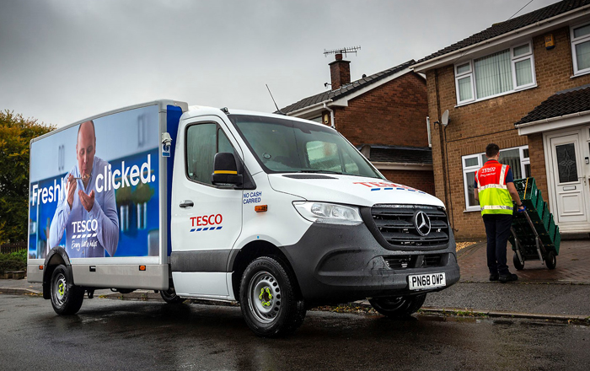
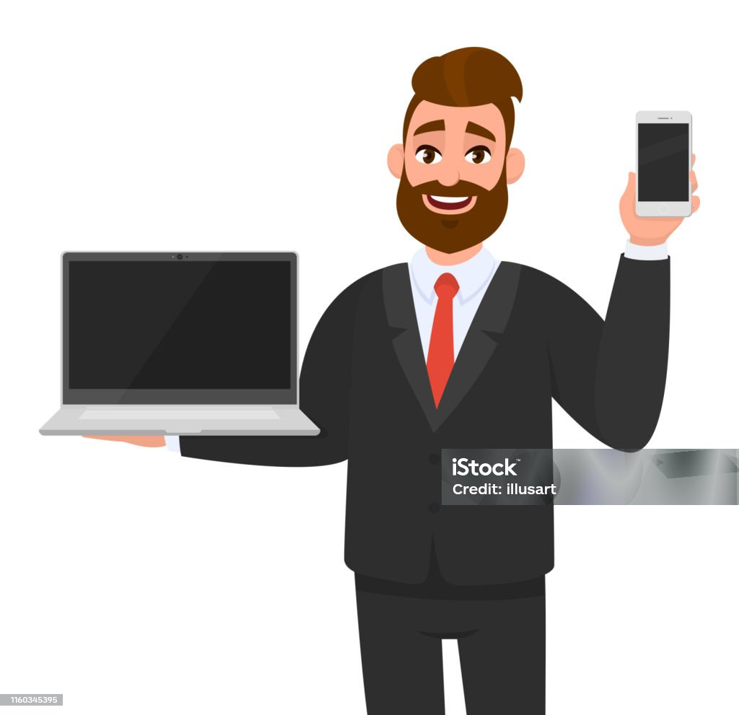
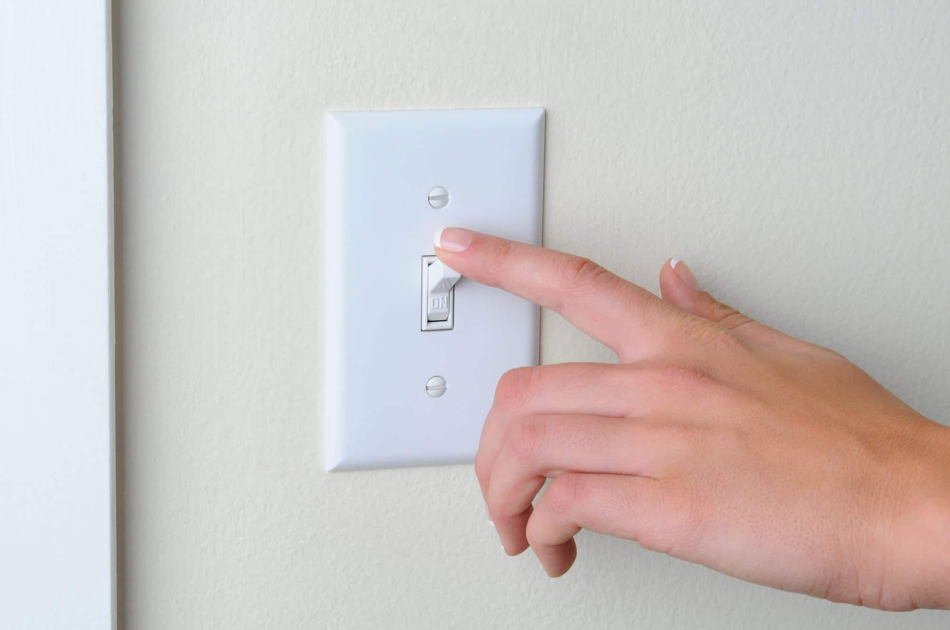

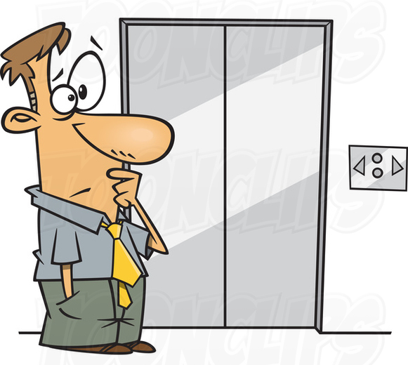
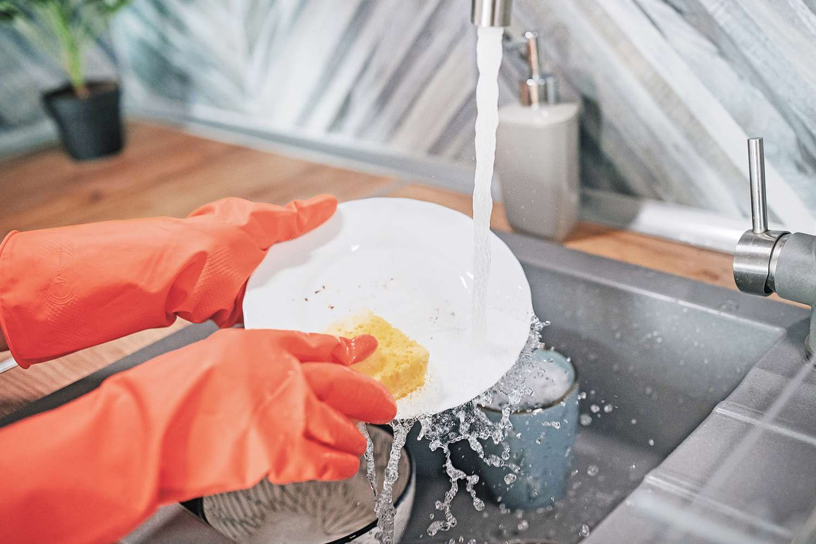
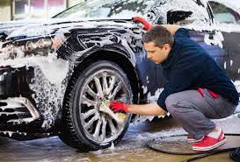
In todays world

Slide 23
Benefits
To Moving More

Slide 24
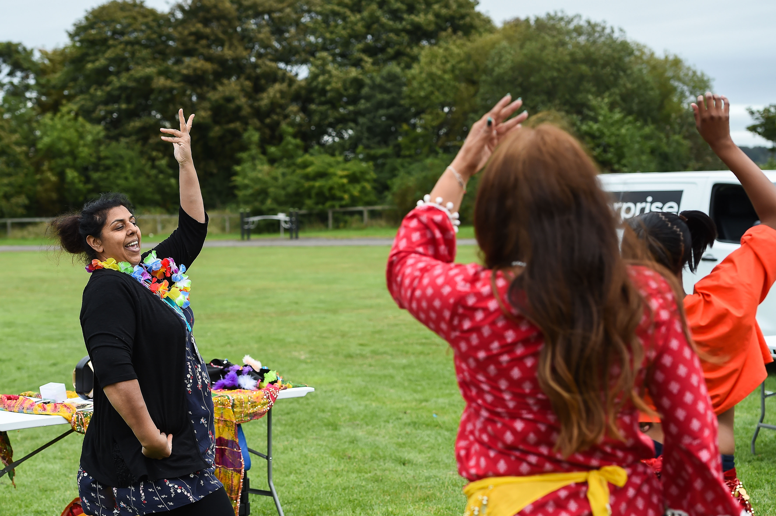
On your tables use the flipchart paper to discuss benefits to Moving More.
Swapping your flip chart paper with another table agree as a group 5 significant benefits.
Feedback

Slide 25
Benefits to Moving More
  Chance of high blood pressure, type 2 diabetes, being over weight or obese and unbalanced cholesterol levels.
Reduces social isolation
Reduces feelings of anxiety and depression
Benefits health
Maintains healthy weight
Combat cancer- related fatigue
Manages stress
Improve joint pain and stiffness
Improves quality of life
Improves brain health
Maintain muscle strength and balance
Notes:
Table top exercise each group discuss and list benefits to Physical Activity, swap tables and circle in red 3 priority areas they would see in cliental. Feedback to group standing in a circle.

Slide 26
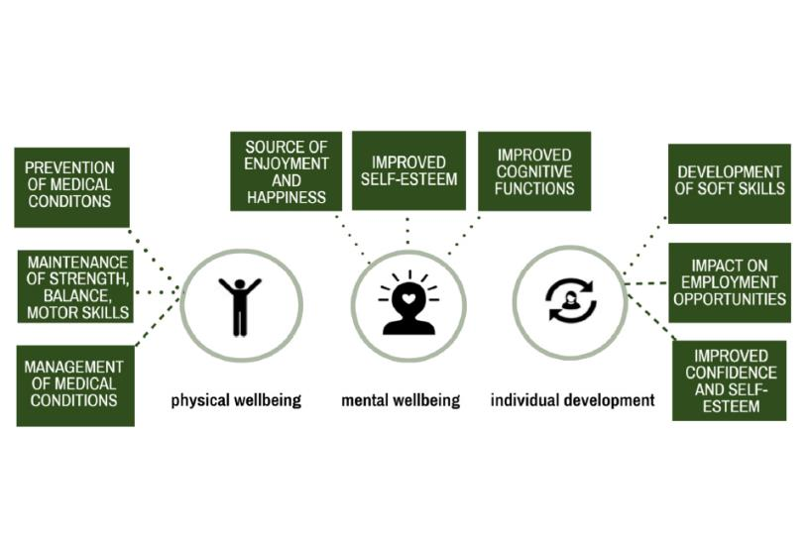

Slide 27

The 5 Ways of Wellbeing
Notes:
This slide was created by New Economics Foundation and is used widely now by Mind, NHS and lots of other organisations.
Research found that building these 5 actions into our daily lives are really important for well-being and this include being active.

Slide 28
Levels of Activity
The good and bad news

Slide 29
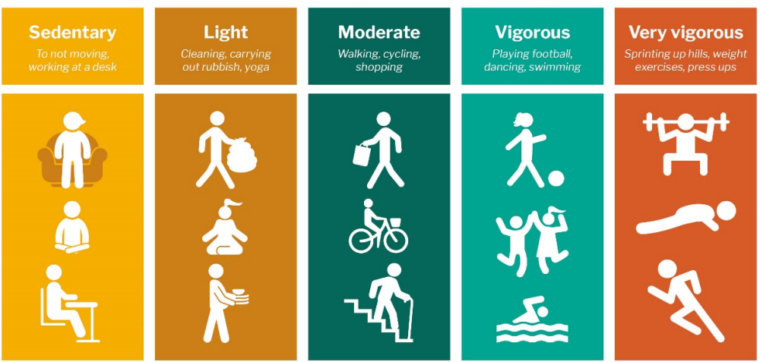
Different Intensities
Around 1 in 3 men and nearly 1 in 2 women are not active enough for good health
Being inactive is responsible for around 1 in 6 deaths in the UK.
The three main types of physical activity are aerobic, muscle strengthening, and bone strengthening. Balance and flexibility activities are also beneficial. Aerobic activity is the type that benefits your heart and lungs the most.
Notes:
Government guidelines on advisory of exercise intensities.
However, the best thing people can do is move from sedentary to moving more.
Moderate just means anything that gets the heart beating faster, feeling warmer and slightly out of breath.
The graph shows rate at which health benefits can be gained for every extra minute of weekly physical activity
Reiterate these is for those who are inactive.
The steepest level of increase is up to 150 minutes
Which means the people who are inactive have the most to gain

Slide 30
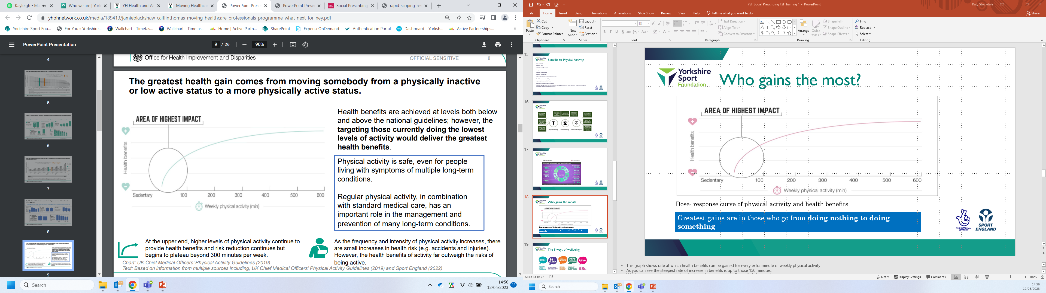
Who gains the most?
Greatest gains are in those who go from doing nothing to doing something
Notes:
This graph shows rate at which health benefits can be gained for every extra minute of weekly physical activity
As you can see the steepest rate of increase in benefits is up to those 150 minutes.
Which means people who are inactive have the most to gain. Even a little helps a lot.
150 minutes is used as it’s a point where we can get much of the health benefits. You still get more after the 150 minutes, but that curve is flatter.
That could be 10-minute chunks – doesn’t need to be in one go.
E.g. could be starting small as walking to the end of the garden and back. Taking the stairs instead of the lift. Walking a small section to work.
Key messages to remember are something is better than nothing (some is good, more is better). It’s never too late to start. Every minute counts.

Slide 31
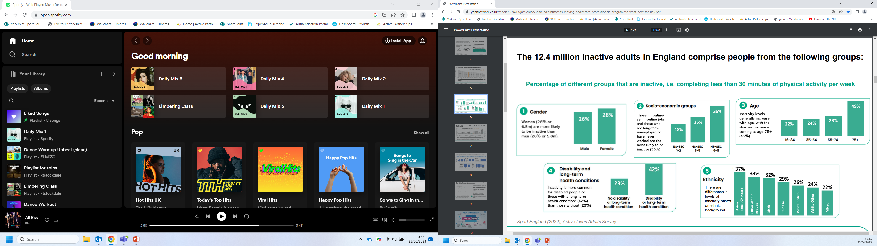
The National Picture- Active Lives Survey (2022)
Notes:
Age category 49% of 75+ are in active
Those who are unemployed or have never worked 36% inactive
Those registered as having a disability or long-term health condition 42% inactivity

Slide 32
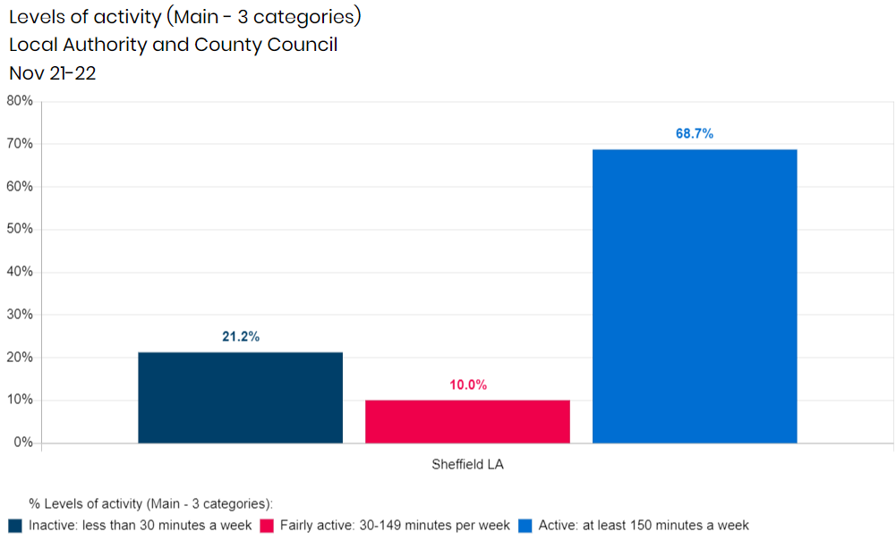

Slide 33
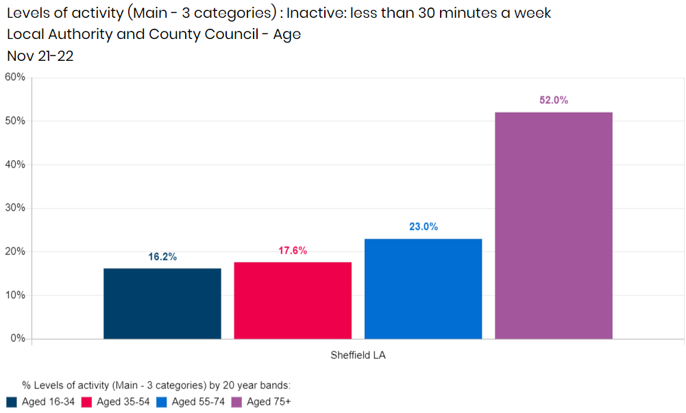

Slide 34
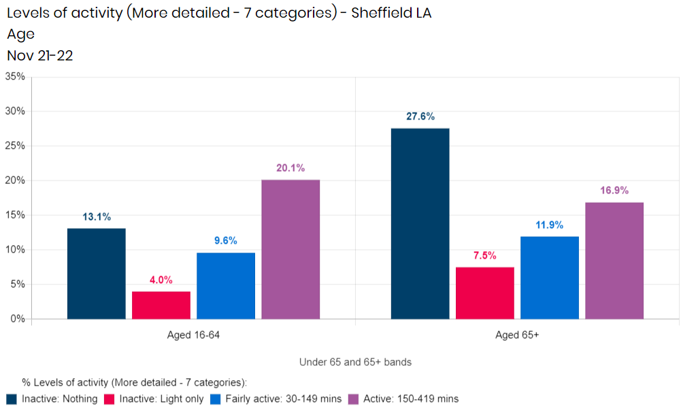

Slide 35
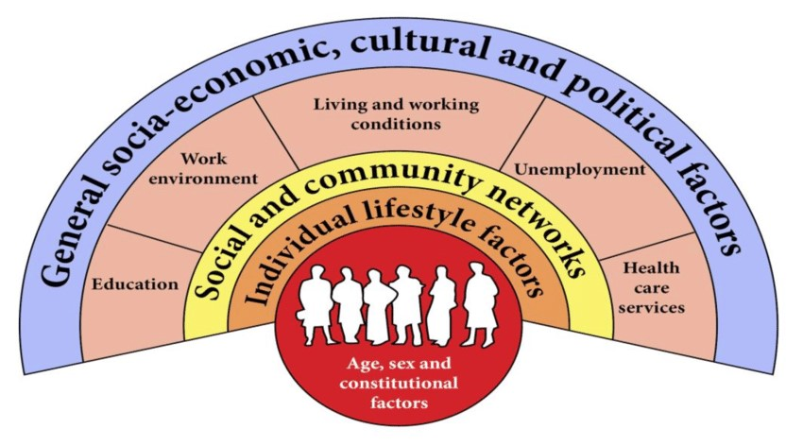
The Dahlgren-Whitehead Rainbow (1991)

Slide 36
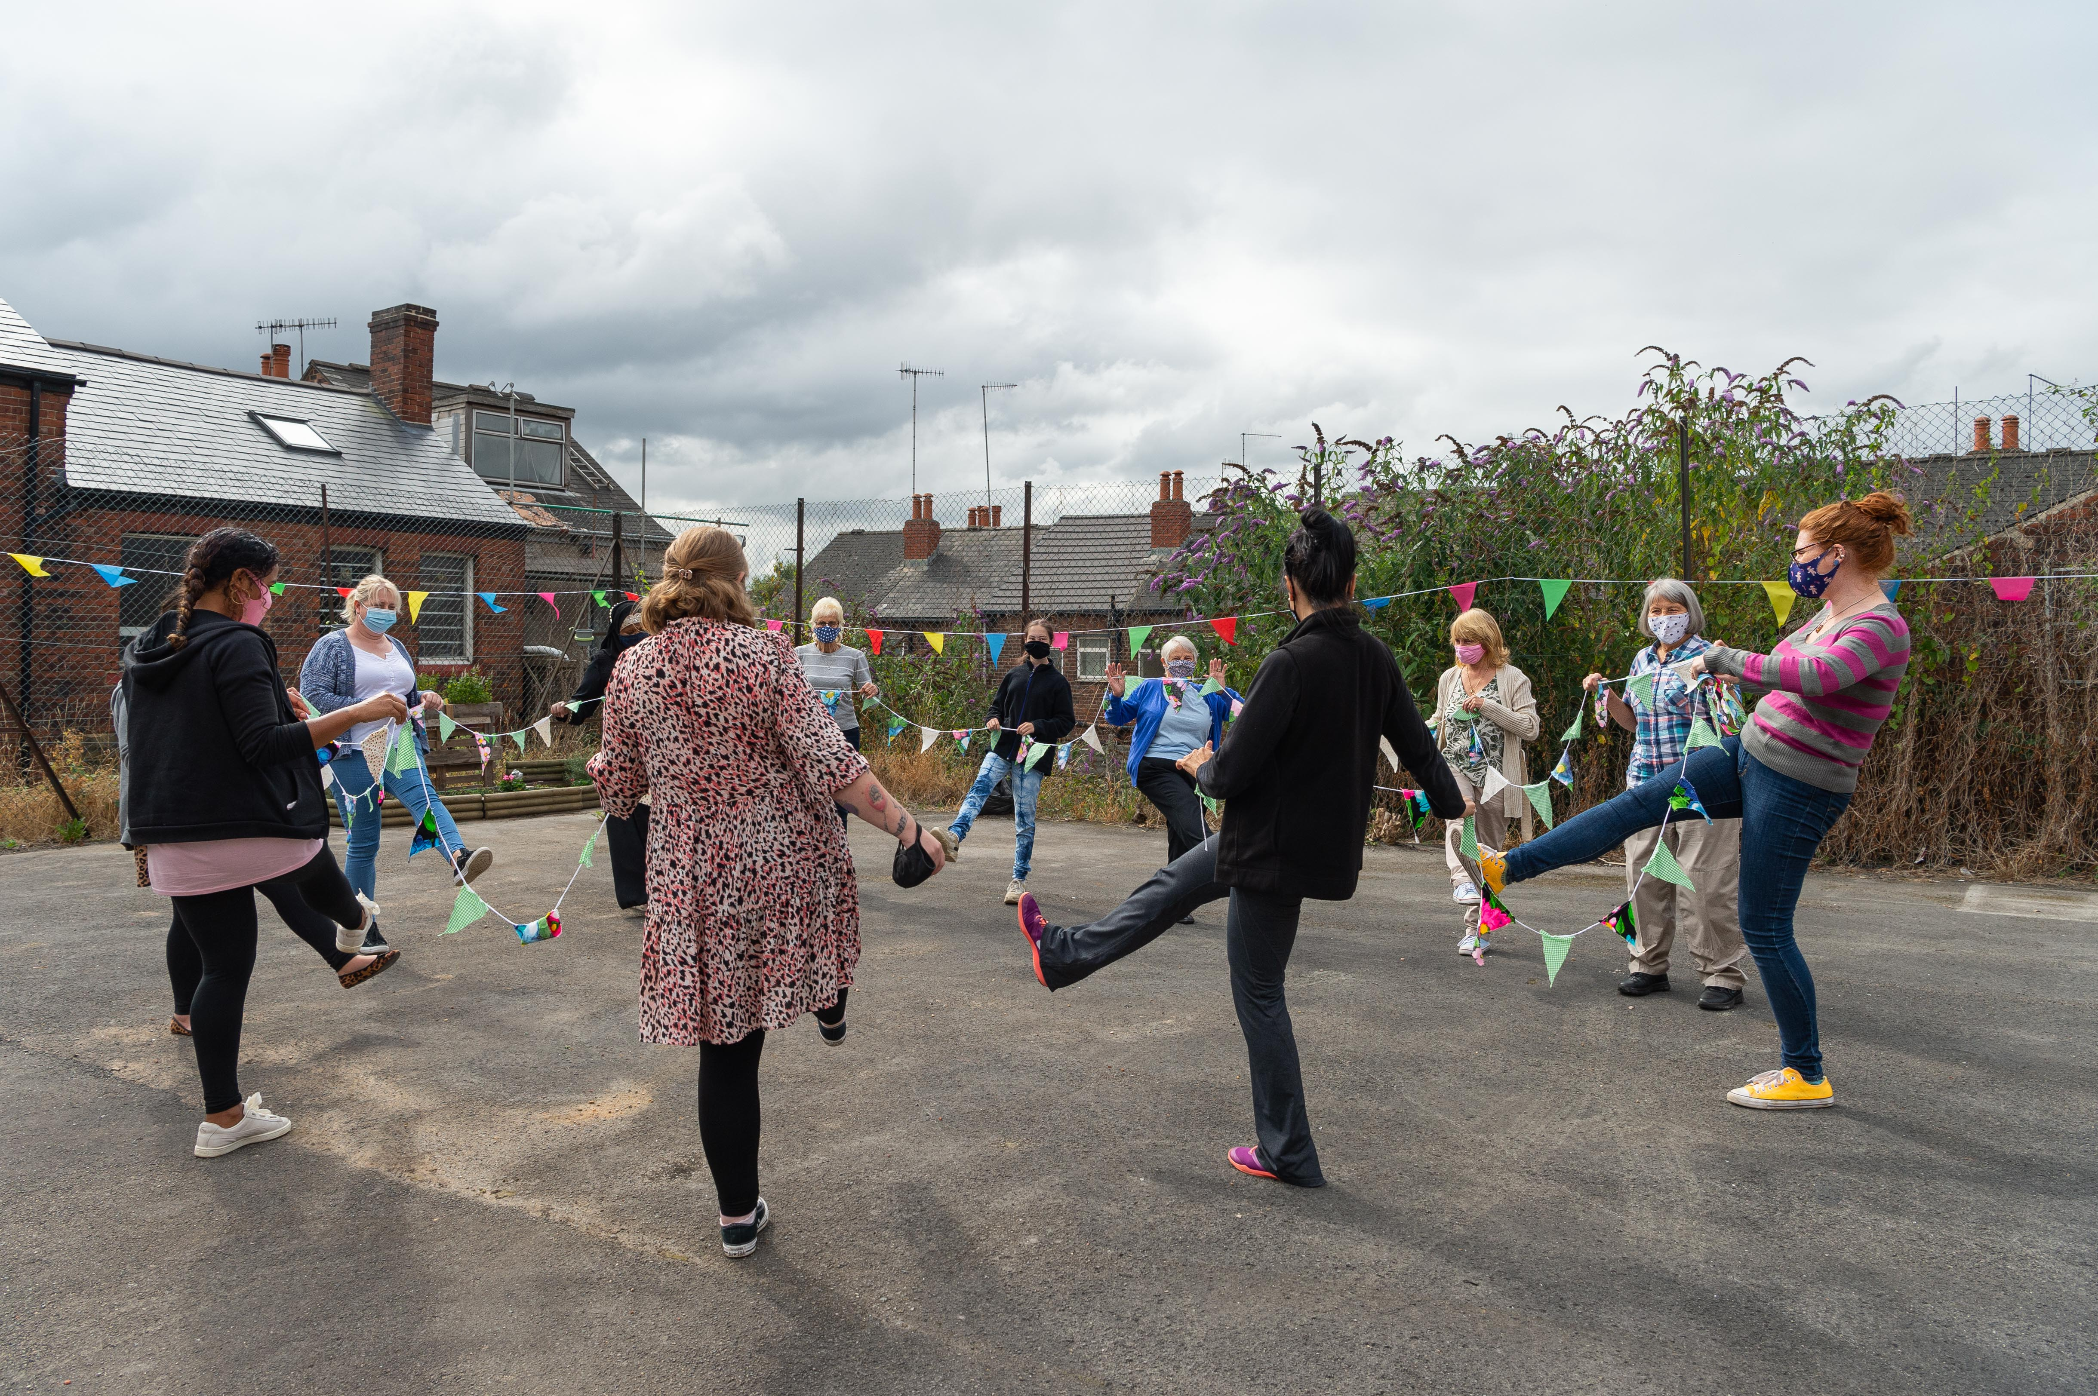
Taking a couple of minutes to reflect
Think about the times in your life you had a positive experience being Physically Active?
How did this make you feel? What were/are the benefits?
How could your experiences help support others?
What changes would you make?
How could these changes benefit others?

Slide 37
Comfort Break

Slide 38
Barriers
To Moving More

Slide 39
Barriers to Physical Activity
Physical barriers
e.g. Lack of time
Social barriers
e.g. Concerned about what
others will think
Psychological barriers
e.g. Low motivation
Technical barriers
e.g. Not knowing what to do or how to do it
Notes:
Introduce the Scenarios and on tables discuss the barriers each scenario may have.

Slide 40
Behaviour Change
Notes:
Behaviour change how can we support through and how?
How introduce the tool of transtheoretical model and discuss the different boxes aligning to a person experience.
Example template for PA
4 stages of motivational interviewing and share video
Outline top tips (in handout as well) consider a creating a goals plan for client’s template in handout.

Slide 41
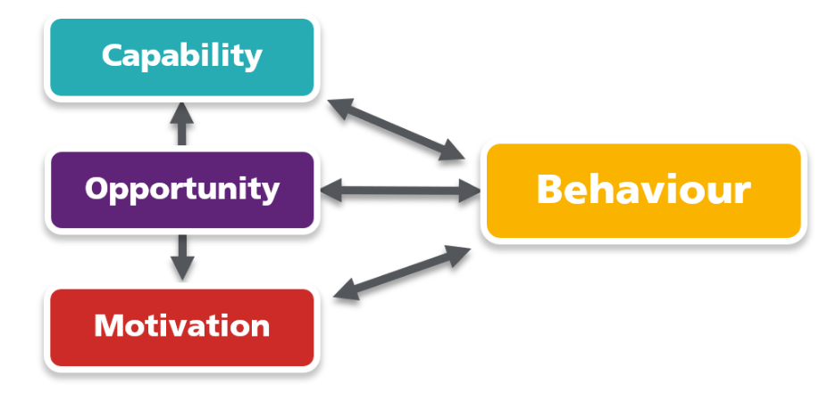
COM-B Model
Capability is the psychological capacity (such as knowledge and understanding) and physical ability (including special skills) to enact a behaviour.
Opportunity refers to the physical and social environment that enables a behaviour. This could include city planning conducive to active travel, or a supportive social circle that encourages healthy behaviour
Motivation is made up of the internal mechanisms that set in motion or inhibit a behaviour. This could include the desire to participate in a sport, or the pleasure (emotion) of engaging in a healthy activity.
Behaviour is understood as physical action that occurs in the body and is controlled by the brain; it’s anything a person does in response to external or internal cues. The intention to eat more fruit, instead of sweet snacks, is not a behaviour – but the act of eating fruit is.

Slide 42
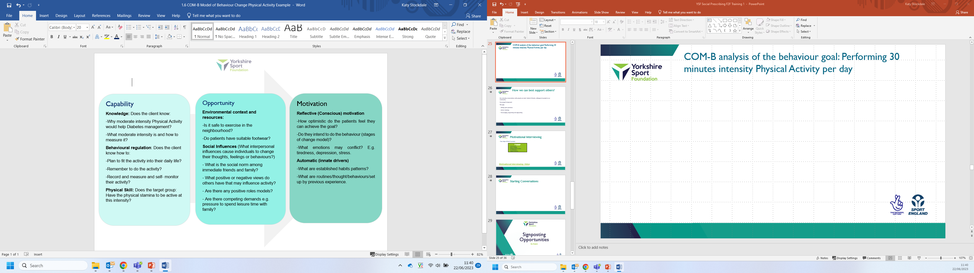
COM-B analysis of the behaviour goal: Performing 30 minutes intensity Physical Activity per day

Slide 43
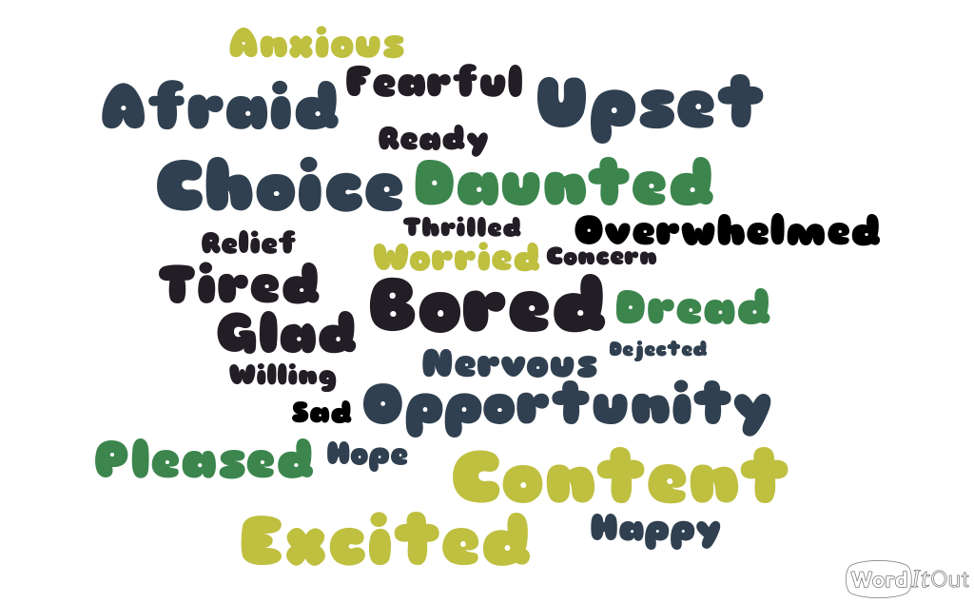
How does thinking about change make you feel?

Slide 44
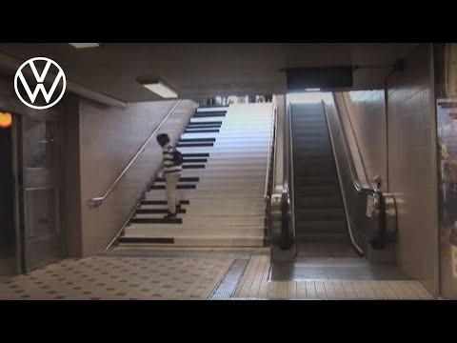
Nudge Theory

Slide 45
Having Active Conversations
Notes:
Behaviour change how can we support through and how?
How introduce the tool of transtheoretical model and discuss the different boxes aligning to a person experience.
Example template for PA
4 stages of motivational interviewing and share video
Outline top tips (in handout as well) consider a creating a goals plan for client’s template in handout.

Slide 46
How we can best support others?
Our everyday conversations are with people we meet- family & friends, colleagues & people in our community.
If you are working in Health and Social Care you’re seen as a part in enabling some to live the life they want.
Its important to remember that we all have an unconscious bias, we develop an inner group of rules that we’ve picked up during our life.
Discussing the impact of activity on health is a good way to help someone identify positive reasons for change and how they may benefit.

Slide 47
The first thing to remember is that whilst you are the health or care expert, the person you are talking to is the expert on themselves. So let that person lead, as you steer the conversation.
Find out what that person knows, thinks, and feels first. Understand what really matters to them before discussing physical activity and its benefits.
It’s about identifying what part physical activity can play in someone’s life and how it will help them achieve what really matters to them.

Slide 48
Ask
What's important to the individual
Allow the individual to be In control
Use a person centred approach
Allow the person to be involved in decision making.
Listen
People are the experts
Try to take the time to pause activities to listen and reflect.
Actively listen for emphasis
Pick up on emotion to uncover important information
Uncover concerns
Find out about all the concerns, worries and challenges the person is feeling.
Show them that what they are saying matters.
This builds confidence and trust.
Summarise
Repeat back to them and summarise what you have agreed.
Help reinforce the conversation
Find out how they are feeling
Acknowledge that the conversation dosent stop here!

Slide 49
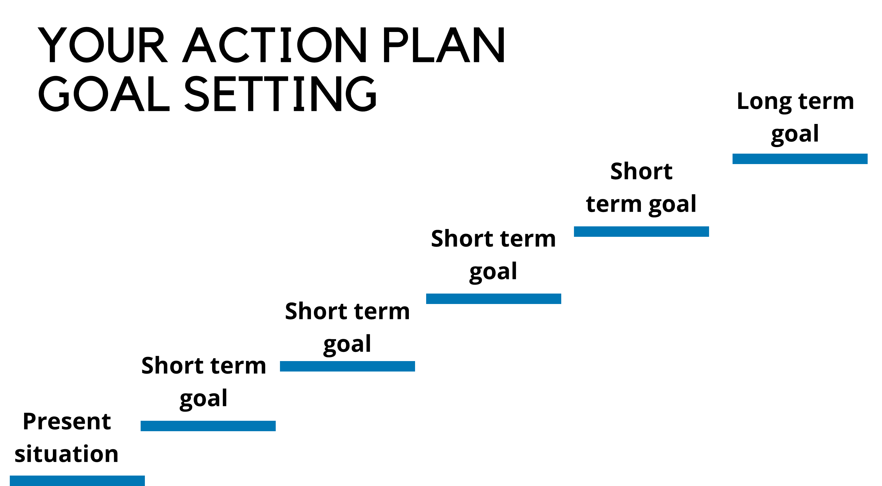
Goal setting

Slide 50
Goal setting
Outcome goals: Are measurable health outcomes or targets that an individual would like to achieve through change their behaviours. The goal may be the expected result of performing a behaviour but it does not involve planning how an individual’s behaviour will change to achieve the goal.
Process goals: A process goal involves the steps an individual is going to take to reach their outcome goal.
Both outcome and process goals are vital for behaviour change. One is unlikely to work without the other. Clear outcome goals are needed to clarify What you want to achieve, but the process goals are essential to know the action steps required to achieve this.

Slide 51
Goal setting
Common problems when we try to change.
Short term fixes
Overcommitment
Not suitable long term
Give up too easily
Its feels like its too hard
Your role:
Be specific
Be realistic
Goals can be broken down into small manageable steps
Make sure the goal is important to the person

Slide 52
Guided goal setting
You may find some people find it hard to set their own goals, or have the understanding to know what's best for them. Rather than jumping in and setting a goal for them, you can use a technique called guided goal setting, which involves providing people with ideas to choose from, based on what you already know about the persons interests and needs. A suggestion would be to create a bubble task with options for residents to choose from, you can break the information down, make it fun and relaxed and start to build a foundation and rapport.
It is common for people to want to change everything at once, but this can be daunting, unsustainable and may be setting them up for failure. Instead try and encourage residents to change one or two small things at a time, and work with them to turn those changes into habits.

Slide 53
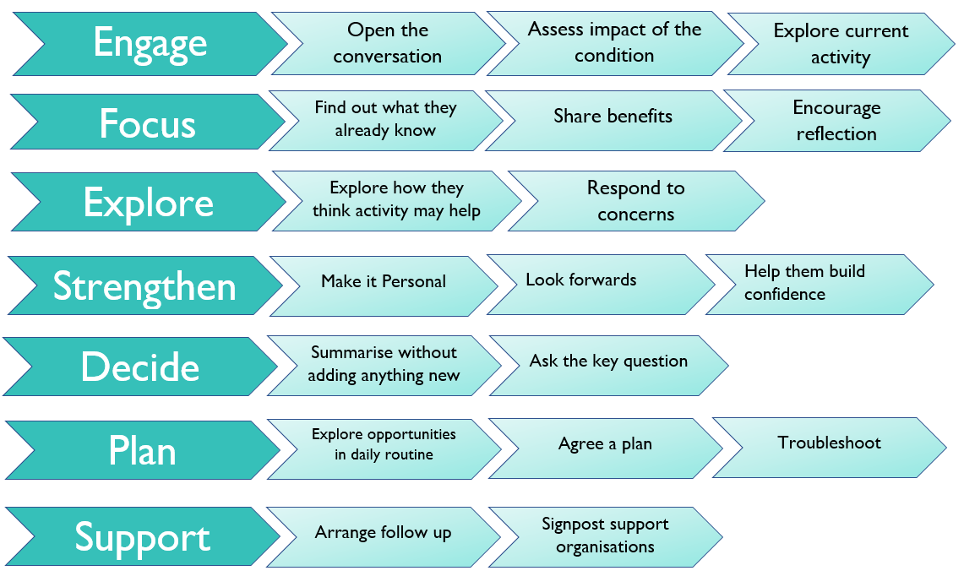
Starting Conversations
Notes:
Small groups to prepare conversations and demonstrate role play or patient and client.
Share with room, going through the process and putting together a full conversation.
Top tips sheet on conversation prompts

Slide 54
Activity
Consider some of your current residents;
Discuss how you might put goal setting into practice
How would you present the change?
What would you consider as short terms goals?
How can you support residents to make it a long term sustainable goal?
What challenges and barriers might you be presented with?

Slide 55
How confident are you in giving advice of benefits to moving more?
Using the width of the room use the scale to position yourself from not confident to very confident. Answering the following statements
Notes:
1 Activities- Scale of how comfortable they are to be actively engaged in providing opportunities for Sport and PA.
How confident do you feel about personally participating in sports and or PA under the governments recommended guidelines?
How confident are you in having conversations about being more active with others?
How confident are you in understanding the benefit of Sports and PA activity?
How important are having conversations about being active with others?
Language sorting activity- mixture of complexed language and statements on tables sort into confidence levels and then share in the room

Slide 56
Signposting Opportunities

Slide 57
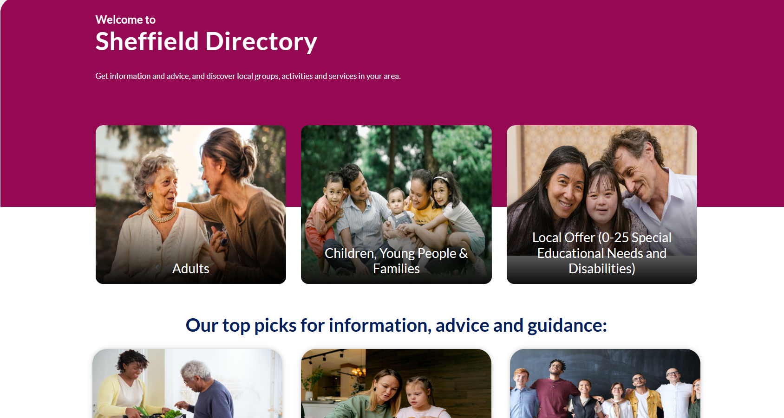
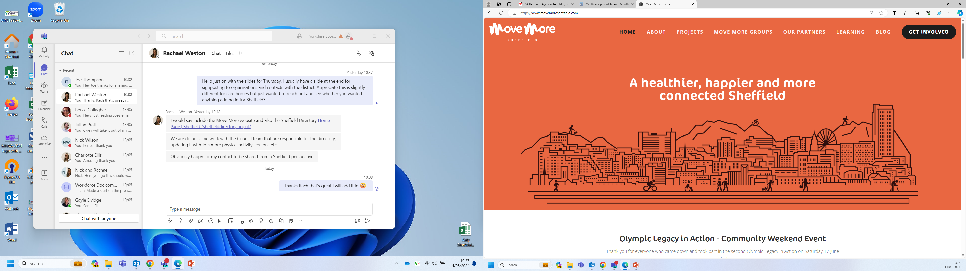
Signposting opportunities
Notes:
Trying to ensure physical activity is part of every conversation.
We have created a resource for people to talk through will clients/patients.
Focus on the benefits and improvements to health particularly the immediate effects.
Co-produced with a variety of medical practitioners an moving medicine resources.

Slide 58
Katy.Fillingham@yorkshiresport.org
Rachael.weston@yorkshiresport.org
Contact Information

Slide 59
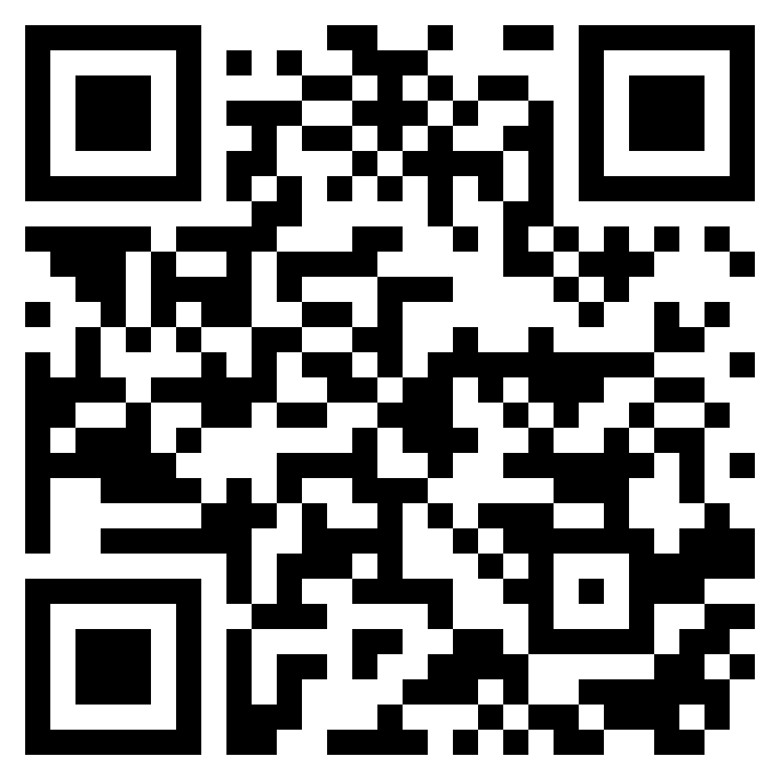
Evaluation

Slide 60
Thank you

