Slide 1

Kirklees Active Leisure (KAL)
Integrating Health & Wellbeing programmes within Leisure Services
‘The focus, approaches & working examples’
Amy Roden – Health Partnership Manager, KAL

Slide 2
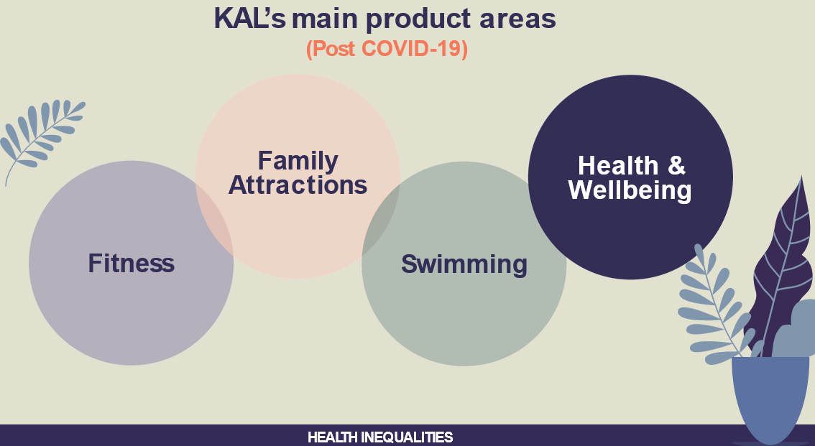
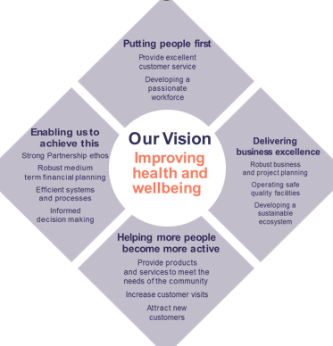
Where did we start?
New KAL Corporate Strategy:
- New Vision: “Improving health & wellbeing”
- From a leisure service to part of the preventative health service…
Local, regional & national insight & focus – Sport England, UK Active, PHE, local HWB plans, etc..
The impact of health inequalities and the need to work with partners to better engage inactive people
Increased capacity & knowledge on how the Health systems work/align with Leisure:
KAL Health Partnership Manager role

Slide 3
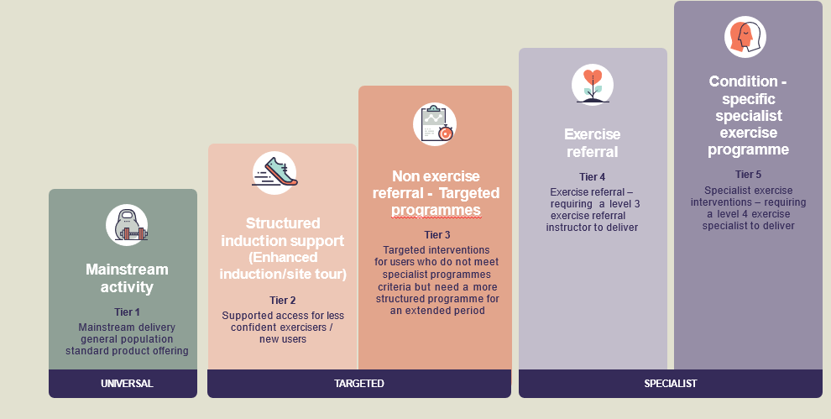
A new approach…
Introducing Targeted and Specialist delivery
Embedding a new culture
Working with new partners from across the health sector to embed, engage and promote
Demonstrating a health impact: robust & validated health related outcomes

Slide 4
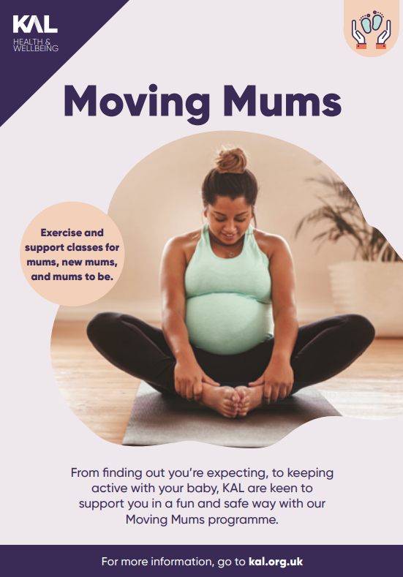
Example 1: Targeted provision -
Moving Mums Programme
The Journey…
What we had..
Programmes aimed at pre and post natal women
Ad hoc/one off sessions, lack of co-ordinated promotion or working with key maternity/early years services
Where did we start..
Engaged with local Best Start partnership
Involvement in the WYH LMS Recommendations (Physical Activity)
In line with the CMO recommendations/promotion of physical activity guidelines for pregnant women/women after child birth
Looked at the workforce - experienced/qualified pre/post natal exercise specialists to deliver sessions
Variety of sessions
Secured evaluation from Sport England’s “This Girl Can” campaign

Slide 5
The Partners & Outcomes
What partners did we engage with:
Public Health team
Local 0-19 service delivery partners
Local maternity services – Hospital and health services
Voluntary sector maternity groups
Outcomes:
Over 500 new self referrals in the last 15 months
Initial Evaluation
Information on moving mums included at maternity clinics, on maternity websites
Links with key groups, Maternity voices (feedback)
Retaining members due to a comprehensive offer
What next:
Continue to work with partners to improve the programme/gather patient feedback
Extension of the programme, post natal offers/
engagement
Specific pathways with maternity services – e.g. maternal obesity
HCP Awareness/training
Nothing too innovative, simply packaging the offer and changing the way we engage
to reach and promote through local health services…

Slide 6

Example 2: Specialist provision -
Cancer Prehab & Rehab Programme
Background
-Current KAL specialist exercise pathways
-Partnership working on a wider footprint/cross boundary working
-Joint approach with the Hospital trust, partner authorities and funding charity
-Based on a successful evaluated pilot model
What’s different?
-Integrated into patient pathways from the beginning/part of patient treatment plan
-Opt out model/approach
-Multidisciplinary approach (Nutrition, Psychological support & Physical Activity)
-One team approach/support

Slide 7
Example 3: Demonstrating the Impact – University of Huddersfield Partnership
Outcomes for KAL:
Robust outcome data from health-related programmes to share with commissioners
Independent evaluation
Opportunities for further research and building the case for health-related physical activity
Recommendations for service delivery improvements
Opportunities for pilot work to expand current delivery
Links to wider networks such as academic health science network
What have we put in place:
Development of a robust evaluation framework across Universal, Targeted and Specialist delivery
Clear health related outcomes/impact – QOL, mental health/social outcomes as well as physiological outcomes
Use of validated questionnaires
Additional Research/evaluation
Process evaluation – service improvement
Research placements – OT & Midwifery
Fully funded PHD post
Economic analysis/cost savings evidence TBC

Slide 8
Any
Questions?

