Slide 1
Kirklees and Calderdale
Health and Wellbeing
Overview of current and future health and wellbeing offers
Michelle Dooling
Kirklees Place Project Coordinator
Michelle.dooling@cht.nhs.uk

Slide 2
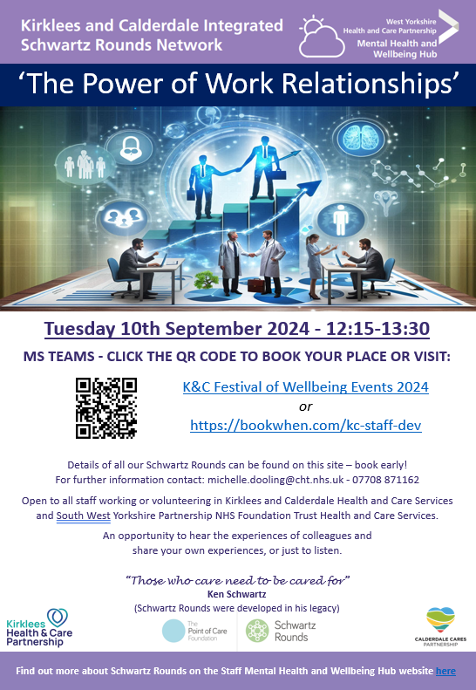
Kirklees and Calderdale Integrated Schwartz Rounds
Tuesday 10th September 2024 - 12.15:13.30 - MSTeams
The Power of Work Relationships
Thursday 10th October 2024 - 10.00:13.00 - John Smith's Stadium
"LIVE ROUND" (linked to World Mental Health Day)
I'm Still Standing
Tuesday 12th November 2024 - 12.15:13.30 – MS Teams
Thinking Differently - Neurodiversity in the Workplace
February 2025 – MS Teams
From Hurt to Healing – Coping with Workplace Bullying
March 2025 - "LIVE ROUND"

Slide 3
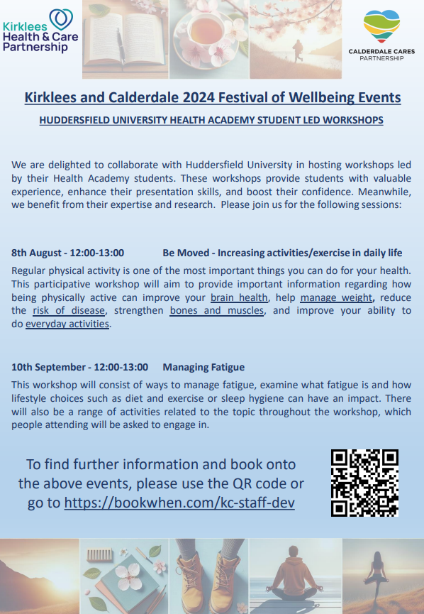
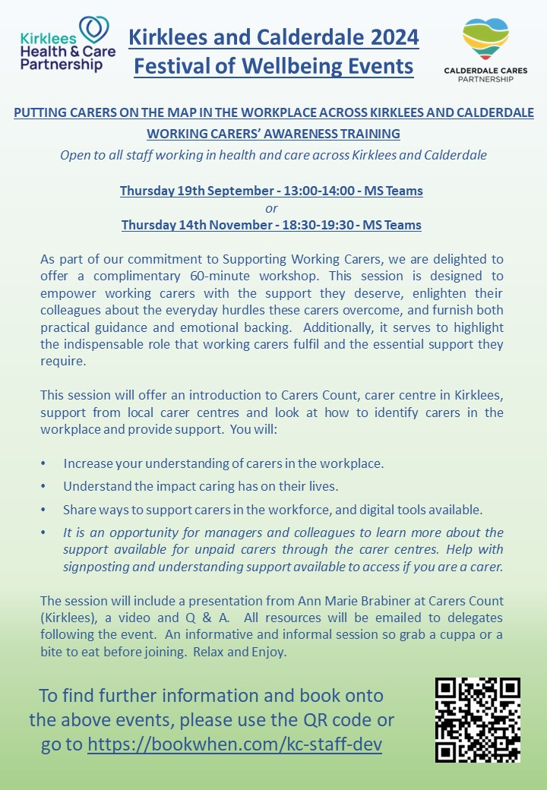

Slide 4
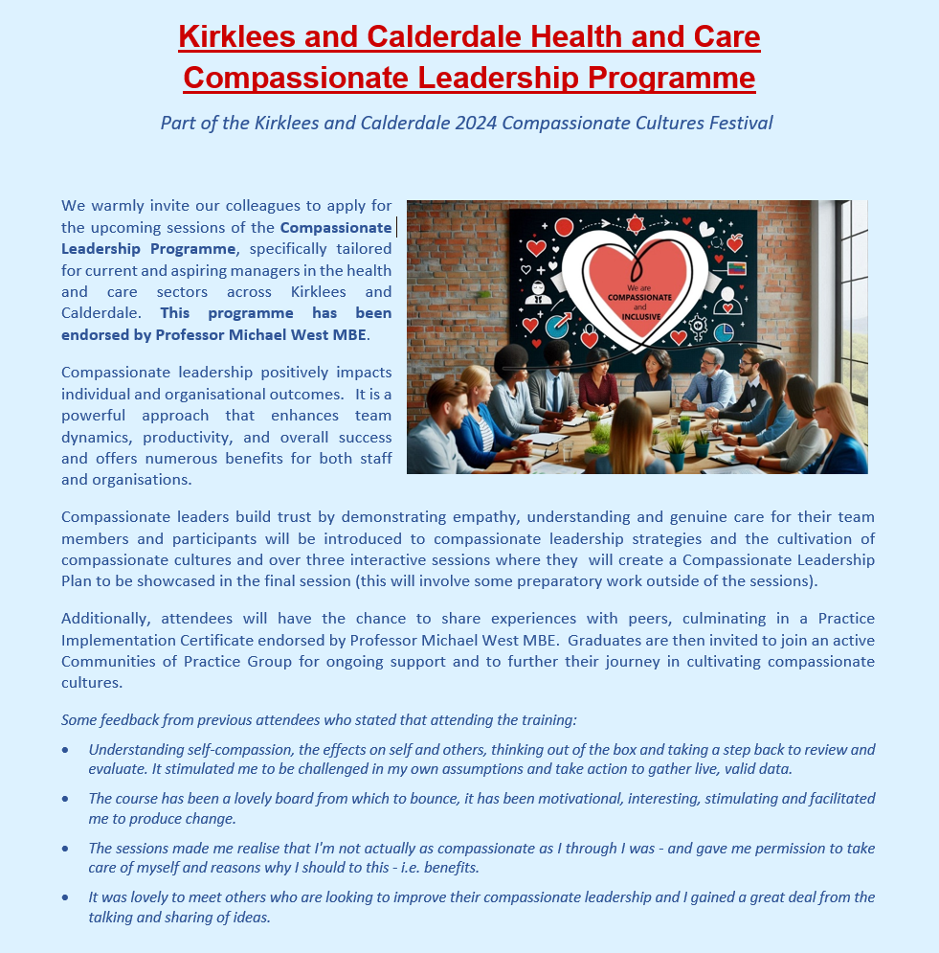
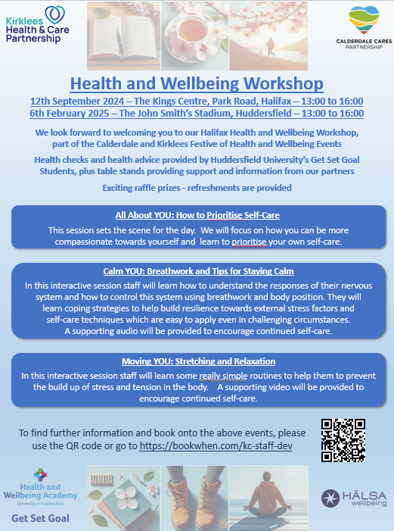

Slide 5

HOW CAN I FIND OUT MORE?
Book onto any of our future events https://bookwhen.com/kc-staff-dev
Watch the video made by the Kirklees and Calderdale Schwartz Round Steering Group
K&C Schwartz Rounds Video
Contact Michelle.dooling@cht.nhs.uk

