Slide 1







Sharing the Learning Series
Whole Systems Physical Activity:
Locality approach and the role of greenspace

Slide 2
Aims:
To bring regional partners together to share learning on whole systems physical activity on:
      A locality/neighbourhood approach
The role of parks and greenspace
Overview:
Three presentations on WSPA Locality working approach
Workshop and discussion
Walking tour of JU:MP Scotchman Road Neighbourhood
12.30 – 1pm Lunch and networking
Two presentations on role of parks and greenspace in WSPA
Workshop and discussion
Sport England; Sharing the future plans on place based
Summary and next steps - networking

Slide 3

Anthony Whittaker – Community Engagement Coordinator
Taking a Whole of Systems Place Based Approach

Slide 4
What Are We Trying to Achieve?
Influencer Behaviour Change Matrix
 | MOTIVATION | ABILITY
PERSONAL | I have reasons to move, reasons that matter to me I have opportunities to give moving a go | I know about the opportunities and ways available to me to move more and are reminded of them regularly
PEOPLE | I see and have role models like me that are moving and being active | I am supported & encouraged to move more by peers, organisations and institutions that I know and trust
PLACE | I have access to safe, accessible and attractive places and spaces to move more – streets, public realm, parks, green spaces | I have access to attractive, inclusive, affordable and timely opportunities to move more – formal and informal

Slide 5
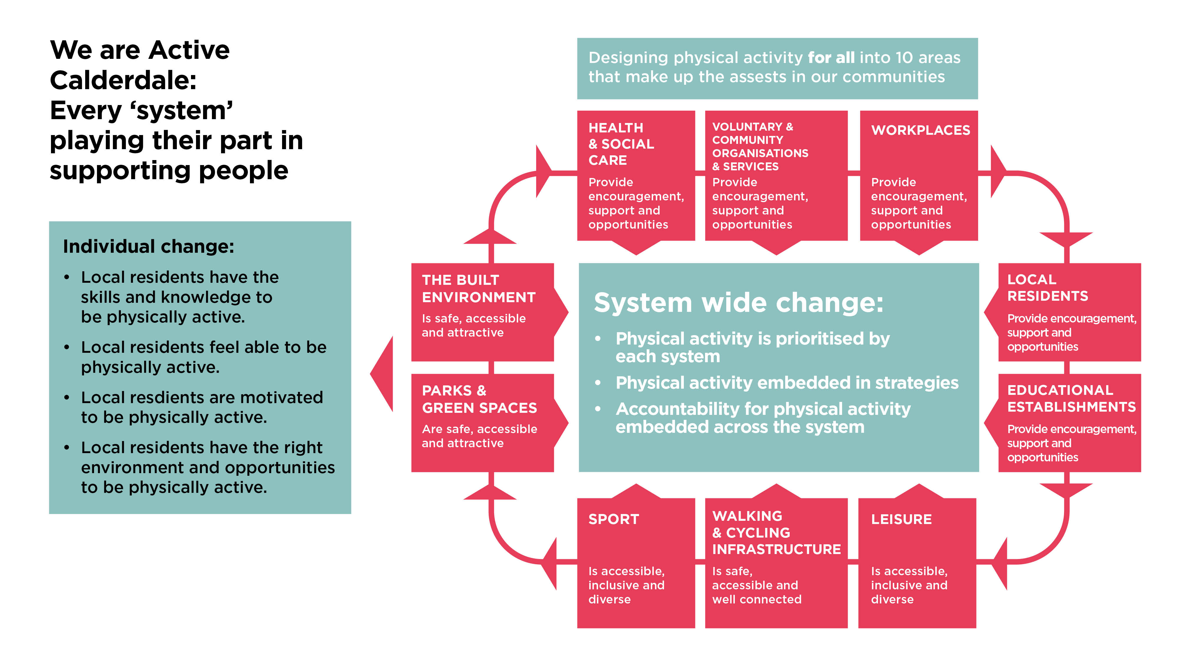
Whole of Systems Based Approach
Lower socio economic groups
Women and girls
Those with a disability or long term health condition
Older adults
Black, Asian and Minority Ethnic (BAME) people

Slide 6
System Working
Myron’s Maxims
People own what they help create
Real change happens in real work
Those who do the work, do the change
Connect the system to more of itself
Start anywhere, follow everywhere
The process you use to get to the future is the future you get

Slide 7
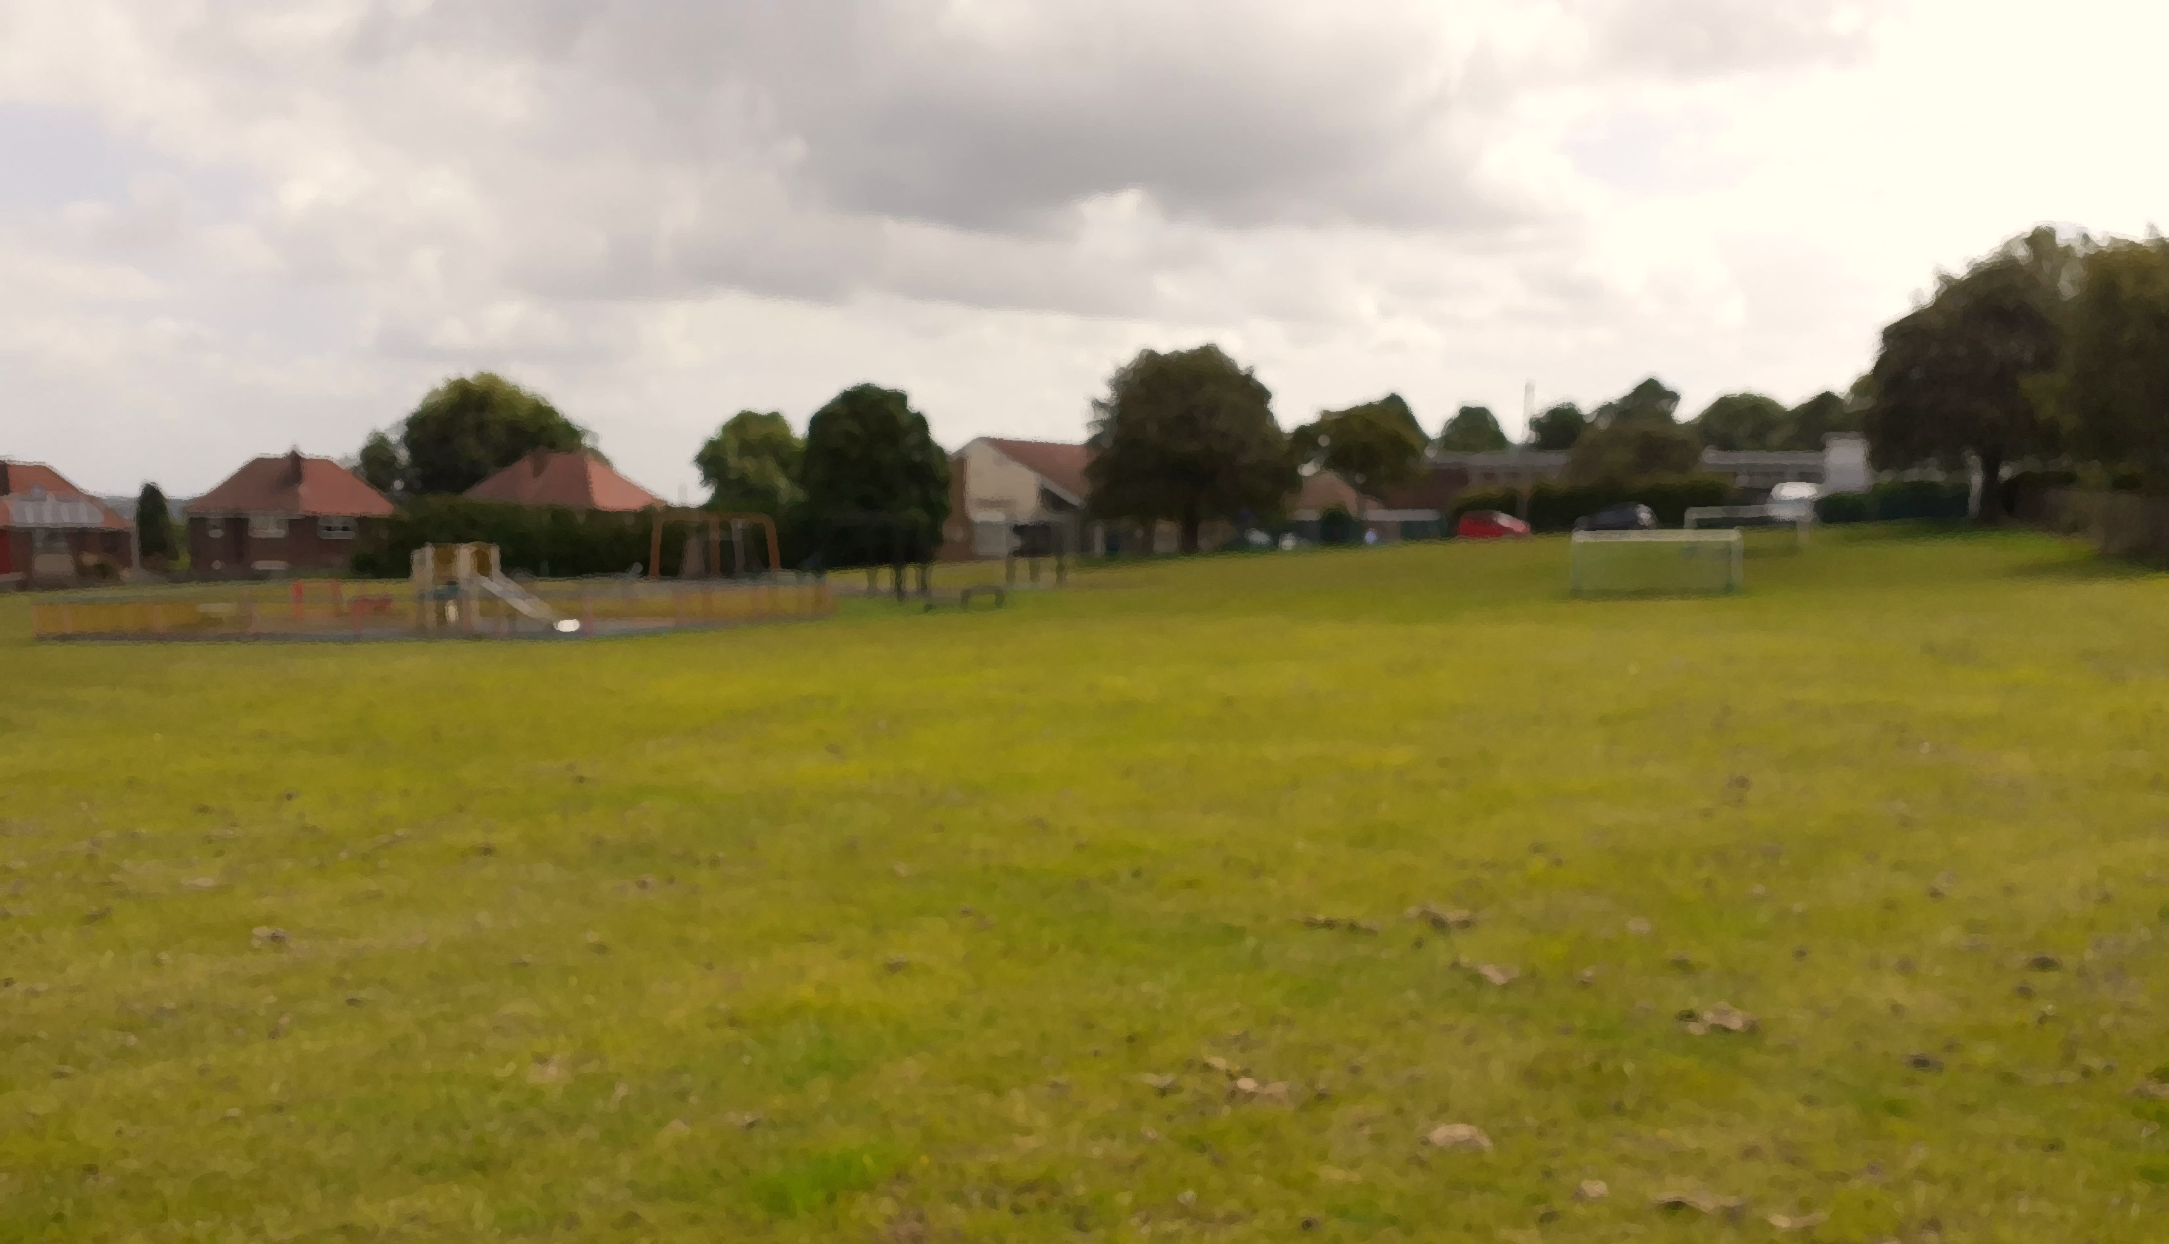
Rastrick Calderdale

Slide 8
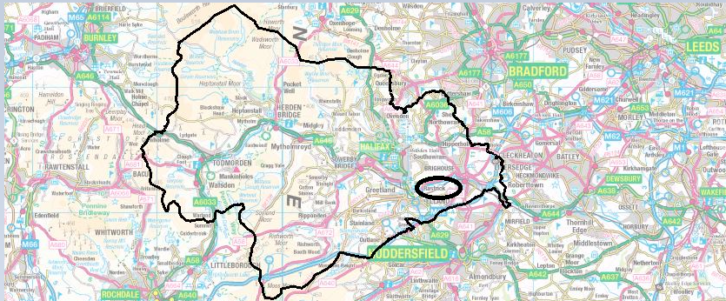
Rastrick

Slide 9
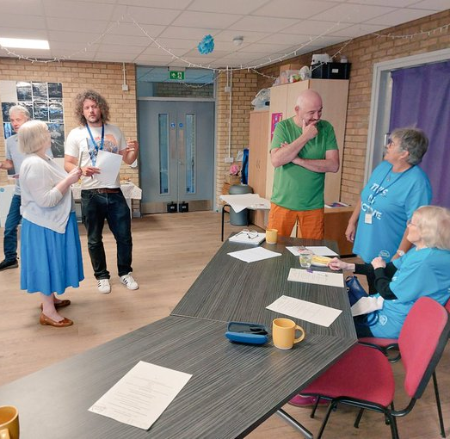
Learnings
Only use when the asset is ready
Varies on how it’s used
Important to be highly interactive and visually pleasing
Redesign Workshop
The Space @ Field Lane
Cement the why
Develop the how
Results from The Space

Slide 10
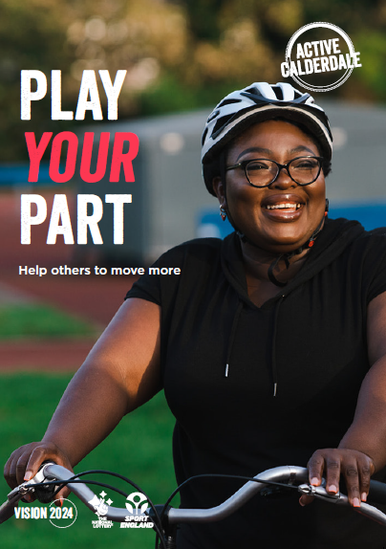
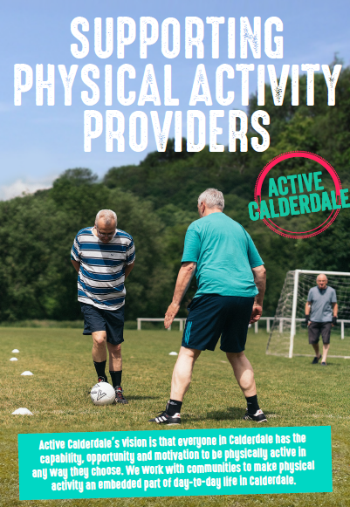
Core Documents

Slide 11
Stimulating Communities
How?
Staff challenges
Rastrick Around the World Challenge
Learnings
Challenges stimulate engagement
Direct experiences act as a catalyst to develop relationships
Bigger challenges should include shared responsibility
Take the time to build some relationships in an area before starting a challenge

Slide 12
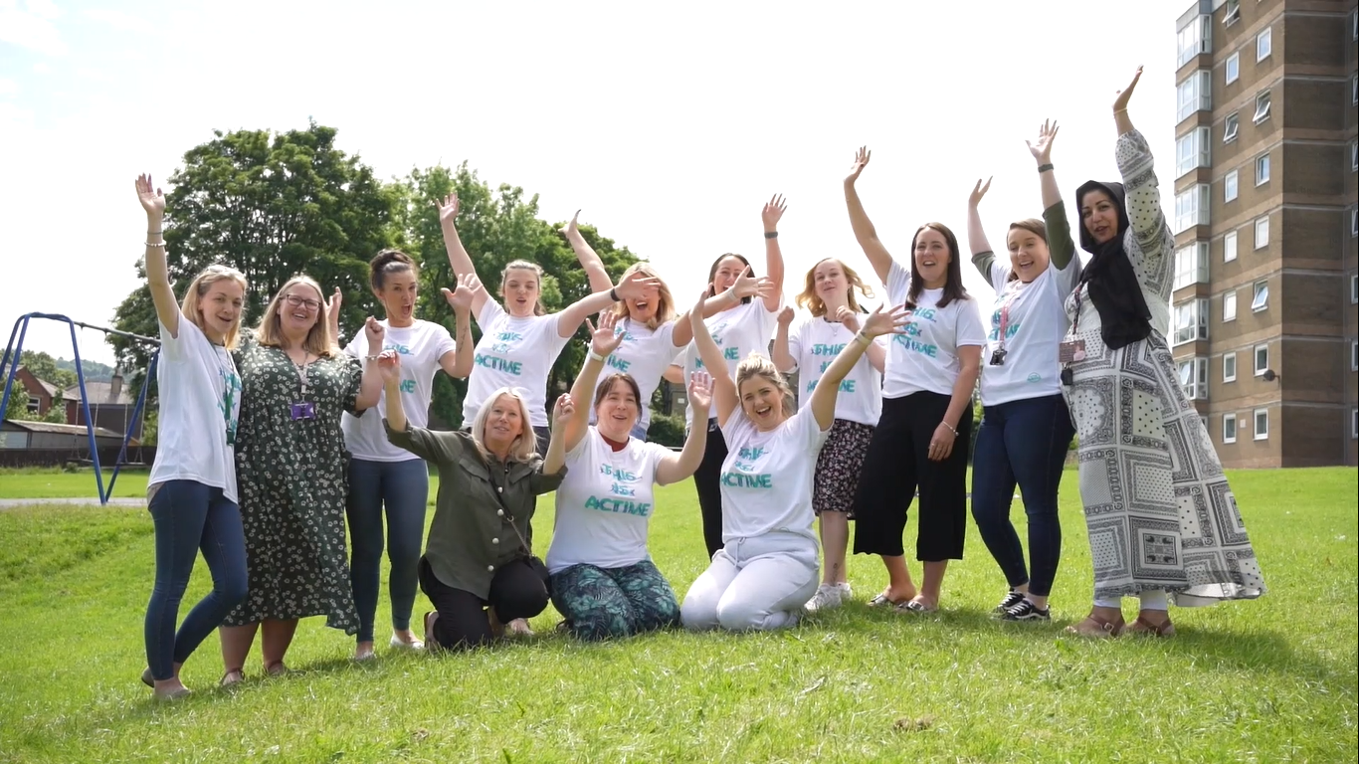
Sure Start Active Challenge
Outcomes
Staff found themselves walking to their visits more often
Staff were taking part in more walking meetings with families
Staff felt more positive, connected and reported improved relationships with each other
Staff also reported improved self-esteem, more get up and go, feeling happier and healthier, better-quality sleep and a general improvement in physical and mental wellbeing
Staff are having more conversations with families about being active, with more signposting to opportunities

Slide 13
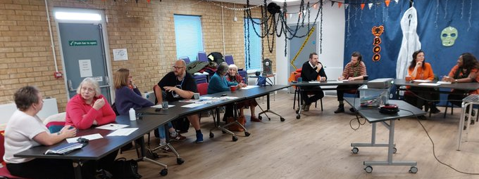
Active Partnerships
Physical activity providers
The public
Care home
Leisure services
South-West Yorkshire Partnership NHS Foundation
Community Centre
Who?
Referring services e.g., SPLW’s
Adult Health and Social Care
Schools
Greenspaces
Library

Slide 14
What Does System Change Look Like in Rastrick?
🗸
🗸
🗸
🗸
🗸
🗸
🗸
🗸
🗸

Slide 15
 | MOTIVATION | ABILITY
PERSONAL
PEOPLE
PLACE
I have reasons to move, reasons that matter to me
I have opportunities to give moving a go
I know about the opportunities and ways available to me to move more and are reminded of them regularly
Local people take part and encourage others when it comes to local community challenges
Local community centre has active conversations with local people
Referring services encourage and support people to access local active opportunities
Local school highlights opportunities to be active
Library highlights local opportunities to be active on noticeboard
Local area newsletter promoting opportunities to be active
Local organisations aware of opportunities to move more through Active Partnership meetings
I see and have role models like me that are moving and being active
I am supported & encouraged to move more by peers, organisations and institutions that I know and trust
Social care staff take part in local activities
Children centre staff take part in regular staff challenges
The majority of local organisations take part and promote organised community challenges including GP Practices
Local people are active in Active Calderdale branded clothing
Staff at children centres have the equipment needed to be active during their workplace
Social care supporting their clients to move and access opportunities in the community
Schools, community centre, library, referring services, children services, social care all having conversations about moving more as part of what they do
I have access to safe, accessible and attractive places and spaces to move more – streets, public realm, parks, green spaces
I have access to attractive, inclusive, affordable and timely opportunities to move more – formal and informal
Local nature reserve has increased its accessibility to ensure it has an offer for all local people
Improved signage to direct more people to more greenspaces
Calderdale leisure service delivering activities in a local community centre due to lack of accessibility of the leisure centre
Local community provides free, informal opportunities to move such as pool and golf putting

Slide 16
What’s Next?
Engage More Assets
There are a number of assets who have not yet responded to our approaches
Invest More
Plans for investment in a local park, canal, opportunities to be active
Active Champions/Ambassadors
Greater level of insight and encouragement
Shift Responsibility
Exploring a further shift in responsibility to the assets
Affordable Opportunities
More affordable provision in response to the current cost of living crisis

