Slide 1
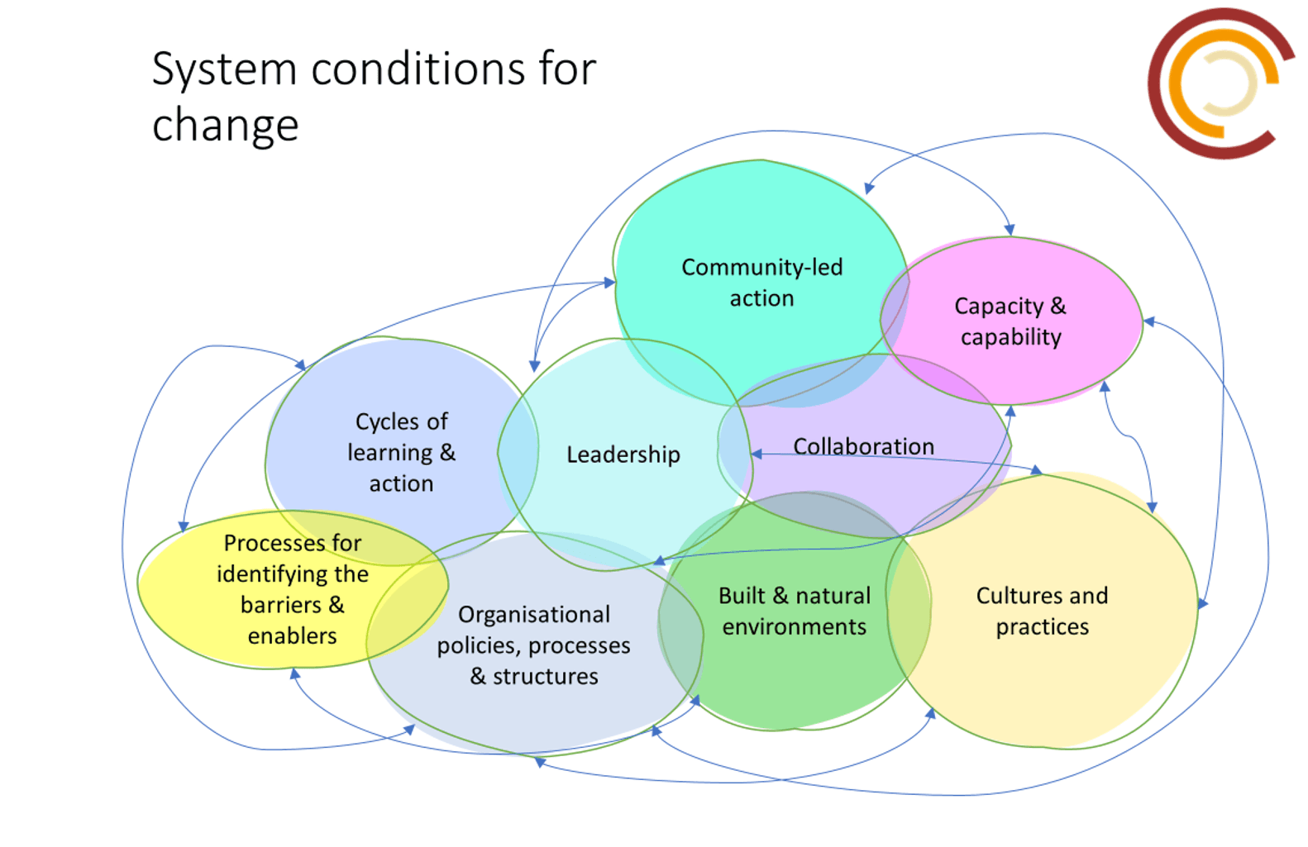

Slide 2
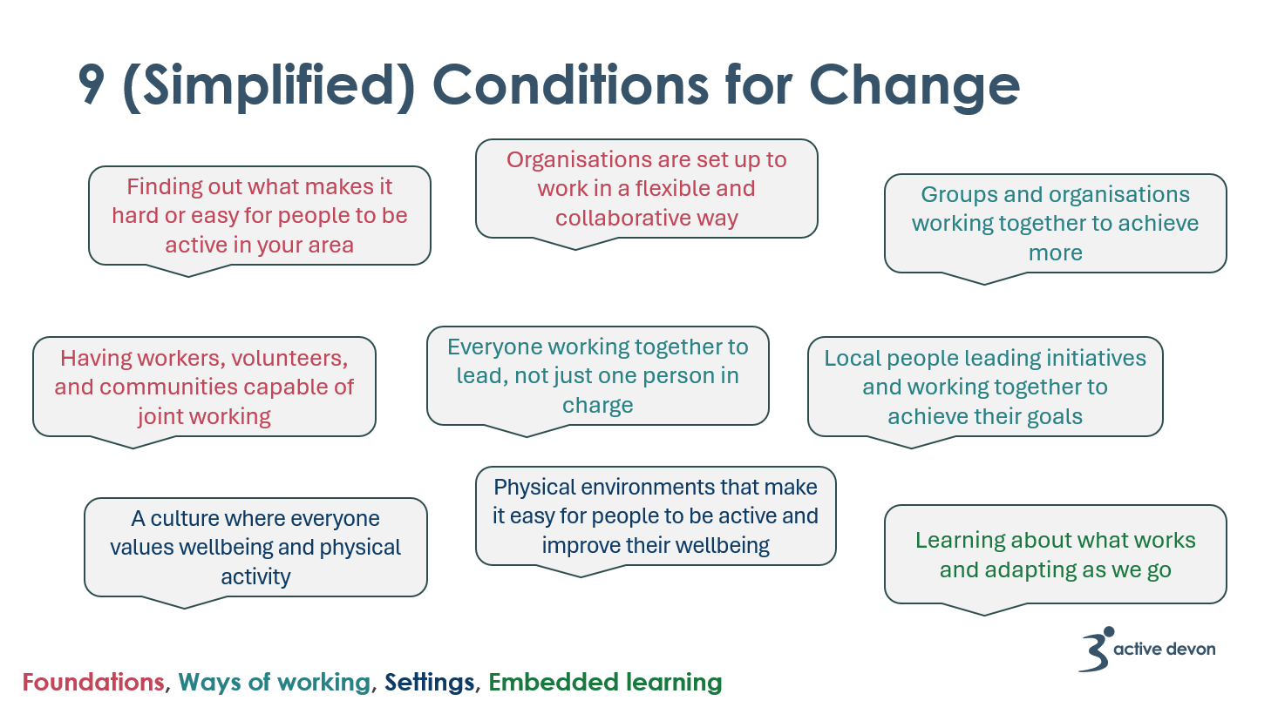

Slide 3
Conditions for tackling physical activity inequalities
Integration of physical activity into sectors
Strengthening community & individual capacities
Tackling structural inequalities
Processes for identifying the barriers and enablers of physical activity
Foundations
Organisational policies, processes and structures that enable place-based working
Capacity and capability across the workforce, volunteers and in communities
Ways of working
Collaboration
Leadership
Community led Action
Settings
Cultures and practices for physical activity
Physical environments that enable physical activity
Embedded learning
Cycles of learning and action
Link to more description on the 9 conditions
Notes:
KEY MESSAGE: This is a signposting slide (do not spend long).
You have probably seen earlier today and heard people talk about the conditions for tackling PA inequalities.
Through our learning from places (the 12 LDPs), we have identified 9 conditions for tackling physical activity inequalities that may be relevant to your local learning. This is not a blueprint, but more of a scaffold or a framework for you to think about local learning and how to structure your evaluation. These conditions can be used to help us share and understand what we are seeing across places. This can be a useful tool for reflective partnership building in place.
There is not time to talk through each condition in depth, however there is a link on the slide to a webpage with more descriptive depth on each condition.
(extra for facilitators)
EXAMPLE TO BRING TO LIFE:
So in our example with the children cycling, we can use these conditions to help us think about the way of working, for instance, if through your local learning you learnt that young girls in a certain postcode were less likely to cycle to school because of feeling uncomfortable with how to dress for cycling, this would relate to the cultures and practice condition – we have lots of resources to help guide your work in this area and equally we would want to hear back from you about your experiences of working in this way and how and why change was able to happen or not.

Slide 4
Approaching evaluation: Cycles of learning to action
What did we learn?
Develop your assumptions (thinking in explanatory way)
Plan next steps
Test them out
Reflect on findings (social learning spaces)
Capture data or findings
Notes:
We need to think about evaluation and learning as a continuous cycle that helps guide you in your work. If you just do this at the end, you miss out on being able to adapt based on what you are hearing and learning along the way. Having points to stop and reflect and make changes, enables you to create a more successful approach to tackling PA inequalities. Over time, this cyclical nature of evaluating and learning can become embedded in the way that people work.
(Important takeaway – we are not evaluating in a linear way).
Talk through the cycle and highlight developing assumptions (explanatory thinking)
Develop your assumptions – we think that if we intervene (changing something) in this way then it will change conditions (e.g. attitudes, behaviours, barriers) because (e.g. people have told us, or research shows that this important to facilitating engagement in PA)
Test- don’t leap to scale – lets see if this works
Capture data or findings – how? (Could be counts, people’s feedback, observation)
Reflect: What has helped or prevented this being effective? Both equally valid learning

Slide 5
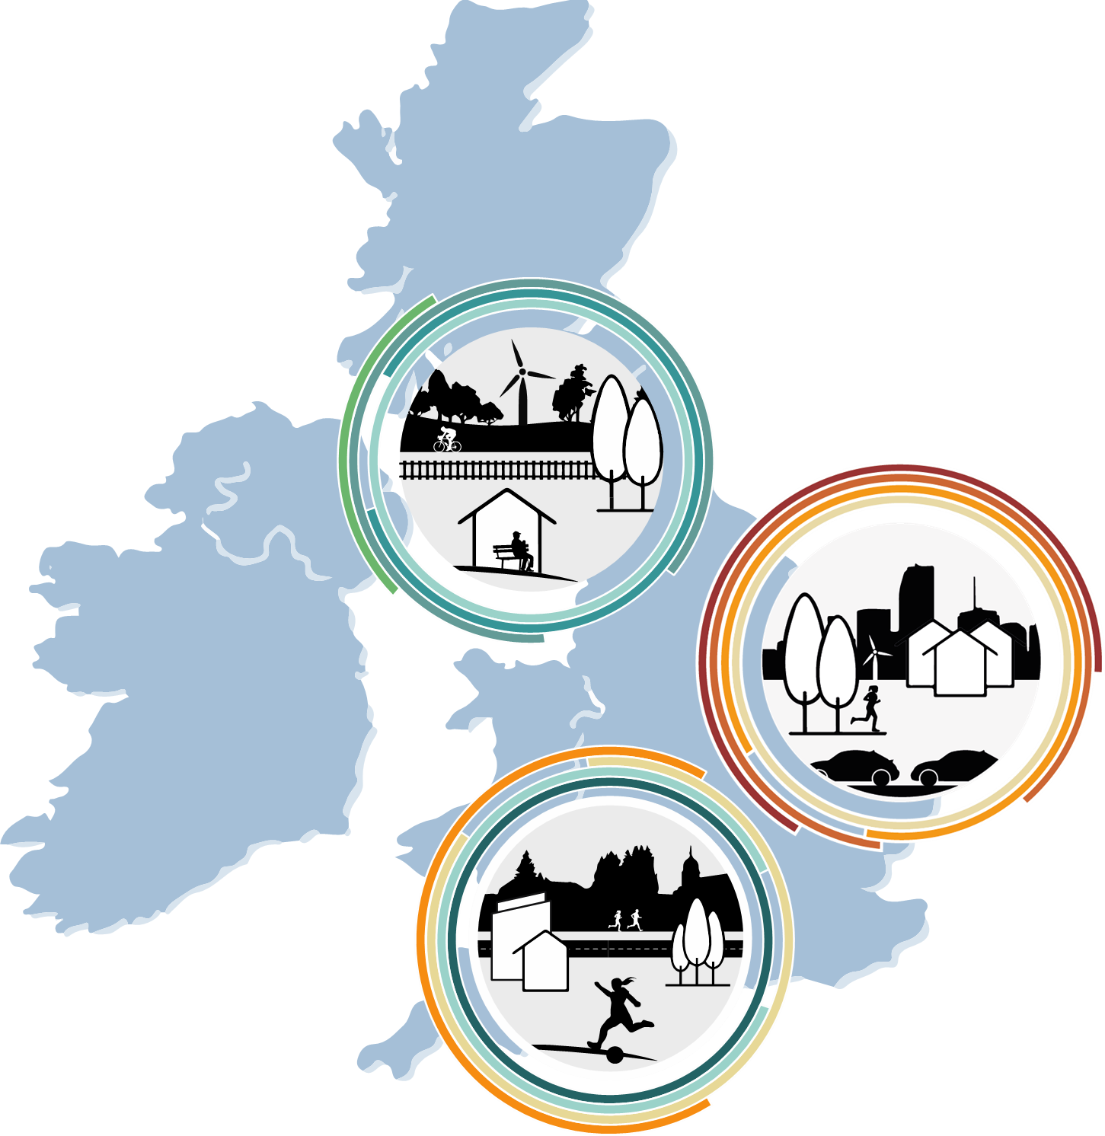
Place Evaluation and Learning Approach (PELA)
Sharing explanations of change
System maturity survey
Place:
Place responsibility
Cross-Place:
NELP responsibility
Evaluation
Locally determined. Explanations of change. Explanatory frameworks
Action
Multi-partner practice and collaboration Community practice and initiatives.
Pathways to impact
Complex case comparison utilising CCA
Synthesis
Realist synthesis
Overarching Conceptual Framework
Social learning spaces –
inform action and adaptation
Collective sense-making

Slide 6

Process evaluation overview
Ripple Effects Mapping (A, B)
Aims:
What is implemented and how, and the feasibility of implementation (A, B)
What about it works (or doesn’t work), how and why it works (or doesn’t work) including interaction with the delivery context (A, B, C)
Lived experiences / acceptability of ‘receiving’ JU:MP (C)
Researcher observations (A, B, C)
Balanced scorecards (B)
Behaviour change surveys (A, B)
Network mapping surveys (B)
Interviews and focus groups (A, B, C)
Reflections (A)
Citizen science study (C)
A = Strategic process evaluation; B = Neighbourhood process evaluation;
C = Child and family process evaluation

Slide 7

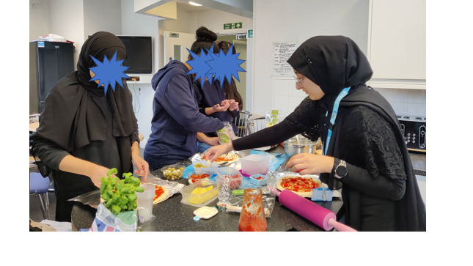
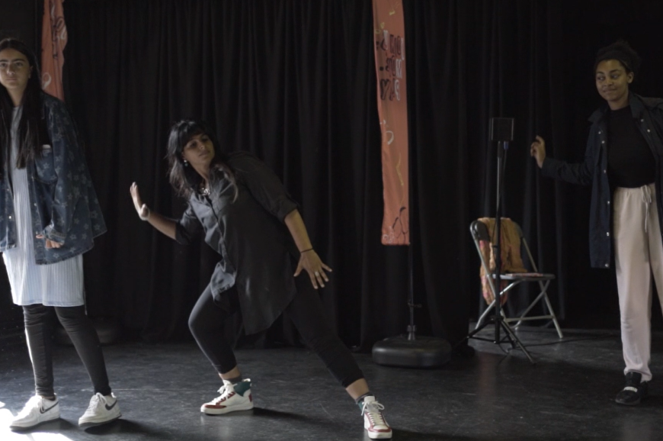
Collaborative citizen science approach

Slide 8

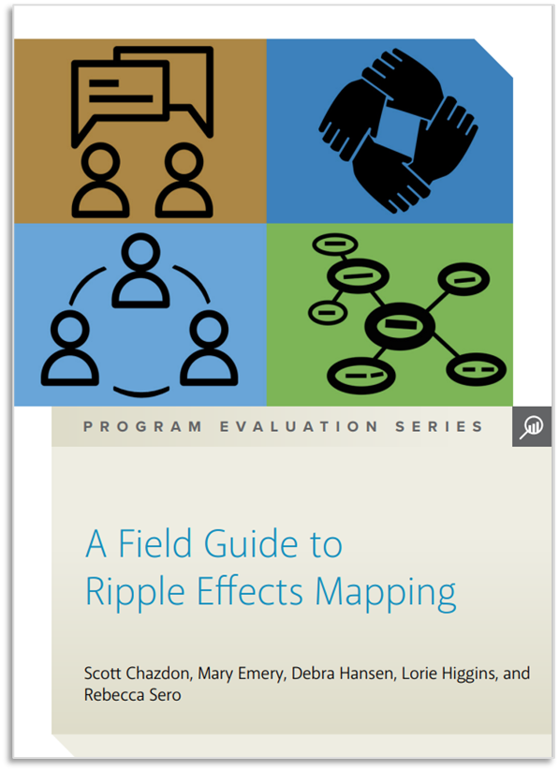
Ripple Effects Mapping
REM originated from Community Development work in America in 2015.
A way of understanding the wider, intended and unintended, impacts of a project or programme over time.
A qualitative form of impact evaluation focused on contribution.
Takes a participatory approach.
Can be used alongside other methods (e.g., interviews, surveys, systems mapping).

Slide 9
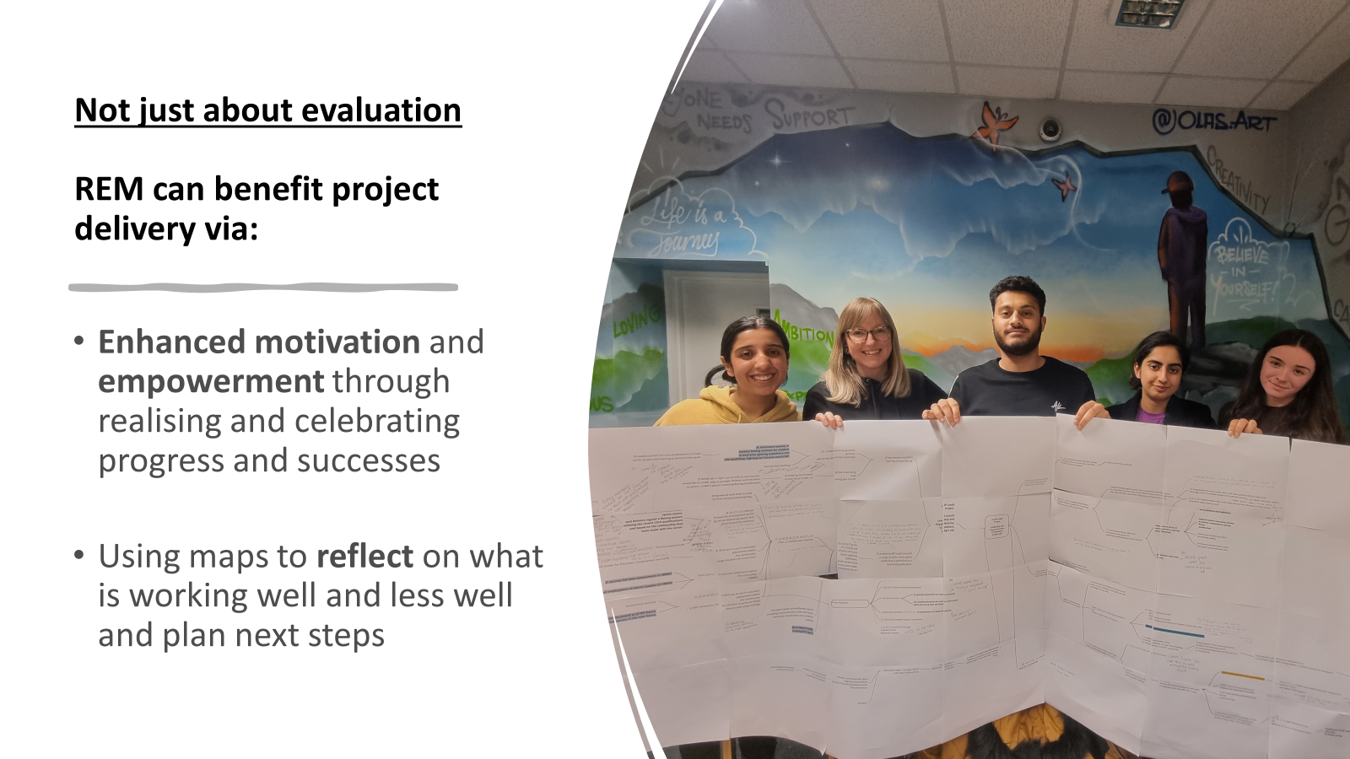

Slide 10
ACTIVITY: REM – how has the place partnership work contributed to change in [place]?
Step 2: Mapping the impacts (60-90 mins)
Focused more on the “what” rather than the “how”.​
Telling the story of your impacts and what you ​have done over time (see timeline).​
Time between impacts only need to be an estimate.​
Links between impacts or between actions. ​
Work forwards and backwards. ​
Don’t need lots of detail, just enough to tell the story
Step 3: Adding further detail (same time as step 2)
Then what happened/what contributed to that happening?
Who has been impacted upon (i.e., people, ​
organisations, ‘systems leaders’)? How many?​ Who was involved?
Have you noted any financial impacts (i.e., did impacts lead to additional funding being generated?)​ How much did it cost?
Of your impacts, which were intended (I) and which were unintended (UI)?​
Any wider contextual factors that contributed to the observed impacts? ​
What do you anticipate will/want to happen in the next three months? (put these in a different colour!)

Slide 11
JU:MP-related publications and wider dissemination outputs
Hall et al. (2021) - Process evaluation protocol. BMC Public Health
Helme et al. (2022) - Impacts of Creating Active Schools on organisational culture. ERPH
Frazer et al. (2023) - Child and family citizen science evaluation protocol. BMJ Open
Bingham et al. (2023) - Effectiveness evaluation protocol. JMIR Research Protocols
Seims et al. (2023) - Systematic review of children's physical activity at home. PLOS ONE
Morris et al. (2023) - Impact and implementation of Creating Active Schools. IJBNPA
Steward et al. (2023) - Young physical activity leaders Delphi study. PLOS ONE
Hall et al. (2024) - Reflections on co-producing toolkit for Islamic Religious Settings. IJBNPA
Crowther et al. (2024) - JU:MP Leads evaluation. Frontiers in Sports and Active Living
Creaser et al. (2024) - Adapting Ripple Effects Mapping for evaluating public health initiatives in complex systems. Evaluation
Hall et al. (2025) - Embedding physical activity in local policy and practice. IJBNPA
Overarching strategic, neighbourhood and child and family process evaluation findings papers currently being drafted!
JU:MP Films: (24) Active Bradford – YouTube
REM training videos: Introduction to Ripple Effects Mapping - ARC West (nihr.ac.uk)
Sport England reporting: Explanatory accounts
Sport England place change makers podcast: Episode 5: The Power of Reflective Practice (youtube.com)
Yorkshire Sport Foundation process learning podcast: Three episodes covering (1) what is process learning?, 2. how to put together a process learning report, and 3. hints and tips for your reporting
JU:MP sharing learning website: Welcome to JU:MP - JU:MP

