Slide 1
Welcome
Training for Health and Care:
Helping People To Move More.

Slide 2
Who are Yorkshire Sport Foundation?
Yorkshire Sport Foundation is a charitable company limited by guarantee and is the Active Partnership for the West Yorkshire and South Yorkshire areas.
Our vision is for there to be ‘a vibrant, healthy, prosperous Yorkshire through everyone moving more’ and our role is to connect, influence and support organisations in doing so.
We believe in the power of movement, physical activity and sport to change people’s lives, bring us together and tackle inequalities. We want as many people as possible to enjoy all the benefits being active can bring.
Notes:
Introductions to myself
Introduction to the training, pilot and Partnership with ICB
Introduction to the wider work for YSF and the organisation

Slide 3






Group Agreement

Slide 4
Angela’s Story
https://vimeo.com/cotswoldtv/review/730634136/f27adae2a0

Slide 5
Introduction
Welcome to this session, designed to help people working in health and social care to encourage the people they support to increase their movement and activity levels.
Supporting people to lead more physically active lives is not only great for health, but brings wider economic, social, and organisational benefits too. When you work in health and social care, you play a key role in helping people to unlock these benefits, but research insights tell us there are many challenges to face.
Today, our aims are to:
Recognise those challenges,
Break down the barriers that exist for people whether cultural, leadership or personal,
Explore solutions, and
Increase your confidence, skill and knowledge in approaching conversations with people about moving more and being more active.

Slide 6
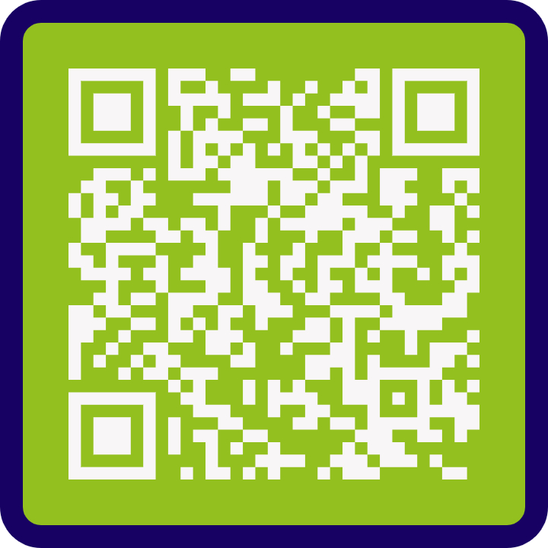
Resource Bank

Slide 7
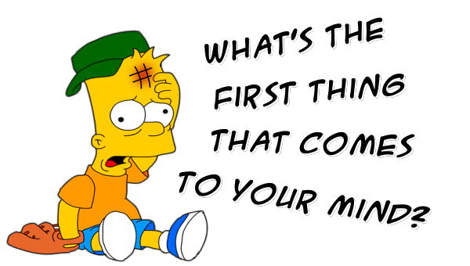
The Definition of Physical Activity
Notes:
Mentimeter to explore definitions and completed language in the world of health and PA.
Understand the space and purpose of training and dispel any myths related to the complexity of language choice and training.
Introduce Parking lot
Explore some definitions and introduce the simplicity of moving more

Slide 8
Exercise
Is typically planned, structured, repetitive and intentional movement.
Exercise is also intended to improve or maintain physical fitness.
Physical Activity
Any movement that is carried out by the muscles that require energy.
In other words, it is any movement a person does.
VS

Slide 9
Quiz
1. What are the UK current physical activity recommendations per week for adults?
A. 3 times 30 minutes
B 2 times 60 minutes
C. Every day 45 minutes
D. 5 times 30 minutes
D. 5 times 30 minutes

Slide 10
2. What frequency are the UK recommendations on strength training per week?
A. 5 times 60 minutes
2 times 30 minutes
B. 2 times 30 minutes
C. 3 times 25 minutes
D. 5 times 30 minutes

Slide 11
3. What is the average time the UK population per day sit down?
5 hours
B. 9.5 hours
The same as a long haul flight!
B. 9.5 hours
C. 11.5 hours
D. 7 hours

Slide 12
4. People who don’t regularly exercise lose what % of muscle strength by age 65?
A. 40%
B. 25%
C. 80%
C. 80%
D. 60%

Slide 13
5. How many teaspoons of sugar does a large Starbucks white chocolate mocha contain.
A. 11
C. 18
B. 5
C. 18
D. 9

Slide 14
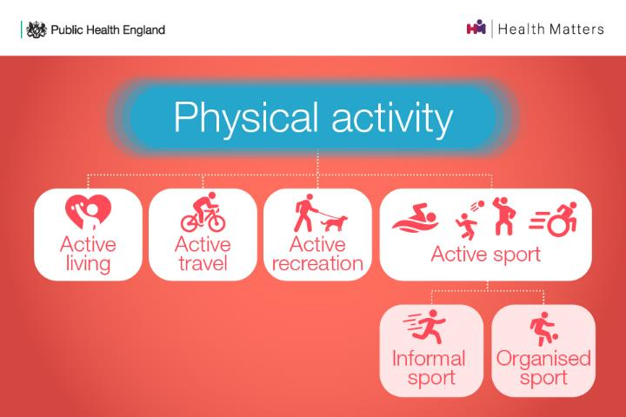
What is Physical Activity?
Notes:
General public Health recommendations to exercise and health
What could PA look like, i.e. travelling to work, household chores, or things we do just for fun.
We’ve circled active living as for many people this may be the most feasible option to incorporating physical activity into their lives
Those people who make being active a part of their everyday lives, they are most likely to continue with it and for it to be sustainable.
Reiterate message any movement. Every movement counts.

Slide 15
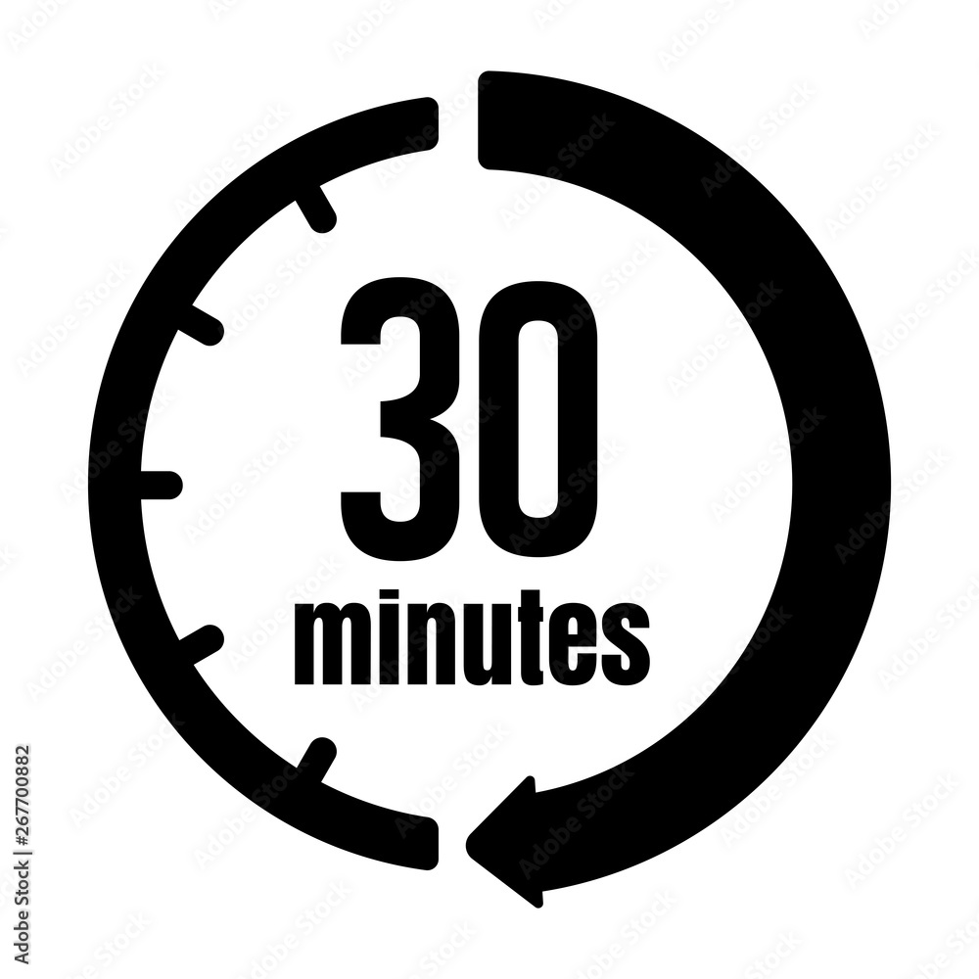
Making Physical activity part of your life
There are 1440 minutes in every day.
Schedule 30 of them for physical activity

Slide 16
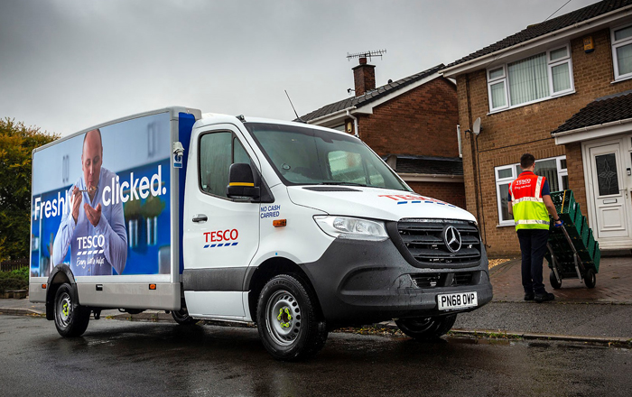
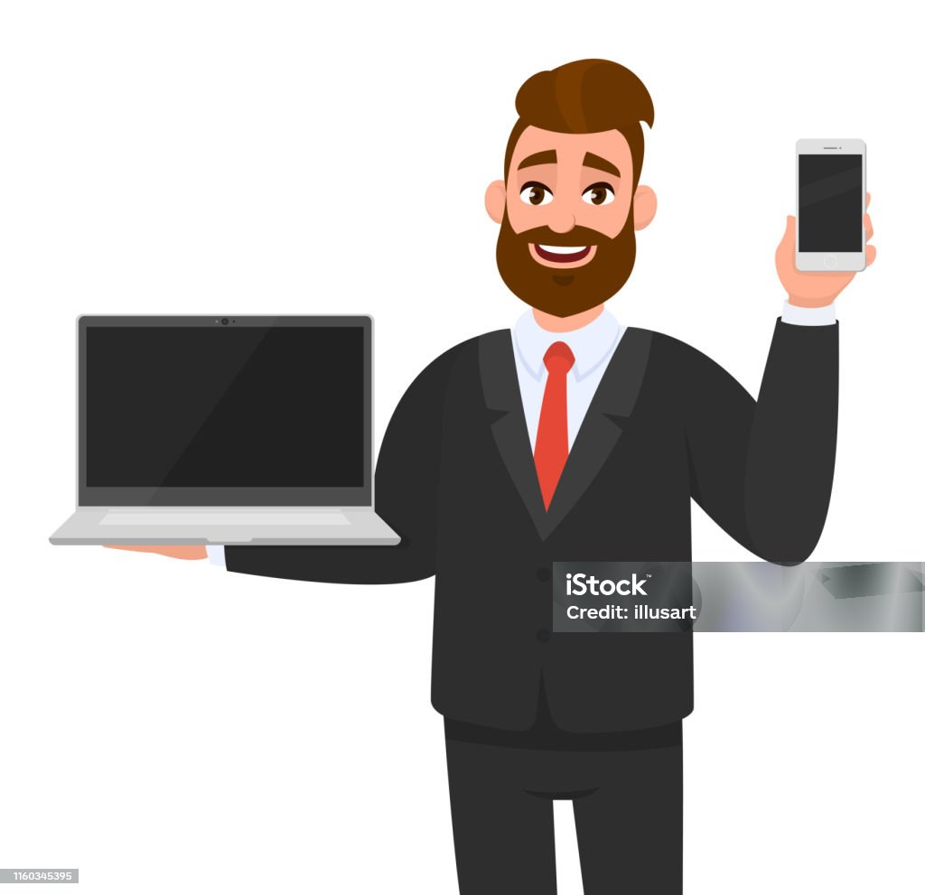
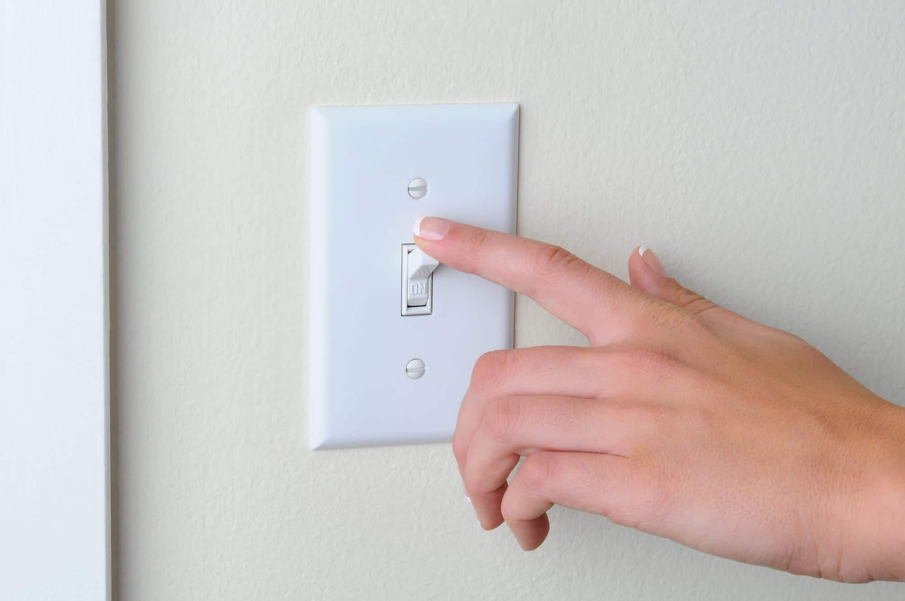

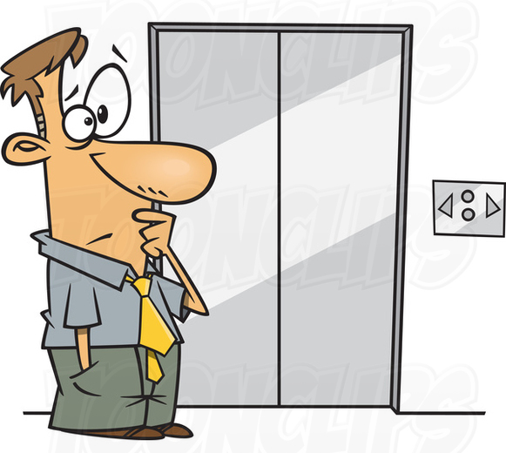
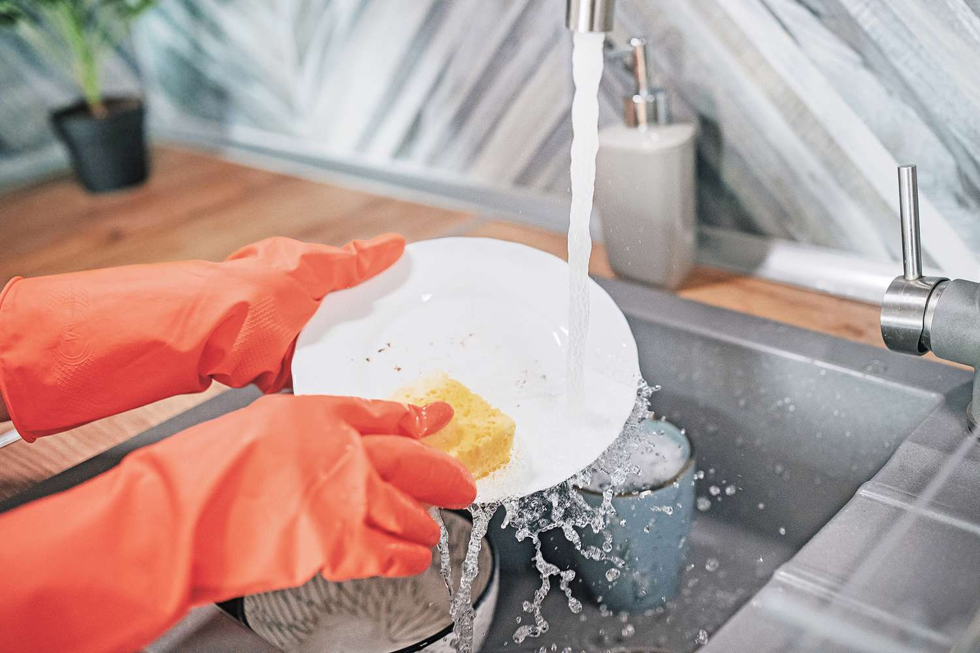
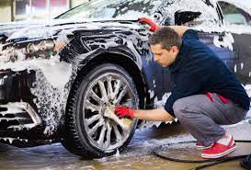
In todays world

Slide 17
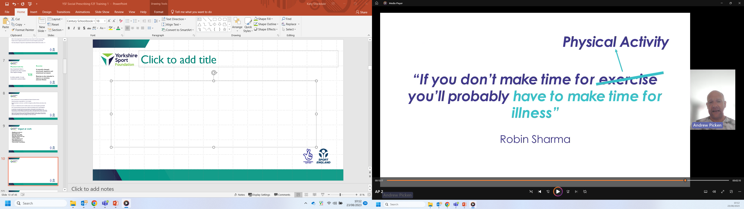
Notes:
Have we ruined exercise, I don’t think we have I think its got a part to play. We are talking about PA and how lifestyle changes can be scaled up, and finding lifestyle opportunities to improve our health.

Slide 18
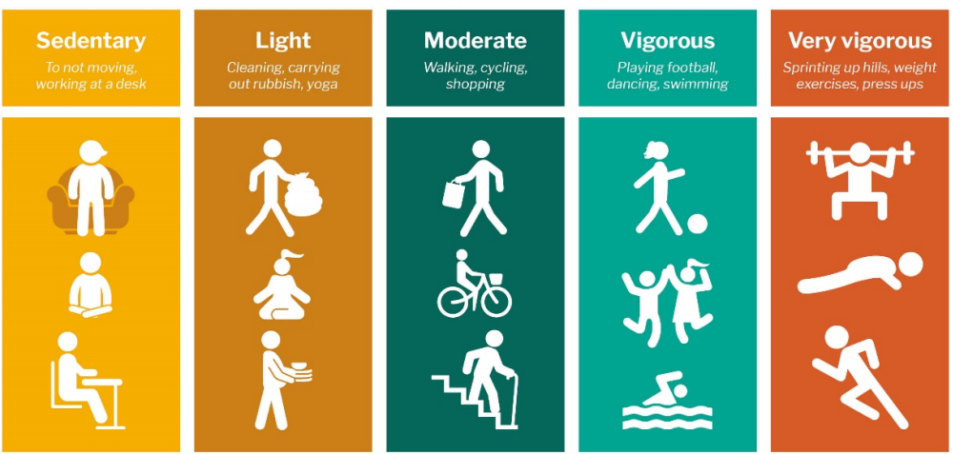
Different Intensities
Nearly 1 in 3 people spend 6+ hours sitting each day.
Around 1 in 3 men and nearly 1 in 2 women are not active enough for good health
Being inactive is responsible for around 1 in 6 deaths in the UK.
Notes:
Government guidelines on advisory of exercise intensities.
However, the best thing people can do is move from sedentary to moving more.
Moderate just means anything that gets the heart beating faster, feeling warmer and slightly out of breath.
The graph shows rate at which health benefits can be gained for every extra minute of weekly physical activity
Reiterate these is for those who are inactive.
The steepest level of increase is up to 150 minutes
Which means the people who are inactive have the most to gain

Slide 19
Levels of Activity
The good and bad news

Slide 20
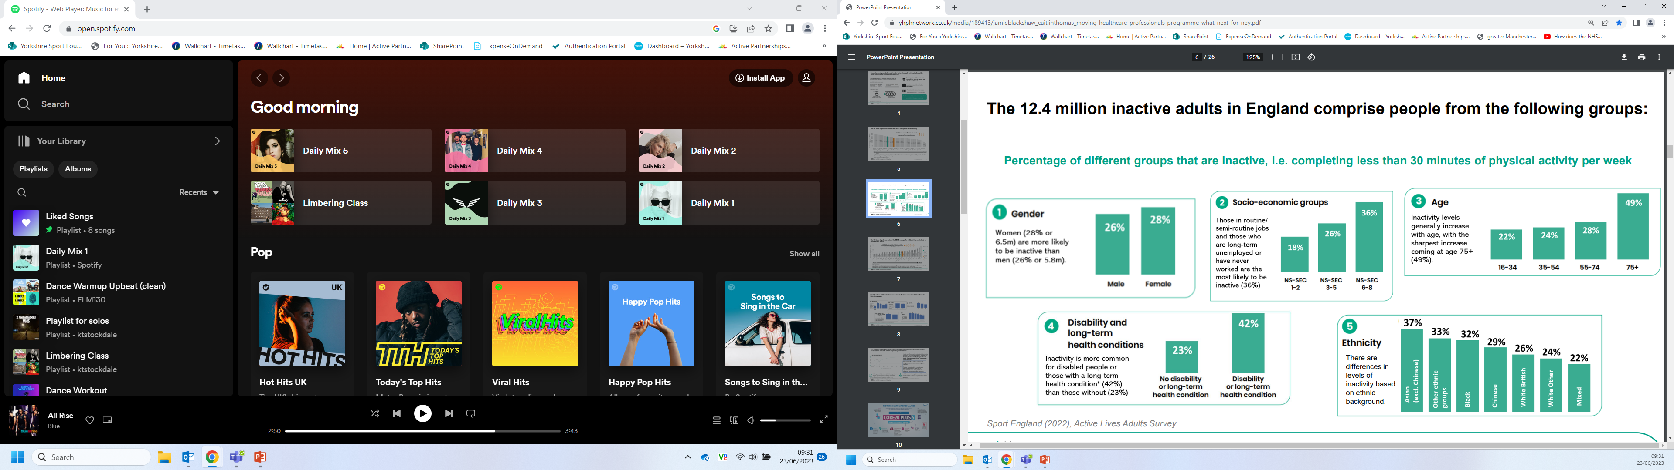
The National Picture- Active Lives Survey (2022)
Notes:
Age category 49% of 75+ are in active
Those who are unemployed or have never worked 36% inactive
Those registered as having a disability or long-term health condition 42% inactivity

Slide 21
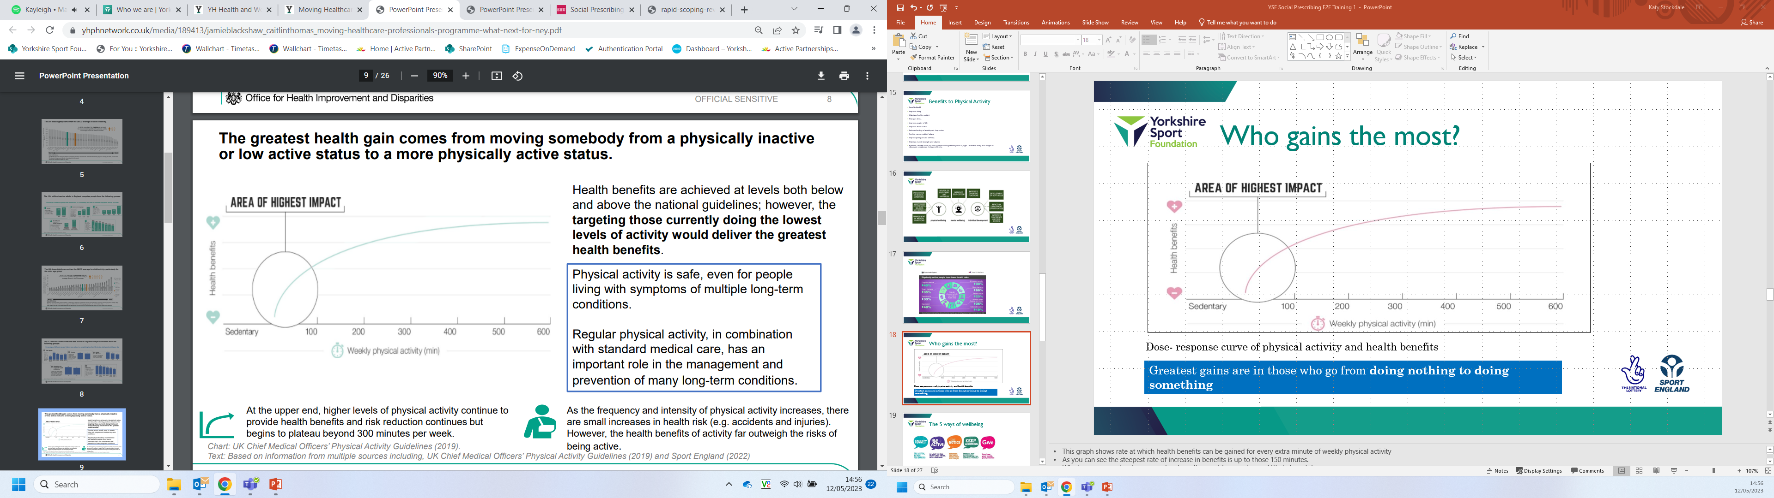
Who gains the most?
Greatest gains are in those who go from doing nothing to doing something
Notes:
This graph shows rate at which health benefits can be gained for every extra minute of weekly physical activity
As you can see the steepest rate of increase in benefits is up to those 150 minutes.
Which means people who are inactive have the most to gain. Even a little helps a lot.
150 minutes is used as it’s a point where we can get much of the health benefits. You still get more after the 150 minutes, but that curve is flatter.
That could be 10-minute chunks – doesn’t need to be in one go.
E.g. could be starting small as walking to the end of the garden and back. Taking the stairs instead of the lift. Walking a small section to work.
Key messages to remember are something is better than nothing (some is good, more is better). It’s never too late to start. Every minute counts.

Slide 22
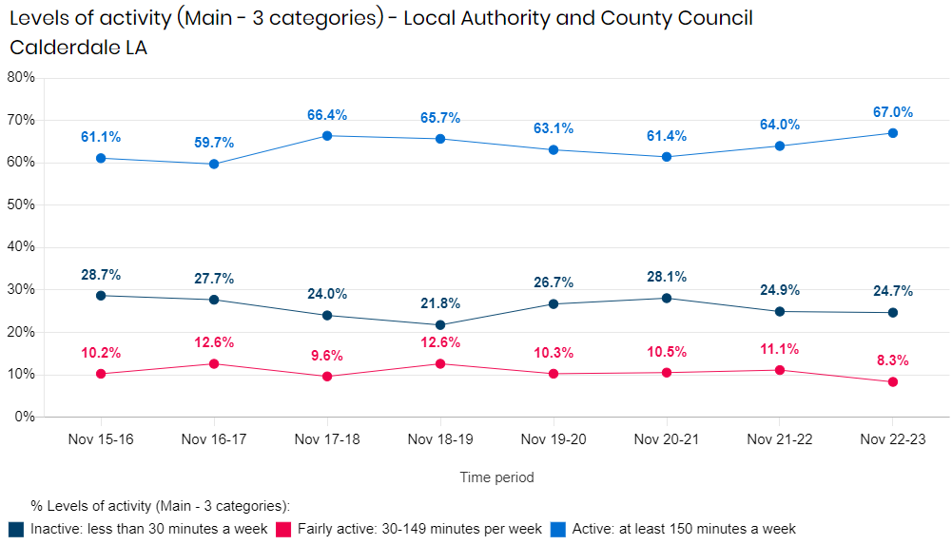

Slide 23
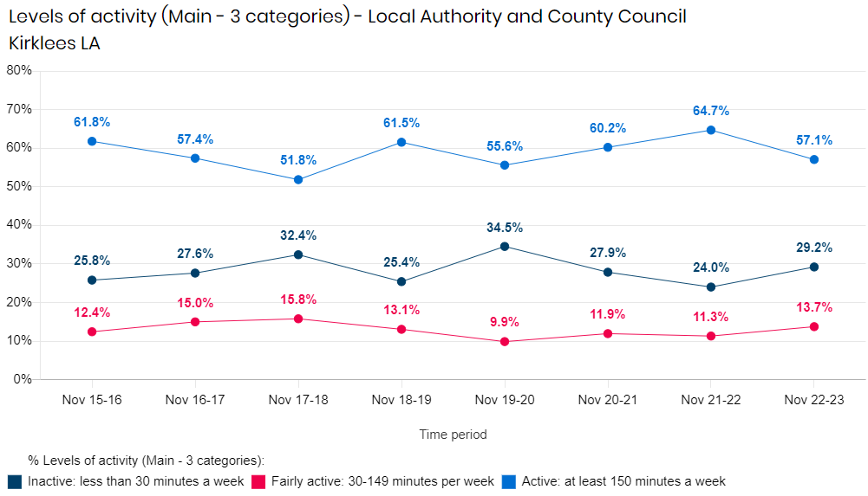

Slide 24
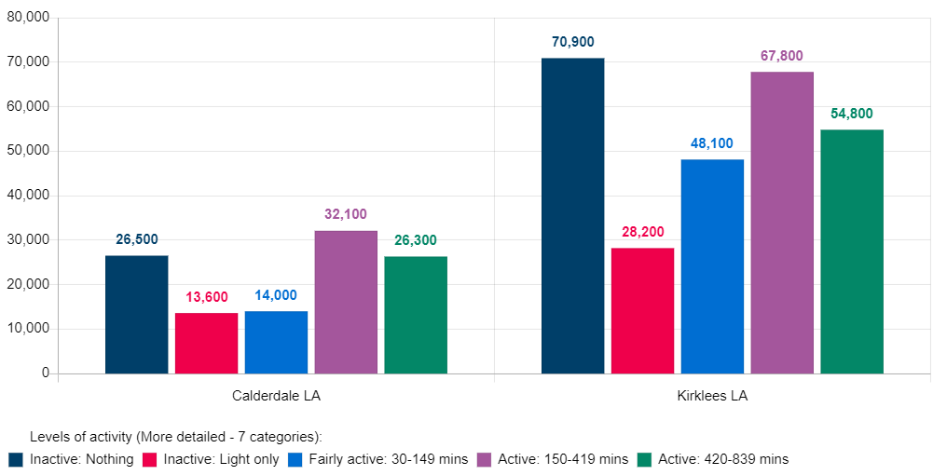

Slide 25
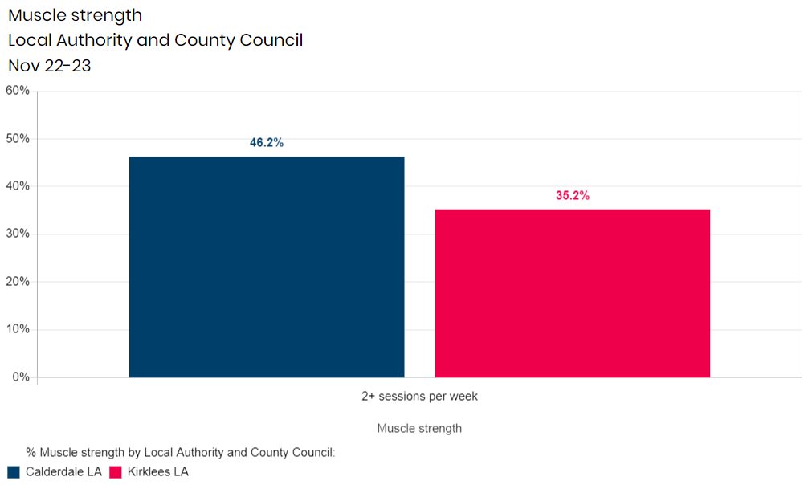
77,600 people
123,300 people

Slide 26
Benefits and Barriers
To Moving More

Slide 27
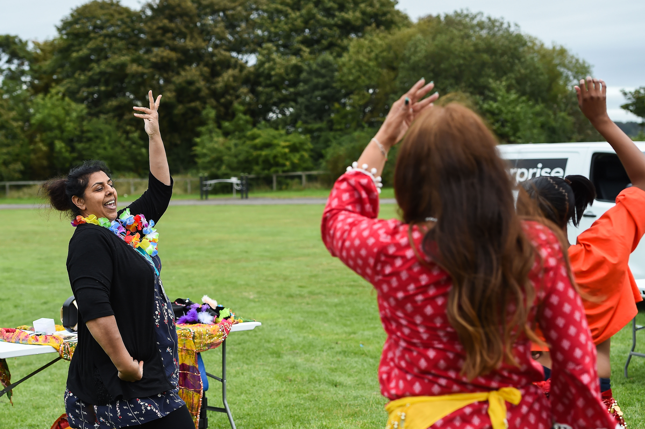
On your tables use the flipchart paper to discuss benefits to Moving More.

Slide 28
Benefits to Moving More
  Chance of high blood pressure, type 2 diabetes, being over weight or obese and unbalanced cholesterol levels.
Reduces social isolation
Reduces feelings of anxiety and depression
Benefits health
Maintains healthy weight
Combat cancer- related fatigue
Manages stress
Improve joint pain and stiffness
Improves quality of life
Improves brain health
Maintain muscle strength and balance
Notes:
Table top exercise each group discuss and list benefits to Physical Activity, swap tables and circle in red 3 priority areas they would see in cliental. Feedback to group standing in a circle.

Slide 29
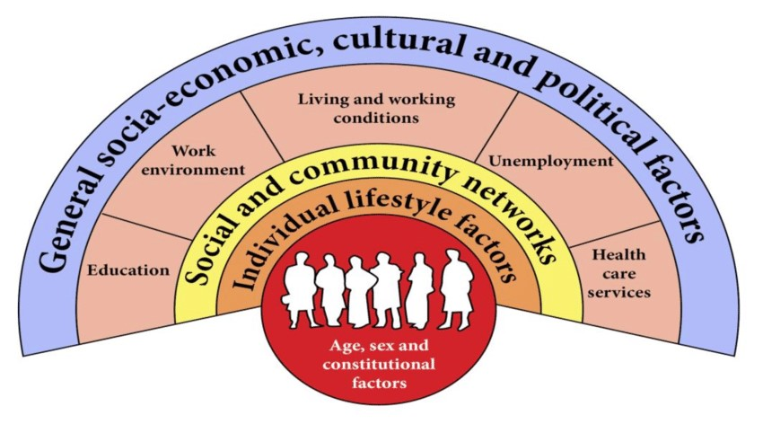
The Dahlgren-Whitehead Rainbow (1991)

Slide 30
Significantly worse than national average
Wider determinants of health in Kirklees:
Significantly better than national average
LOCAL ECONOMY & ENVIRONMENT
(Where we live, our opportunities and finances)
LOCAL COMMUNITIES
(Our interactions with others)
69% of adults have used parks and green spaces at least once a month in the last 12 months.
1 in 20 deaths are attributable to air pollution
There are 10 Air Quality Management Areas in Kirklees
85% of adults feel safe in their local area during the day
52% of adults feel safe in their local area during the day
Those dissatisfied with their local area are more likely to say their home isn’t suitable for their needs, and those who feel their home isn’t suitable for their needs are more likely to be dissatisfied with their local area
High rates of hospital admissions for violence
10.7% of the population are income deprived
28.2% of children are living in poverty
55% of adults agree they live in an area where people trust each other
ACTIVITIES
(Things we do and experience)
5.4% unemployment benefits claimants
16.8% of households experience fuel poverty
Social housing tenants are more likely to say their home is unsuitable for their needs
92.3% of adults are socially connected
60.3% of 5-year olds have a good level of development
Lower job density than national and regional averages
23.7% (physical) and
37.3% (emotional) of 14 year olds have been bullied in the last 6 months
The density of hot food takeaways is 143 per 100,000 population
Average Attainment 8 score of 48.1
Homes more affordable than national and regional averages
71% of working-age adults are qualified to Level 2
25% of people aged 50+ volunteer monthly
Low levels of adults walking or cycling for travel
LIFESTYLE
(Health-related behaviours)
LOCAL ECONOMY & ENVIRONMENT
2 in 5 young people walk or cycle to school
LOCAL COMMUNITIES
24.8% of 5 year olds and 40.7% of 11 year olds are overweight or obese
ACTIVITIES
50% of adults eating the recommended ‘5 a day’
High-level of alcohol-specific mortality
LIFESTYLE
12.1% of adults smoke
69.7% of adults are overweight or obese
INDIVIDUAL
10.4% of mother’s smoke the time of delivery
Low rate of under 18s hospital admissions for alcohol
62.8% of adults achieve recommended physical activity levels
HEALTH & SOCIAL CARE

Slide 31
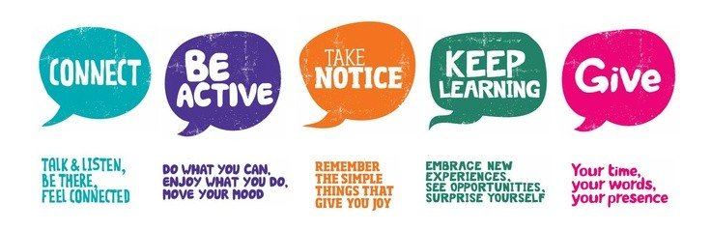
The 5 Ways of Wellbeing
Notes:
This slide was created by New Economics Foundation and is used widely now by Mind, NHS and lots of other organisations.
Research found that building these 5 actions into our daily lives are really important for well-being and this include being active.

Slide 32
Comfort Break

Slide 33
Barriers to Physical Activity
Physical barriers
e.g. Lack of time
Social barriers
e.g. Concerned about what
others will think
Psychological barriers
e.g. Low motivation
Technical barriers
e.g. Not knowing what to do or how to do it
Notes:
Introduce the Scenarios and on tables discuss the barriers each scenario may have.

Slide 34
Behaviour Change
Notes:
Behaviour change how can we support through and how?
How introduce the tool of transtheoretical model and discuss the different boxes aligning to a person experience.
Example template for PA
4 stages of motivational interviewing and share video
Outline top tips (in handout as well) consider a creating a goals plan for client’s template in handout.

Slide 35
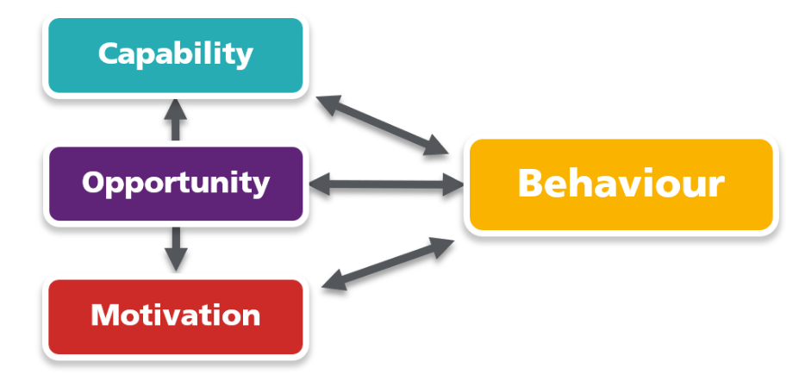
COM-B Model
Capability is the psychological capacity (such as knowledge and understanding) and physical ability (including special skills) to enact a behaviour.
Opportunity refers to the physical and social environment that enables a behaviour. This could include city planning conducive to active travel, or a supportive social circle that encourages healthy behaviour
Motivation is made up of the internal mechanisms that set in motion or inhibit a behaviour. This could include the desire to participate in a sport, or the pleasure (emotion) of engaging in a healthy activity.
Behaviour is understood as physical action that occurs in the body and is controlled by the brain; it’s anything a person does in response to external or internal cues. The intention to eat more fruit, instead of sweet snacks, is not a behaviour – but the act of eating fruit is.

Slide 36
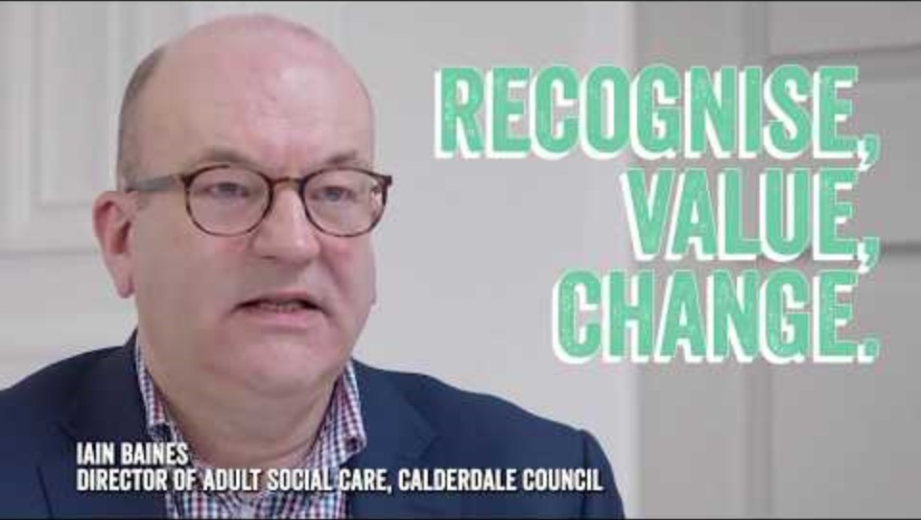
Change in the Adult Social Care System

Slide 37
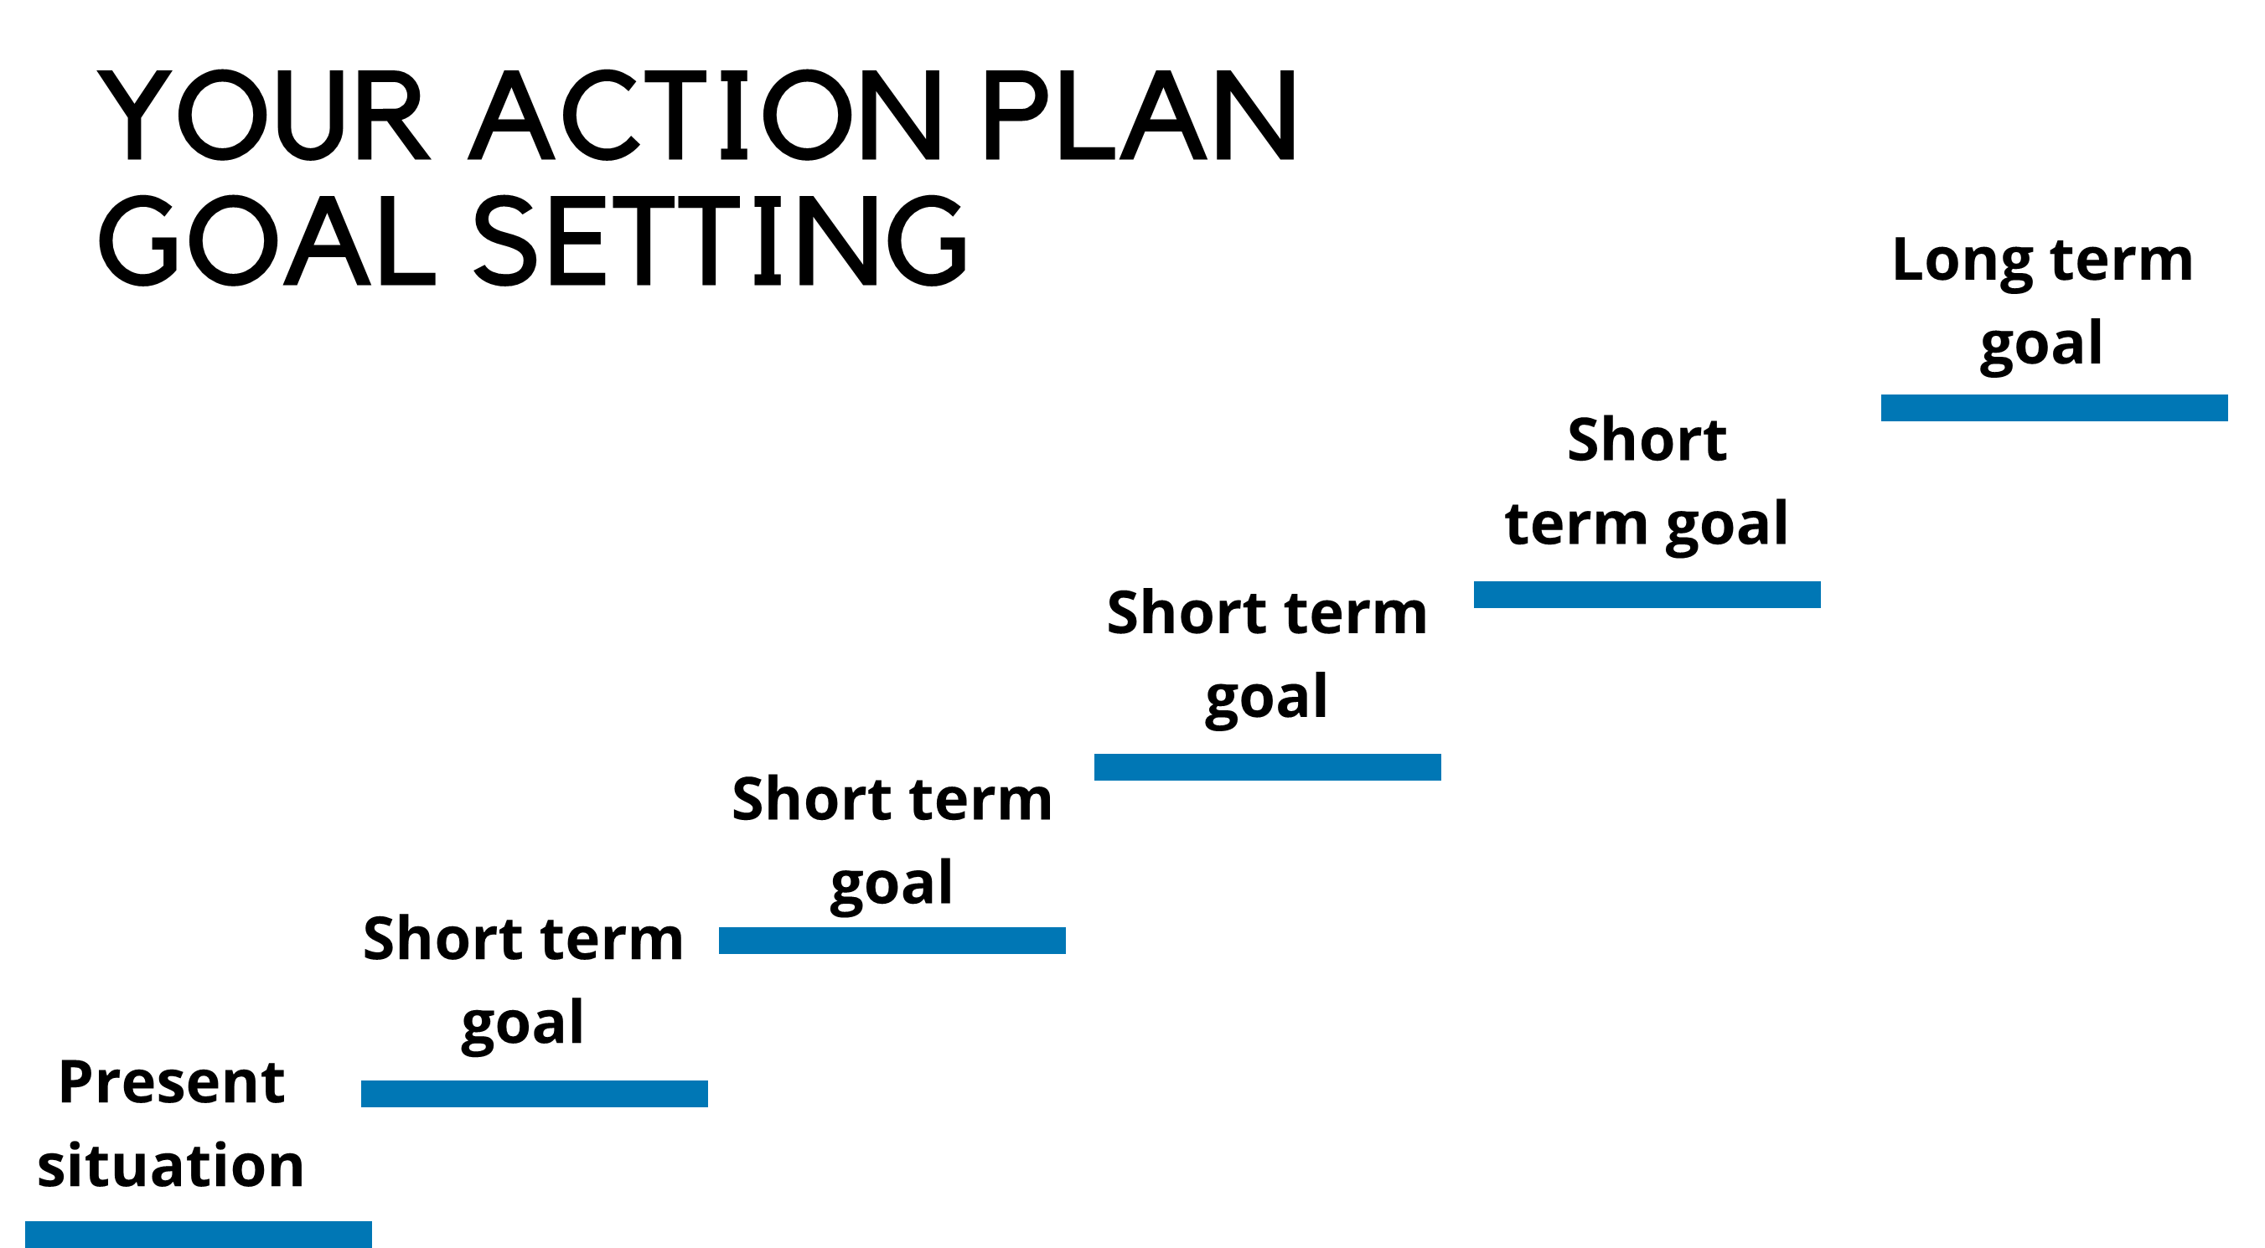
Goal setting

Slide 38
Goal setting
Outcome goals: Are measurable health outcomes or targets that an individual would like to achieve through changing their behaviours. The goal may be the expected result of performing a behaviour but it does not involve planning how an individual’s behaviour will change to achieve the goal.
Process goals: A process goal involves the steps an individual is going to take to reach their outcome goal.
Both outcome and process goals are vital for behaviour change. One is unlikely to work without the other. Clear outcome goals are needed to clarify What you want to achieve, but the process goals are essential to know the action steps required to achieve this.

Slide 39
Goal setting
Common problems when we try to change.
Short term fixes
Overcommitment
Not suitable long term
Give up too easily
Its feels like its too hard
Your role:
Be specific
Be realistic
Goals can be broken down into small manageable steps
Make sure the goal is important to the person

Slide 40
Guided goal setting
You may find some people find it hard to set their own goals, or have the understanding to know what's best for them. Rather than jumping in and setting a goal for them, you can use a technique called guided goal setting, which involves providing people with ideas to choose from, based on what you already know about the persons interests and needs. A suggestion would be to create a bubble task with options for patients to choose from, you can break the information down, make it fun and relaxed and start to build a foundation and rapport.
It is common for people to want to change everything at once, but this can be daunting, unsustainable and may be setting them up for failure. Instead try and encourage patients to change one or two small things at a time, and work with them to turn those changes into habits.

Slide 41
Having Active Conversations
Notes:
Behaviour change how can we support through and how?
How introduce the tool of transtheoretical model and discuss the different boxes aligning to a person experience.
Example template for PA
4 stages of motivational interviewing and share video
Outline top tips (in handout as well) consider a creating a goals plan for client’s template in handout.

Slide 42
How we can best support others?
Our everyday conversations are with people we meet- family & friends, colleagues & people in our community.
If you are working in Health and Care you’re seen as a part in enabling some to live the life they want.
Its important to remember that we all have an unconscious bias, we develop an inner group of rules that we’ve picked up during our life.
Discussing the impact of activity on health is a good way to help someone identify positive reasons for change and how they may benefit.

Slide 43
The first thing to remember is that whilst you are the health or care expert, the person you are talking to is the expert on themselves. So let that person lead, as you steer the conversation.
Find out what that person knows, thinks, and feels first. Understand what really matters to them before discussing physical activity and its benefits.
It’s about identifying what part physical activity can play in someone’s life and how it will help them achieve what really matters to them.

Slide 44
Ask
What's important to the individual
Allow the individual to be In control
Use a person centred approach
Allow the person to be involved in decision making.
Listen
People are the experts
Try to take the time to pause activities to listen and reflect.
Actively listen for emphasis
Pick up on emotion to uncover important information
Uncover concerns
Find out about all the concerns, worries and challenges the person is feeling.
Show them that what they are saying matters.
This builds confidence and trust.
Summarise
Repeat back to them and summarise what you have agreed.
Help reinforce the conversation
Find out how they are feeling
Acknowledge that the conversation dosent stop here!

Slide 45
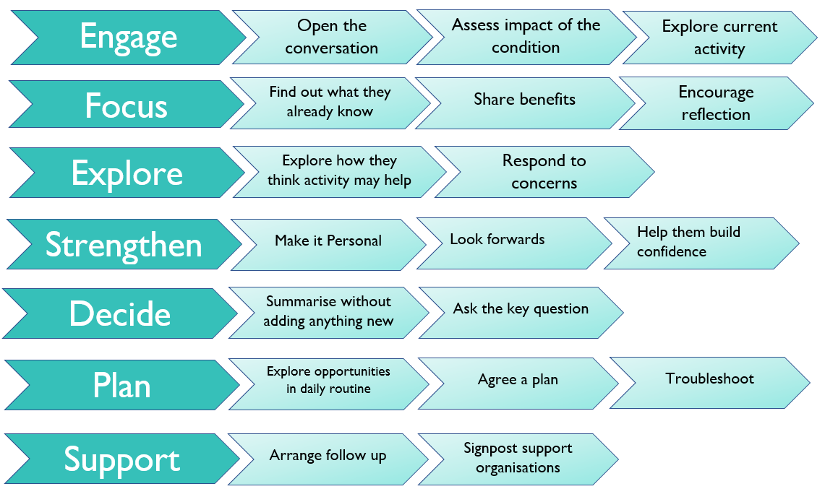
Starting Conversations
Notes:
Small groups to prepare conversations and demonstrate role play or patient and client.
Share with room, going through the process and putting together a full conversation.
Top tips sheet on conversation prompts

Slide 46
Scenario 1
Kate is 60, a supply teacher and lives with depression.
Rachel is 62, a P.E Teacher, is highly active and has been a dancer all her life.
Kate expressed frustration at Rachel who’d often say with the best intent, ‘Why don’t you start running, join a walking club or sign up to the local leisure club, that’s what I do and it helps on so many levels. I’ll come with you.’
Kate described how her friend simply didn’t understand that the idea of those things filled her with complete horror on many levels, not least because on some days she doesn’t even feel up to getting dressed. She described how well-meant comments like this damage her feeling of self-worth further, triggering feelings of guilt and uselessness as she compares herself unfavourably to others, placing more barriers in the way.

Slide 47
Scenario 2
Alison, a 53-year-old woman who attended an asthma check-up at her local GP practice.
As part of the appointment Alison was weighed. The nurse commented on her weight positively, it was consistent and well-managed. The nurse then started talking about how she wished she could stay at a weight like that, found it hard to lose weight after the menopause and couldn’t find enough time to do regular exercise.
Alison came away feeling that the appointment was a waste of time, just a tick box exercise and that the NHS weren’t interested in her well-being at all.

Slide 48
Scenario 3
Ross, 35 an autistic person, with a mild learning disability was weighed at an annual health check. He became upset when the doctor talked about exercise as a way to manage his weight.
The doctor backed off, and moved away from the subject of exercise, not wanting to upset him more.
Ross explained after to his mum that he was upset because he didn’t understand a lot of what the doctor was saying to him about blood pressure and BMI, and it scared him.
Ross would have liked to talk about exercise, he enjoys it. He walks his dog every day and is a member of a local football team.

Slide 49
Signposting Opportunities

Slide 50
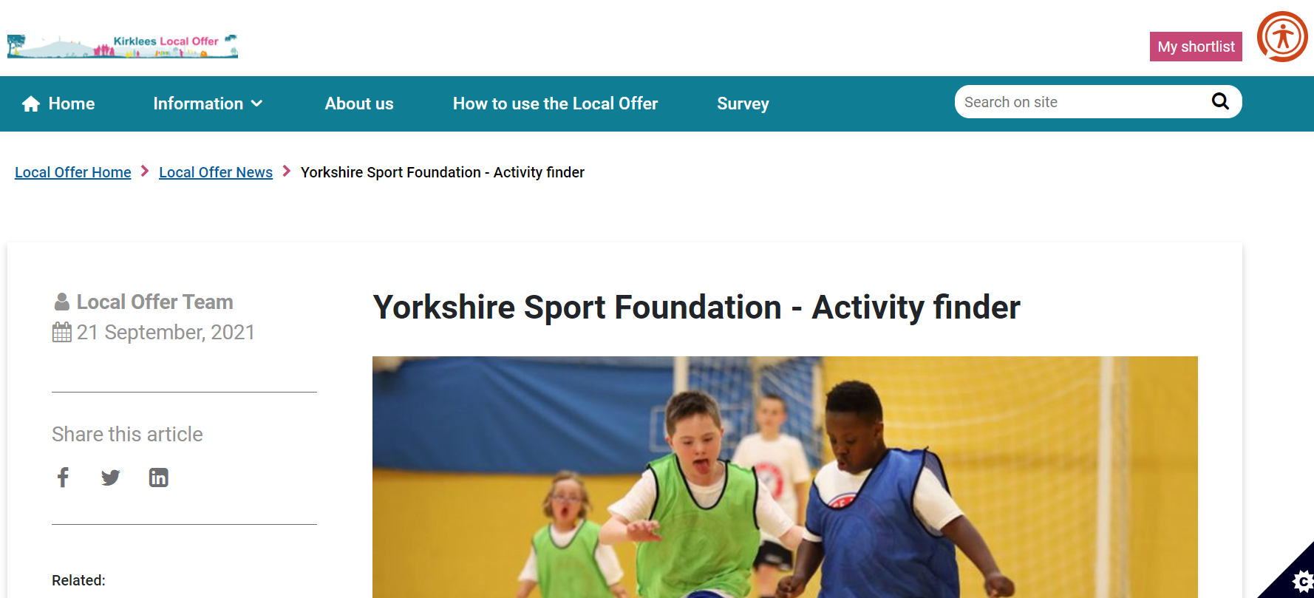
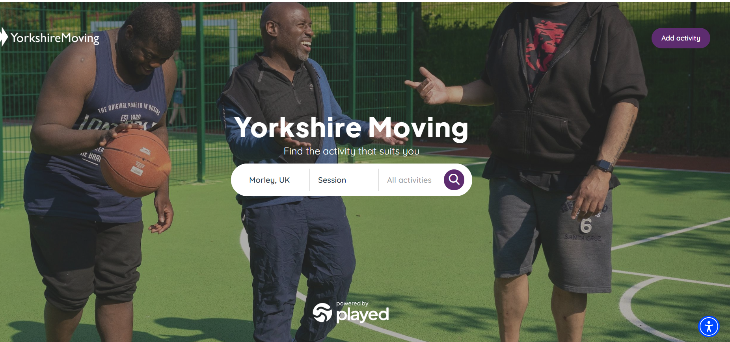
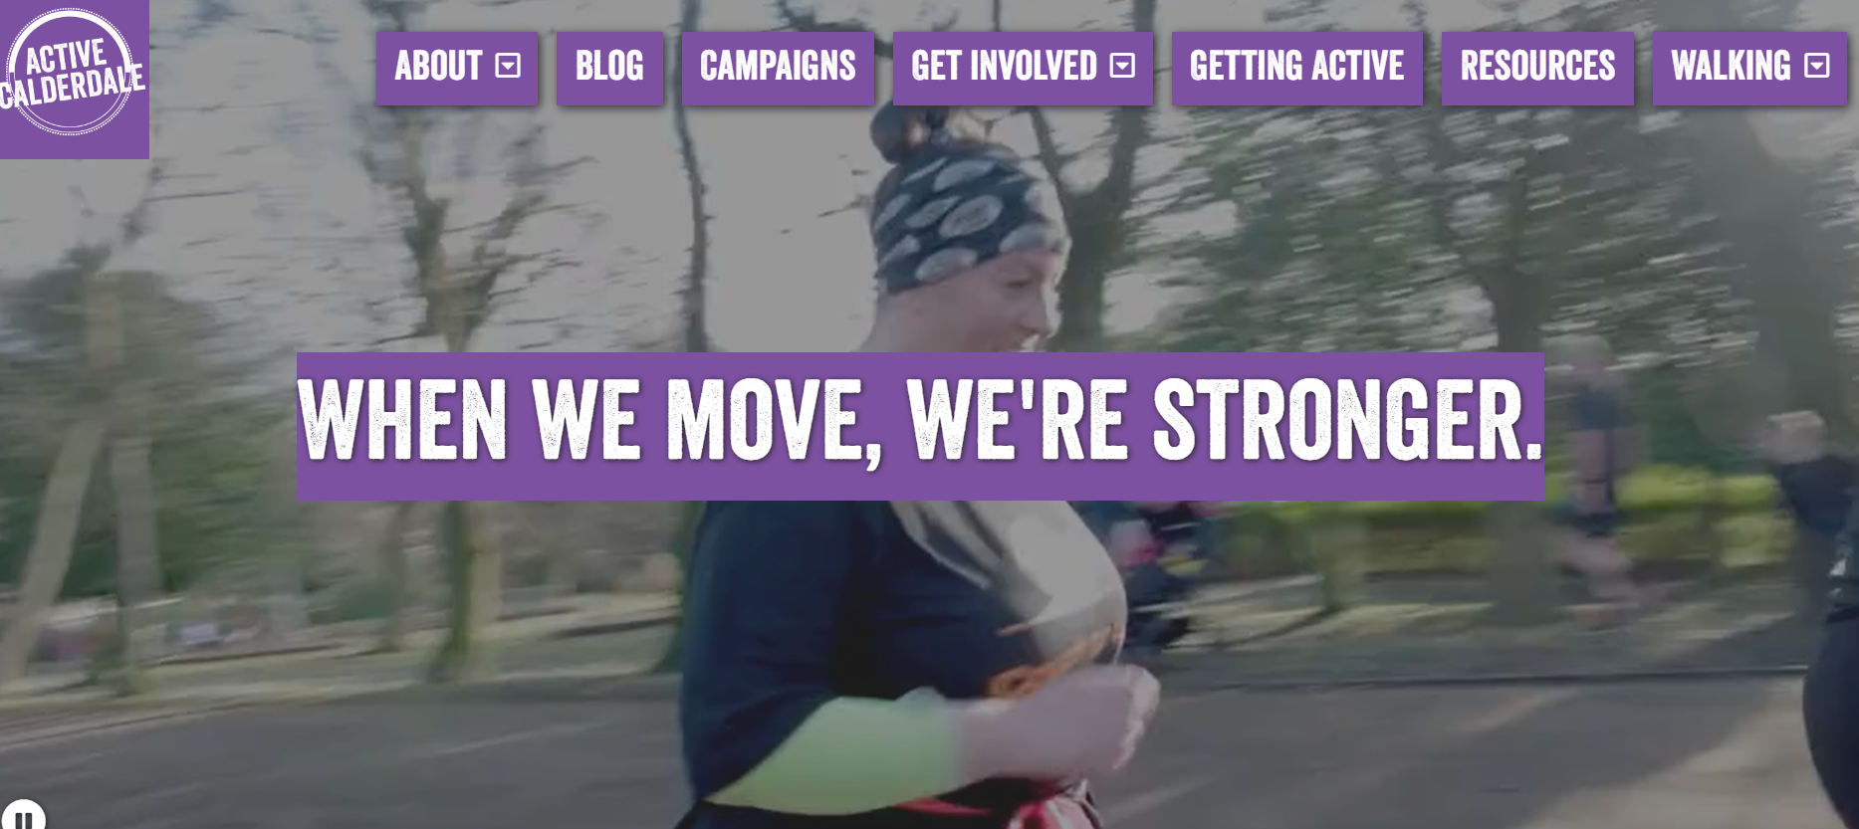
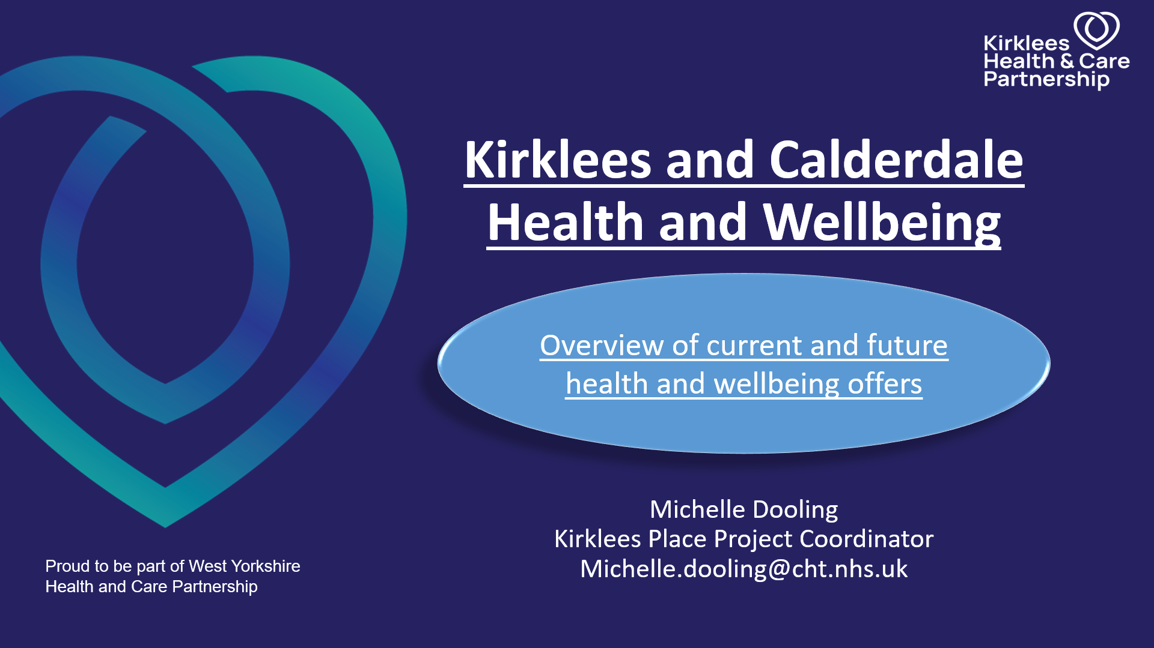

Slide 51
Julie.Smith@yorkshiresport.org
Katy.Fillingham@yorkshiresport.org
Contact Information

Slide 52
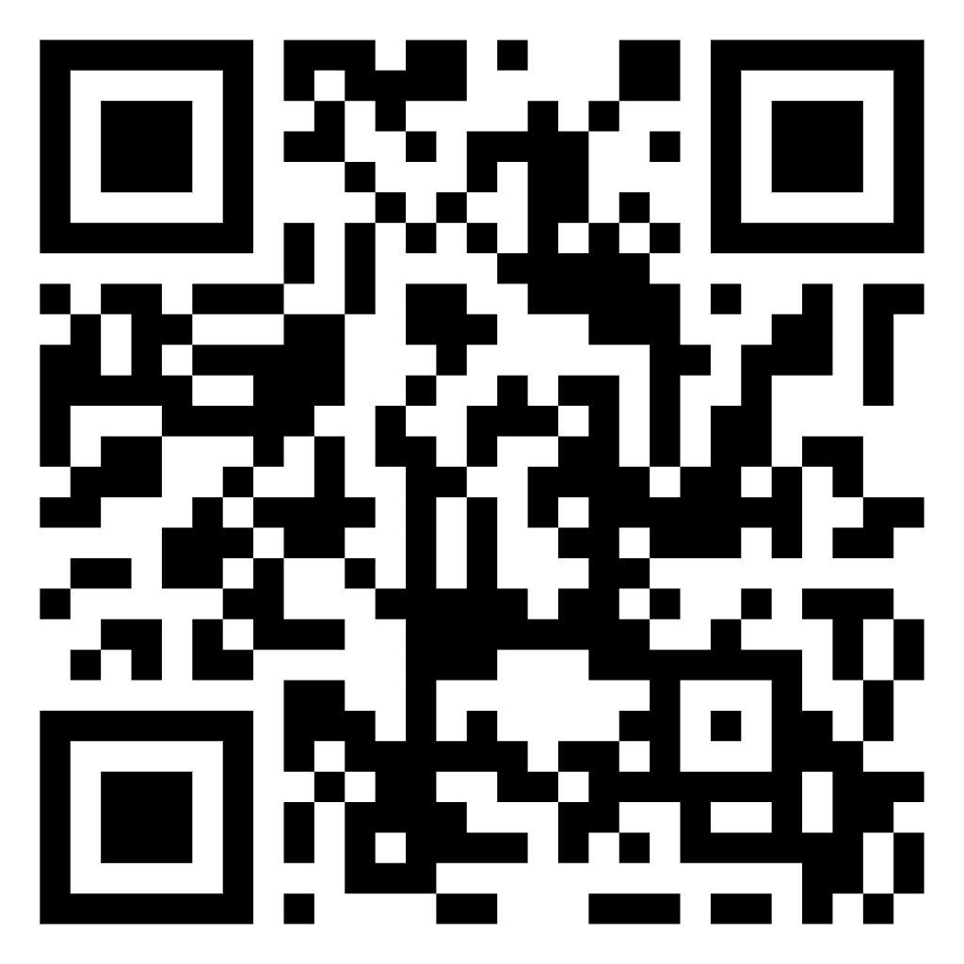
Thank you

